Slide 1
Java
Collections
Nguyen Van Son

Slide 2
1/ String objects
Sort
2/ Wrapper class object
3/ Class objects (User-defined)

Slide 3
01
String objects

Slide 4
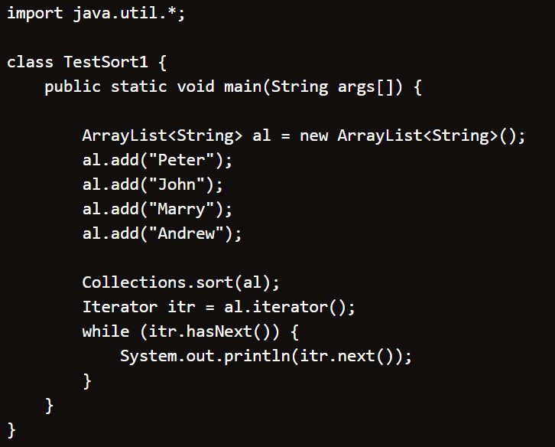
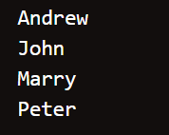
String Object

Slide 5
02
Wrapper class objects

Slide 6
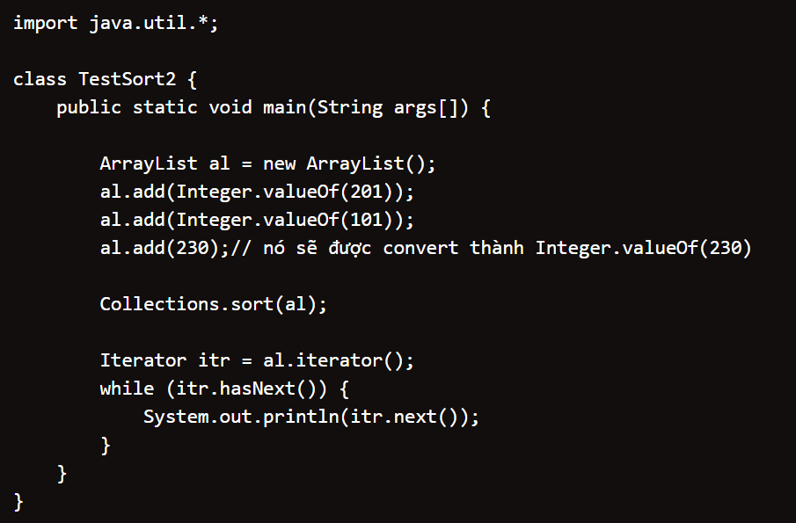
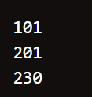
Wrapper class objects

Slide 7
03
Class objects (User-defined)

Slide 8
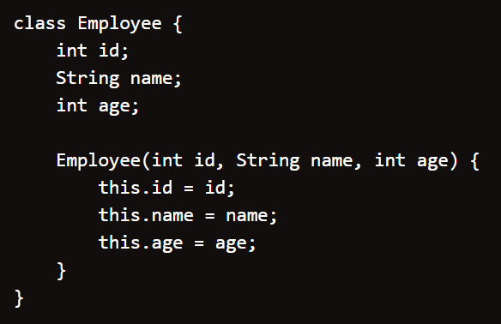
Comparable
Implements
Comparator

Slide 9
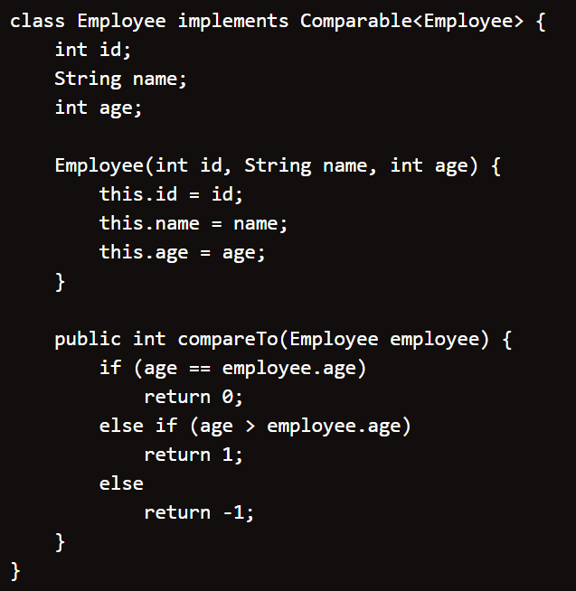
Class objects (User-defined)
implements Comparable
01

Slide 10
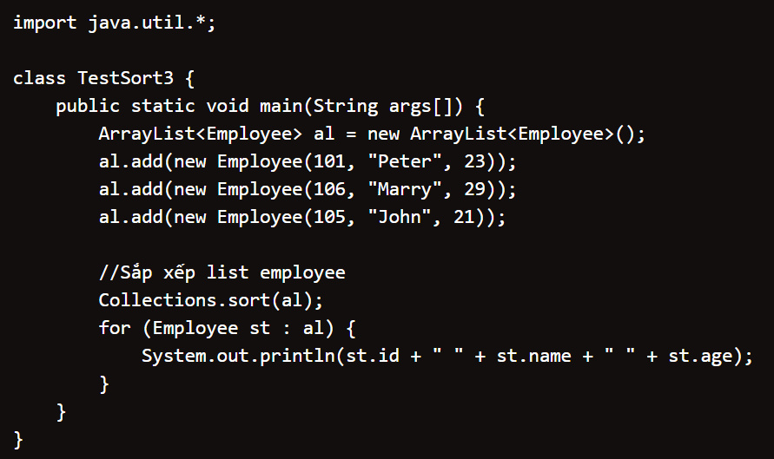
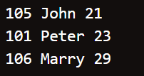
Class objects (User-defined)

Slide 11
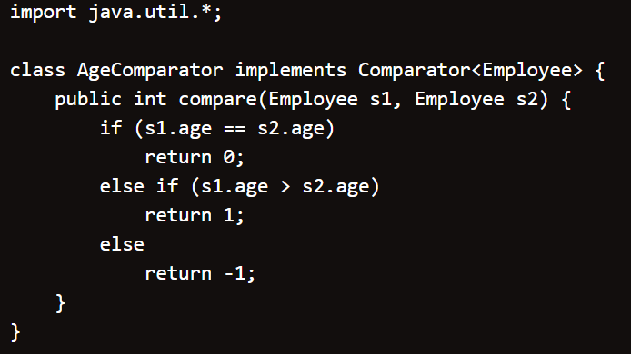
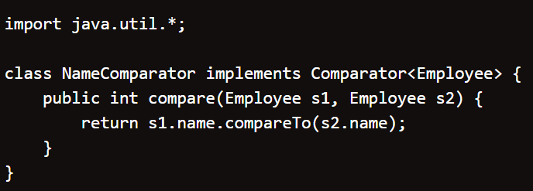
Class objects (User-defined)
implements Comparator
02

Slide 12
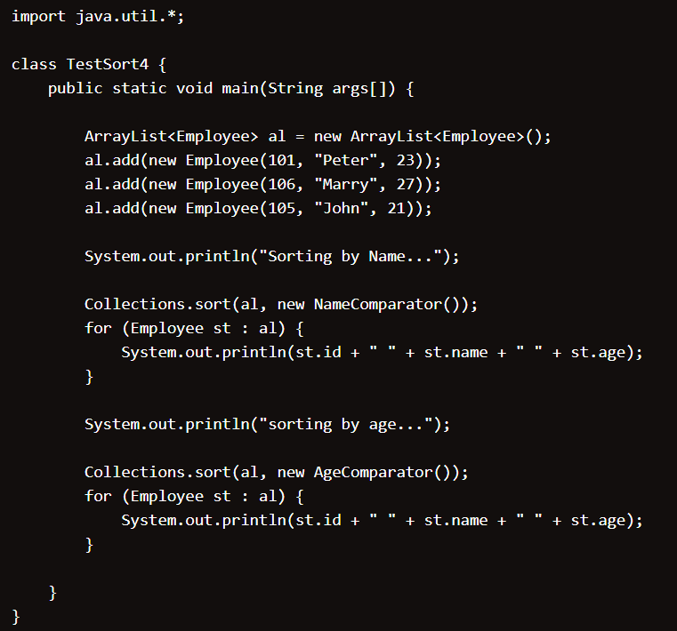
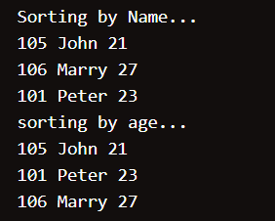
Class objects (User-defined)

Slide 13
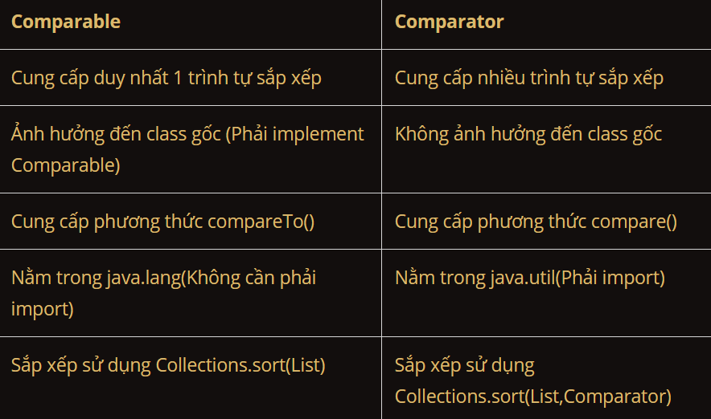
Title goes here

Slide 14
THANKS YOU FOR WATCHING

