Slide 1

Triggers and order of execution
May 8, 2019

Slide 2
Triggers and Order of Execution Rules
There can be following cases for Trigger execution for which the rules are specified in Sales-force. These rules are standard.
System Validation Rule
Before Trigger are Executed
After Trigger Execution
Custom Validation Rule
Assignment Rules
Auto-Response Rule
Workflow Rules
Escalation Rules
Before Trigger Rules
After Trigger Rules
Criteria Bases Sharing Rules
Post-Commit Rule

Slide 3
Triggers and Order of Execution Rules
There can be following cases for Trigger execution for which the rules are specified in Sales-force. These rules are standard.
Loads the original record from the database or initializes the record for an upsert statement
Loads the new record field values from the request and overwrites the old values.
Executes all before triggers

Slide 4
System Validation Rule
Validation rules verify that the data a user enters in a record meets the standards you specify before the user can save the record. A validation rule can contain a formula or expression that evaluates the data in one or more fields and returns a value of “True” or “False”. Validation rules also include an error message to display to the user when the rule returns a value of “True” due to an invalid value.

Slide 5
System Validation Rule
Validation rules verify that the data a user enters in a record meets the standards you specify before the user can save the record. A validation rule can contain a formula or expression that evaluates the data in one or more fields and returns a value of “True” or “False”.

Slide 6
When any record is saved in the Sales-force then the following events occur in order on the server side:
The original record loaded from the database of the statement of upsert or insert or update.
The field value of the record is loaded and the new value is overwritten on the old value. In case if the record is updated through Standard UI edit page then the Sales-force applies validation rules to check the records for following:
Validate the record for maximum field length
Validate for field formats
Checks the value for layout and field level value
Check for layout specific rules
After Trigger Execution
Custom Validation Rule

Slide 7
Sales-force validates only the foreign key if the request comes from another source like Apex application or SOAP API.
All rules defined in before triggers
Most system validation steps are executed like to verify the null values of fields and to ensure the user-defined validation rules. Sales-force does not run secondly defined system validation rules
The rule of duplicate is applied
The record is saved in the database
Now all after triggers get executed
All assignment rules get executed
Auto-response rules get executed
Workflow rules get executed

Slide 8
If any record or field rule is there in workflow then it gets updated
If the record is updated through workflow trigger, then once again before trigger and after trigger is fired and standard validation, custom validation, duplicate and escalation rules are also executed once again
Now all escalation rules get executed
Then all entitlement rules get executed
If roll-up summary is there then it gets executed
Criteria based sharing gets evaluated
All DML operations are committed
Post-commit logic gets executed, e.g. sending emails

Slide 9



Choose a Layout
…then click the placeholders to add your own pictures and captions.

Slide 10

On the Picture Tools | Format tab, you can create your own frames and make picture corrections such as adjusting contrast and brightness or cropping the picture for just the right look.

Slide 11

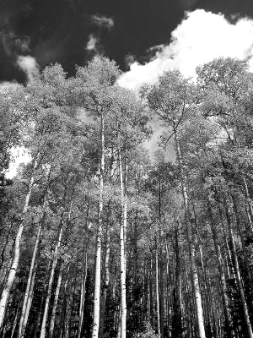

Picture Quick Styles give you great looking “frames” in a single click.

Slide 12


Slide 13


