Slide 1
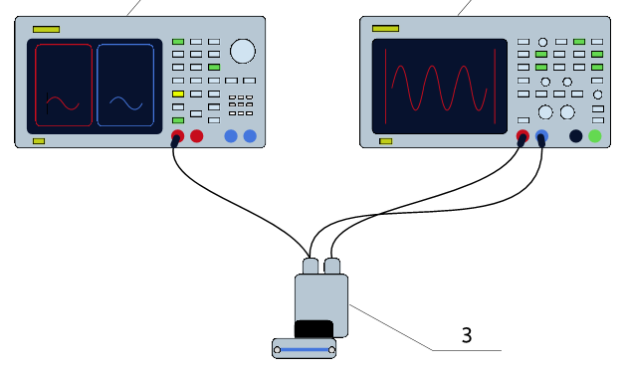
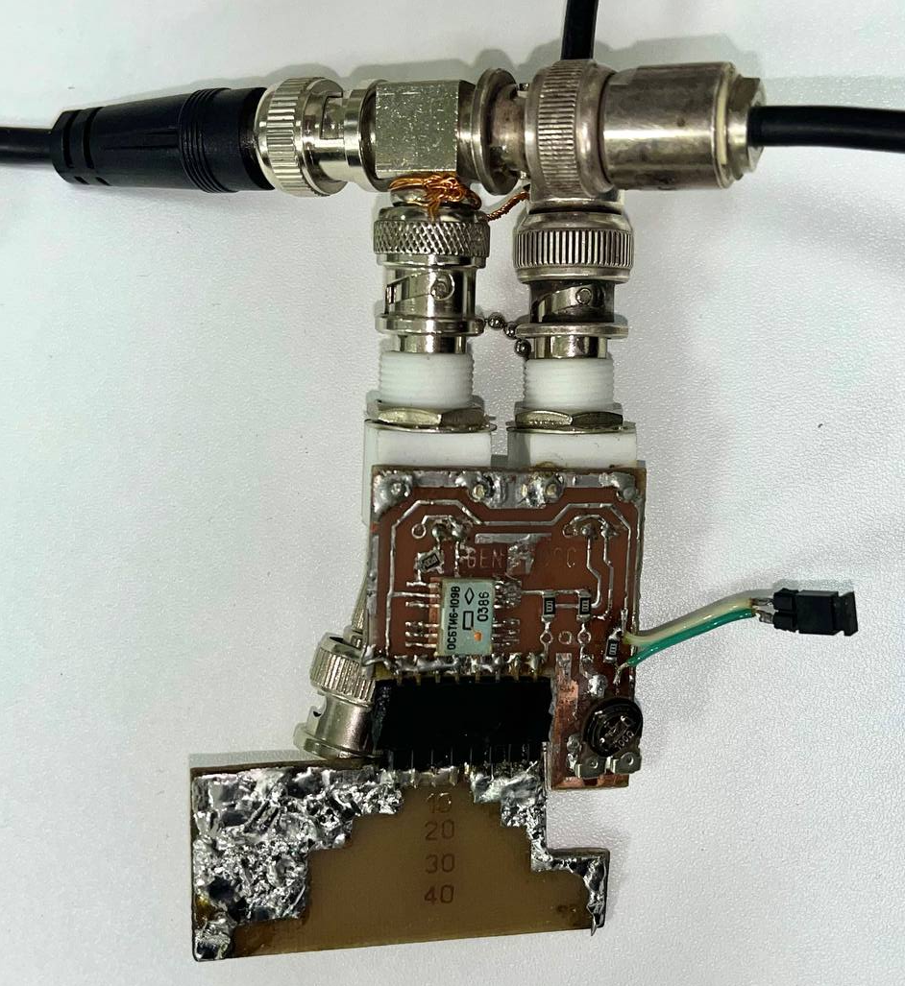
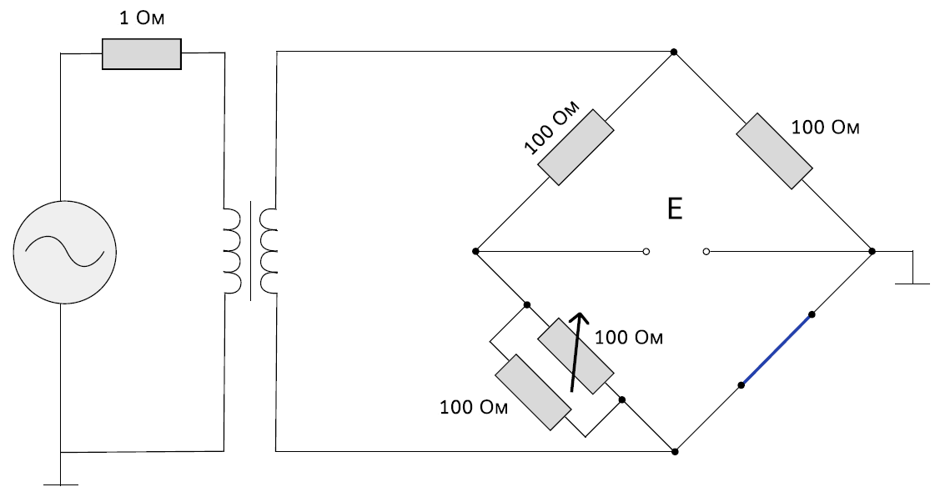
Generator RIGOL DG4102
Oscilloscope RIGOL DS1104
Channel 1
Channel 2
PCB designed to accommodate wire samples of varying lengths
Bridge scheme
Signal
Measurement cell

Slide 2
R₁
R₃
R₀
∼
V_{out}
V₀
R₂
R_{w}

Slide 3
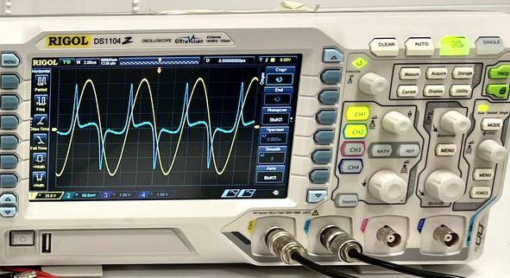
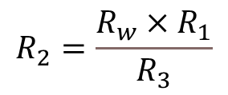
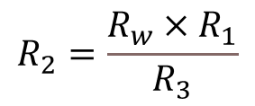
The output signal (blue) observed at the balanced bridge when R_{w} is substituted with a ferromagnetic microwire of the same DC resistance.
R₁
R₃
R₀
R₁
R₃
∼
V₀
R₀
V_{out}
V_{w}
∼
$$R_{2}=\frac{R_{w}×R_{1}}{R_{3}}$$
R_{w}
V_{M}
$$R_{2}=\frac{R_{w}×R_{1}}{R_{3}}$$
R_{w}

Slide 4

R₁
R₃
R₀
V_{out}
∼
The output signal (blue) observed at the balanced bridge when R_{w} is substituted with a ferromagnetic microwire of the same DC resistance.
V_{M}
$$R_{2}=\frac{R_{w}×R_{1}}{R_{3}}$$
R_{w}

Slide 5



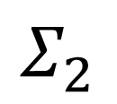


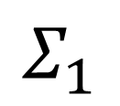
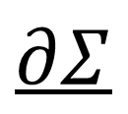
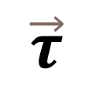
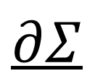

l
$$∂Σ$$
$$\vec{τ}$$
$$\vec{E}$$
$$\vec{n}$$
$$Σ_{2}$$
a
$$μ_{0}\vec{M}$$
$$Σ_{1}$$
$$\vec{n}$$
$$\vec{τ}$$
$$\vec{E}$$
$$∂Σ$$

Slide 6

R₁
R₃
R₀
∼
$$R_{2}=\frac{R_{w}×R_{1}}{R_{3}}$$
R_{w}

Slide 7
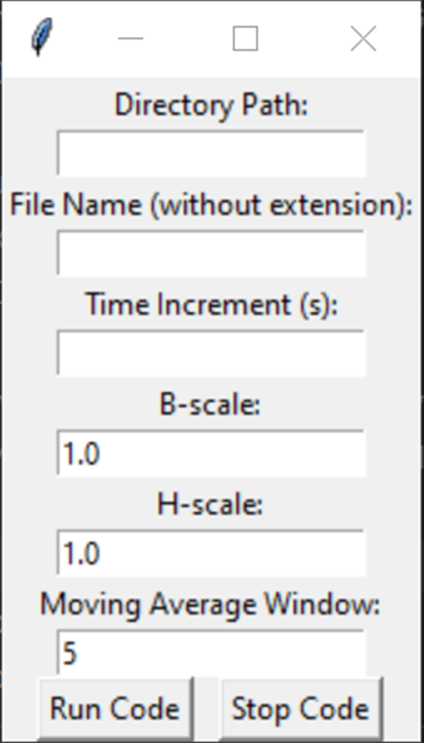
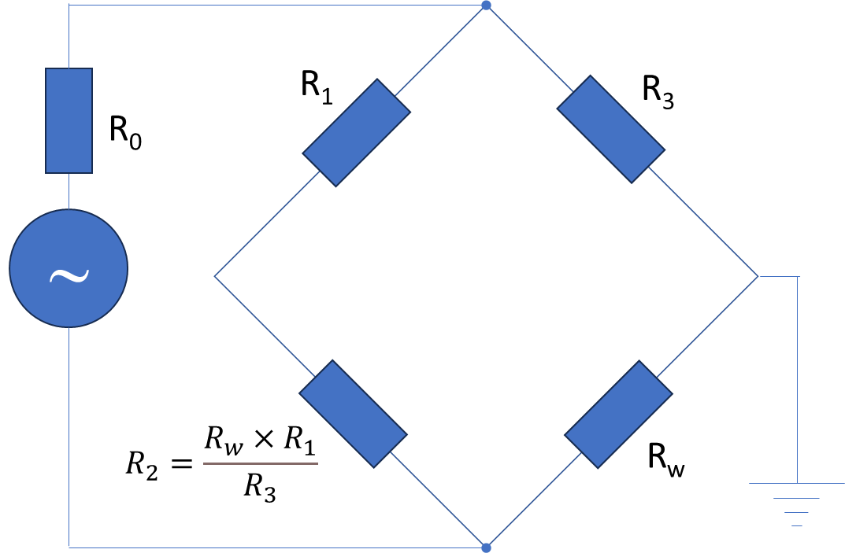
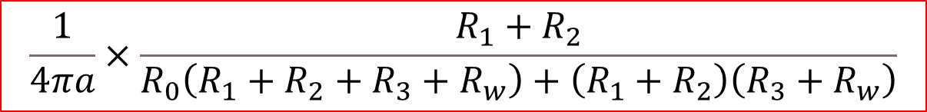

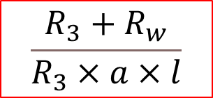
All measured voltages must be saved in Volts (V)
Resistors in the bridge circuit are measured in Ohms (Ω)
Microwire radius a and length l are measured in meters (m)
$$\frac{R_{3}+R_{w}}{R_{3}×a×l}$$
(T)
$$R_{2}=\frac{R_{w}×R_{1}}{R_{3}}$$
(A/m)
microwire
DC resistance
$$\frac{1}{4πa}×\frac{R_{1}+R_{2}}{R_{0}\left(R_{1}+R_{2}+R_{3}+R_{w}\right)+\left(R_{1}+R_{2}\right)\left(R_{3}+R_{w}\right)}$$

Slide 8
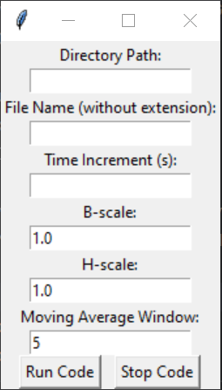
GUI in Python: run main.py
Copy and paste the directory with the experimental data, e.g. E:\Dropbox\MISiS\BH-loop\Experimental data
Type the file name, e.g. 50kHz
Type the time increment in the scientific format, e.g. 5e-8
Your scale coefficients here (1 by default)
Used to smooth the BH curves (5 by default)
Change the file name and run the code. All output files will be rewritten.
Stop the code

Slide 9
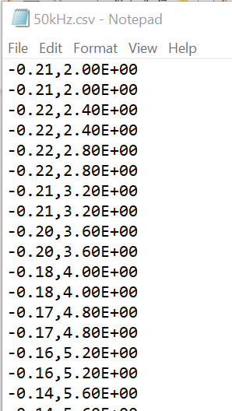
Structure of the CSV file: no header, two columns, comma delimiter
First column: signal response
Second column: excitation sinusoid (more than two periods)

