Slide 1
Multiverse Smaug Superiority
Help Smaug in the multiverse Auction House Game.

Slide 2
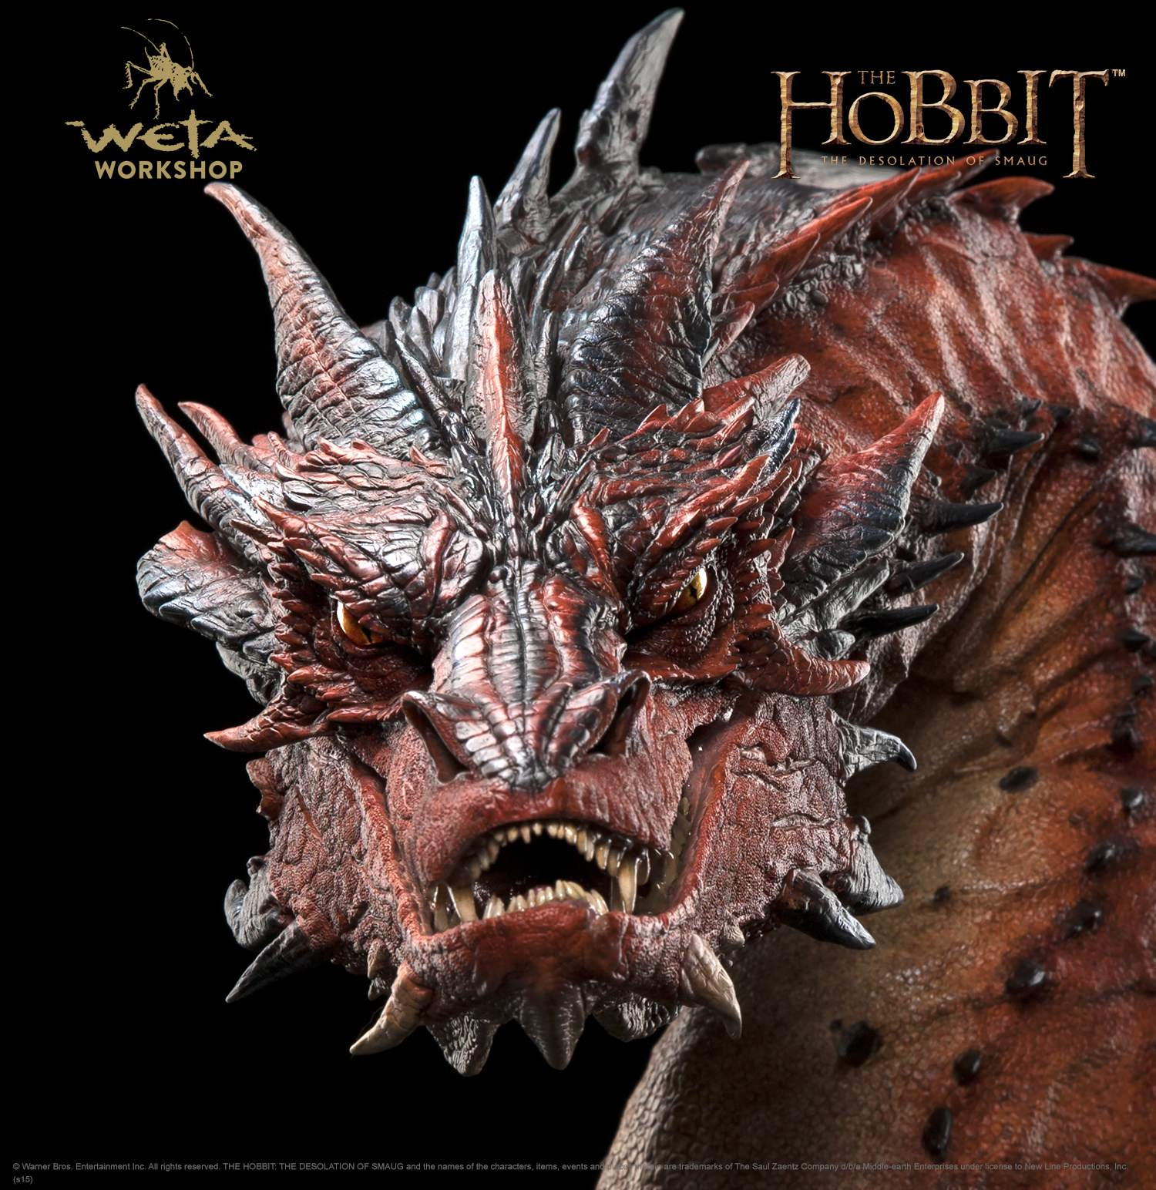
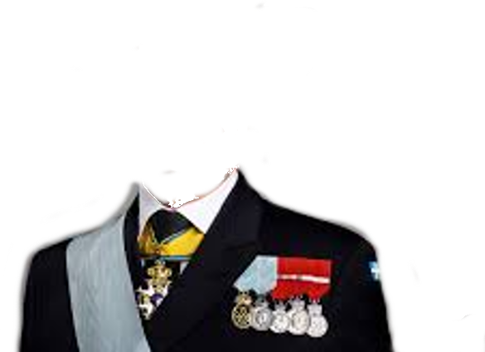

The client: Multiverse Smaug
Smaug
Smaug, the Magnificent (and slightly greedy) Dragon from The Hobbit, seeks to prove his superiority among his interdimensional counterparts. To settle this once and for all, he's calling upon the genius AI developers from Fremtiden Consulting across the multiverse to participate in an epic competition!
The Facilitator:
None other than the Master of the Mystic Arts, Doctor Strange, will oversee this grand competition. With his magical prowess and interdimensional know-how, he'll ensure a fair and exhilarating contest.

Slide 3

Mission Statement
Craft the ultimate Auction House Bot! Your creation will go head-to-head (or rather, claw-to-claw) against other Smaug-hired bots in a thrilling battle of wits, strategy, and point hoarding!

Slide 4
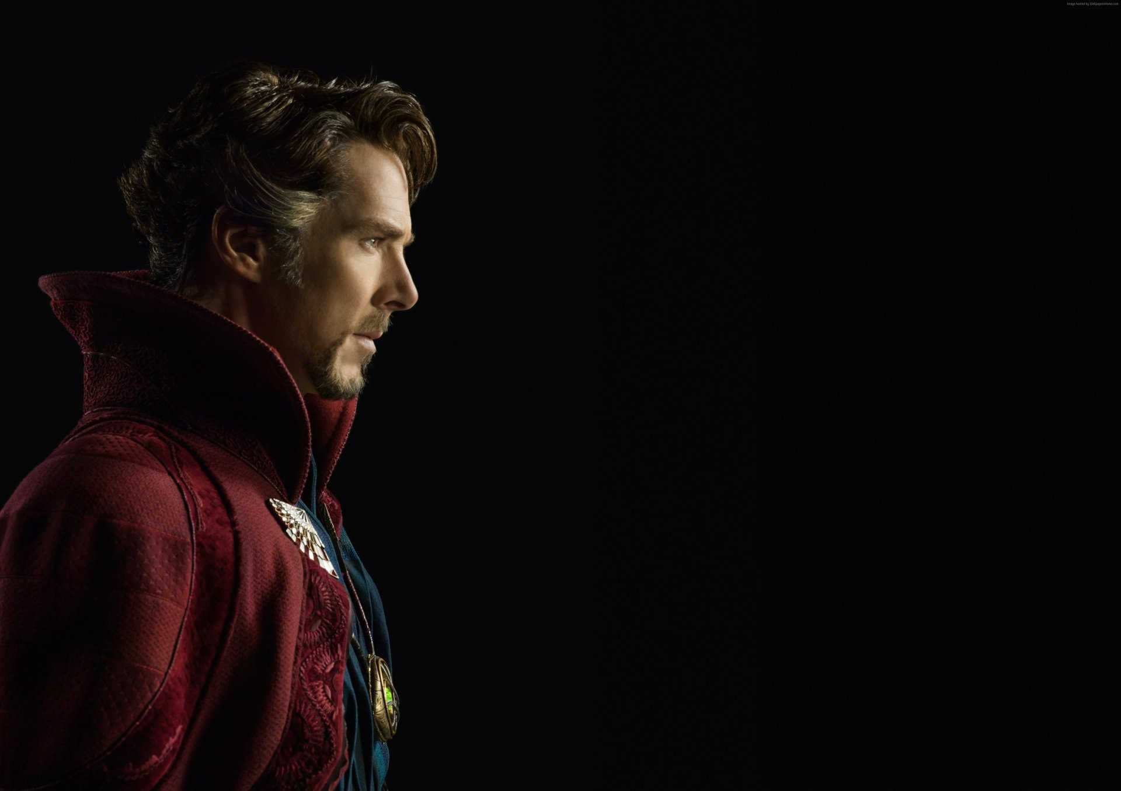
Tools:
Raw python, with some numpy where needed. Plotting libs are ok :)
The package can be installed with:
pip install dnd-auction-game
See the git repo for more info:
github.com/ooki/dnd_auction_game

Slide 5

Milestones
Before 9 Oct:
  Get the framework up and running
  Create your own AI Agent
  Deliver a expected results on Canvas.
Friday ( 9 Oct )
  We will battle the grades out
  Small break (to improve the AI)
  Another round of battle
After 9 Oct
  Present for Smaug why your AI did win/did not win.

Slide 6




R&D Flow: “Must Have’s”
Requirements the project must have.
Expected Results and Eval before Actual Battle
Obtain a passing grade in the AH battle using your own AI
Diagnose with plots why your agent performed as it did.
Short pitc/summary for Smaug (using Fremtiden Consulting slide template)

