Slide 1
Cybersecurity Crash Course Social engineering attacks getting smarter
Assessment 2 - Part C
a1844790
Presented by Dylan Rohan

Slide 2
Introduction
Data Sources & Information
Data Usage & Value
Social Engineering
Timeline of events
Security Measures and Summary
Types of Data
Information content
The value of data
Utilitarian and nefarious uses
Human hacking
Types of attack
A brief history of social engineering
Current state and developments
Cyber Hygiene practices
External Resources

Slide 3
Data Sources and Information

Slide 4
Natural World Data
Business Data
Temperature
Humidity
Inventory
Sales numbers
Air pressure
Luminosity
ROI
Magnetic field
Suppliers
Cost prices & Mark up
Local Ecology
Current and tides
Transport network
Project budgets
Engagement Data
Internet-of-Things Data (IoT Data)
Views
Heart rate
Financial information
Likes
Search history
Sleep cycles
Weather data
Communications data
Subscribership
Watch history
Comments
View duration
Energy usage
Network information
Location data
Genres
Personally Identifiable Information (PII)
Name
DOB
Census details
Address
Contact details
Membership/ identification numbers
IP addresses & devices serial numbers

Slide 5
Audible and Visual Data
Voice identifiers
Frequency
Tone
Pictures
Video
Traffic and Network Data
Train timetables
Bus Routes
Road layouts
Stop light frequency
Speed Information
Congestion data
Medical Data
Outage information
Blood Pressure
Cell counts
Family History
Medications
Previous Doctors
Medical history
Fitness level
Medical imaging

Slide 6
Data Usage and Value

Slide 7
Data Tye | Information Content | Utilitarian purpose | Nefarious purpose
PII Data | Personal records Likely behaviours Financial records Utilities record | Processing transactions Providing relevant marketing Recommendation algorythms | Authentication keyword Fraud Identity theft Target selection
Natural World Data | Local system disruption/ delays Travel times Route disruptions Signal disruptions | Planning and forecasting Targeted Marketing | Targeted disruption
Engagement Data | Primary interests Behavioural patterns Device and location | Recommendation systems Marketing Analytics | Adversarial attacks Target selection
Business Data | Business health Business value Likely business strategy | Business metrics/ KPIs | Competitive advantage Held for ransom
IoT Data | Health records Behavioural patterns | Convenience Complete history + RT record Disability supports Outlier logging | Target selection System infiltration

Slide 8
Social Engineering

Slide 9
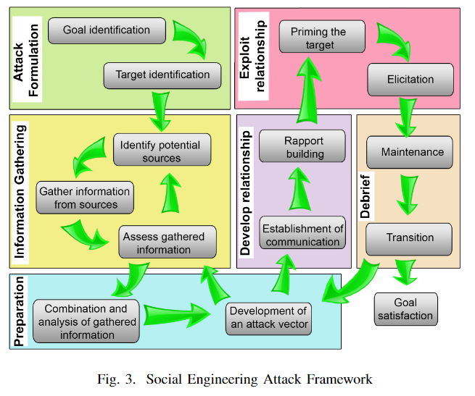
Social Engineering
Psychological manipulation to obtain access to sensitive data or systems for nefarious purposes.
(Mouton, Malan et al.)

Slide 10
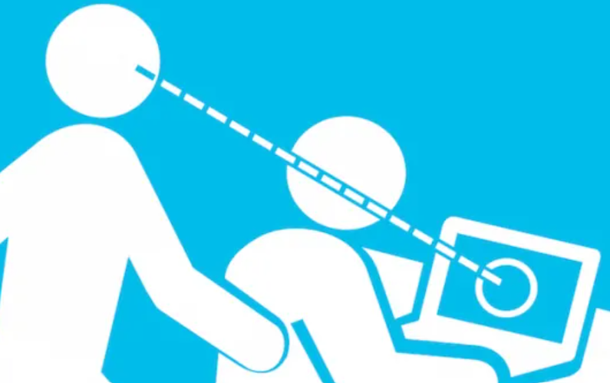
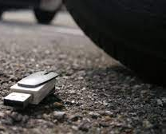
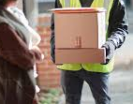
Social Engineering Attacks
Physical based
Dumpster diving
Shoulder surfing
Baiting
Tailgating
Eavesdropping
Impersonation
(Bhusal 2021)

Slide 11
Dumpster Diving | Shoulder Surfing | Baiting | Tailgating | Eavesdropping | Impersonation
Gathering improperly discarded information. E.g. computer drives, reports, CDs, receipts, etc. | Involves discreetly viewing over the targets shoulder to obtain desired information. E.g. Passwords, confidential information, Pin numbers, etc. | Storage devices housing malicious content are left in public places for unsuspecting victims to stumble upon. E.g. USBs, CDs, SD cards, etc. | An attacker waits for someone with security clearance to open a restricted passage and exploits the opening. E.g. Following close behind, entering with a ladder/ false delivery/uniform, requesting someone ‘hold the door’, etc. | Listening in on a conversation in secret. E.g. Telephone lines, emails, through doors/cubicle walls | Attackers use a false identity to gain access to physical devices or networks E.g. False ID cards, uniforms, identity theft

Slide 12

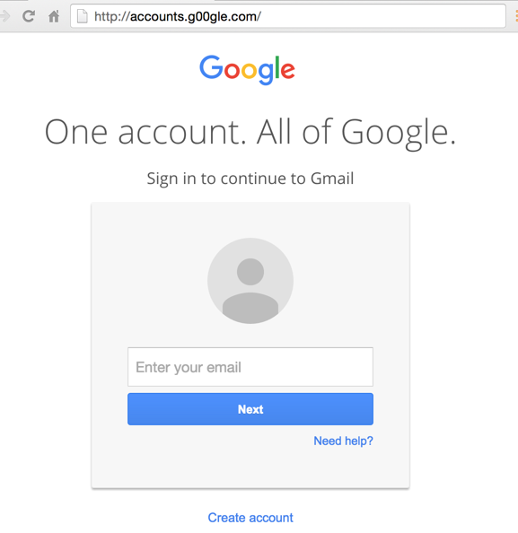
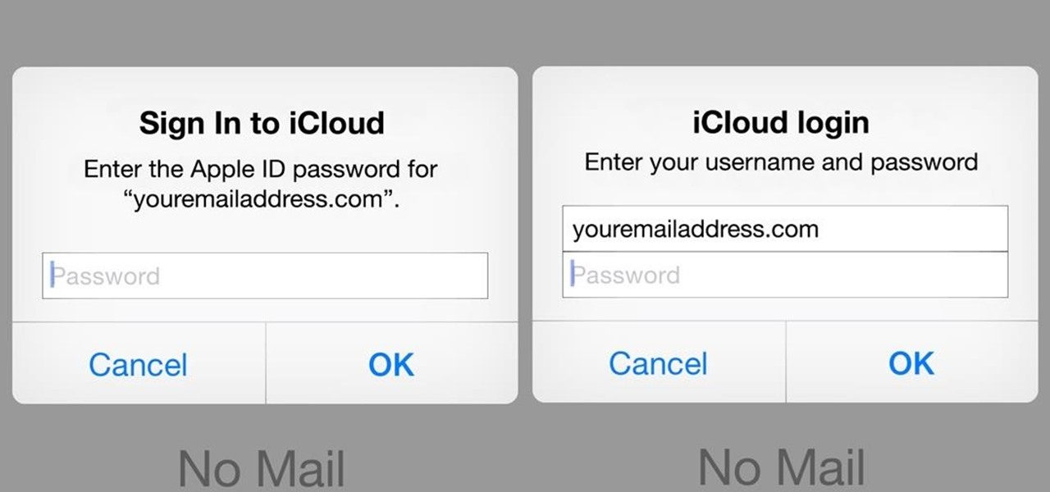
Social Engineering Attacks
Technical based
Watering Hole
Pop-up window
Robocalls
Reverse social engineer attacks
(Bhusal 2021)

Slide 13
Watering Hole | Pop-up Window | Robocalls | Reverse Social Engineer Attacks
Attackers compromise a site the target is likely to visit. | A pop-up window prompts users to enter credentials or download malicious content. | An autonomous attack contacting targets by phone with a recorded message invoking fear. | Attackers create a disruption resulting in the user requesting help from the attacker. They then wind back the disruption while stealing information or preparing an advanced persistent attack. As the target reached out to them there is a high degree of trust.

Slide 14
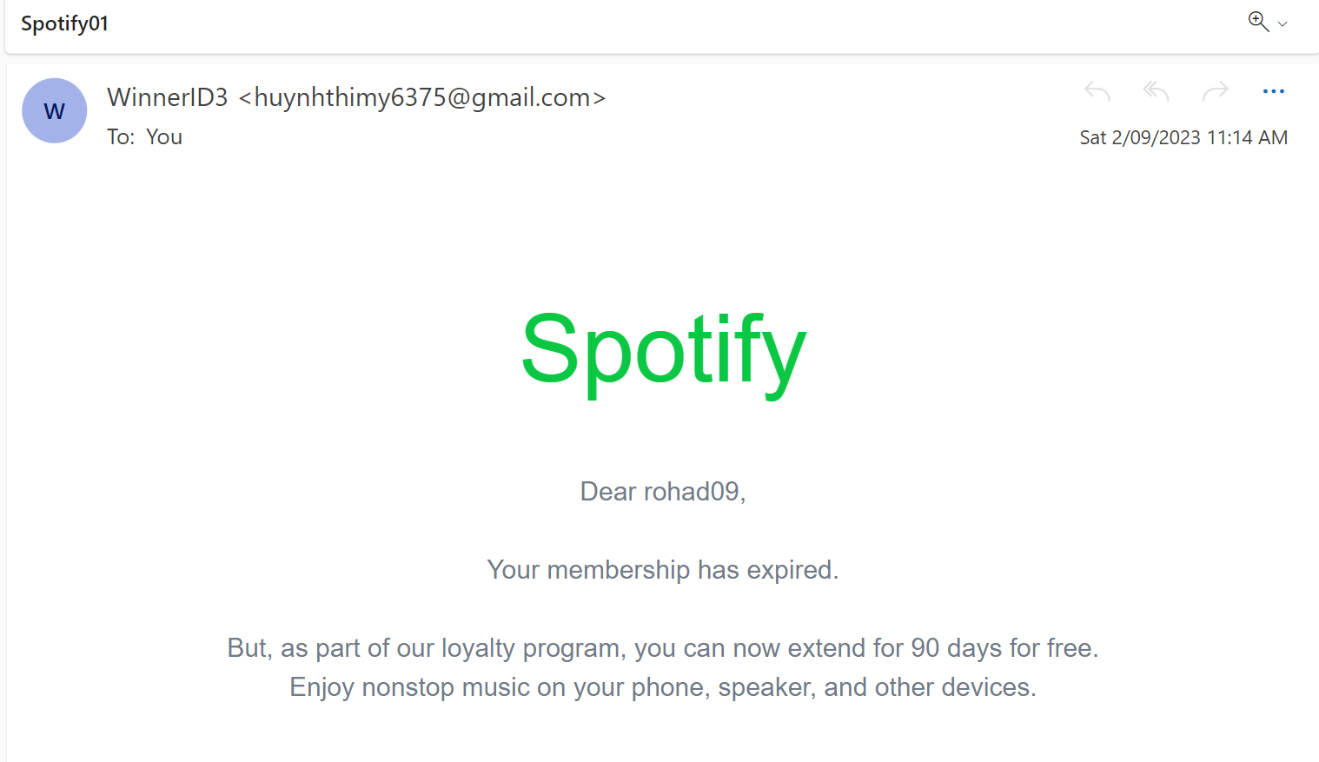
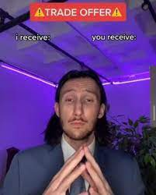
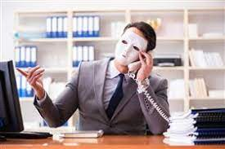
Social Engineering Attacks
Social based
Phishing, spear phishing, whaling
Reverse social engineering
Quid pro quo
Vishing
Pretexting
(Bhusal 2021)

Slide 15
Phishing | Spear Phishing | Whaling | Reverse social engineering | Quid pro quo | Vishing | Pretexting method
Attackers send fake emails in the hope that a random victim will provide confidential information. | Attackers send fake emails to a select to obtain confidential information or financial assets. | Attackers launch an attack on a specific target connected to a huge payload. May involve extortion, blackmail, fraud, or theft. | As seen in technical based attacks | The attacker falsely offers something of value, in exchange for their target information. | Phone phishing. | The attacker provides a context that the target gets swept up in resulting in them divulging confidential information. E.g. Winning the lottery, helping a loved one, tax office, etc.

Slide 16
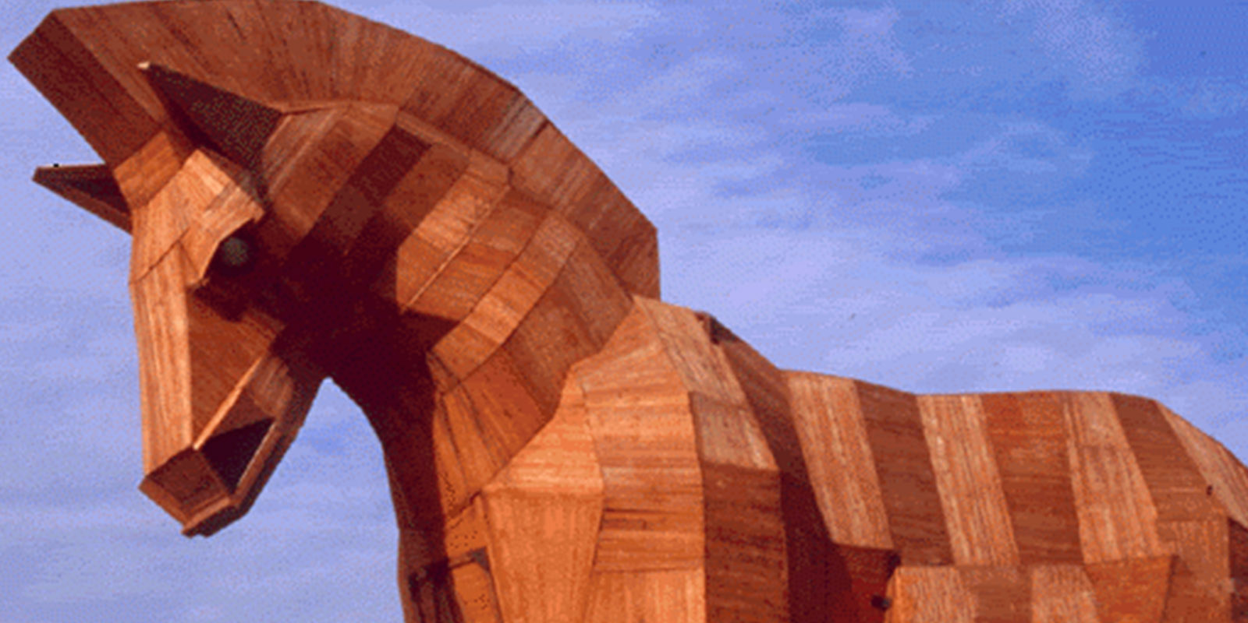
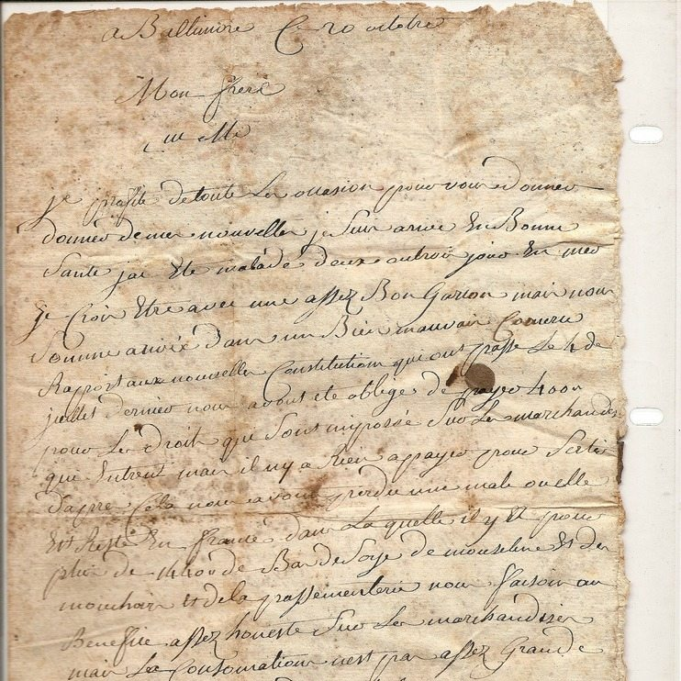
Timeline
1184 BC
Trojan Horse (Baiting)
1500 BC
Spanish Prisoner Con (Phishing)

Slide 17
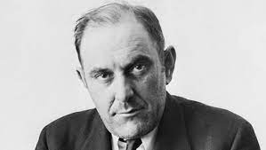
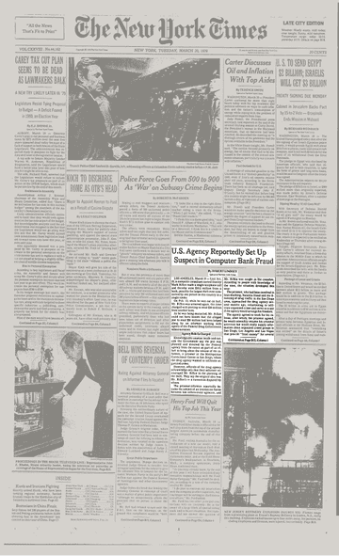
Timeline
1925
Eiffel Tower (phishing)
1970s
Nigerian Prince scam letter (Phishing)
1978
Security Pacific national bank (phishing)
Nigerian Prince scam Faxes (Phishing)
1980s
Nigerian Prince scam emails (Phishing)
1990s
Notes:
1925 - “Count” Victor Lustig convinced scrap yards of Paris that he had the writes to the Eiffel tower during a time when it was considered an expensive eye sore. He gathered several together and made the sale to his primary target. The target was too embarrassed to report Lustig that he returned from his escape to Austria and attempted to repeat the con but abandoned the attempt and fled to the US
1970s – First appearance of the Nigerian prince scam 419 scam (section 419 of Nigerian criminal code makes this type of fraud illegal)
1978 – Security pacific national bank is robbed by computer technician of USD10 million (allegedly in the guiness book of records for ‘biggest computer fraud’ despite not involving a modern computer). He knew how to wire money but required the daily code. Instead of remembering the code, workers would write it down. So he entered the room, obtained the code and wired the money then transferred funds to a swiss bank account where he converted the money into diamonds.
1980s – Nigerian prince scam went from letters to faxes
1990s- Nigerian prince scam moved to email

Slide 18
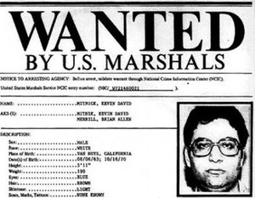
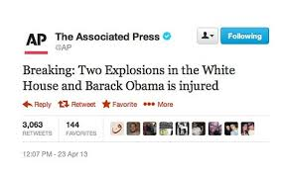
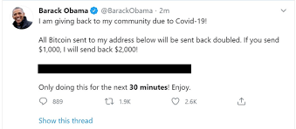
Timeline
1992
Motorola (Phishing)
2011
RSA (Phishing)
Target (Phishing)
Associate Press (Phishing)
The new York times (Phishing)
Apple, Facebook, and Twitter (Watering-hole)
Sony Pictures (Phishing)
2013
US Presidential Election (Phishing)
Snapchat (whaling)
2014
Toyota (Phishing)
2016
2019
Barack Obama, Joe Biden, Bill Gates, Jeff Bezos, MrBeast, Michael Bloomberg, Warren Buffett, Floyd Mayweather Jr., Kim Kardashian (Spear phishing)
Ukrainian agencies (Phishing)
2020
2022
Notes:
1992 - Motorola – Mitnick called his way through the Motorola hierarchy to obtain and exploit source code. The final barrier involved an employee going to get their security officer but instead being sent back with their credentials to enable the attack. The information Mitnick obtained was work created by a Tsutomu Shimomura. As a fellow hacker, he took this as a challenge and began tracking down the criminal. Mitnick muddied his attempts by impersonating an official and being brought in on the investigation through reverse social engineering. He was captured in the end and jailed for 6 years (predominantly in confinement as the jusge was worried he’d use the phone to continue hacking). Mitnick went on to become a cybersecurity professional.
2011 - RSA Security – supplier of two factor authentication devices were bamboozled by a primitive phishing attack even though security is their business the recover cost 66 Million.
2013 – Target was breached through a third party which involved the PII data of 101 million customers
2013 – Associate press’s twitter account was hacked and let the world believe that the white house had been compromised and the president injured for 15 minutes.
2013 – The new York times were breached when one employee clicked a link in a Fake fed ex email
2013 – Apple, facebook, and twitter were breached with a zero-day attack on a java vulnerability which was launched through a water-hole attack where attackers new developers would congregate.
2014 – Sony productions appear to be hacked by north korea in retaliation to the movie ‘the interview’. They delete the original data and threatened to release copies of the companies confidential data.
2016 – Private emails were obtained through a phishing attack launched by Russia. The false emails sent to staffers contained a bitly url which users were lead to believe would help them increase their security. In fact, the emails stole their credentials compromised users that clicked the link. Hackers found success getting into gmail accounts, that was when top officials of the Clinton campaign were hacked. The documents ended up with wikileaks.
2016 – Snapchat ‘CEO’ sent an email requesting sensitive payroll information, but it wasn’t them
2019 – Toyota was hit by a phishing attack that cost them 37 million.. The third such attack that year.
2020- The twitter accounts of several high profile people were hacked through a spear phishing campaign which promoted a quid pro quo involving sending bitcoin to various addresses.
2022 – Ukrainian agencies are being hit by Russia as a modern form of cyber espionage.
Global average cost of data breach was AUD6.98 million a 15% increase over three years. 51% of companies were going to improve cybersecurity as the result of a breach.
2.76 million is saved on average with security AI compared to organizations that do not.
Cost of a Data Breach Report 2023 IBM
According to Forbes $6.9 billion was stolen in 2021 solely through social engineering attacks, a 64% increase on the prior year

Slide 19
Emerging and Future Social Engineering attacks
Language barriers removed, sophisticated messages, ability to improve on failed attempts with AI (Blauth, Gstrein et al. 2022)
Deepfakes (Mirsky and Lee 2022)
Underhanded surveillance tactics (Geng, Huang et al. 2022)
Cloned speech (Neekhara, Hussain et al. 2021)
Autonomous attacks (Zeng 2022)

Slide 20
Security Measures and Summary
Individual Level
Email address and format peculiarity or sense or urgency
Check hyperlink address
Report attempts
Strong unique passwords, regular updates
Don’t use passwords with keywords that exist in your public social media profile
Verify people when unsure
Organization level
Spam blocks and firewalls
Regular patching
Company policies and protocol
Two factor authentication and password storage system
Proper removal of old devices

Slide 21
References
Bhusal, CS 2021, 'Systematic review on social engineering: Hacking by manipulating humans', Journal of Information Security, vol. 12, pp. 104-114.
FBI 2021, Internet Crime Report 2021, FBI, https://www.ic3.gov/Media/PDF/AnnualReport/2021_IC3Report.pdf.
Geng, J, Huang, D & Fernando 2022, 'DensePose From WiFi', arXiv pre-print server, 2022-12-31.
IBM 2023, Cost of a Data Breach Report 2023, IBM, https://www.ibm.com/reports/data-breach, viewed 06/09/2023 2023.
Koyun, A & Al Janabi, E 2017, 'Social engineering attacks', Journal of Multidisciplinary Engineering Science and Technology (JMEST), vol. 4, no. 6, pp. 7533-7538.
Krombholz, K, Hobel, H, Huber, M & Weippl, E 2015, 'Advanced social engineering attacks', Journal of Information Security and applications, vol. 22, pp. 113-122.
Mirsky, Y & Lee, W 2022, 'The Creation and Detection of Deepfakes', ACM Computing Surveys, vol. 54, no. 1, pp. 1-41.
Mouton, F, Malan, MM, Leenen, L & Venter, HS 'Social engineering attack framework', in IEEE.
Neekhara, P, Hussain, S, Dubnov, S, Koushanfar, F & McAuley, J 2021, 'Expressive neural voice cloning', in Asian Conference on Machine Learning, PMLR, pp. 252-267.
Pienta, D, Thatcher, JB & Johnston, A 2020, 'Protecting a whale in a sea of phish', Journal of Information Technology, vol. 35, no. 3, 2020/09/01, pp. 214-231.
Salahdine, F & Kaabouch, N 2019, 'Social engineering attacks: A survey', Future internet, vol. 11, no. 4, p. 89.
Zeng, Y 2022, 'AI Empowers Security Threats and Strategies for Cyber Attacks', Procedia Computer Science, vol. 208, pp. 170-175.

