Slide 1
Big Data Technology IS 6733
Convolution Neural Network
Paul Rad, Ph.D.
Associate Professor
Information Systems and Cyber Security, College of Business School
Electrical and Computer Engineering, College of Engineering

Slide 2
https://medium.com/machine-learning-bites/deeplearning-series-convolutional-neural-networks-a9c2f2ee1524

Slide 3
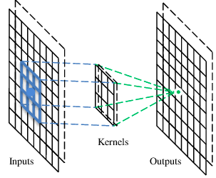
A convolutional layer
A CNN is a neural network with some convolutional layers. A convolutional layer has a number of filters that does convolutional operation.

Slide 4
These are the network parameters to be learned.
1 | -1 | -1
-1 | 1 | -1
-1 | -1 | 1
1 | 0 | 0 | 0 | 0 | 1
0 | 1 | 0 | 0 | 1 | 0
0 | 0 | 1 | 1 | 0 | 0
1 | 0 | 0 | 0 | 1 | 0
0 | 1 | 0 | 0 | 1 | 0
0 | 0 | 1 | 0 | 1 | 0
Kernel 1
-1 | 1 | -1
-1 | 1 | -1
-1 | 1 | -1
Kernel 2
……
6 x 6 image
Each filter detects a small pattern (3 x 3).

Slide 5
stride=1
1 | -1 | -1
-1 | 1 | -1
-1 | -1 | 1
1 | 0 | 0 | 0 | 0 | 1
0 | 1 | 0 | 0 | 1 | 0
0 | 0 | 1 | 1 | 0 | 0
1 | 0 | 0 | 0 | 1 | 0
0 | 1 | 0 | 0 | 1 | 0
0 | 0 | 1 | 0 | 1 | 0
Dot
product
3
-1
6 x 6 image

Slide 6
If stride=2
1 | -1 | -1
-1 | 1 | -1
-1 | -1 | 1
Filter 1
1 | 0 | 0 | 0 | 0 | 1
0 | 1 | 0 | 0 | 1 | 0
0 | 0 | 1 | 1 | 0 | 0
1 | 0 | 0 | 0 | 1 | 0
0 | 1 | 0 | 0 | 1 | 0
0 | 0 | 1 | 0 | 1 | 0
3
-3
6 x 6 image

Slide 7
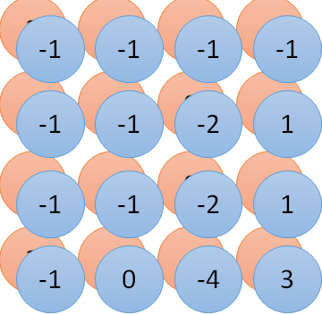
1 | 0 | 0 | 0 | 0 | 1
0 | 1 | 0 | 0 | 1 | 0
0 | 0 | 1 | 1 | 0 | 0
1 | 0 | 0 | 0 | 1 | 0
0 | 1 | 0 | 0 | 1 | 0
0 | 0 | 1 | 0 | 1 | 0
1 | -1 | -1
-1 | 1 | -1
-1 | -1 | 1
-1 | 1 | -1
-1 | 1 | -1
-1 | 1 | -1
convolution
image
Fewer parameters
1 | 0 | 0 | 0 | 0 | 1
0 | 1 | 0 | 0 | 1 | 0
0 | 0 | 1 | 1 | 0 | 0
1 | 0 | 0 | 0 | 1 | 0
0 | 1 | 0 | 0 | 1 | 0
0 | 0 | 1 | 0 | 1 | 0
Fully-connected
……
……

Slide 8
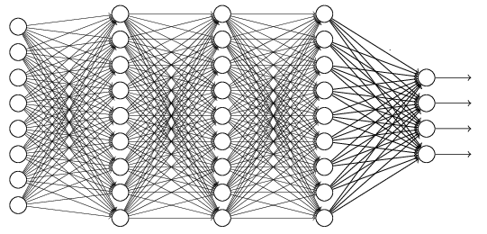
Object
Output label ……
Convolution
Max Pooling
Fully Connected
Convolution
Max Pooling
Flattened

Slide 9
Max Pooling
-1
-1
-1
-1
-1
-1
-2
1
-1
1
-1
-1
-2
1
0
3
-1
0
-4
3
Subsampling

Slide 10
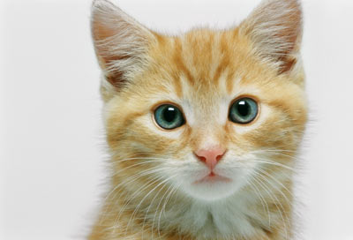
Subsampling pixels will not change the object
Cat
Cat
Subsampling
make image smaller

Slide 11
Convolution
Max Pooling
A new image
Convolution
Max Pooling

