Slide 1
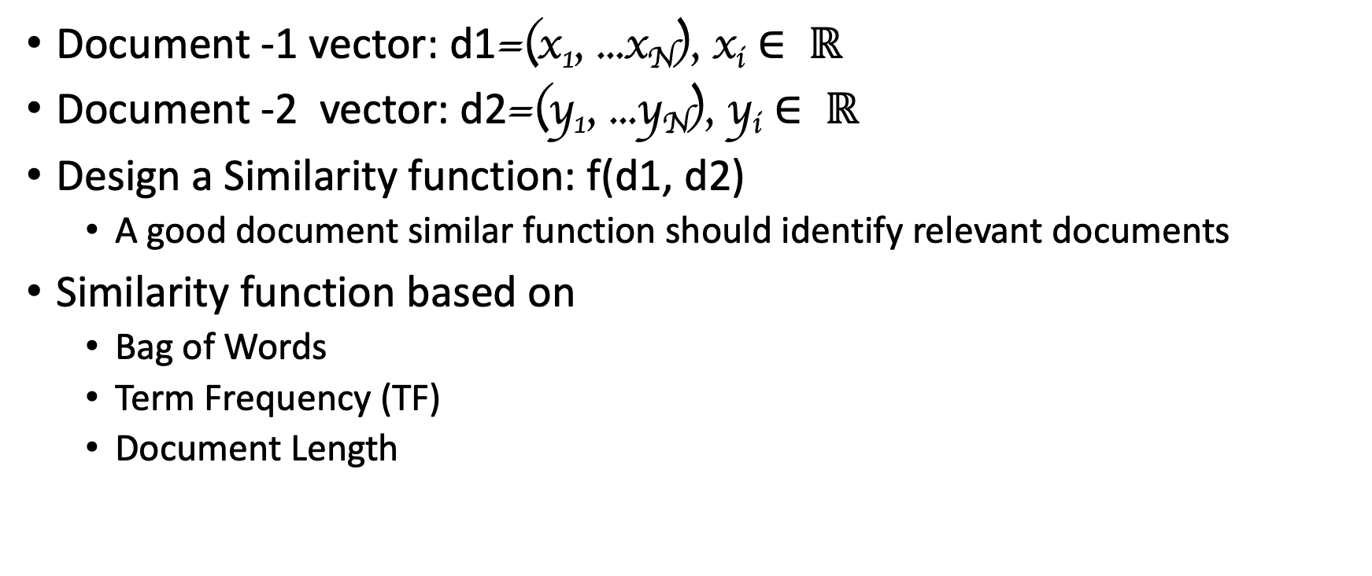
Document Classification
Document -1 vector: d1=(x₁, ...x_{N}), x_{i} $∈ ℝ$
Document -2 vector: d2=(y₁, ...y_{N}), y_{i} $∈ ℝ$
Design a Similarity function: f(d1, d2)
A good document similar function should identify relevant documents
Similarity function based on
Bag of Words
Term Frequency (TF)
Document Length

Slide 2
Many Similarity Function
Distance Function (q, d)
Vector space model
Probabilistic models P(s=1 | q, d)
Probabilistic inference model f(q, d) = p(d→q)
Axiomatic model
Deep Learning

Slide 3
Vector Space Model (VSM) Assumptions
Terms are assumed to be orthogonal (independent from each other)
Term: basic concepts such as word or phrase (n-gram)
N terms define an N-dimensional space
Vector Placements base on Terms (w₁, ...w_{N})
Term weight in query and document indicates how well the term characterizes the document or query.
We need to define a similarity function Distance Function (q, d) for measuring the relevance.

Slide 4
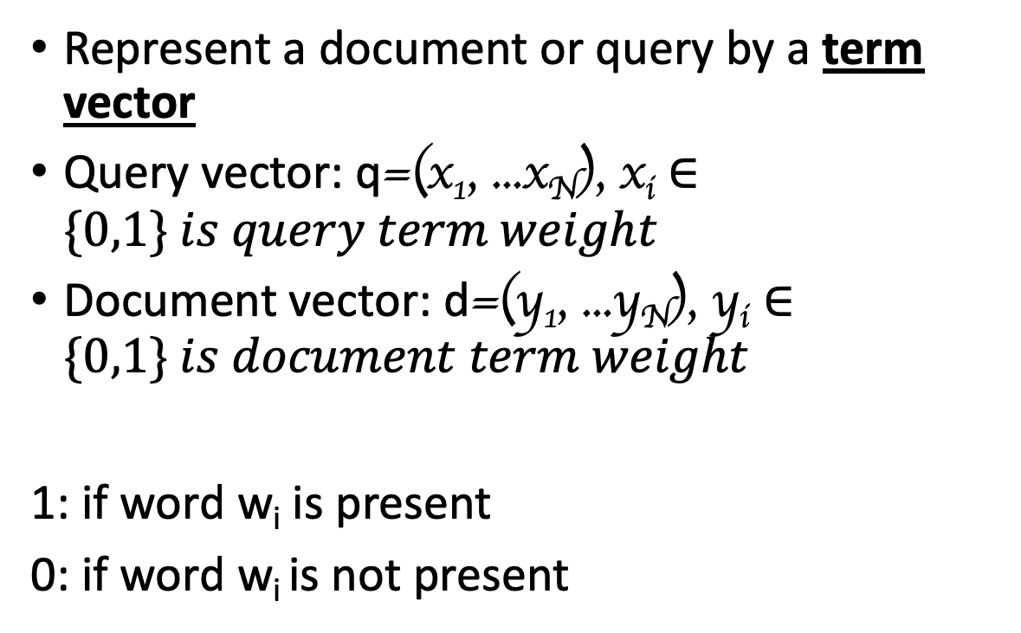
Bit Vector Presentation
Represent a document or query by a term vector
Query vector: q=(x₁, ...x_{N}), x_{i} $∈\{0,1\} is query term weight$
Document vector: d=(y₁, ...y_{N}), y_{i} $∈\{0,1\} is document term weight$
1: if word w_{i} is present
0: if word w_{i} is not present
w3
N-dimensional space,
Dictionary = (w₁, ...w_{N})
q=(x₁, ...x_{N})
d=(y₁, ...y_{N})
w2
w1

Slide 5

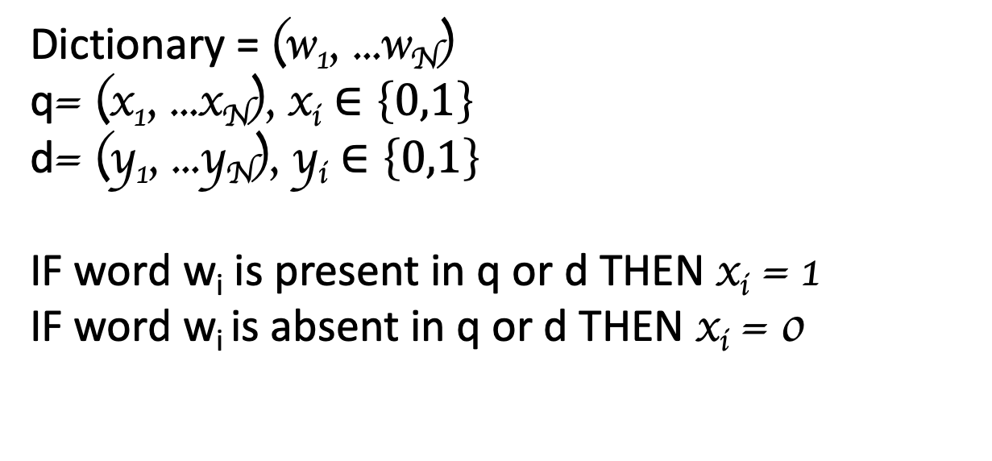

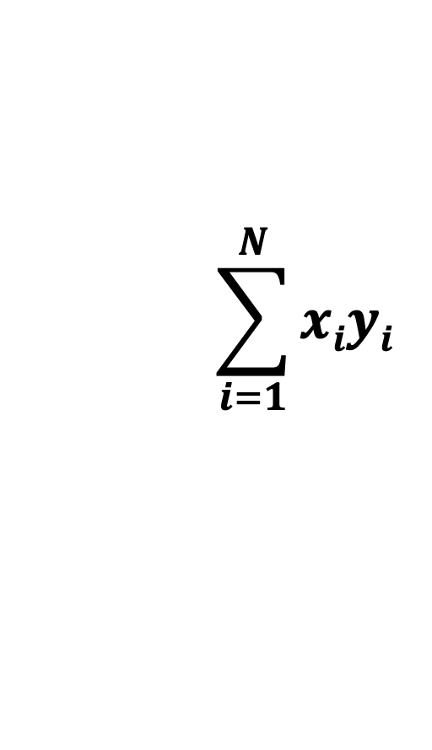


Similarity → Distance Function: DoT Product
Dictionary = (w₁, ...w_{N})
q= (x₁, ...x_{N}), x_{i} $∈\left\{0,1\right\}$
d= (y₁, ...y_{N}), y_{i} $∈\left\{0,1\right\}$
IF word w_{i} is present in q or d THEN x_{i} = 1
IF word w_{i} is absent in q or d THEN x_{i} = 0
$$\sum_{i=1}^{N}{xiyi}$$
$$→$$
$$→$$
.
D (q, d) =
$$q$$
$$d$$
= x₁y₁ + x₂y₂ + …. x_{n}y_{n} =

Slide 6
Example 1
I hate running
I like NLP
I like deep learning
Terms = {I, like, hate, Deep, Learning, NLP, flying}

Slide 7
Example 2
Query = news about sport campaign
Document 1 = .. news about food campaign
Document 2 = .. news of sport campaign
Document 3 = .. news of sport campaign … sport activities ..

Slide 8
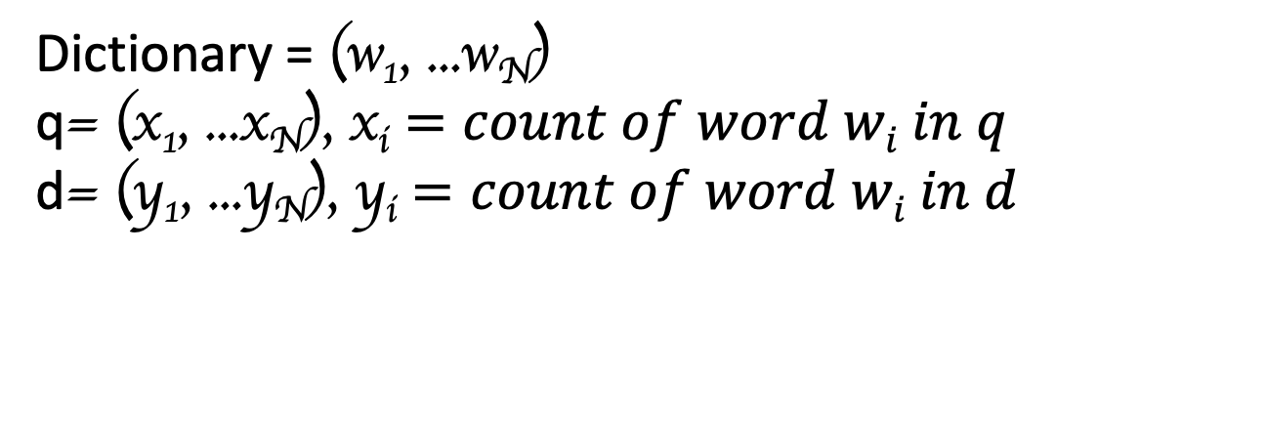
Similarity → Distance Function: DoT Product Improved SVM with Term Frequency Weighting
Dictionary = (w₁, ...w_{N})
q= (x₁, ...x_{N}), x_{i} $=count of word wi in q$
d= (y₁, ...y_{N}), y_{i} $=count of word wi in d$
$$\sum_{i=1}^{N}{xiyi}$$
$$→$$
$$→$$
.
D (q, d) =
$$q$$
$$d$$
= x₁y₁ + x₂y₂ + …. x_{n}y_{n} =

Slide 9
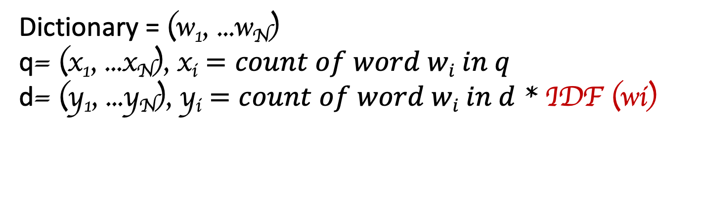
Similarity → Distance Function: DoT Product Further Improvement of Vector Placement Inverse Document Frequency (IDF)
Dictionary = (w₁, ...w_{N})
q= (x₁, ...x_{N}), x_{i} $=count of word wi in q$
d= (y₁, ...y_{N}), y_{i} $=count of word wi in d$ * IDF (wi)
$$\sum_{i=1}^{N}{xiyi}$$
$$→$$
$$→$$
.
D (q, d) =
$$q$$
$$d$$
= x₁y₁ + x₂y₂ + …. x_{n}y_{n} =

Slide 10
IDF Weighting Penalizing popular terms
IDF (w) = Log (D + 1)/k)
D = total number of docs in collection
k = total number of docs containing w (Doc frequency)
IDF(w)
Log(D+1)
k
Document Frequency

Slide 11
Example 2
Query = news about sport campaign
Document 1 = .. news about food campaign
Document 2 = .. news of sport campaign
Document 3 = .. news of sport campaign … sport activities ..

Slide 12
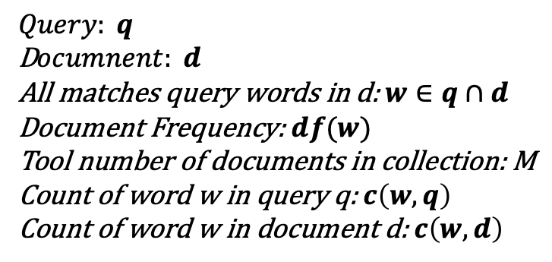
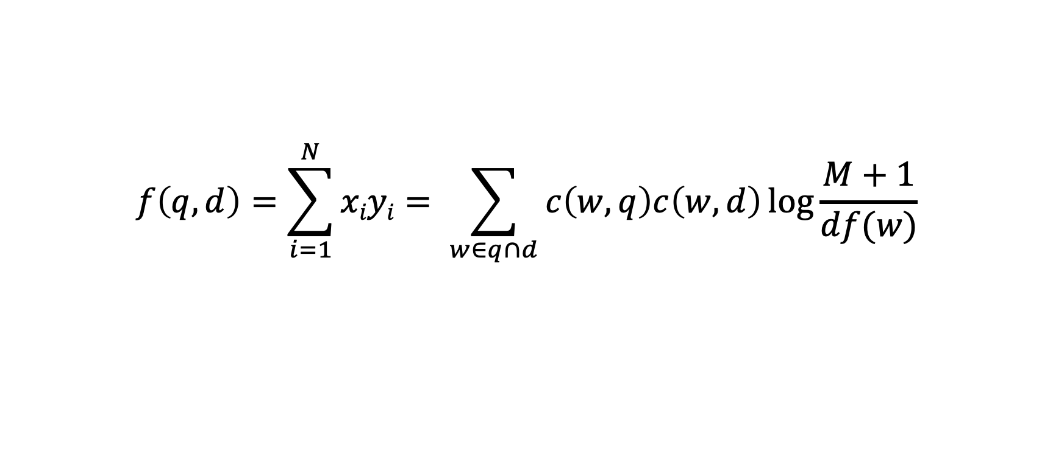
Similarity Function with TF-IDF Weighting
$$f\left(q, d\right)=\sum_{i=1}^{N}{xiyi}= \sum_{w∈q∩d}{c\left(w,q\right)c\left(w,d\right)\log{\frac{M+1}{df(w)}}}$$
$$Query: q$$
D$ocumnent: d$
All matches query words in d: $w∈q∩d$
Document Frequency: $df(w)$
Tool number of documents in collection: M
Count of word w in query q: $c\left(w,q\right)$
Count of word w in document d: $c\left(w,d\right)$

