Slide 1
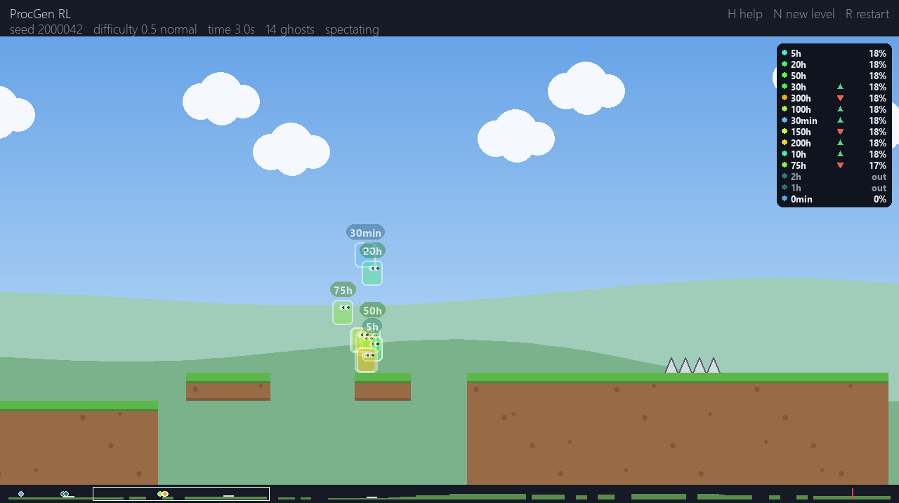
Teaching an agent to play levels it has never seen
PROCGEN RL
Reinforcement learning on a procedurally generated platformer, raced against its own past selves
[Your name] · [Course, date]
Notes:
Hi, I’m [name]. This project asks a simple question: can an agent learn to play a platformer in general, rather than memorising particular levels? Every level here is generated on the fly, so the agent never sees the same one twice. To make the learning visible, the final demo lets you race against snapshots of the agent from different points in its training, like the ghost cars in a racing game.

Slide 2
A platformer the agent can’t memorise
THE IDEA
01
02
03
Procedural levels
A learning agent
A ghost race
A new level every episode, built from a seed: gaps, stairs, spikes and floating platforms.
PPO learns from reward alone: move right, don’t die, reach the flag. No hand-written rules.
You play against snapshots of the agent after 0 min, 1 h, 10 h … 300 h of simulated training.
The question: does it learn to play, or does it just learn these levels?
Notes:
Three parts. First, a level generator, so the agent cannot simply memorise a button sequence. Second, a standard RL algorithm, PPO, which only ever sees a reward signal. Third, the demo: snapshots of the agent saved during training become ghosts you race against, so you can watch it go from useless to better than you. The key question for the whole talk is the difference between learning to play and learning particular levels.

Slide 3
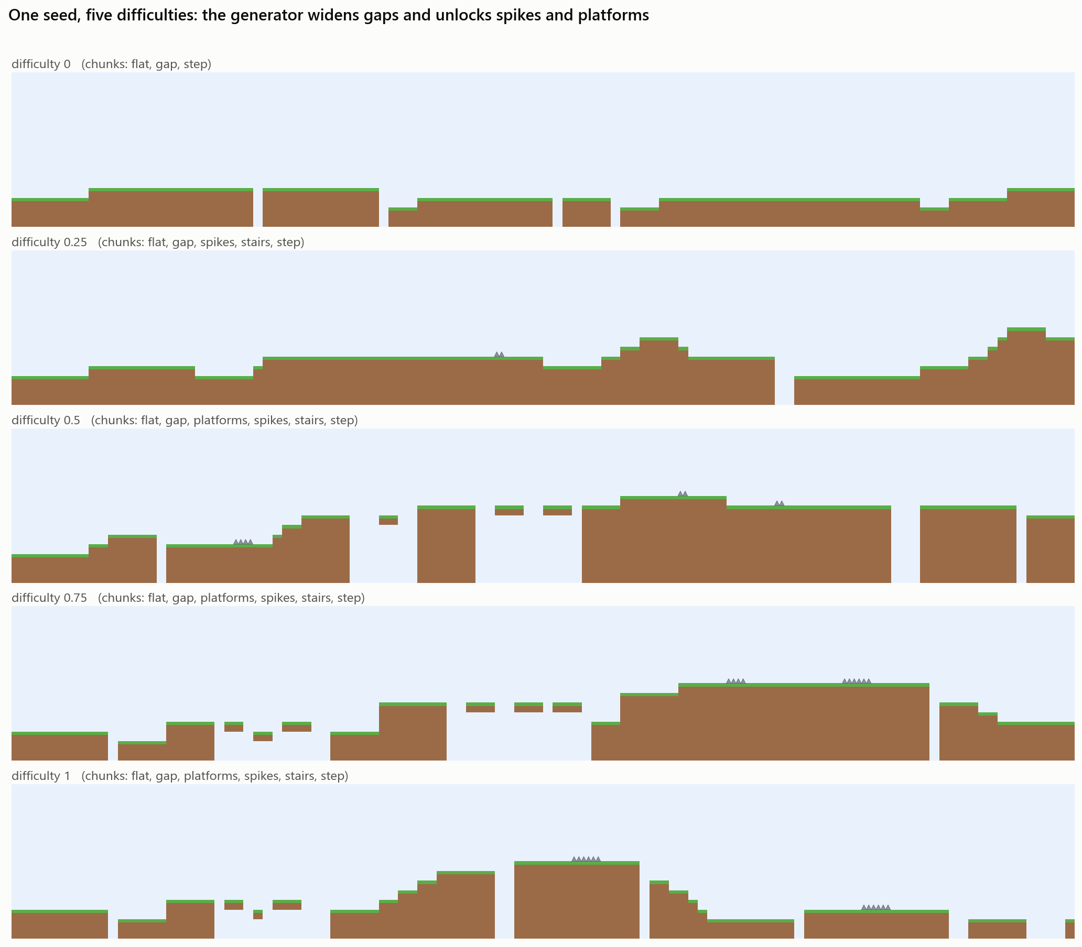
Run right, reach the flag
THE GAME
Stage 1: terrain
Flat ground, steps, stairs and gaps, each sized from the jump physics.
Stage 2: hazards
Spikes from difficulty 0.25, floating platform hops from 0.35.
Physics
Deterministic 60 FPS tile physics: jumps up to 3.8 tiles, hold for higher, coyote time.
Difficulty 0 to 1 (demo: up to 2)
Widens gaps and height changes and adds hazards. Enemies are phase 2.
Notes:
A Mario-style side-scroller kept deliberately simple. The picture is the same seed at five difficulty settings. Difficulty is one number from 0 to 1 that widens gaps, increases height changes and unlocks the stage 2 hazards. The physics are deterministic, so a ghost replays identically in the demo and in evaluation. Jump height and gap limits come from the physics, which is how the generator guarantees a level can be beaten.

Slide 4
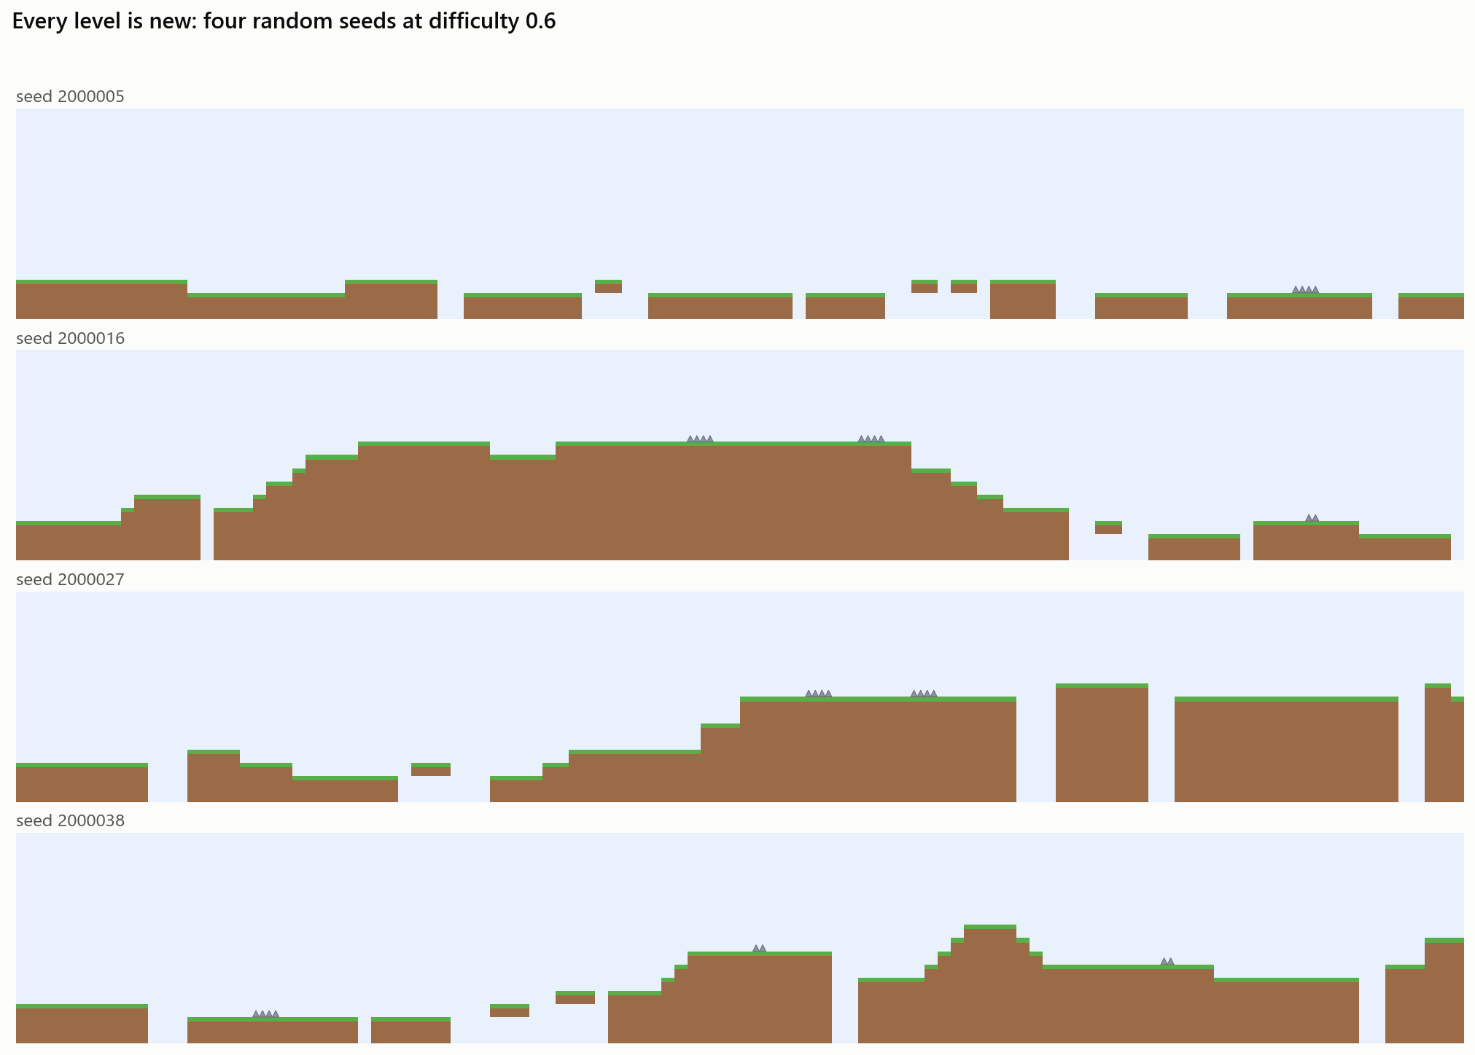
Every level is new and beatable
LEVEL GENERATOR
1,000,000
training seeds. A fresh level is drawn for every episode, built from chunks with a seeded random generator.
100%
of tested levels solvable. A search-based solver beats every level in the test suite.
3 ranges
of seeds that never overlap: training, evaluation and the demo. The agent is never tested on a level it trained on.
Notes:
Four seeds, same difficulty, four different levels. Levels are stitched together from chunks such as gaps, stairs, spikes and platforms, using Python’s seeded random generator so the same seed gives the same level on any machine. Random levels are only useful if they are fair, so the test suite runs a search-based solver over 200 levels and requires it to finish every one. Training, evaluation and demo seeds come from separate ranges, which keeps the evaluation honest.

Slide 5
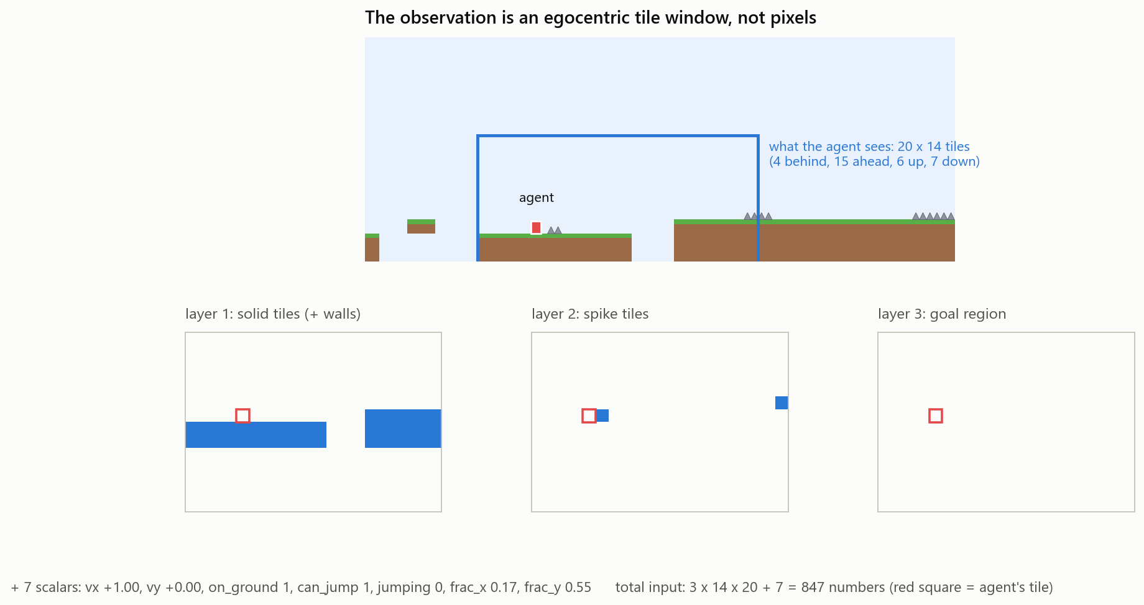
What the agent sees
OBSERVATION
20 × 14 tiles
around the agent: 4 behind, 15 ahead
3 layers
solid, spike, goal; each tile is 0 or 1
+ 7 numbers
its own speed, on ground, can jump, jumping, position within the tile
847 inputs
cheaper than pixels, and the same on every level because it is relative to the agent
Notes:
Instead of pixels the agent gets a small grid of tiles centred on itself, looking mostly ahead because that is where the danger is. The grid is split into three yes/no layers: is this tile solid, is it a spike, is it the goal. On top of that come seven numbers about its own motion. 847 numbers in total. Because the view moves with the agent, a gap looks the same wherever it appears in a level, which is exactly what helps it generalise. It also means a small network on a CPU is enough.

Slide 6
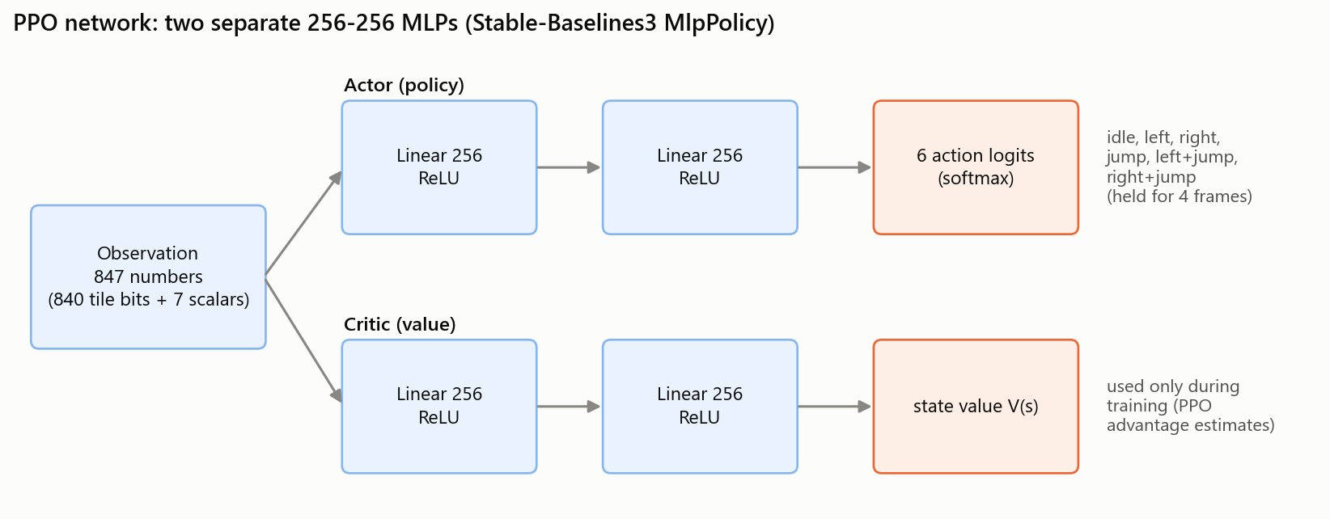
PPO with two small networks
THE AGENT
The actor picks one of 6 actions; the critic estimates how good the situation is. Only the actor ships in a ghost file, and the demo runs it with NumPy in about 0.1 ms.
Notes:
The algorithm is Proximal Policy Optimisation from Stable-Baselines3, the standard choice for this kind of problem. There are two networks with the same shape: the actor decides what to do, and the critic predicts future reward, which PPO uses to judge whether an action turned out better or worse than expected. Each has two hidden layers of 256 units. At each milestone the actor’s weights are exported to a small file, a ghost, and the demo runs it with plain NumPy, so it needs no PyTorch at all.

Slide 7
Make progress, don’t die
REWARD AND TRAINING
Event | Reward
Each new tile of ground reached | +0.1
Each decision (time penalty) | −0.002
Falling into a pit or hitting spikes | −1
Reaching the flag | +5
No new ground for 90 decisions | episode ends
Training setup
6 actions: idle, left, right, jump, left + jump, right + jump
One decision every 4 frames (15 per second)
8 games in parallel on a 16-thread laptop CPU
About 2,700 decisions per second
1 simulated hour = 54,000 decisions
Notes:
The reward is deliberately simple. The agent earns a little for every new tile of ground it reaches, so it gets feedback long before it ever sees the flag. A tiny time penalty discourages dawdling, dying costs one point, and the flag is worth five. If it makes no progress for 90 decisions the episode is cut short, so it does not waste time stuck against a wall. Time is reported in simulated hours: one hour of gameplay at 15 decisions per second is 54,000 decisions, so we can say “this ghost has 10 hours of practice”.

Slide 8
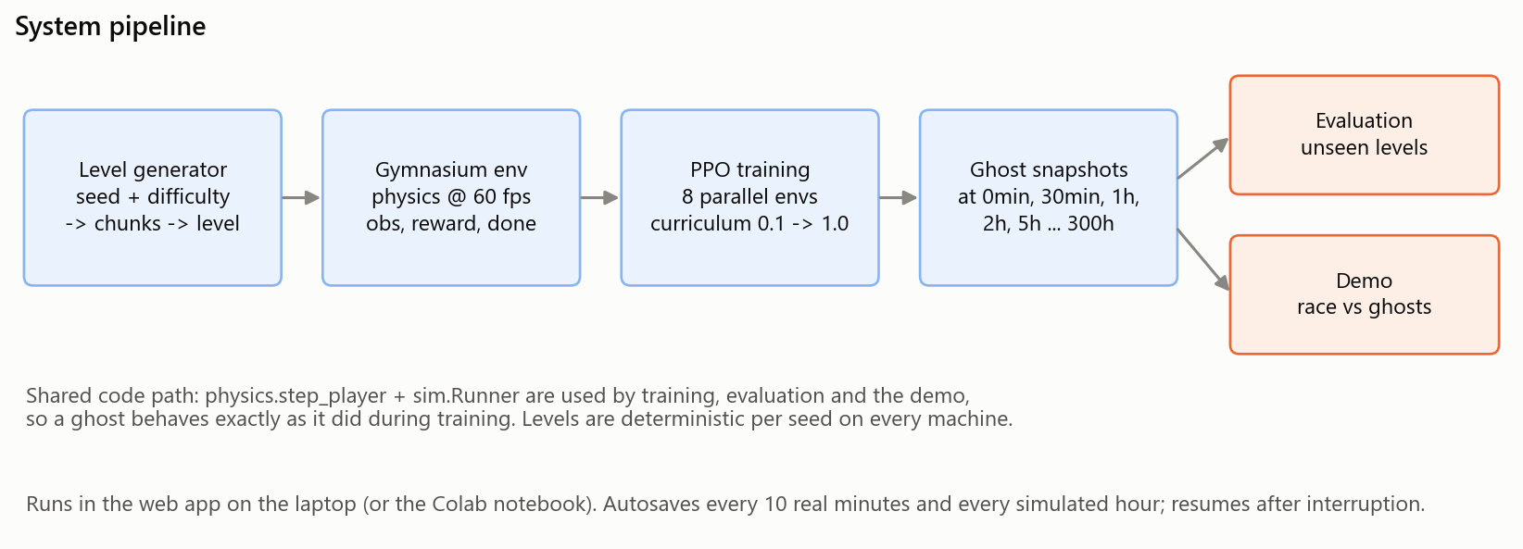
From seed to ghost
SYSTEM
A local web app runs the queue overnight, autosaves every 10 minutes, tests each new ghost on 400 unseen levels and redraws these charts.
Notes:
The whole system end to end. A seed goes into the generator, the level goes into a Gymnasium environment, and PPO trains on eight of them in parallel. At fixed amounts of simulated time, 30 minutes, 1 hour, 10 hours and so on, the actor is saved as a ghost. Each ghost is then tested on 100 never-seen levels at each of four difficulties, and the same files drive the demo. Everything ran overnight from a small local web dashboard that queues runs, autosaves and resumes. That paid off: at around 3 a.m. the disk filled up, two runs crashed, and both resumed from their saves.

Slide 9
One night on a laptop
RESULTS
300 h
4.7 h
96%
85%
of simulated play: 16.2 million decisions
of real training time, CPU only
of never-seen levels completed at difficulty 0.75
at the hardest training difficulty, 1.0
Notes:
The headline numbers for the main run. 300 hours of simulated gameplay took under five hours of real time on a laptop CPU, no GPU needed. The final ghost was tested on 100 levels it had never seen at each difficulty. It finishes 96% of them at difficulty 0.75 and 85% at the hardest setting. The next few slides show how it got there.

Slide 10
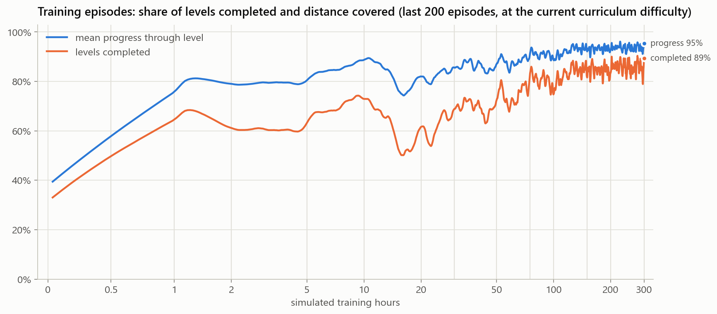
The learning curve
TRAINING
33% → 89%
of training levels completed, first rollout to last
Dips are good news
each one is the curriculum making the levels harder
Log time axis
most of the learning happens in the first 30 hours
Notes:
This is the share of training levels completed, averaged over the last 200 episodes. Note the time axis is logarithmic. The curve is not smooth because the levels keep getting harder: every time the agent gets good at one difficulty, the curriculum raises it, and performance drops for a while. The big dip around 15 hours is the jump to the hardest settings. By the end it completes almost 9 out of 10 training levels at full difficulty.

Slide 11
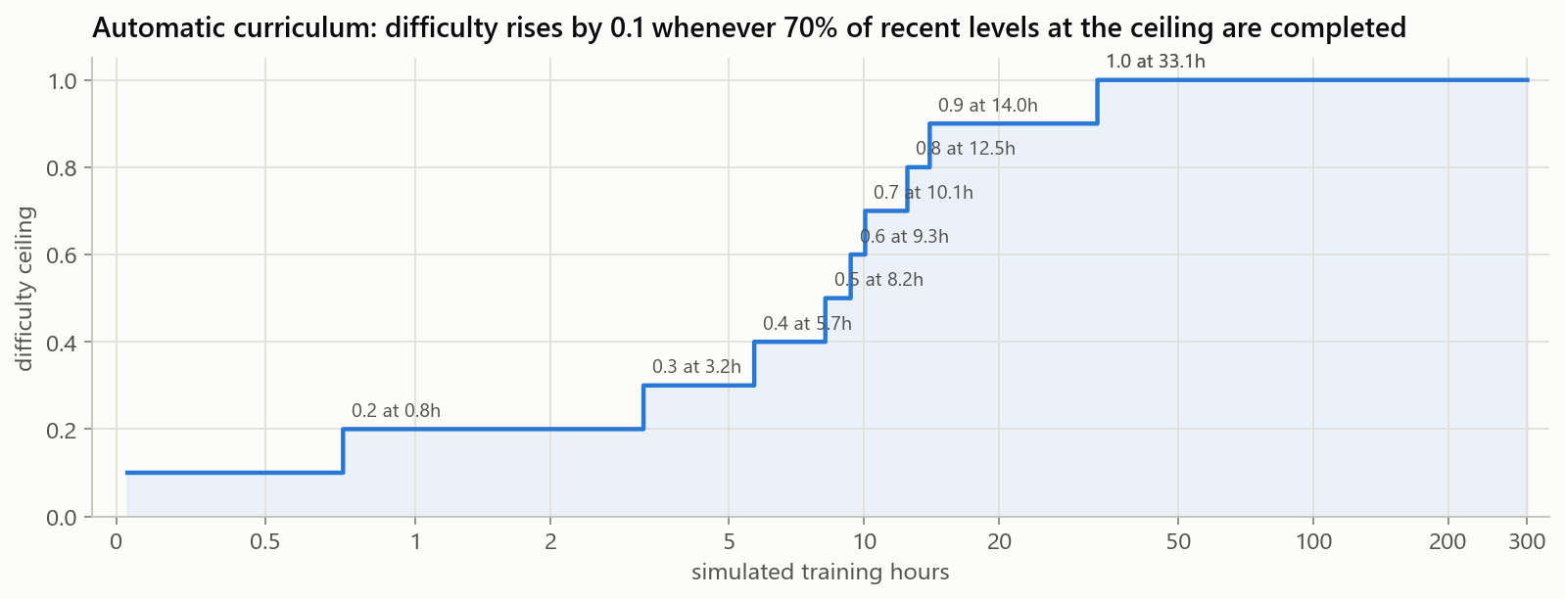
A curriculum from easy to hard
TRAINING
0.1 → 0.9 in 14 h
eight promotions in the first 14 simulated hours
1.0 took until 33 h
the last step, with the widest gaps, was the hardest
Promotion rule
complete 70% of the last 100 levels at the current ceiling
Notes:
Throwing a random agent at the hardest levels wastes time, because it almost never gets any reward. So training starts at difficulty 0.1 and moves up by 0.1 every time the agent completes 70% of its recent levels at the current ceiling. 70% of the time it plays at the ceiling, and the rest of the time it plays easier levels so it doesn’t forget them. It reached 0.9 in 14 simulated hours, but the final step to 1.0 took until hour 33.

Slide 12
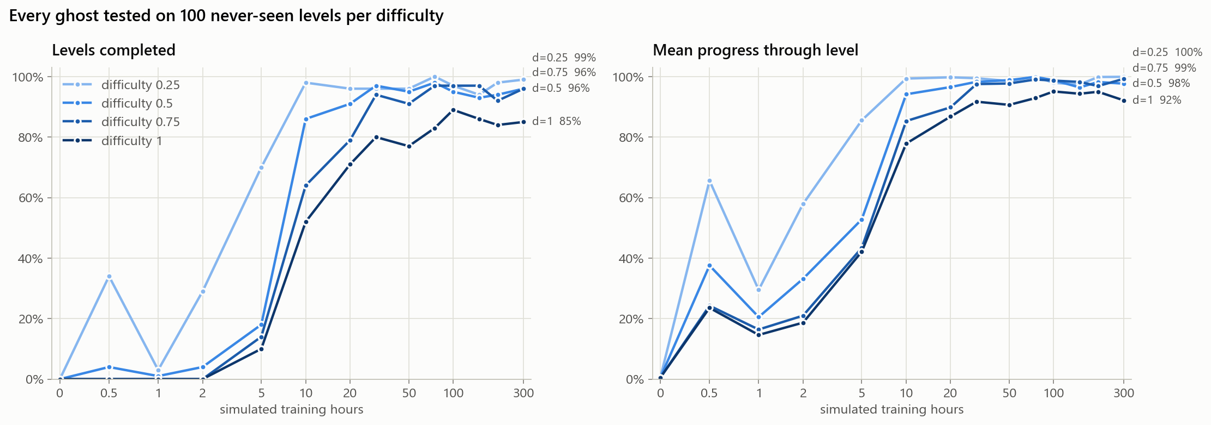
Tested on levels it has never seen
EVALUATION
Between 2 h and 10 h it goes from 4% to 86% at difficulty 0.5. From 30 h on it stays above 90% on all but the hardest levels.
Notes:
This is the honest measurement. Every ghost was played deterministically on 100 levels from a seed range never used in training, at four difficulties. Left is the share completed; right is how far through the level it got on average. The big jump is between 2 and 10 hours, when it learns to clear gaps reliably. After that the easier difficulties saturate and the gains are at the hardest setting.

Slide 13
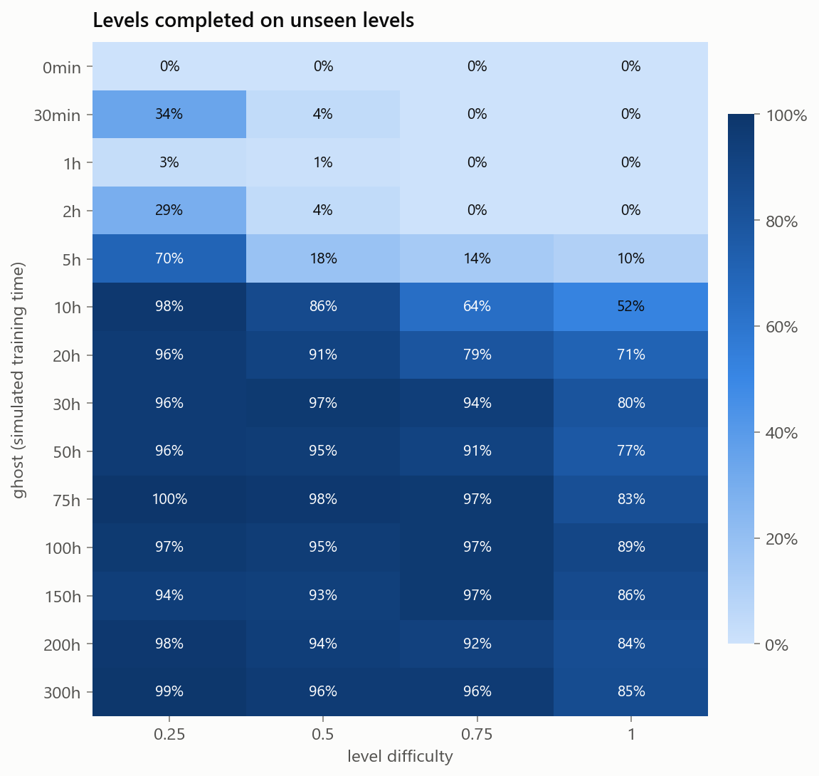
Every ghost at every difficulty
EVALUATION
Read across: harder levels need more practice
At 10 h it finishes 98% of easy levels but only 52% of the hardest.
Read down: fast, then flat
From 30 h to 300 h, ten times more training, the hardest setting goes from 80% to 85%.
The top rows make the demo fun
Ghosts from 0 min to 2 h almost never finish a medium level: a human beats them easily.
Notes:
The same data as a grid: one row per ghost, one column per difficulty. Reading across a row, harder levels always need more training. Reading down a column, the improvement is quick and then levels off: going from 30 to 300 hours is ten times the training for five more points at the hardest setting. That spread is exactly what the demo needs. The early ghosts are easy to beat, the middle ones are a fair race, and the late ones are very hard to beat.

Slide 14
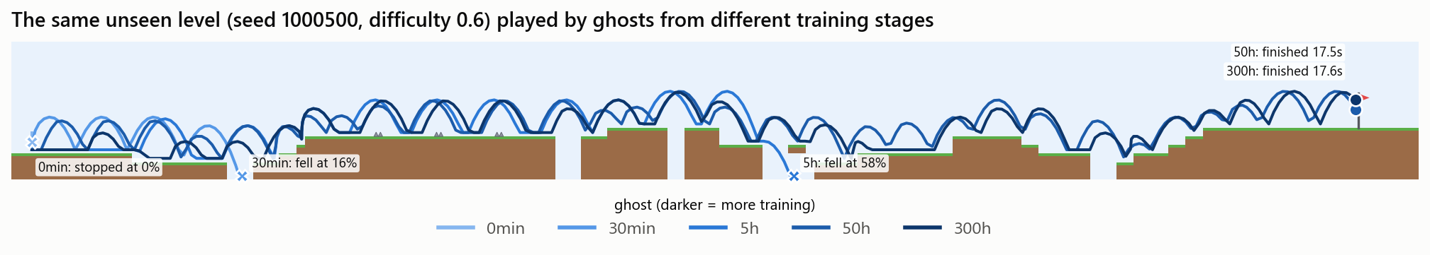
One unseen level, five stages of training
GHOSTS
0 min
30 min
5 h
50 h
300 h
Barely moves: 0%
Falls into the first pit at 16%
Falls into a later pit at 58%
Finishes in 17.5 s
Finishes in 17.6 s
Training buys survival, not speed: every ghost that finishes takes about 17 s.
Notes:
This is the static version of the demo. Five ghosts play the same level, seed 1,000,500 at difficulty 0.6, which none of them trained on. The untrained ghost barely moves. The 30-minute ghost has learned to run and jump but falls into the first pit. The 5-hour ghost gets more than half way. The 50- and 300-hour ghosts both finish, in almost the same time, because once an agent can finish it is already running flat out. Further training buys reliability on hard levels, not speed.

Slide 15
Trained on 10 levels: 100% on those, 60% on new ones
GENERALISATION EXPERIMENT
Same agent, same 100 simulated hours, same difficulty (0.5). The only change is how many different levels it practised on: 10, 100, 1,000 or unlimited.
Notes:
To prove that procedural generation matters, I trained four more agents identically except for the number of distinct levels in their training set. The agent that only ever saw ten levels finishes every one of them, but only 60% of new levels at the same difficulty. It memorised the levels instead of learning the game. This matches the finding of the Procgen benchmark paper by Cobbe et al., 2019.

Slide 16
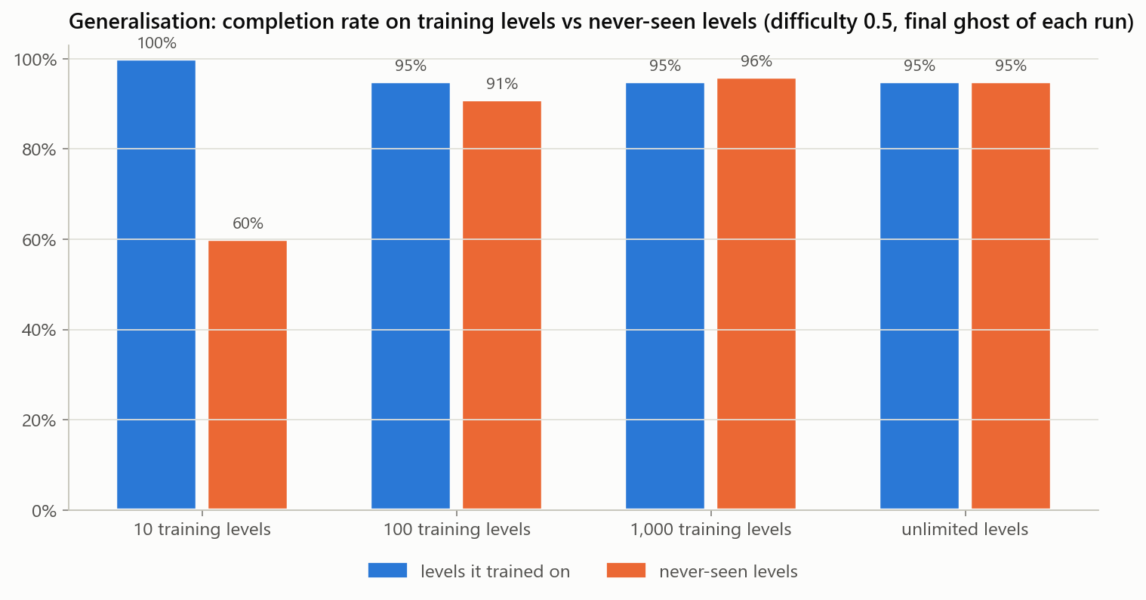
More levels close the gap
GENERALISATION
Levels | Own | New
10 | 100% | 60%
100 | 95% | 91%
1,000 | 95% | 96%
unlimited | 95% | 95%
By 1,000 levels the gap is gone: the agent plays the game instead of replaying levels.
Notes:
Blue is performance on the agent’s own training levels; orange is 100 levels it has never seen. With 10 levels the gap is 40 points. With 100 levels it is down to 4. With 1,000 levels or more there is no gap at all, so the agent has learned the game rather than the levels. For the unlimited run every training level is new, so its two numbers are the same measurement.

Slide 17
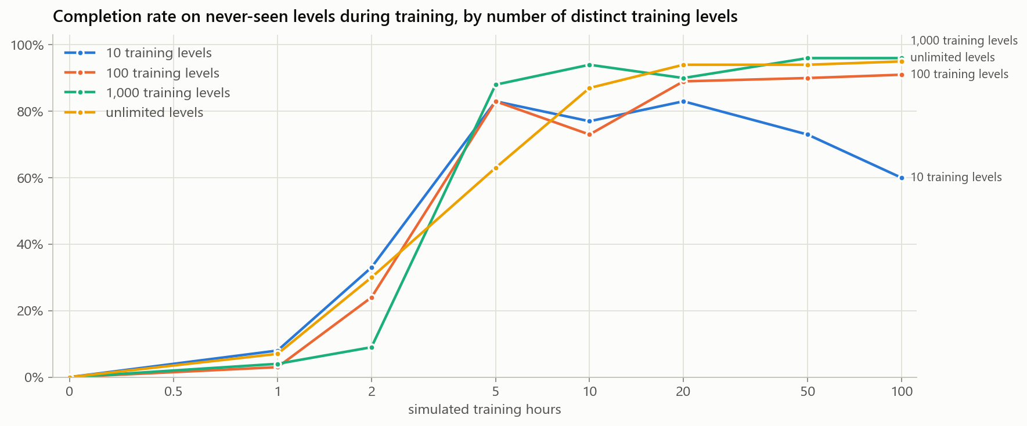
Memorising gets worse with time
GENERALISATION
10 levels: up, then down
83% on new levels at 5 h, 60% at 100 h. The longer it trains, the more it overfits.
Difficulty matters too
At 100 h, the curriculum agent finishes 89% of the hardest new levels; the unlimited agent trained only at 0.5 finishes 64%.
Notes:
The same experiment over time, measured on new levels. Every run improves early on. But the ten-level agent peaks at 83% after 5 hours and then falls to 60% by 100 hours: extra training makes it fit its ten levels better and the game worse. That is overfitting, happening live. The other runs keep improving. One more comparison: variety alone isn’t enough. The unlimited agent trained only at difficulty 0.5 finishes 64% of the hardest levels, while the main curriculum agent at the same 100 hours finishes 89%. You need varied levels and the right difficulty.

Slide 18
Race the ghosts
DEMO
14 see-through ghosts, 0 min to 300 h; you are the solid red one
A fresh level every round, never used in training
Compact leaderboard: arrows mark overtakes
Arrows or A/D to run, Space to jump
[ and ] change difficulty, up to 2.0
python demo.py
Notes:
Time for the live demo. You play the red character; every other character is the same agent at a different point in training, labelled with how much practice it had. The level is new every round and comes from a seed range never used in training, so nobody has seen it before, including the ghosts. You can usually beat everything up to about 2 hours. From 30 hours on, the ghosts are hard to beat. [Switch to the demo window now.]

Slide 19
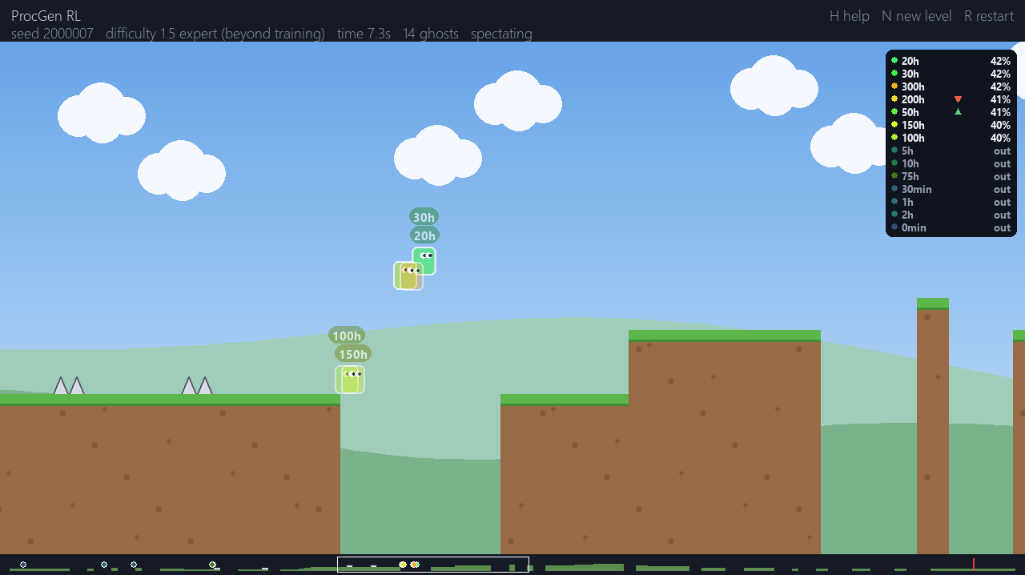
Harder than anything in training
EXPERT LEVELS
Gaps up to 6 tiles
was 4; the jump can clear 7
Spike runs of 4, often twice
plus spikes at gap edges and just after landings
One-tile pillars, less rest
narrower platforms, shorter flat ground
Same tiles, same physics
no retraining; the solver checks every level is beatable
Notes:
Difficulty 1.0 was the top of the training range, and the best ghosts finish almost 90% of those levels, so for a human the top setting felt too easy. So the demo now goes up to difficulty 2.0. Nothing new was added to the game: same tiles, same physics, so the ghosts can play these levels without retraining. The generator pushes the existing pieces harder. I measured with the solver what the jump can actually clear: gaps of 7 tiles and spike runs of 4. Expert levels go up to one tile below that limit, with more hazards and less rest in between. Every expert level is still checked by the solver before it is played, and the levels from training are byte-for-byte unchanged.

Slide 20
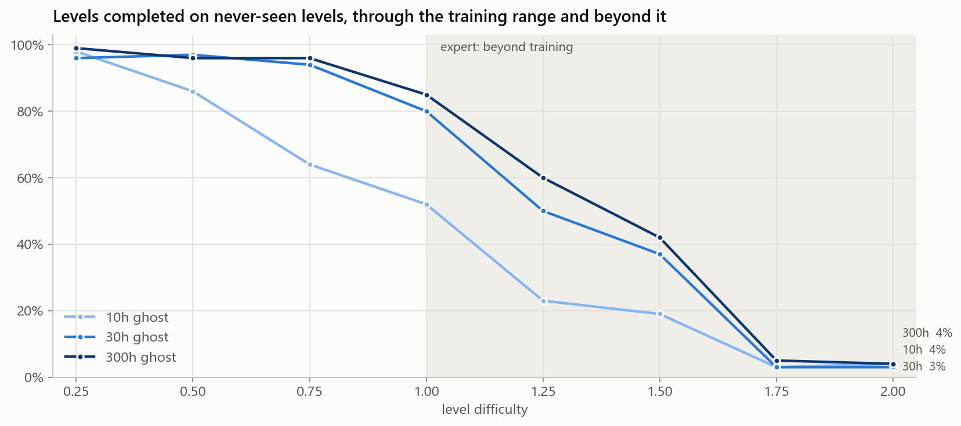
Beyond training, even 300 h struggles
EXPERT LEVELS
Difficulty | 300 h ghost
1.0 | 85%
1.25 | 60%
1.5 | 42%
1.75 | 5%
2.0 | 4%
100 never-seen levels each. Now a good human can beat the best ghost.
Notes:
Here is what happens to the ghosts on the expert levels, 100 never-seen levels per setting. The shaded area is difficulty the agent never trained on. Its skills partly carry over: at 1.25 the 300-hour ghost still finishes 60%, and 42% at 1.5. At 1.75 and above it collapses to around 5%, because gaps and spike runs are longer than anything it practised. This is the other side of generalisation: an agent generalises well inside the range it trained on, and less and less beyond it. For the demo it is exactly what we want, because now a skilled human can beat the best ghost.

Slide 21
What I learned, and what’s next
WRAP-UP
What worked
What was hard
Next
A tile view relative to the agent: cheap and level-independent
A curriculum from easy to hard
A new level every episode
One shared game loop, so demo ghosts act exactly as in training
Guaranteeing every random level is beatable: a solver in the tests
Reward for progress, so it learns before it ever reaches a flag
Overnight runs: a full disk crashed two of them; autosave and resume recovered both
Phase 2: enemies
Pixel input with a convolutional network
Record human runs and compare them with the ghosts
Notes:
Three takeaways. First, the design choices that mattered most were the observation, the curriculum and the endless supply of new levels; the generalisation experiment shows that last one directly. Second, a lot of the work was engineering: making random levels fair, shaping the reward, and making overnight training survive a crash. Third, the obvious next step is enemies, which were deliberately left for phase 2, and then learning from raw pixels.

Slide 22
Thank you
PROCGEN RL
Questions, or want a race?
Code: github.com/DYNAMAXD/ProcGen_RL
[Your name] · [Course, date]
Notes:
Thanks for listening. Happy to take questions, and anyone who wants to try beating the 300-hour ghost can have a go on the demo afterwards.

Slide 23
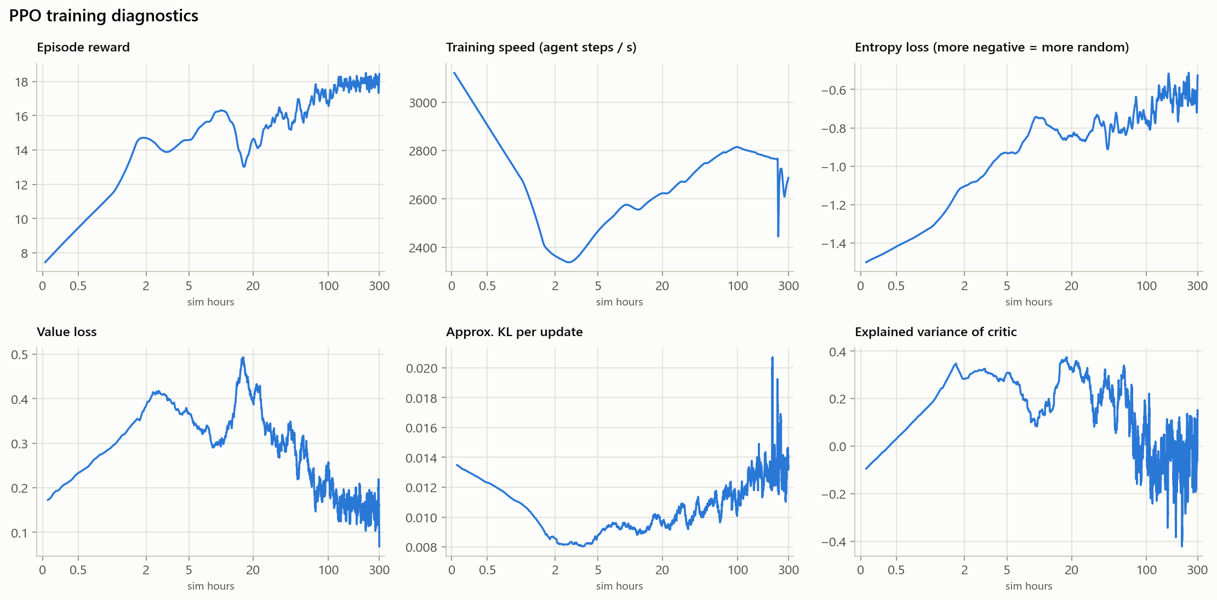
PPO health checks
APPENDIX
Reward rises from about 7 to 18 per episode.
Entropy falls slowly: fewer random actions.
KL stays near 0.01: stable updates.
Explained variance stays low, under 0.4: the critic is weak. A clear thing to improve.
Notes:
Backup slide for questions about training stability. These are the standard checks for PPO. Reward goes up. Entropy, the randomness of the policy, decreases gradually rather than collapsing. The KL divergence between successive policies stays around 0.01, so no single update changed the policy too much. The weak spot is the critic: explained variance never gets above about 0.4 and is noisy late in training, so its predictions of future reward are rough. That is plausible here, because whether the agent dies or reaches the flag on a level it has never seen is hard to predict. The policy still learned well, but a better critic, for example a larger value network or tuned discounting, is an obvious next experiment.

