Slide 1
procgen_rl.py
■ ■ ■
PROCGEN RL
Teaching an agent to play levels it has never seen
$ python train.py --hours 300
> generating levels ............. ok
> training the agent (PPO) ...... ok
> explaining its decisions ...... ok
> racing the ghosts ............. ok █
[Your Name] // [Course] // October 2026
Notes:
Hi, I'm [name]. This project asks one question: can an agent learn to play a platformer in general, rather than memorising particular levels? Every level is generated on the fly, so the agent is always tested on levels it has never seen. I will show what the agent actually receives as input, what the neural network looks like inside, how it learns, and a debug mode that shows its decisions live.

Slide 2
AGENDA█
[ 00 ]
> ls talk/
01 the problem: a game it can't memorise
02 what the agent sees: its 847 inputs
03 the model: network and one decision
04 how it learns: reward and PPO
05 opening the black box: debug mode
06 results and generalisation
07 live demo: race the ghosts
procgen_rl :: agenda
█░░░░░░░░░░░░░░░░░░░░░░░░░░░░░ [ 01/42 ]
Notes:
The talk has seven parts. Parts 2 to 5 are the technical core: what goes into the network, what the network is, how training changes it, and how we can see what it is paying attention to.

Slide 3
> cd section_01
01
THE PROBLEM█

Slide 4
RL IN ONE SLIDE█
[ 01 ]
> agent
action: 1 of 6
> game
> in plain words
neural network
(the policy)
level + physics
60 frames / s
Nobody tells the agent how to play.
It starts by pressing random buttons. Actions that led to more points become more likely; actions that led to dying become less likely.
Repeat 16 million times.
what it sees + reward
agent the player the network controls
observation what it sees: 847 numbers
action one of 6 button combinations
reward points: + progress, - dying, + flag
episode one attempt at one level
policy the rule from observation to action
trial and error, at scale
procgen_rl :: the problem
██░░░░░░░░░░░░░░░░░░░░░░░░░░░░ [ 03/42 ]
Notes:
Reinforcement learning in one slide. There is an agent, here a small neural network, and an environment, here the game. Fifteen times a second the game tells the agent what it sees, the agent picks one of six button combinations, and the game hands back a reward: a few points for moving forward, a penalty for dying, a bonus for the flag. Nobody ever shows it how to play. Training is just trial and error: whatever led to more points becomes more likely next time. The words on the left are the vocabulary I will use for the rest of the talk.

Slide 5
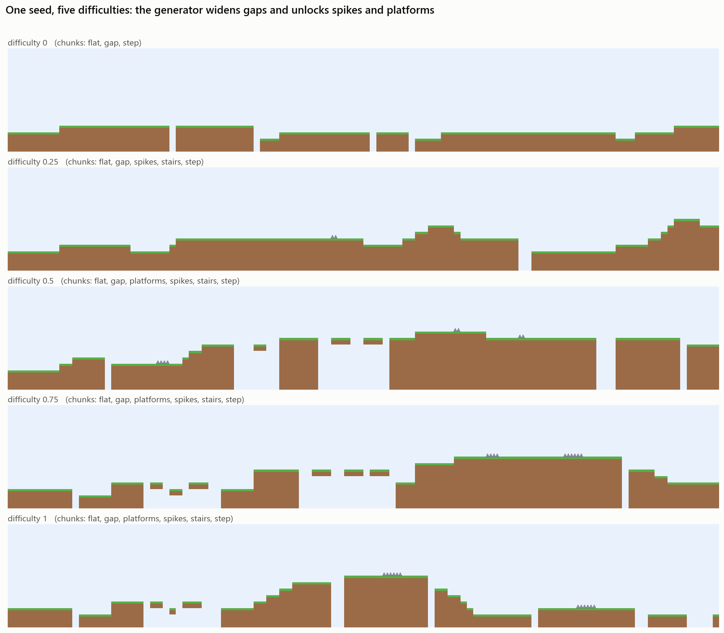
THE GAME█
[ 01 ]
Goal: run right and touch the flag
Terrain: flat ground, steps, stairs, gaps
Hazards: spikes from difficulty 0.25, floating platforms from 0.35
Physics: 60 frames/s, jumps up to 3.8 tiles, hold jump to go higher
Difficulty: one number from 0 to 1 widens gaps and adds hazards (the demo goes up to 2)
one seed at five difficulties
procgen_rl :: the problem
███░░░░░░░░░░░░░░░░░░░░░░░░░░░ [ 04/42 ]
Notes:
A Mario-style side-scroller kept deliberately simple. The picture is the same seed at five difficulty settings. Difficulty is one number from 0 to 1 that widens gaps, increases height changes and unlocks spikes and floating platforms. Enemies are planned for phase 2.

Slide 6
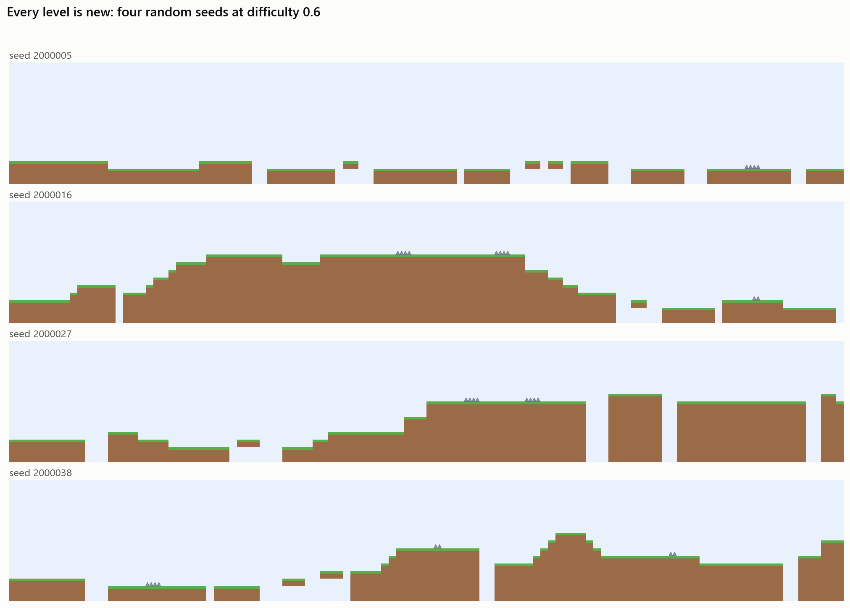
EVERY LEVEL IS NEW█
[ 01 ]
1,000,000
training seeds: a fresh level for every attempt
100%
of tested levels solvable: a search solver beats every one
3 ranges
of seeds that never overlap: training, testing, demo
procgen_rl :: the problem
████░░░░░░░░░░░░░░░░░░░░░░░░░░ [ 05/42 ]
Notes:
Four seeds, same difficulty, four different levels. Levels are stitched together from chunks such as gaps, stairs, spikes and platforms using Python's seeded random generator, so the same seed always gives the same level on any machine. A search-based solver in the tests proves the levels are beatable. Training, evaluation and the demo use separate seed ranges, so the agent is always tested on levels it has never seen.

Slide 7
> cd section_02
02
WHAT THE AGENT SEES█

Slide 8
ONE DECISION, START TO END█
[ 02 ]
> game state
> observation
> network
> probabilities
> action
position, speed,
the level's tiles
847 numbers:
840 tiles + 7
about itself
847 -> 256
-> 256 -> 6
6 numbers that
add up to 100%
the most likely
one, held for
4 frames
15 / s
< 1 ms
1 code path
decisions per second of play (every 4th frame)
per decision, plain NumPy, no GPU
the same stepping code in training, testing and the demo
frame 0: decide -> frames 0-3: hold the buttons -> frame 4: decide again
procgen_rl :: what the agent sees
█████░░░░░░░░░░░░░░░░░░░░░░░░░ [ 07/42 ]
Notes:
This is everything that happens for one decision. The game state is turned into a list of 847 numbers. Those go through the neural network, which outputs six numbers, one per action, turned into probabilities. The agent takes the most likely action and holds those buttons for four frames, a fifteenth of a second, then decides again. One decision takes well under a millisecond on the CPU. The same code runs in training, in evaluation and in the demo, so what you see in the demo is exactly what was trained.

Slide 9
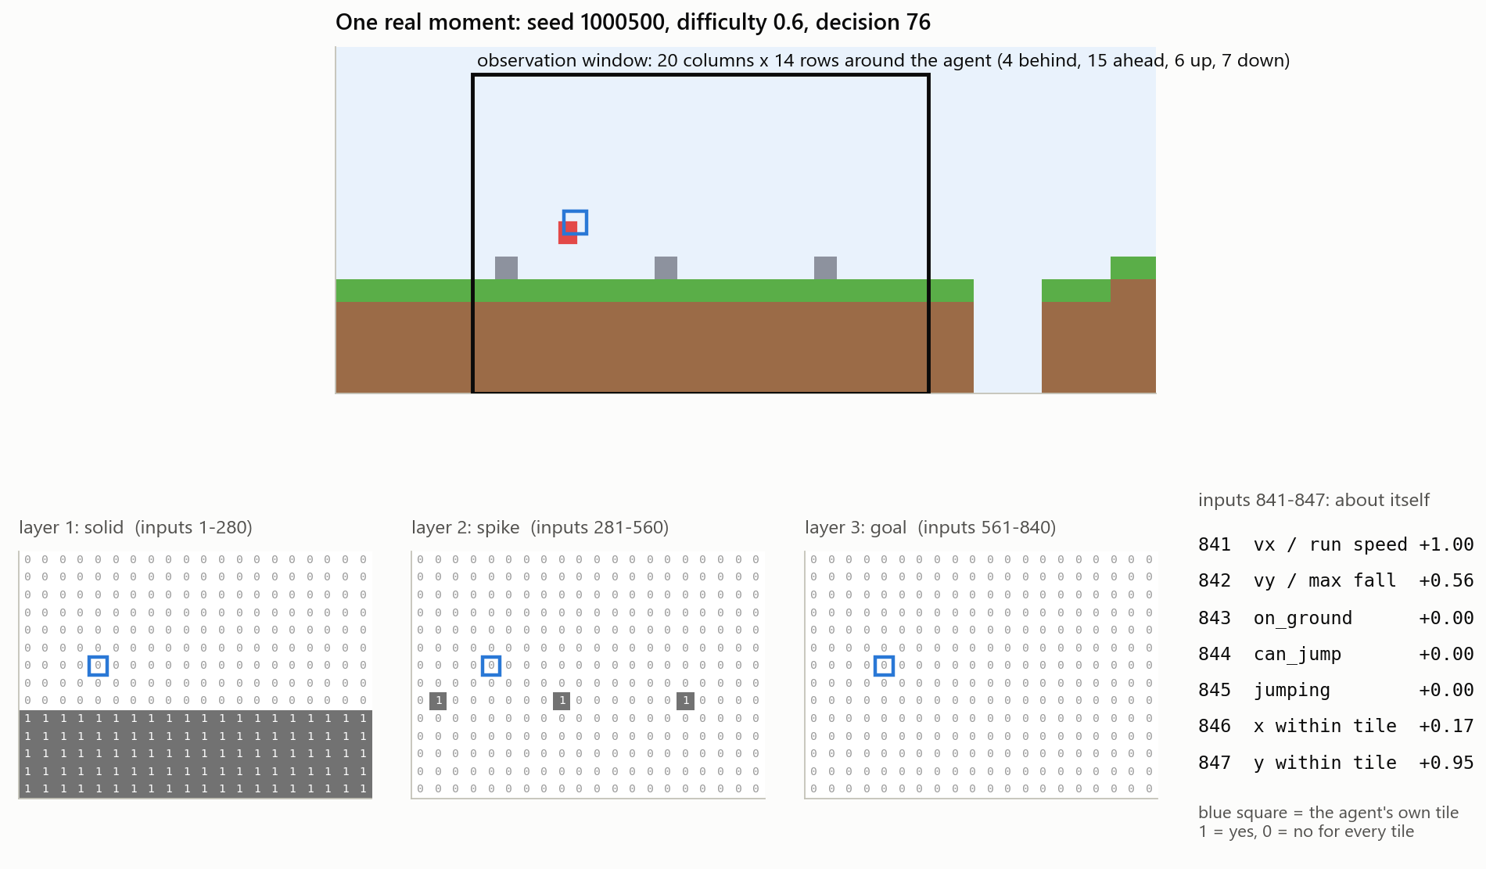
INPUT 1: THE TILE WINDOW█
[ 02 ]
A real moment of the 300h ghost (seed 1000500, difficulty 0.6). Grey squares in the level are spikes; the blue square is the agent's own tile.
procgen_rl :: what the agent sees
██████░░░░░░░░░░░░░░░░░░░░░░░░ [ 08/42 ]
Notes:
Instead of pixels the agent gets a small grid of tiles centred on itself: 20 columns wide and 14 rows tall, 4 columns behind and 15 ahead, because the danger is ahead. Each tile is described by three yes-or-no layers: is it solid, is it a spike, is it past the finish line. That is 3 times 14 times 20, or 840 numbers. Below you can see the actual zeros and ones for this exact moment. On the right are the 7 numbers the agent gets about itself.

Slide 10
HOW A TILE BECOMES NUMBERS█
[ 02 ]
tile | solid | spike | goal
air | 0 | 0 | 0
ground / platform | 1 | 0 | 0
spike | 0 | 1 | 0
outside the level (wall) | 1 | 0 | 0
air past the finish line | 0 | 0 | 1
> numbering
input = layer x 280 + row x 20
+ column + 1
layer 0 solid, 1 spike, 2 goal
row 0 (6 up) .. 13 (7 down)
column 0 (4 behind) .. 19 (15 ahead)
spike 2 tiles ahead, at foot level
= 1x280 + 6x20 + 6 + 1 = input 407
Why 3 yes/no layers and not one number per tile?
"air = 0, solid = 1, spike = 2" would tell the network a spike is "twice a solid". Separate yes/no layers carry no fake ordering (one-hot encoding).
procgen_rl :: what the agent sees
██████░░░░░░░░░░░░░░░░░░░░░░░░ [ 09/42 ]
Notes:
Every tile turns into three yes-or-no values. Air is 0 0 0, ground is 1 0 0, a spike is 0 1 0. Outside the level counts as a solid wall. Anything at or past the flag switches on the goal layer. Every input has a fixed number. For example, a spike two tiles ahead of the agent at foot level is always input number 407. Why three layers instead of one number per tile? If spike were 2 and solid were 1, the network would treat a spike as a bigger solid, which is meaningless. Separate yes-or-no layers, called one-hot encoding, avoid that.

Slide 11
INPUT 2: 7 NUMBERS ABOUT ITSELF█
[ 02 ]
# | name | computed as | range | why it needs it | example
841 | vx | run speed / 0.15 | -1 .. 1 | how far a jump will carry | +1.00
842 | vy | vertical speed / 0.5 (+ = down) | -0.8 .. 1 | rising or falling | +0.56
843 | on_ground | 1 if standing on something | 0 / 1 | can it jump right now | +0.00
844 | can_jump | 1 up to 5 frames after a ledge | 0 / 1 | late jumps still work | +0.00
845 | jumping | 1 while rising with jump held | 0 / 1 | letting go cuts the jump | +0.00
846 | x in tile | position inside its tile | 0 .. 1 | exact take-off point | +0.17
847 | y in tile | position inside its tile | 0 .. 1 | exact height | +0.95
example = the moment on the previous slides: running at full speed, in the air, falling
all 847 inputs are between -1 and 1: neural networks learn best on small numbers
procgen_rl :: what the agent sees
███████░░░░░░░░░░░░░░░░░░░░░░░ [ 10/42 ]
Notes:
The tile window cannot tell the agent how fast it is moving or whether it is standing on the ground, so it gets seven extra numbers about itself. They are all scaled to roughly minus one to one, because neural networks train best on small numbers. In the example the agent is running at full speed and falling, so it is not on the ground and cannot jump.

Slide 12
HOW THE NETWORK READS 847 NUMBERS█
[ 02 ]
solid 1-280
spike 281-560
goal 561-840
self
one flat list of 847 numbers: the network's whole world
> no picture, just a list
> relative to the agent
The network never sees an image. Input 407 always means "spike, 2 tiles ahead, at foot level". Meaning comes only from the position in the list.
The window moves with the agent, so a gap 3 tiles ahead gives the same numbers anywhere, in any level. That is why it can play levels it has never seen.
> nothing hand-coded
> small on purpose
No rule says "jump before a gap". Each first-layer neuron gives every input a learned weight; training finds weights that turn tile patterns into the right button.
847 numbers instead of about 100,000 pixels, so a small fully connected network is enough and it trains on a laptop CPU.
procgen_rl :: what the agent sees
████████░░░░░░░░░░░░░░░░░░░░░░ [ 11/42 ]
Notes:
Put together, the input is one flat list of 847 numbers. The network has no idea it is looking at a picture; it only knows that position 407 behaves in a certain way. Because the window moves with the agent, the same situation produces the same numbers anywhere in any level, which is the key to playing new levels. And nothing is hand-coded: the network has to discover by itself which combinations of inputs mean 'jump now'.

Slide 13
> cd section_03
03
THE MODEL█

Slide 14
ARCHITECTURE█
[ 03 ]
> input
actor (policy): decides what to do
> dense 256
> dense 256
> dense 6
6 action
probabilities
847
numbers
840 tiles
+ 7 self
+ ReLU
217,088 weights
+ ReLU
65,792 weights
+ softmax
1,542 weights
critic (value): judges how good the moment is, used in training
> dense 256
> dense 256
> dense 1
1 number:
expected reward
+ ReLU
217,088 weights
+ ReLU
65,792 weights
257 weights
284,422
283,137
ReLU MLP
2.3 MB
actor parameters
critic parameters
no convolution, no memory between decisions
one ghost file (NumPy weights)
procgen_rl :: the model
█████████░░░░░░░░░░░░░░░░░░░░░ [ 13/42 ]
Notes:
The model is the standard one for PPO in Stable-Baselines3: two separate fully connected networks with the same shape. The actor takes the 847 inputs, passes them through two hidden layers of 256 neurons with ReLU, and ends in 6 outputs, one per action, turned into probabilities. The critic has the same body but a single output: how much reward it expects from this moment on. The critic is only needed during training. Together that is about 570 thousand numbers, the weights, which is what training adjusts. A saved ghost is just those weights in a 2 megabyte file.

Slide 15
WHAT ONE LAYER COMPUTES█
[ 03 ]
> 1 weighted sum
> 2 ReLU
> 3 softmax
z = W x + b
Each of 256 neurons multiplies all 847 inputs by its own weight, adds them up and adds a bias.
= "how much does this view look like my pattern?"
h = max(0, z)
Negative results become 0: a neuron stays silent unless its pattern is there.
In the example, 57 of 256 neurons in layer 1 fire.
p = e^z / sum(e^z)
Turns the 6 output scores into probabilities that add up to 100%.
The demo takes the largest; training samples from them to explore.
layer 1 finds tile patterns -> layer 2 combines them into situations -> output scores each button
W and b are the 567,559 numbers training adjusts; everything else is fixed
procgen_rl :: the model
██████████░░░░░░░░░░░░░░░░░░░░ [ 14/42 ]
Notes:
Each layer does three simple things. First a weighted sum: every neuron multiplies each input by its own weight and adds them up, which measures how much the current view matches the pattern that neuron has learned. Second, ReLU: negative results are set to zero, so a neuron only fires when its pattern is present. Third, at the very end, softmax turns the six scores into probabilities. The weights and biases are the only things training changes.

Slide 16
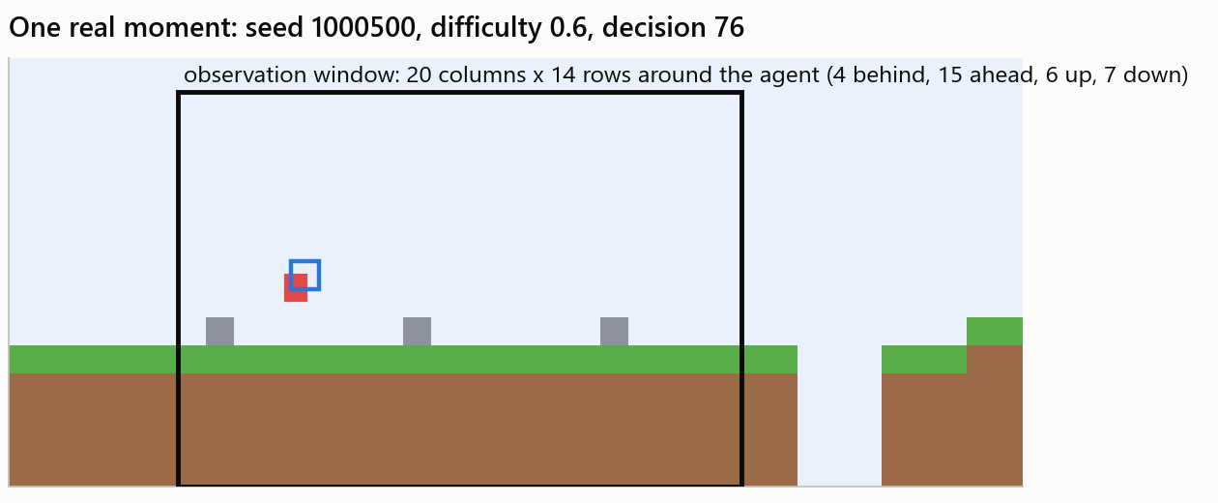
A REAL FORWARD PASS█
[ 03 ]
action | score (logit) | probability
idle | 3.12 | 19.1%
left | -2.66 | 0.1%
> right | 3.95 | 44.0%
jump | 1.53 | 3.9%
left+jump | -2.05 | 0.1%
right+jump | 3.66 | 32.9%
input: 847 numbers, 103 of them are 1
hidden 1: 57 of 256 neurons fire
hidden 2: 16 of 256 neurons fire
critic: expects +5.43 more reward
> reading it
It is in the air and falling, so "right" (44%) and "right+jump" (33%) do almost the same thing. The demo takes the top one: right.
procgen_rl :: the model
███████████░░░░░░░░░░░░░░░░░░░ [ 15/42 ]
Notes:
Here is one real decision of the 300-hour ghost, at the moment shown on the left. Of the 847 inputs, 103 are ones. In the first hidden layer 57 neurons fire, in the second only 16. The output layer gives a score to each action, and softmax turns those into probabilities. Right gets 44 percent, right plus jump 33, idle 19. That split is not confusion: the agent is in mid-air, where holding jump or not barely matters. The critic expects about 5.4 more points from here, which means it expects to finish the level.

Slide 17
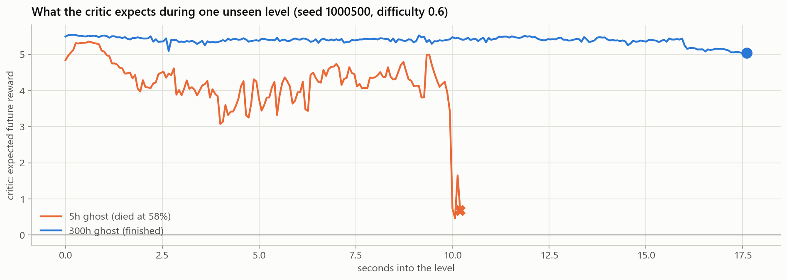
THE CRITIC: HOW IT JUDGES A MOMENT█
[ 03 ]
> what
> why
> what it shows
A second network, same shape, one output: how much reward it expects from here on.
Training compares what really happened with this guess. Better than expected: do that more.
5h ghost: 5.3 falls to 0.5 as it drops into a pit. 300h: stays above 5.0.
procgen_rl :: the model
███████████░░░░░░░░░░░░░░░░░░░ [ 16/42 ]
Notes:
The critic is the second network. It never chooses actions; it only predicts how much reward is still to come from the current moment. On this unseen level the 300-hour ghost's critic stays high the whole way: it correctly expects to finish. The 5-hour ghost's critic wobbles and then collapses as it runs into a pit. So the critic is a kind of confidence meter, and the debug mode shows it live. In training its job is to be the baseline: if things went better than the critic expected, the action that was taken gets reinforced.

Slide 18
> cd section_04
04
HOW IT LEARNS█

Slide 19
REWARD: THE ONLY FEEDBACK█
[ 04 ]
> reward
> reward
> reward
> reward
+0.1
for every new tile of progress to the right
-0.002
every decision: hurry up
-1
for dying: falling or touching a spike
+5
for touching the flag
> an attempt ends when
> why reward progress
it dies or reaches the flag
6 s pass without new progress
100 s pass in total
A random agent almost never reaches the flag. Points for every new tile give feedback from the very first second; moving back and forth earns nothing.
procgen_rl :: how it learns
█████████████░░░░░░░░░░░░░░░░░ [ 18/42 ]
Notes:
The reward is deliberately simple. A tenth of a point for every new tile of ground reached, so the agent gets feedback long before it ever sees a flag. A tiny penalty every step against dawdling. Minus one for dying and plus five for the flag. Only new progress counts, so running back and forth to farm points earns nothing. An attempt also ends if the agent makes no progress for six seconds.

Slide 20
PPO, STEP BY STEP█
[ 04 ]
> 1 play
> 2 score
> why PPO
8 copies of the game, 256 decisions each: 2,048 decisions with the current network. It samples actions, so it explores.
For each decision: advantage = what really followed (rewards, discounted by 0.99 per step) minus what the critic expected.
Proximal Policy Optimization (Schulman et al., 2017).
The standard, stable choice for games like this.
The clip stops one lucky or unlucky batch from wrecking what was learned.
Implementation: Stable-Baselines3.
> 4 repeat
> 3 update
7,911 rounds for 300 h of play. The critic is also trained to predict the rewards better.
Positive advantage: make that action more likely; negative: less. Clip: no probability moves more than 20% per round. 5 passes, batches of 512.
procgen_rl :: how it learns
██████████████░░░░░░░░░░░░░░░░ [ 19/42 ]
Notes:
PPO in four steps. One: play. Eight copies of the game run in parallel and the current network plays 256 decisions in each, 2,048 in total. Two: score every decision. The advantage is how much better things went than the critic predicted. Three: update. Actions with a positive advantage are made more likely, negative ones less likely, but PPO clips the change so that no single round can move a probability by more than about 20 percent. That clipping is what makes PPO stable. Four: repeat, almost eight thousand times for the 300-hour run.

Slide 21
TRAINING SETUP█
[ 04 ]
setting | value
algorithm | PPO (Stable-Baselines3)
network | 2 x 256 ReLU, actor and critic separate
parallel games | 8
decisions per game per round | 256
batch size / passes | 512 / 5
learning rate | 0.0003
discount gamma / GAE lambda | 0.99 / 0.95
clip range | 0.2
entropy bonus (keep exploring) | 0.01
300 h
of simulated play = 16.2 million decisions
4.7 h
of real time on a laptop CPU, no GPU
~2,700 / s
decisions: about 180x faster than real time
"300 h" = 16.2 M decisions / 15 per second: practice time summed over the 8 parallel games
procgen_rl :: how it learns
██████████████░░░░░░░░░░░░░░░░ [ 20/42 ]
Notes:
The settings are mostly the Stable-Baselines3 defaults for this kind of problem. When I say a ghost has 300 hours of training, I mean 300 hours of gameplay: 16.2 million decisions at 15 decisions per second, counted across the 8 games running in parallel. Because the game runs without graphics, and 8 at a time, that took 4.7 hours of real time on a laptop CPU.

Slide 22
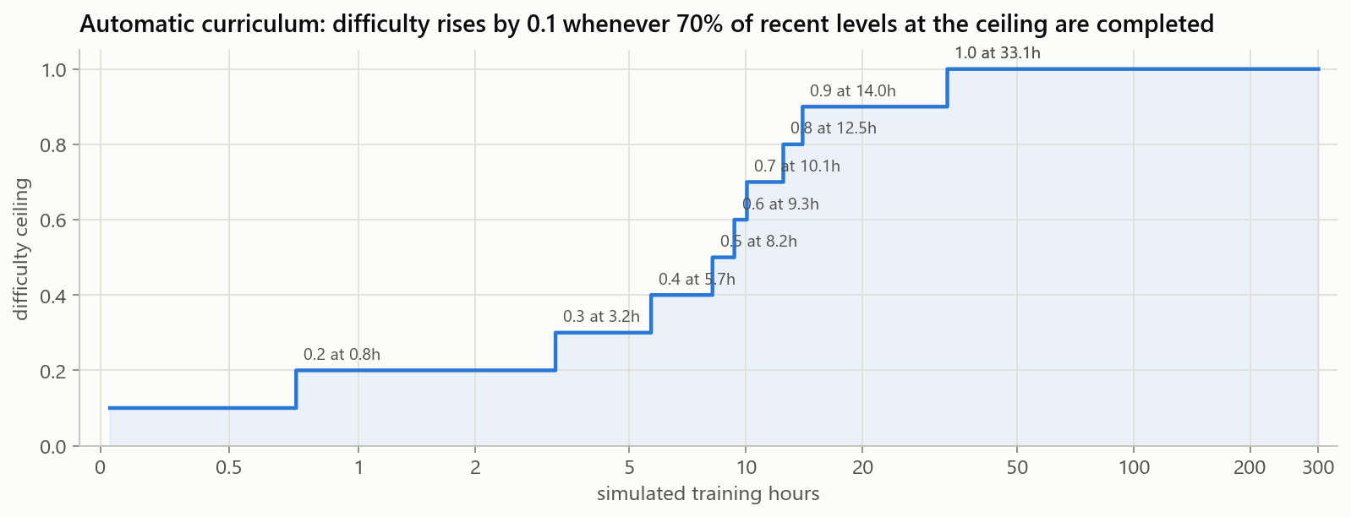
A CURRICULUM FROM EASY TO HARD█
[ 04 ]
0.1 -> 0.9
difficulty in the first 14 simulated hours
1.0 at 33 h
the last step, the widest gaps, was the hardest
70%
of recent levels completed: move up by 0.1
70% of levels at the current ceiling, 30% easier ones, so old skills are not forgotten
procgen_rl :: how it learns
███████████████░░░░░░░░░░░░░░░ [ 21/42 ]
Notes:
Throwing a random agent at the hardest levels wastes time, because it almost never earns anything. So training starts at difficulty 0.1 and moves up by 0.1 every time the agent completes 70 percent of its recent levels at the current ceiling. It reached 0.9 in 14 simulated hours, but the last step to 1.0 took until hour 33.

Slide 23
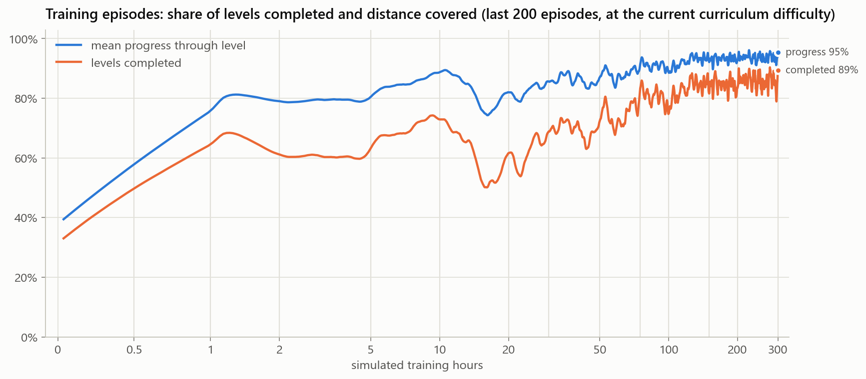
THE LEARNING CURVE█
[ 04 ]
33% -> 89%
of training levels completed, first to last
dips
= the curriculum making levels harder
log axis
most learning happens in the first 30 hours
procgen_rl :: how it learns
████████████████░░░░░░░░░░░░░░ [ 22/42 ]
Notes:
This is the share of training levels completed, averaged over the last 200 attempts. The time axis is logarithmic. The curve is not smooth because the levels keep getting harder: every promotion of the curriculum causes a dip. By the end it completes almost 9 out of 10 training levels at full difficulty.

Slide 24
> cd section_05
05
OPENING THE BLACK BOX█

Slide 25
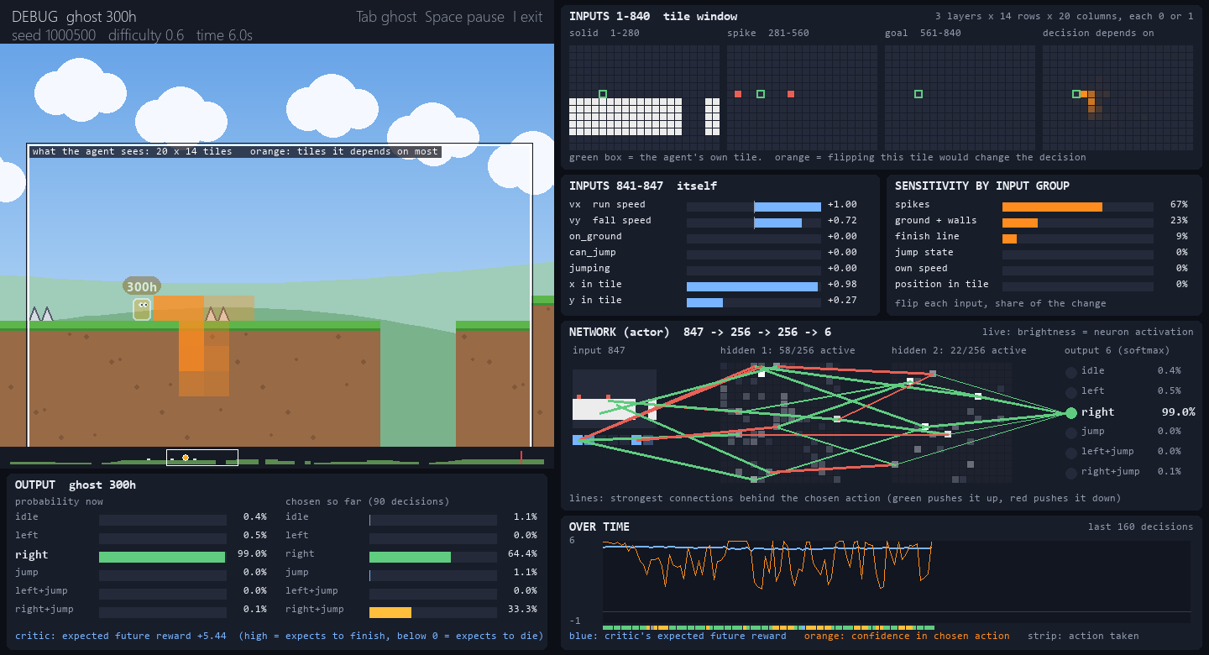
DEBUG MODE: ONE GHOST, FULLY VISIBLE█
[ 05 ]
view window on the level; orange = tiles the decision depends on
840 tile inputs as the 3 layers it receives
7 numbers about itself
sensitivity by input group, in %
live network: every neuron, strongest links
6 probabilities and actions chosen so far
critic and confidence over time
$ python demo.py --debug 300h
I on/off Tab ghost Space pause Right step O overlay F slow-mo
procgen_rl :: opening the black box
█████████████████░░░░░░░░░░░░░ [ 24/42 ]
Notes:
This is the new debug mode in the demo. One ghost plays alone, and everything it computes is on screen. The white frame on the level is exactly what it sees, and the orange tiles are the ones its current decision depends on most. On the right: the three tile layers exactly as the network receives them, the seven numbers about itself, how much each group of inputs matters right now, and the network itself: every one of the 512 hidden neurons lit by how strongly it fires, with the strongest connections behind the chosen action drawn as lines. Bottom left are the six output probabilities. You can pause and step one decision at a time. Here it is about to land between two spikes: the orange tiles sit on the spike ahead, and it is 99 percent sure about pressing right without jumping.

Slide 26
HOW WE ASK "WHAT MATTERED?"█
[ 05 ]
> flip test (every decision, live)
> blindfold test (whole levels)
1 take the 847 inputs
2 flip one: tile 0 <-> 1; speeds set to 0
3 run the network again
4 measure how far the 6 probabilities moved
0 = not at all, 1 = a different decision
5 all 847 at once: one batched pass, ~7 ms
gives: the orange tiles, the % per group
1 remove one group of inputs for a whole
run (set it to 0)
2 play 100 levels it has never seen
3 count how many it still finishes
gives: what it really relies on
sensitive to != relies on: "what if this were different?" vs "can it cope without it?"
procgen_rl :: opening the black box
██████████████████░░░░░░░░░░░░ [ 25/42 ]
Notes:
Neural networks are often called black boxes, so here are two simple ways to look inside. The flip test changes one input at a time and measures how much the decision changes. Doing it for all 847 inputs takes one batched pass of the network, about 7 milliseconds, so the debug mode does it live for every decision. The blindfold test is the opposite: remove a whole group of inputs for an entire run and see whether the agent can still finish levels. The first measures sensitivity, the second measures real reliance; they answer different questions.

Slide 27
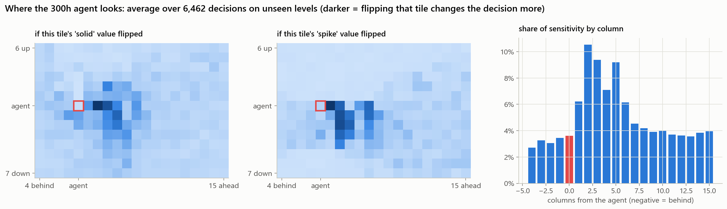
WHERE IT LOOKS█
[ 05 ]
2 tiles ahead
49%
13%
the column it watches most
of its sensitivity is 1 to 6 tiles ahead
on the 4 columns behind it
average over 6,462 decisions of the 300h ghost on 25 unseen levels, difficulty 0.75
procgen_rl :: opening the black box
███████████████████░░░░░░░░░░░ [ 26/42 ]
Notes:
Averaging the flip test over more than six thousand decisions on unseen levels gives a map of where the agent looks. It concentrates on the ground and spikes one to six tiles ahead, at and just below its own height, with a peak two tiles ahead: exactly where its next jump has to start. The tiles far ahead and behind it matter much less. Nobody told it to look there.

Slide 28
WHAT IT IS SENSITIVE TO█
[ 05 ]
spikes 48%: a spike appearing ahead would change its mind most
ground 34%: where the ground starts and ends
finish line 15%
its own state ~2%: speed and jump flags matter only in the moment before a jump
share of the total flip-test change per input group, averaged over all decisions on unseen levels
procgen_rl :: opening the black box
███████████████████░░░░░░░░░░░ [ 27/42 ]
Notes:
Grouping the flip test by type of input: about half of the agent's sensitivity is to the spike layer, a third to the solid ground, and most of the rest to the finish-line layer. The seven numbers about itself account for only about two percent. That does not mean they are useless; it means they change the decision only in a few moments, around take-off. The blindfold test on the next slide shows which of these it truly needs.

Slide 29
BLINDFOLD TEST█
[ 05 ]
spikes are essential: 96% -> 12%
8 tiles of look-ahead are enough (99%); 2 tiles are not (20%)
jump flags, position in tile: -10 points each
own speed, finish line: hardly needed
300h ghost, 100 unseen levels at difficulty 0.75; removed inputs read as 0 (empty air, standing still)
procgen_rl :: opening the black box
████████████████████░░░░░░░░░░ [ 28/42 ]
Notes:
Now the blindfold test, on 100 unseen levels. With everything it finishes 96 percent. Hide the spike layer and it drops to 12 percent: it really uses that layer to survive. Limit its sight to 8 tiles ahead and it still finishes 99 percent, so the far part of the window is spare. At 4 tiles it is 82 percent and at 2 tiles only 20, because it cannot plan a jump over a gap it sees too late. The jump flags and the position inside the tile are each worth about ten points. Hiding the finish line or its own speed barely matters, because it is running at full speed almost all the time anyway.

Slide 30
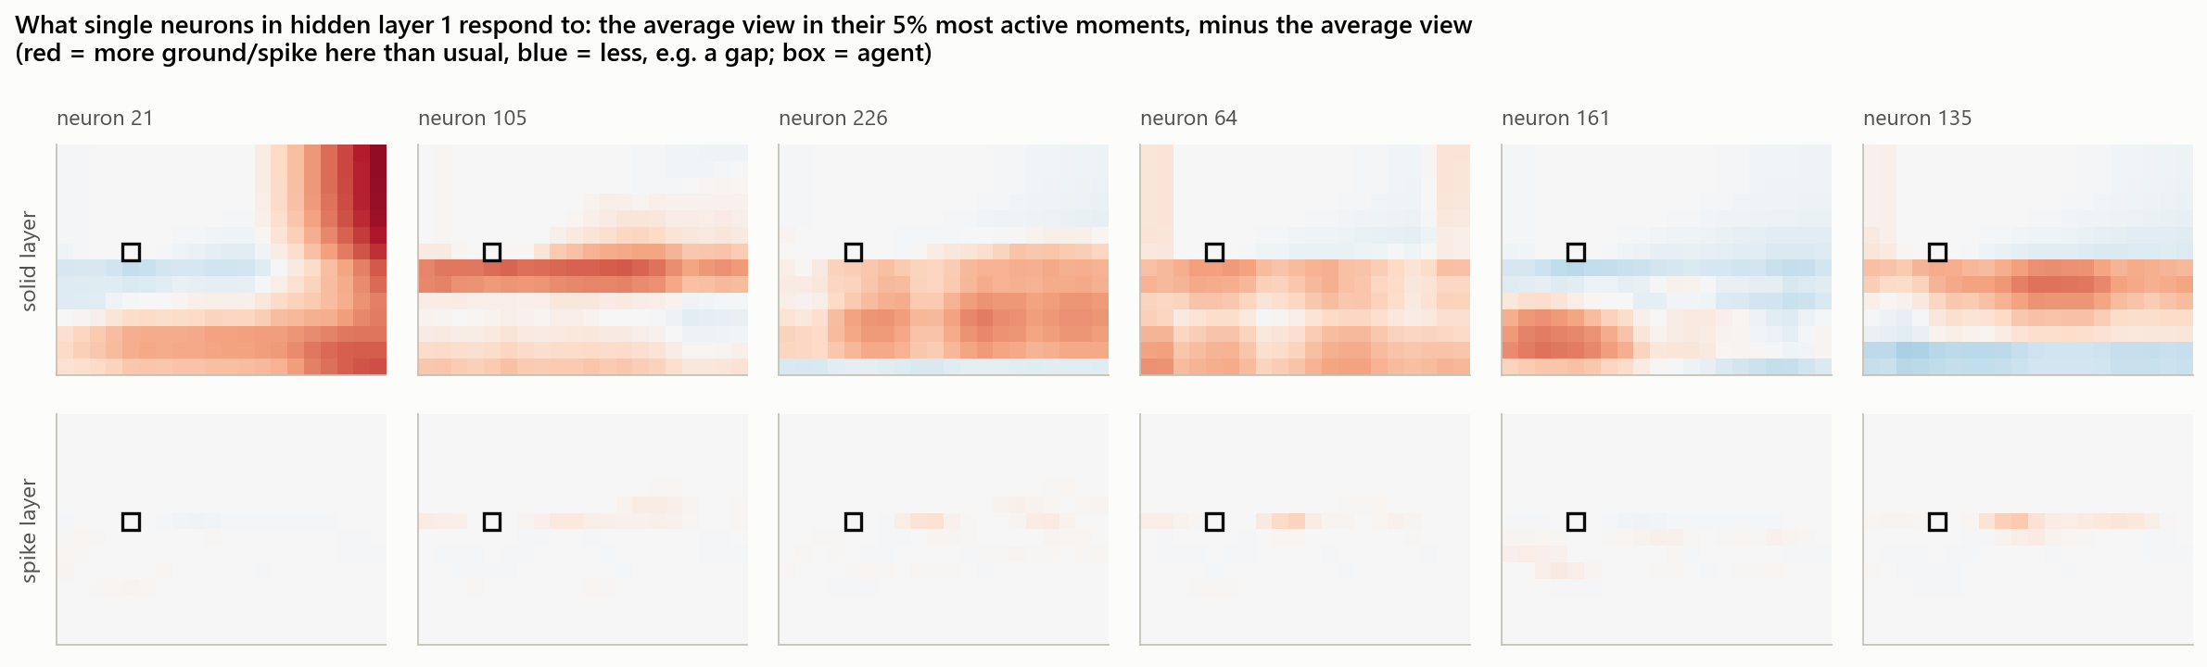
NEURONS LEARN DETECTORS█
[ 05 ]
neuron 21: the wall at the end of the level
neuron 105: flat ground under its feet
neuron 161: no ground ahead at foot level
neuron 135: a step up ahead
> fewer, sharper neurons
Active per decision (layer 1 / 2): untrained 138 / 135, 30h 93 / 110, 300h 66 / 30. Training made it specialised.
procgen_rl :: opening the black box
█████████████████████░░░░░░░░░ [ 29/42 ]
Notes:
What does a single neuron do? For each neuron I took the moments when it fires most strongly and averaged what the agent saw, compared with an average moment. Red means more ground than usual at that position, blue means less. One neuron fires at the wall at the end of the level, one for flat ground under its feet, one when the ground ahead disappears, one for a step up. Nobody programmed these. Also interesting: as training goes on, fewer neurons fire per decision. The untrained network has about half of them active; the 300-hour one uses about 66 in the first layer and 30 in the second. It has become more specialised.

Slide 31
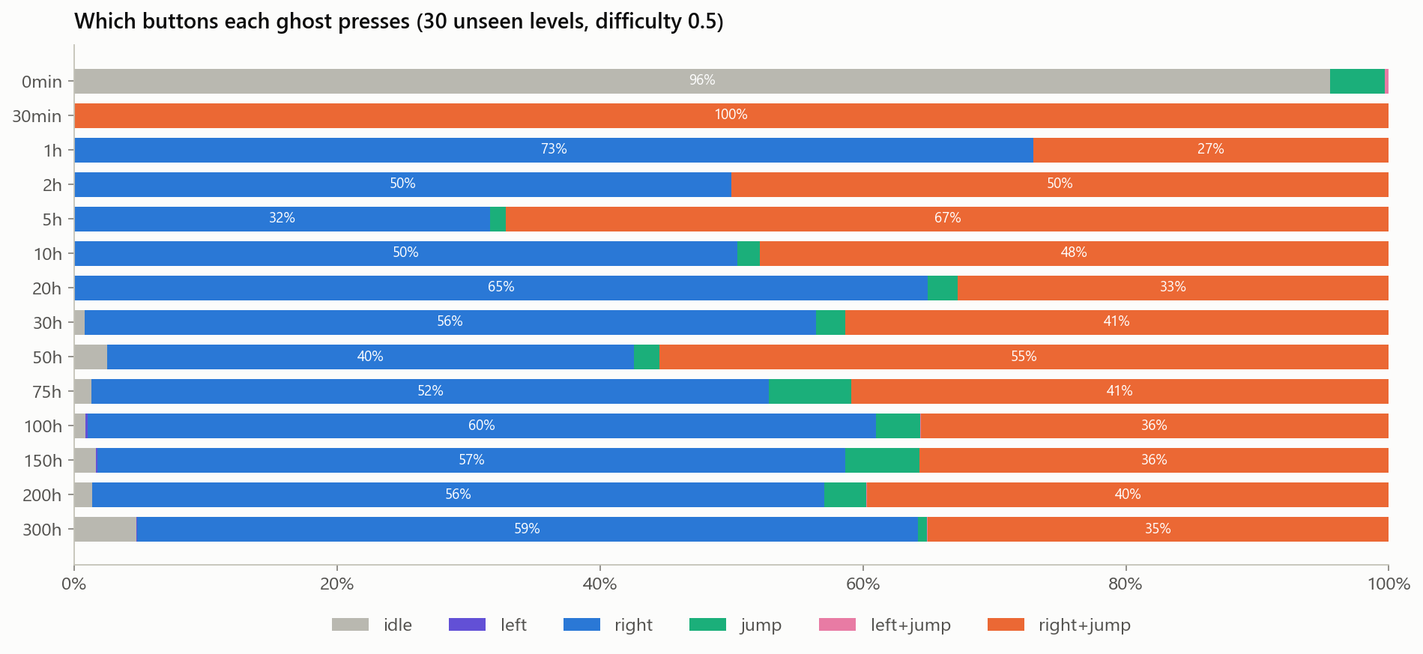
WHAT IT LEARNED TO PRESS█
[ 05 ]
0 min: idle 96%; random weights happen to favour idle
30 min: right+jump 100%; hop over everything
300 h: right 59%, right+jump 35%, idle 5%; jumps only when needed
left is never used: nobody told it which way to go
procgen_rl :: opening the black box
█████████████████████░░░░░░░░░ [ 30/42 ]
Notes:
Which buttons does each ghost press? The untrained network mostly stands still. After 30 minutes it has found a crude strategy: hold right and jump all the time, hopping over everything, which works on easy levels but falls into pits. From then on it learns to jump only when needed: the 300-hour ghost runs without jumping 59 percent of the time and jumps 35 percent of the time, with a few short pauses. It never presses left. It worked out that right is the useful direction purely from the reward.

Slide 32
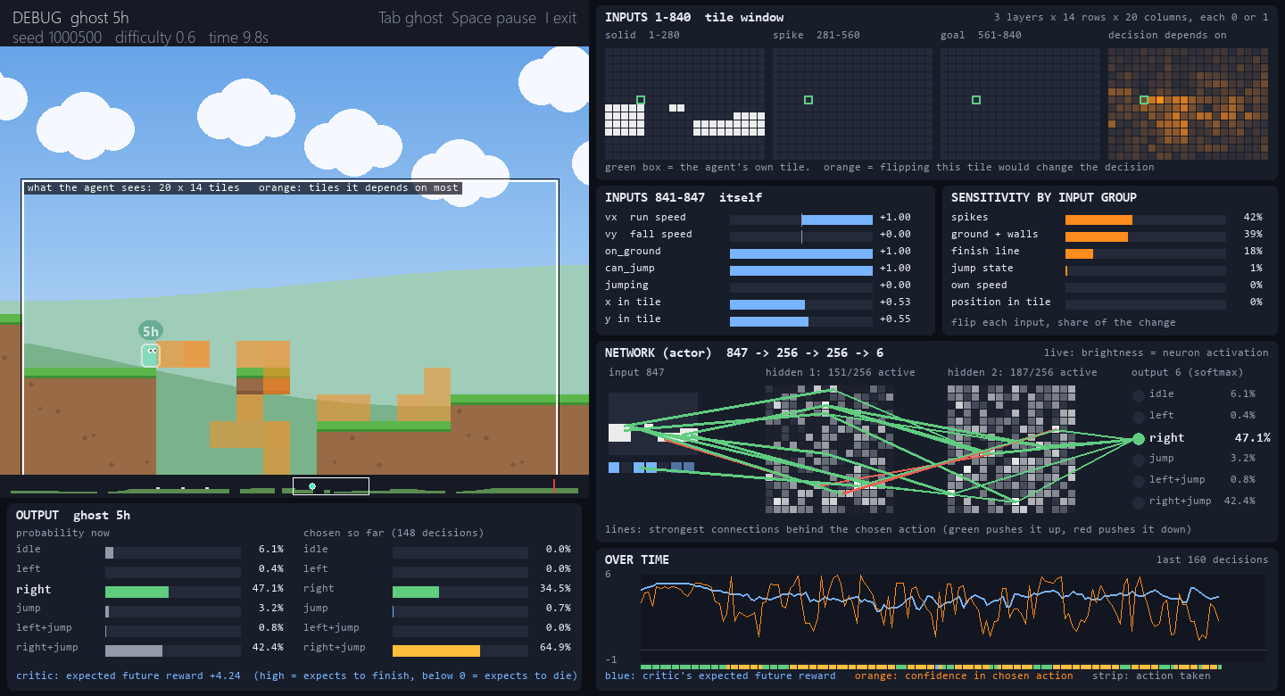
A FAILURE, EXPLAINED█
[ 05 ]
5h ghost at the edge of a pit, 9.8 s in
undecided: right 47% vs right+jump 42%
busy network: 151 of 256 neurons fire; the 300h ghost needs about 60
result: it runs off the edge; its critic falls from 5.3 to 0.5
same level, same moment: the 300h ghost is 99% sure and jumps in time
procgen_rl :: opening the black box
██████████████████████░░░░░░░░ [ 31/42 ]
Notes:
The debug mode also explains failures. This is the 5-hour ghost at the edge of the pit where it dies. It is torn between running and jumping, 47 against 42 percent, and many more of its neurons are firing than in the trained network. It takes the wrong one, runs off the edge, and you can watch its critic drop as it falls. The 300-hour ghost reaches the same spot confident and jumps in time.

Slide 33
> cd section_06
06
RESULTS█

Slide 34
ONE NIGHT ON A LAPTOP█
[ 06 ]
> main run
> main run
> main run
> main run
300 h
of simulated play:
16.2 million decisions
4.7 h
of real training time,
CPU only
96%
of never-seen levels
finished at difficulty 0.75
85%
at the hardest training
difficulty, 1.0
every test level comes from a seed range never used in training
procgen_rl :: results
████████████████████████░░░░░░ [ 33/42 ]
Notes:
The headline numbers for the main run. 300 hours of simulated gameplay took under five hours of real time on a laptop CPU. The final ghost was tested on 100 levels it had never seen at each difficulty: it finishes 96 percent at 0.75 and 85 percent at the hardest training setting.

Slide 35
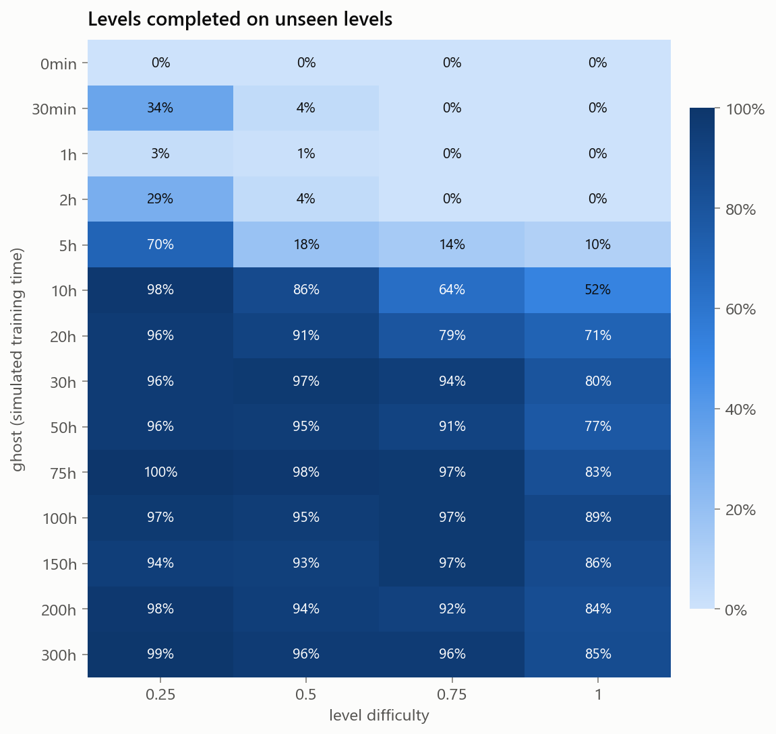
EVERY GHOST AT EVERY DIFFICULTY█
[ 06 ]
Across: harder levels need more practice. At 10 h: 98% of easy levels, 52% of the hardest.
Down: fast, then flat. 30 h to 300 h, ten times more training: 80% -> 85% on the hardest.
Top rows make the demo fun: ghosts up to 2 h almost never finish a medium level.
procgen_rl :: results
████████████████████████░░░░░░ [ 34/42 ]
Notes:
One row per ghost, one column per difficulty, 100 unseen levels per cell. Reading across, harder levels always need more training. Reading down, improvement is quick and then levels off. That spread is exactly what the demo needs: early ghosts are easy to beat, middle ones are a fair race, late ones are very hard to beat.

Slide 36
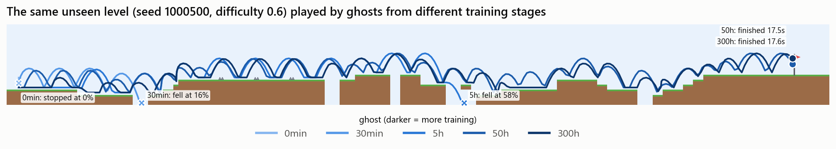
ONE UNSEEN LEVEL, FIVE STAGES█
[ 06 ]
> 0 min
> 30 min
> 5 h
> 50 h
> 300 h
barely moves: 0%
first pit, 16%
a later pit, 58%
finishes, 17.5 s
finishes, 17.6 s
training buys survival, not speed: every ghost that finishes takes about 17 s
procgen_rl :: results
█████████████████████████░░░░░ [ 35/42 ]
Notes:
The static version of the demo: five ghosts on the same unseen level. The untrained ghost barely moves; the 30-minute one falls into the first pit; the 5-hour one gets past halfway. The 50 and 300-hour ghosts both finish, in almost the same time, because once an agent can finish it already runs flat out. More training buys reliability on hard levels, not speed.

Slide 37
GENERALISATION: MEMORISE OR LEARN?█
[ 06 ]
Same agent, same 100 h, same difficulty 0.5. Only the number of different training levels changes.
10 levels: 100% on those, 60% on new ones. It memorised them.
1,000+ levels: no gap. It learned the game.
matches the Procgen benchmark finding (Cobbe et al., 2019)
procgen_rl :: results
██████████████████████████░░░░ [ 36/42 ]
Notes:
To prove that procedural generation matters, I trained four more agents identically except for how many different levels they practised on. The one that saw only ten levels finishes every one of them but only 60 percent of new levels: it memorised instead of learning. With 100 levels the gap is 4 points, and from 1,000 levels on there is no gap at all. This matches the Procgen benchmark paper by Cobbe and colleagues from 2019.

Slide 38
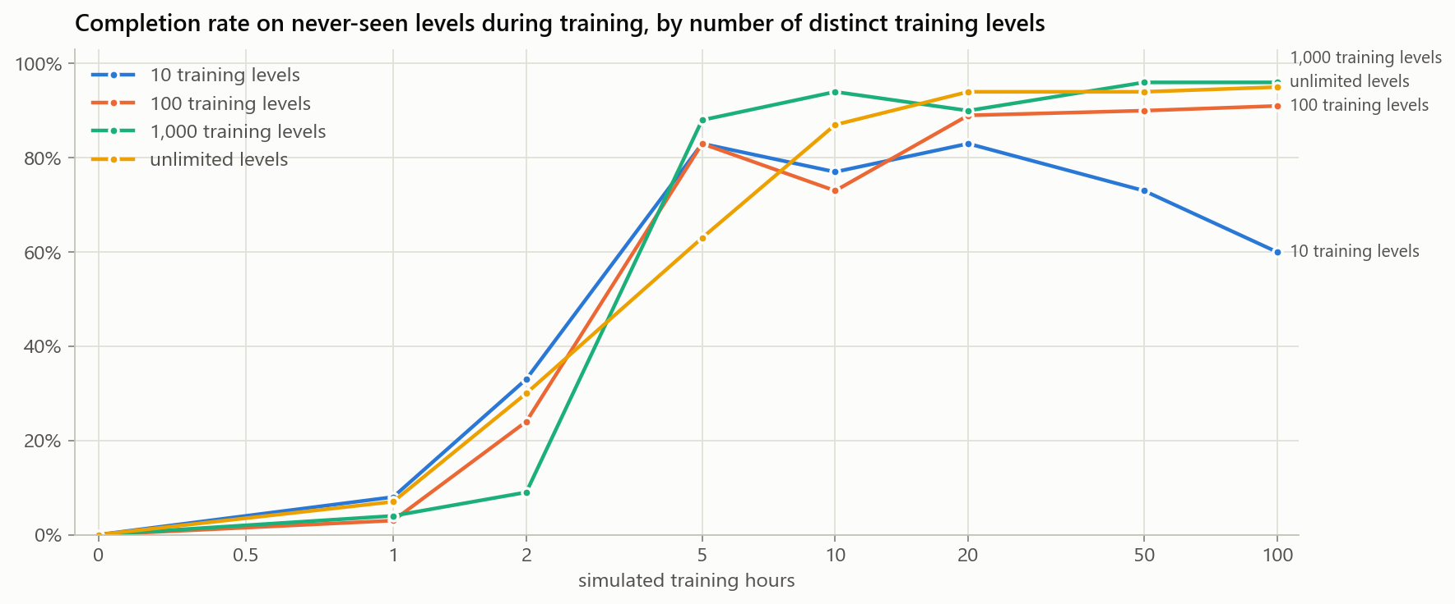
MEMORISING GETS WORSE WITH TIME█
[ 06 ]
10 levels: up, then down. 83% on new levels at 5 h, 60% at 100 h.
More training made it worse at the real game: overfitting, live.
Variety is not enough: at 100 h the curriculum agent finishes 89% of the hardest levels, the one trained only at 0.5 finishes 64%.
procgen_rl :: results
██████████████████████████░░░░ [ 37/42 ]
Notes:
The same experiment over time, measured on new levels. The ten-level agent peaks at 83 percent after 5 hours and then falls to 60: extra training fits its ten levels better and the game worse. That is overfitting happening live. And variety alone is not enough: the unlimited agent trained only at difficulty 0.5 finishes 64 percent of the hardest levels, while the curriculum agent finishes 89.

Slide 39
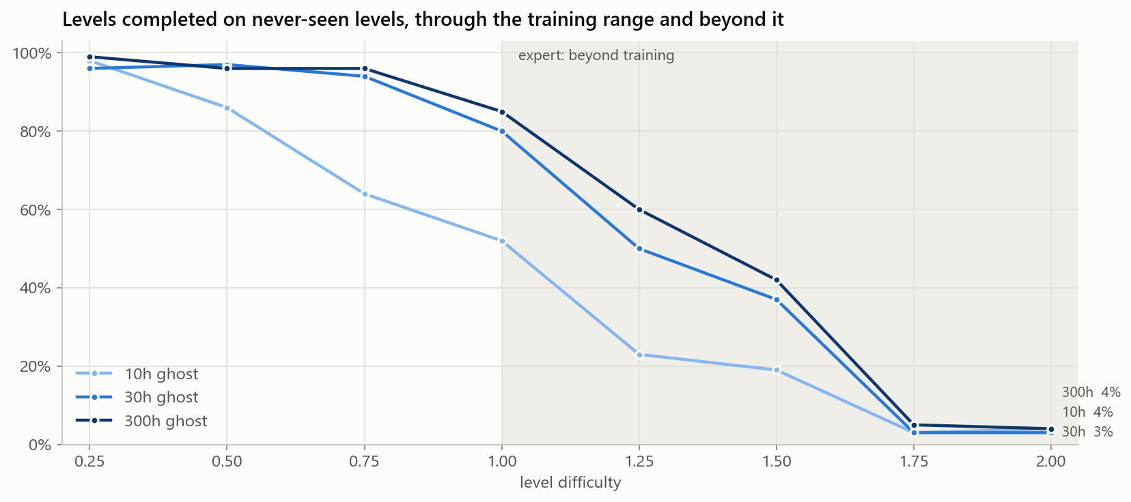
EXPERT LEVELS: BEYOND TRAINING█
[ 06 ]
Difficulty 1 to 2: gaps up to 6 tiles, spike runs of 4, one-tile pillars, less rest
Same tiles, same physics, no retraining; the solver checks every level
300h ghost: 85% at 1.0, 60% at 1.25, 42% at 1.5, 5% at 1.75
procgen_rl :: results
███████████████████████████░░░ [ 38/42 ]
Notes:
Difficulty 1 was the top of the training range, so I added expert levels from 1 to 2 for the demo: the same tiles and physics pushed towards what a jump can just clear. The ghosts were never trained there. Their skills partly carry over, 60 percent at 1.25, but collapse at 1.75, where gaps and spike runs are longer than anything they practised. An agent generalises well inside its training range and less and less beyond it.

Slide 40
> cd section_07
07
DEMO█

Slide 41
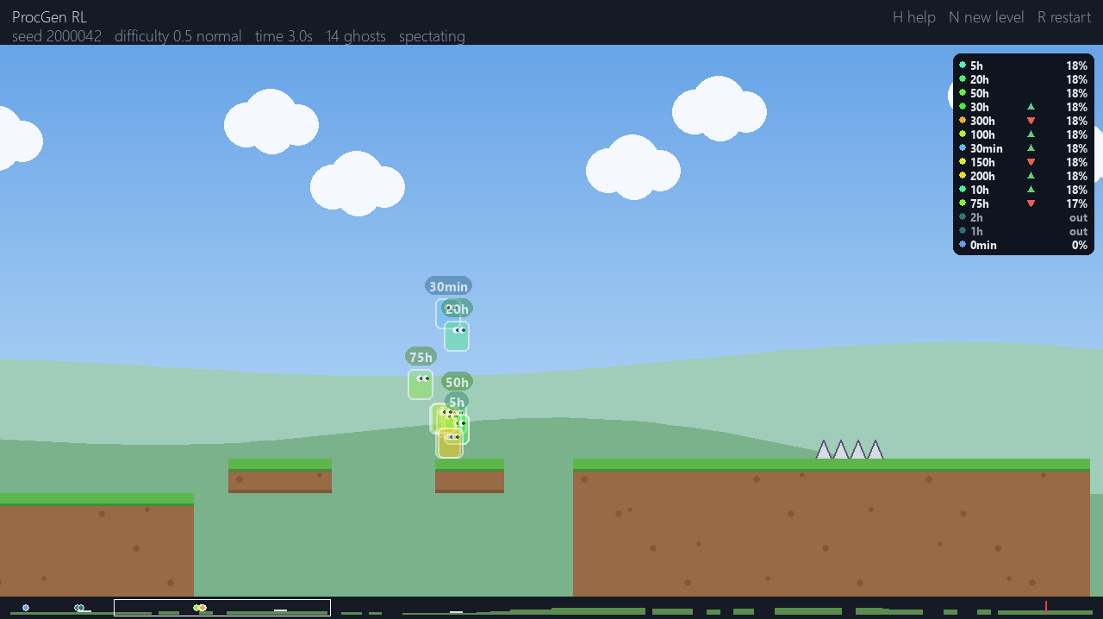
RACE THE GHOSTS█
[ 07 ]
> controls
arrows / A D run
Space jump
N new level
[ ] difficulty
I debug mode
H all keys
$ python demo.py
$ python demo.py --debug
14 see-through ghosts from 0 min to 300 h; you are the solid red one; every round is a fresh level
procgen_rl :: demo
█████████████████████████████░ [ 40/42 ]
Notes:
Time for the live demo. You play the red character; every other character is the same agent at a different point in training. The level is new every round and comes from a seed range never used in training, so nobody has seen it before, including the ghosts. You can usually beat everything up to about 2 hours. Then I will press I to switch to the debug mode and step through a few decisions of the 300-hour ghost.

Slide 42
WRAP-UP█
[ 07 ]
> what worked
> what was hard
> next
a tile view relative to the agent
a curriculum from easy to hard
a new level every attempt
one shared game loop: ghosts act exactly as in training
guaranteeing every random level is beatable (a solver in the tests)
a reward it can learn from before ever reaching a flag
overnight runs that survive a crash (autosave + resume)
phase 2: enemies
pixel input with a convolutional network
a stronger critic (it is the weakest part)
compare human runs with the ghosts
not a black box: it watches 2-6 tiles ahead, relies on spikes and ground, and built its own detectors
procgen_rl :: demo
█████████████████████████████░ [ 41/42 ]
Notes:
Three takeaways. The design choices that mattered most were the agent-centred observation, the curriculum and the endless supply of new levels, and the generalisation experiment shows the last one directly. A lot of the work was engineering: making random levels fair, shaping the reward, making overnight training survive a crash. And the debug mode shows the agent is not a mystery: it looks a few tiles ahead, relies on the spike layer, and has learned its own detectors for ground and gaps.

Slide 43
$ talk --questions
QUESTIONS?█
[Your Name] // github.com/DYNAMAXD/ProcGen_RL
Notes:
Thanks for listening. Happy to take questions, and anyone who wants to try beating the 300-hour ghost can have a go on the demo afterwards.

Slide 44
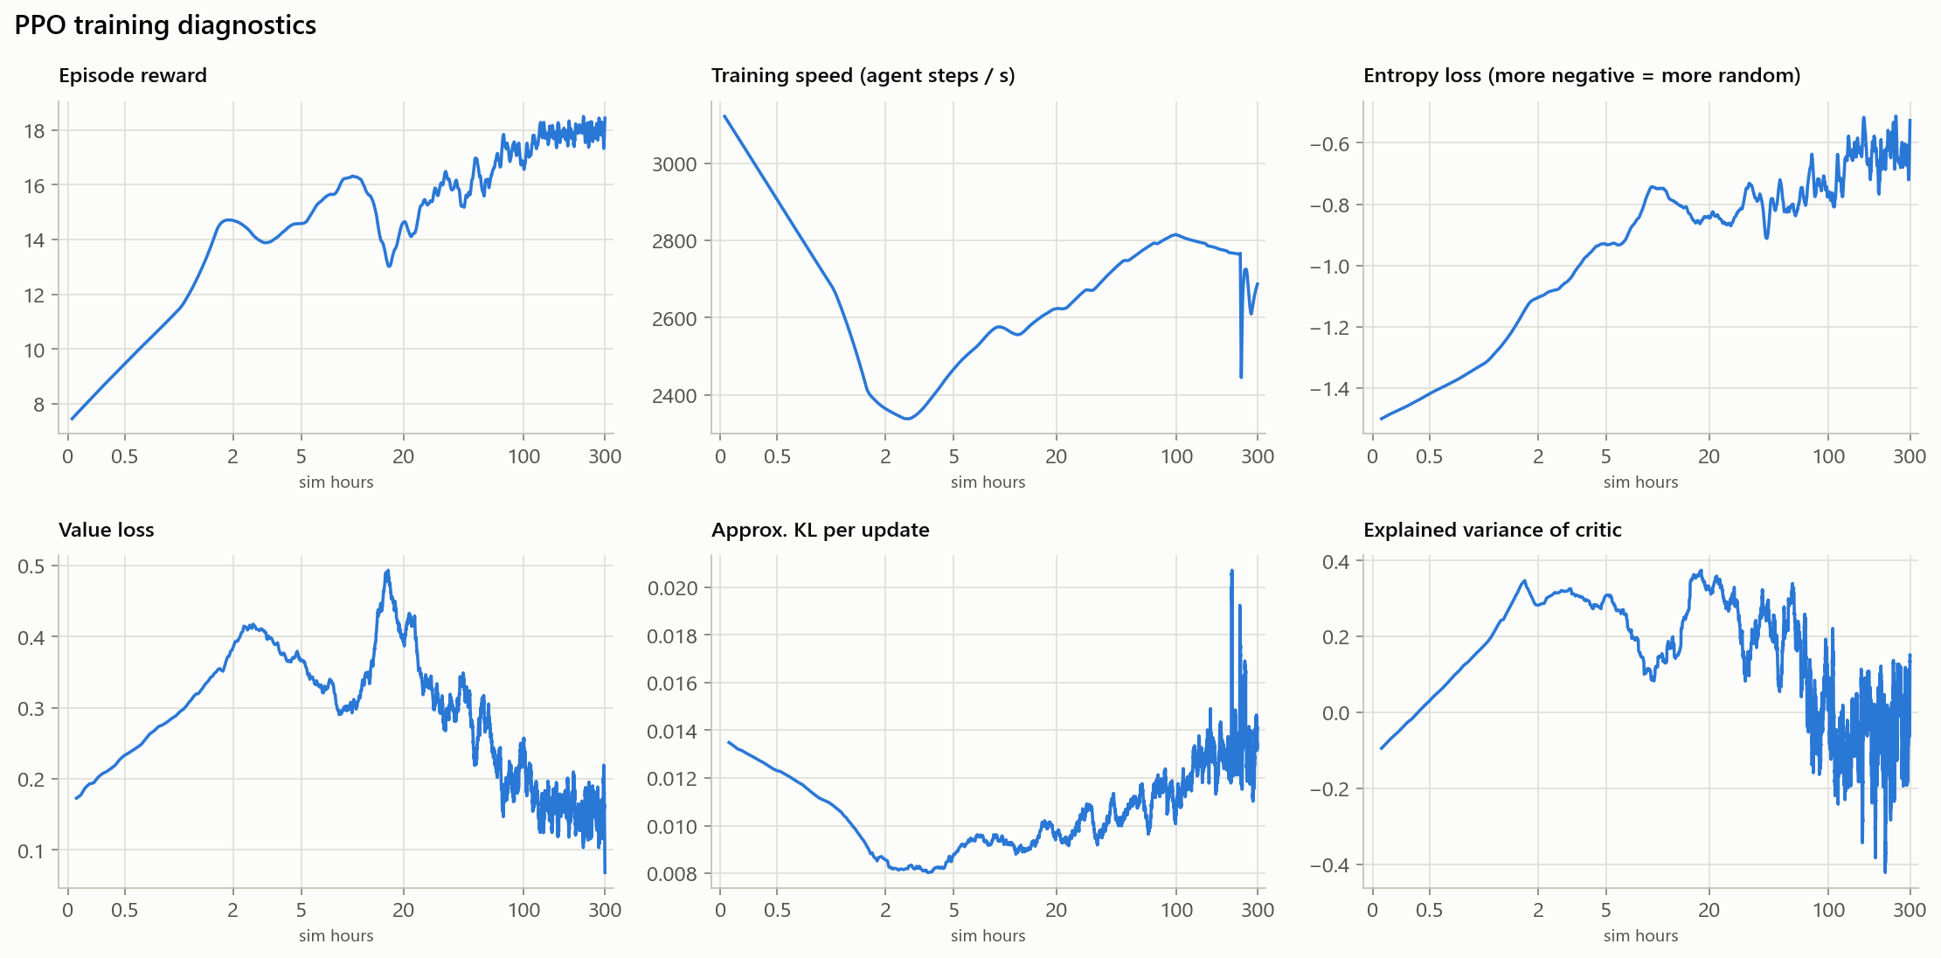
BACKUP: PPO HEALTH CHECKS█
[ A1 ]
reward rises from about 7 to 18 per attempt
entropy falls slowly: fewer random actions
KL stays near 0.01: stable updates
explained variance below 0.4: the critic is the weak part
procgen_rl :: appendix
███████████████░░░░░░░░░░░░░░░ [ 01/02 ]
Notes:
Backup for questions about training stability. Reward goes up, entropy, the randomness of the policy, decreases gradually instead of collapsing, and the change between successive policies stays small. The weak spot is the critic: explained variance never gets above about 0.4, so its predictions are rough. That is plausible, because whether the agent survives an unseen level is hard to predict.

Slide 45
BACKUP: GLOSSARY█
[ A2 ]
term | meaning here
reinforcement learning | learning from rewards by trial and error, without examples of correct play
policy / actor | the network that maps the 847 inputs to 6 action probabilities
critic / value | the network that predicts how much reward is still to come
advantage | how much better an action turned out than the critic expected
PPO | the training algorithm: small, clipped updates of the policy
episode | one attempt at one level, until death, the flag or a time-out
ghost | a saved copy of the policy after some amount of training
sim hours | hours of gameplay practised (decisions / 15 per second)
generalisation | doing well on levels never seen during training
overfitting | doing well on training levels by memorising them, badly on new ones
procgen_rl :: appendix
██████████████████████████████ [ 02/02 ]
Notes:
A glossary for reference.

