Slide 1

Deyaa Yousef Supervisor: Harald Wahl WebCrawler
Innovation Lab 3, Summer Semester 2024

Slide 2

Introduction: The WebCrawler project aims to develop a tool that can crawl specified websites, extract PDF documents, and analyze the content of these documents to generate statistics and visualizations such as word clouds.

Slide 3

Features
- To implement a user registration and login system.
- To enable users to enter URLs for crawling.
- To provide settings for defining the depth of crawling.
- To display and allow downloading of found PDF documents.
- To generate statistics of the most frequent words in the documents.
- To create word clouds from the collected data

Slide 4
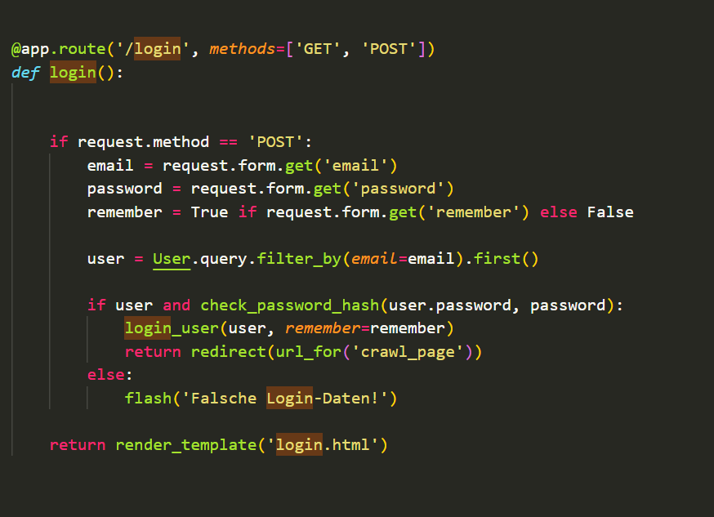
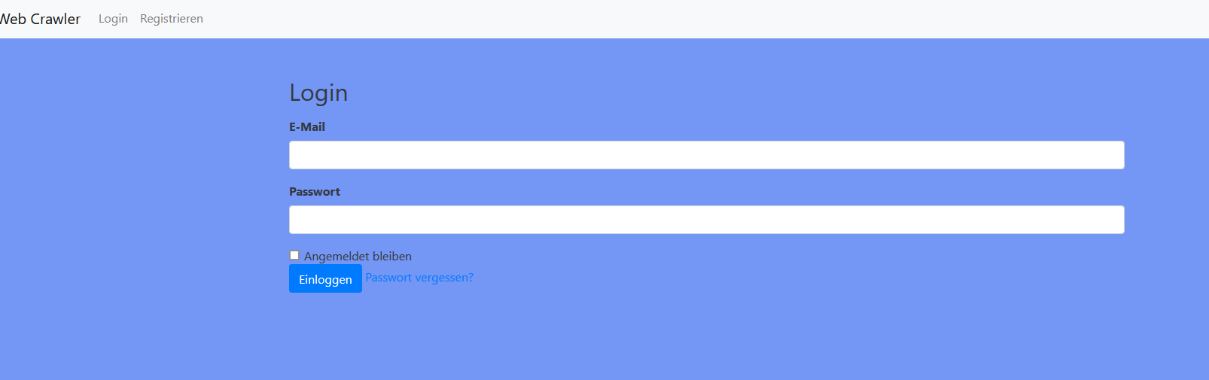
Login & Registration System

Slide 5
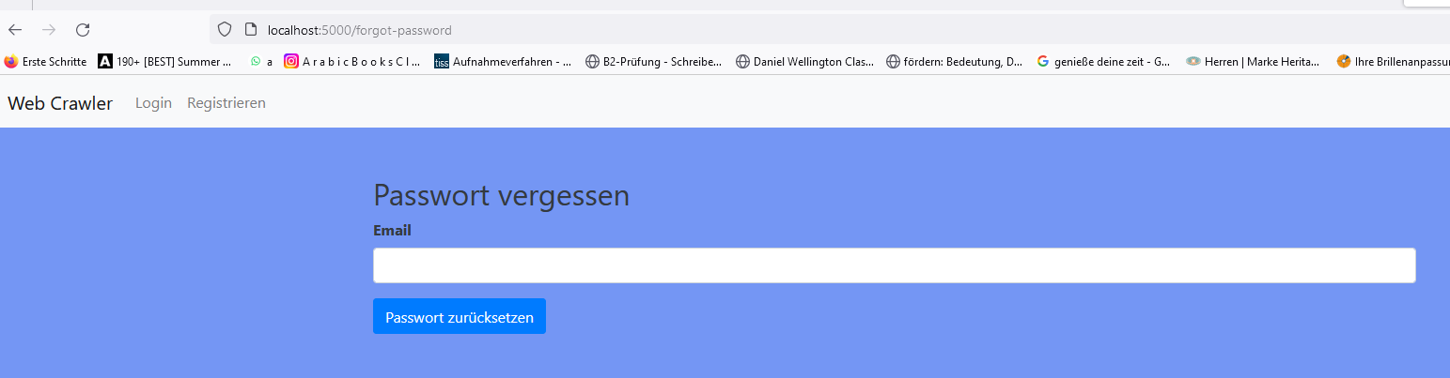
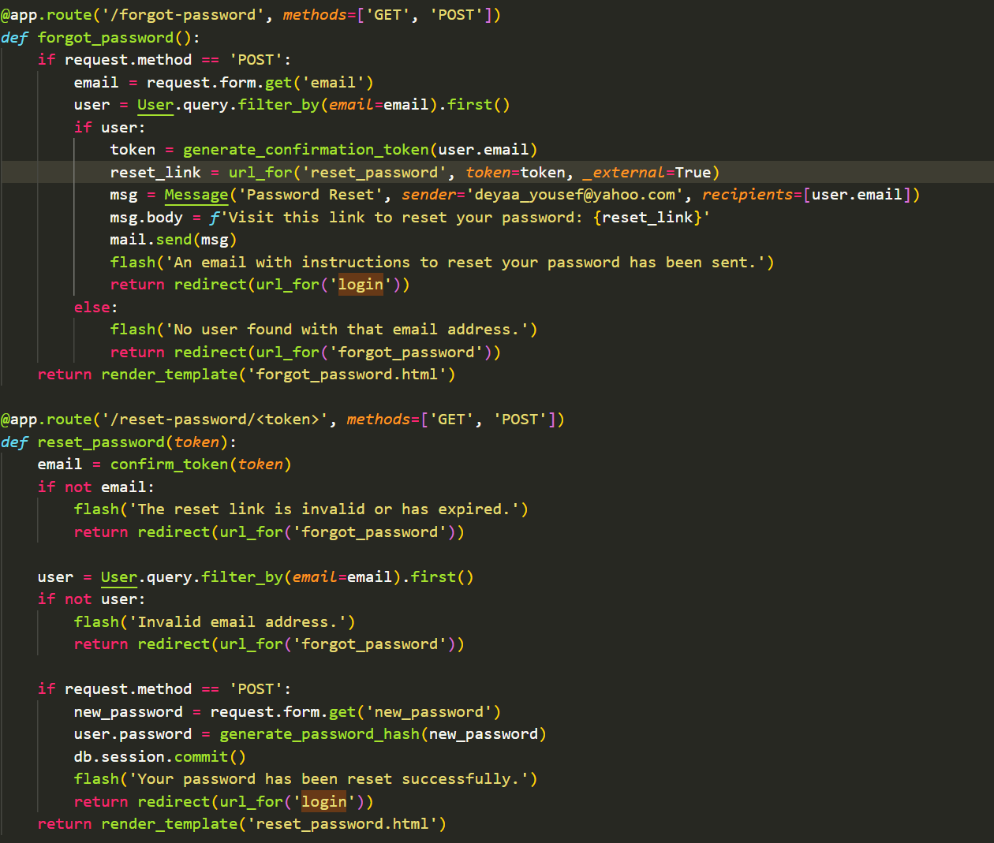
Reseting Password

Slide 6
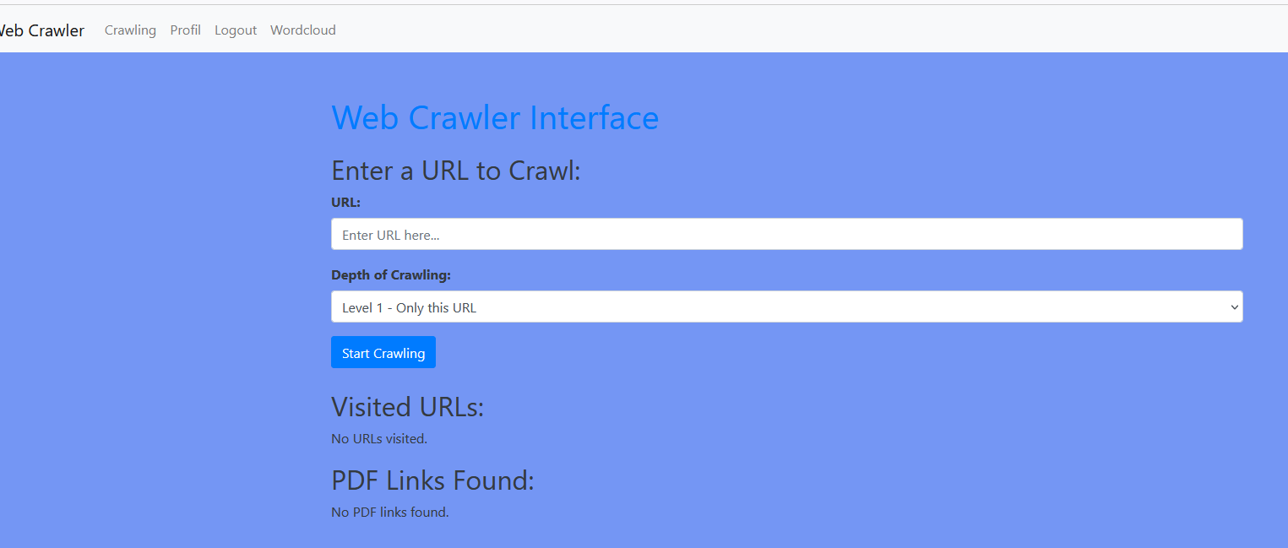
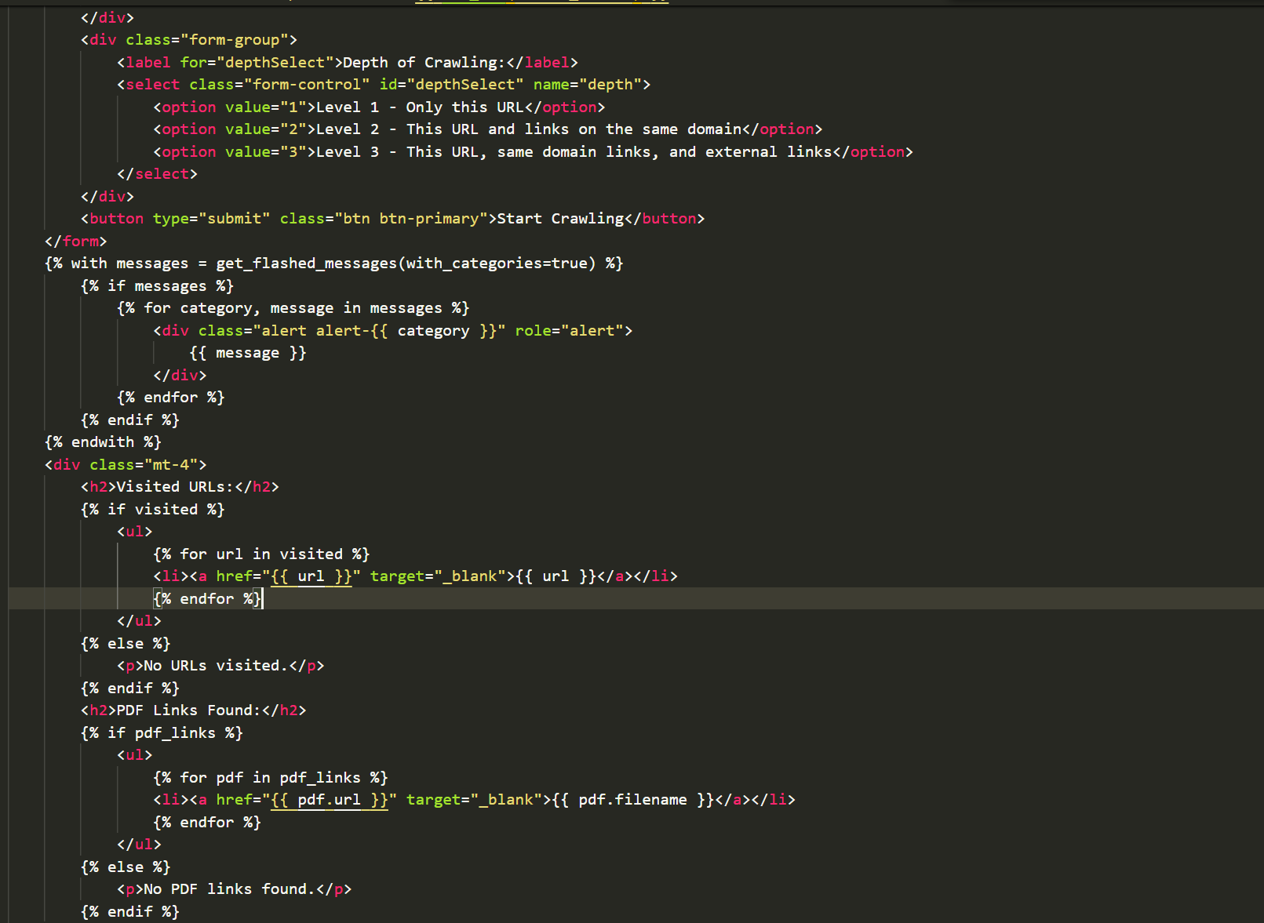
Crawling Interface

Slide 7

The End
Thank You for Your Attention

Slide 8
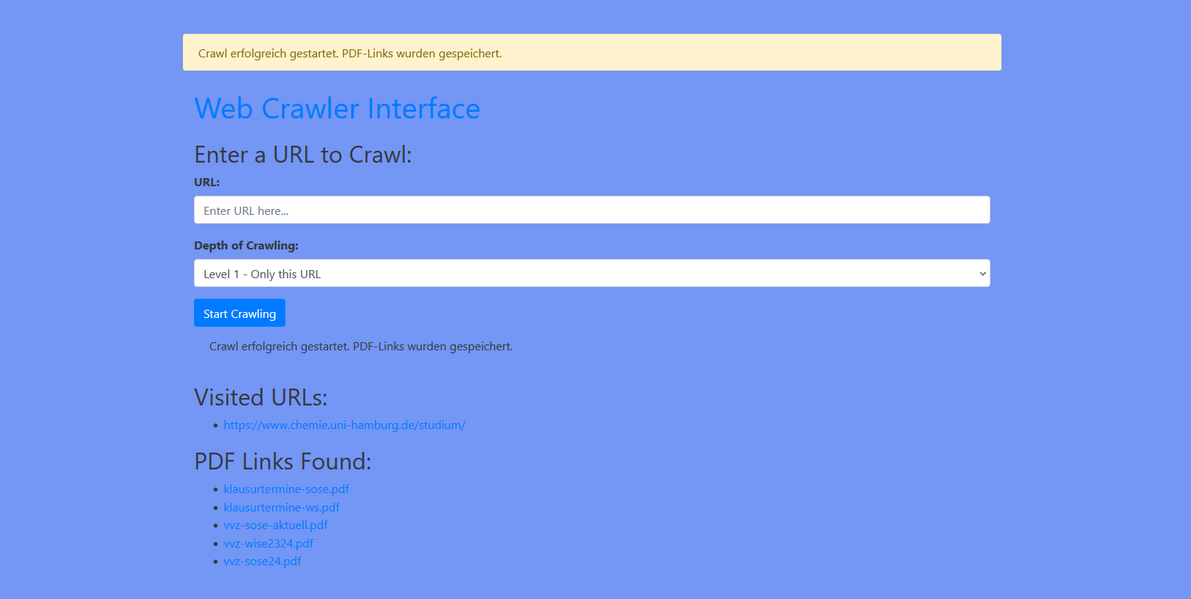
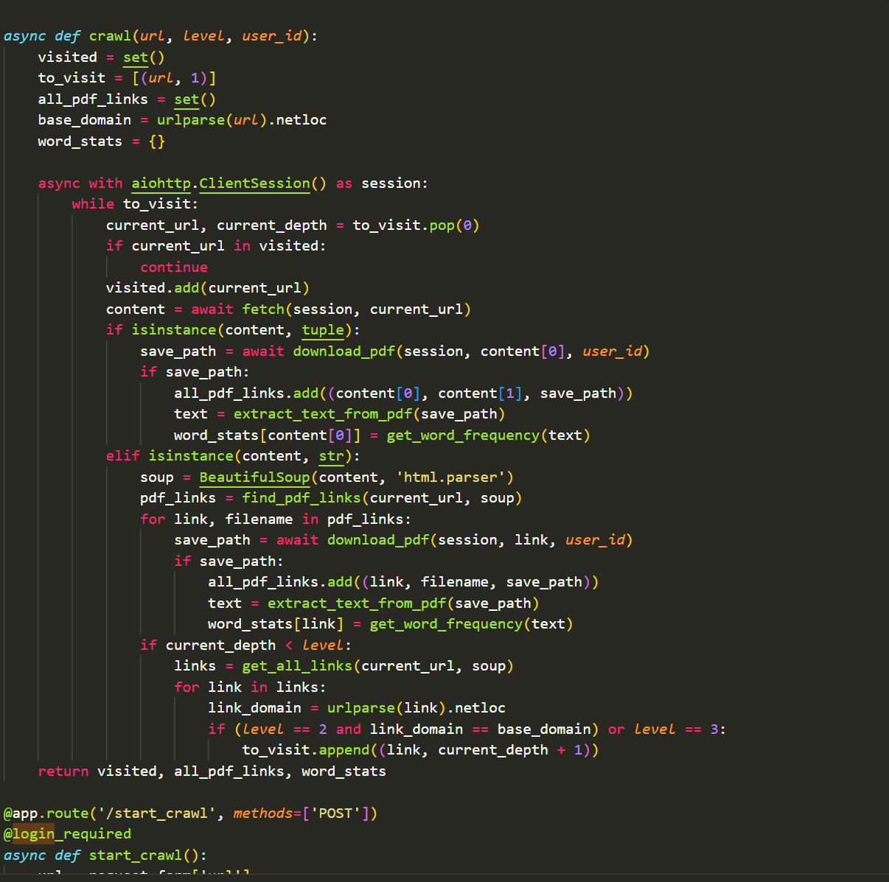
Crawling Functionality

Slide 9
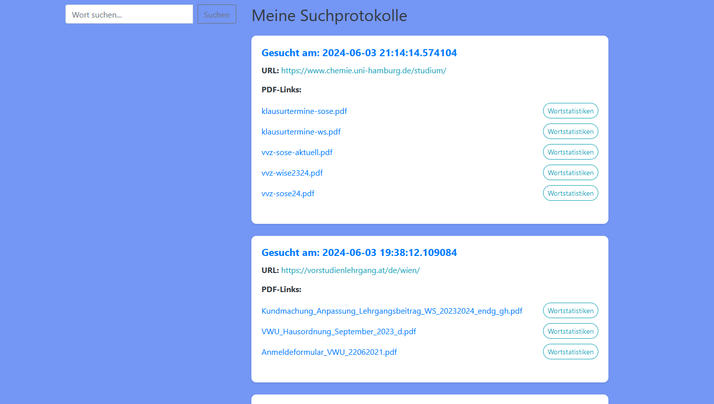
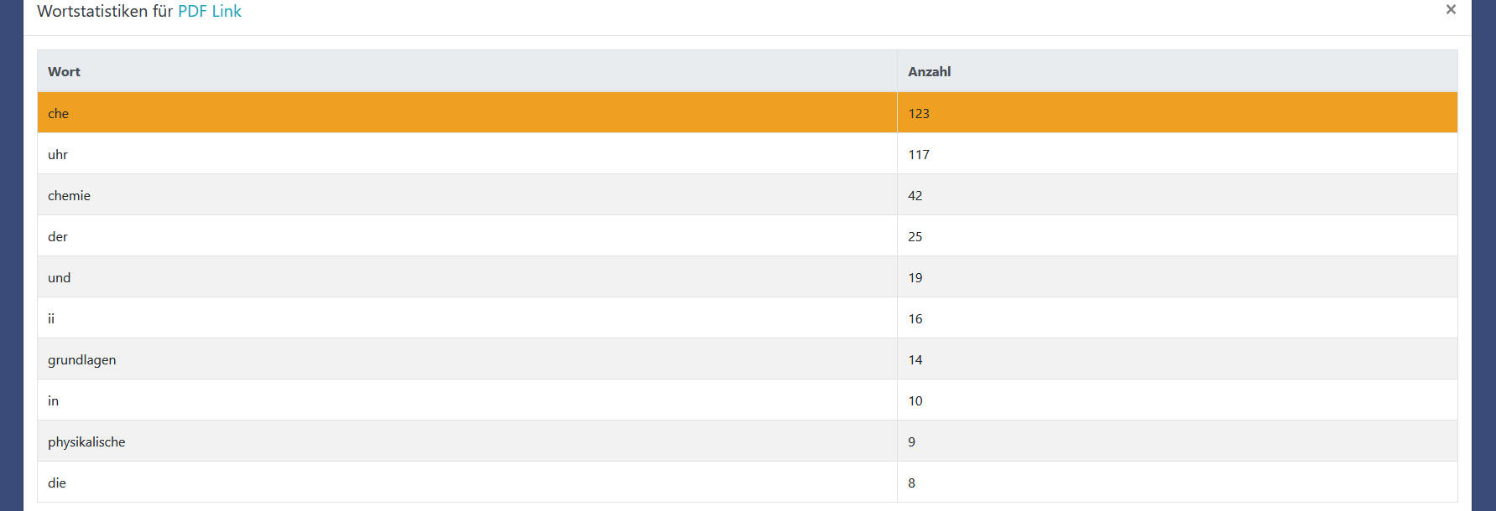
Profile & Word statistics

Slide 10
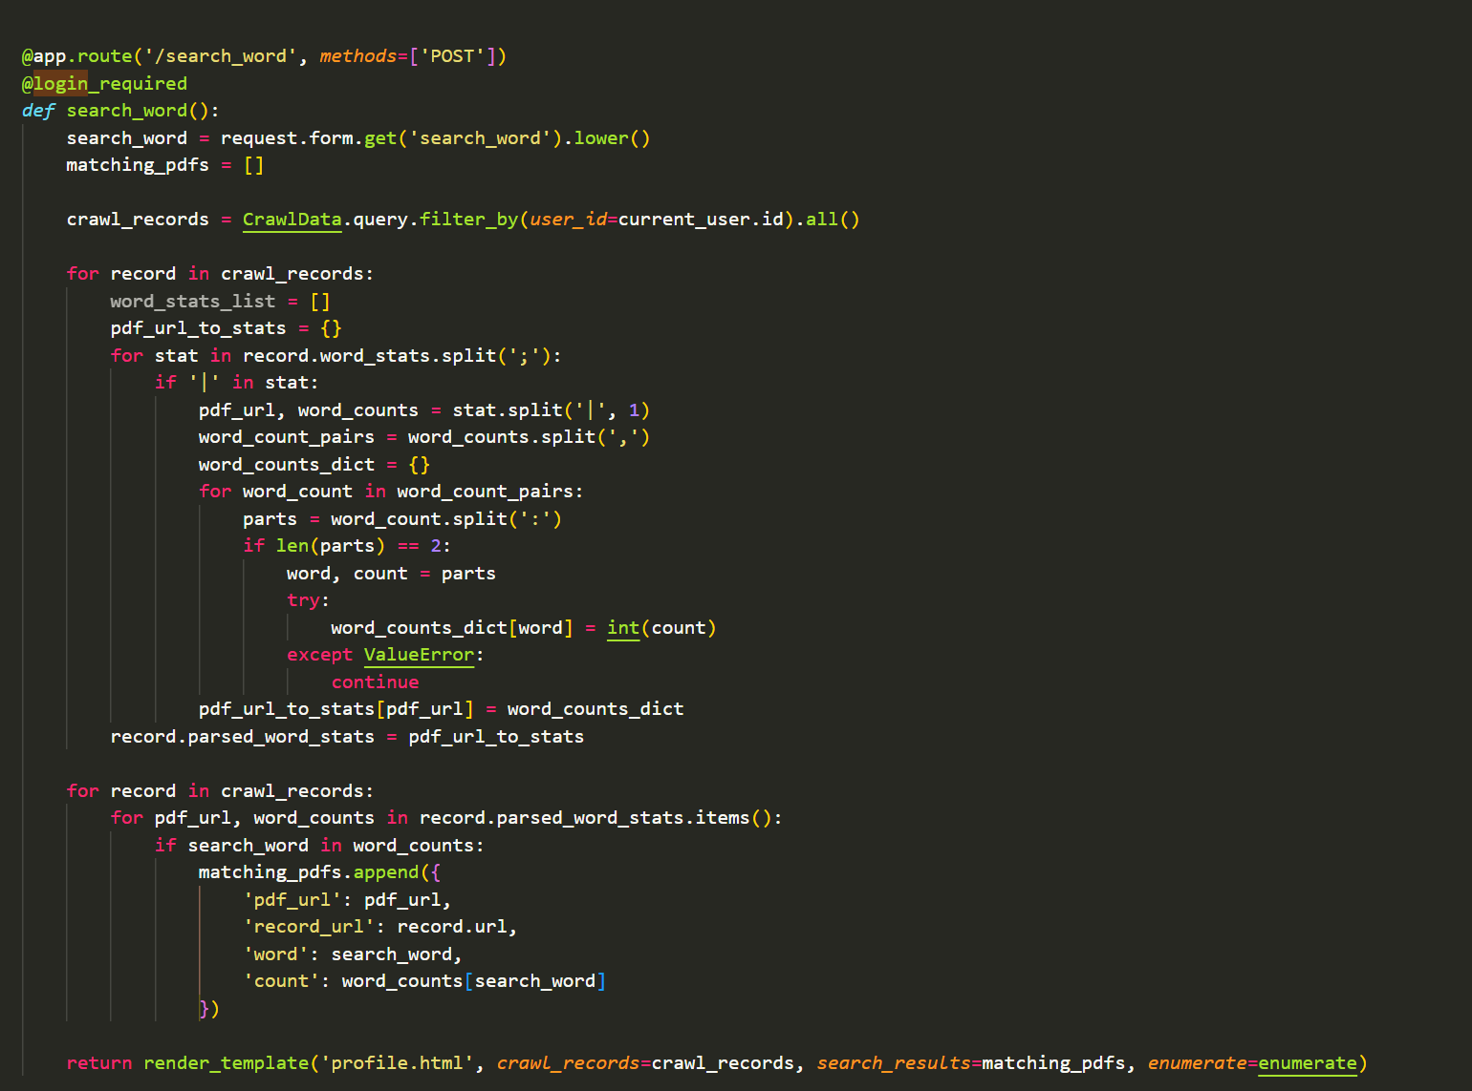
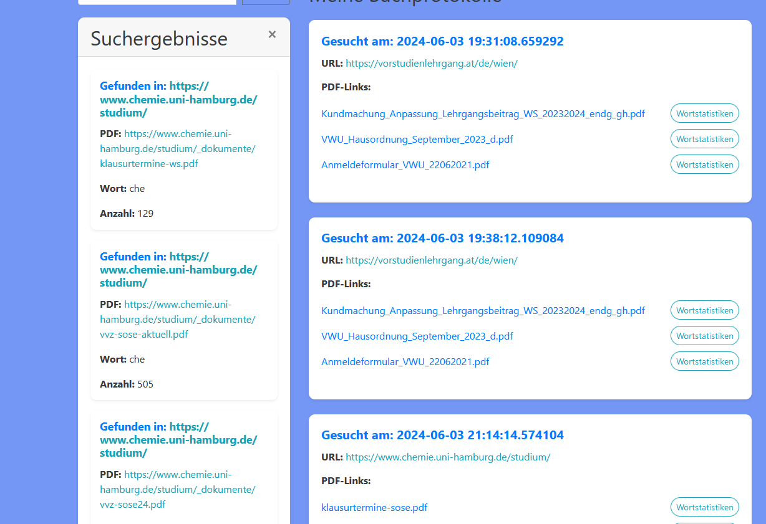
Searching in Word Statistics

Slide 11
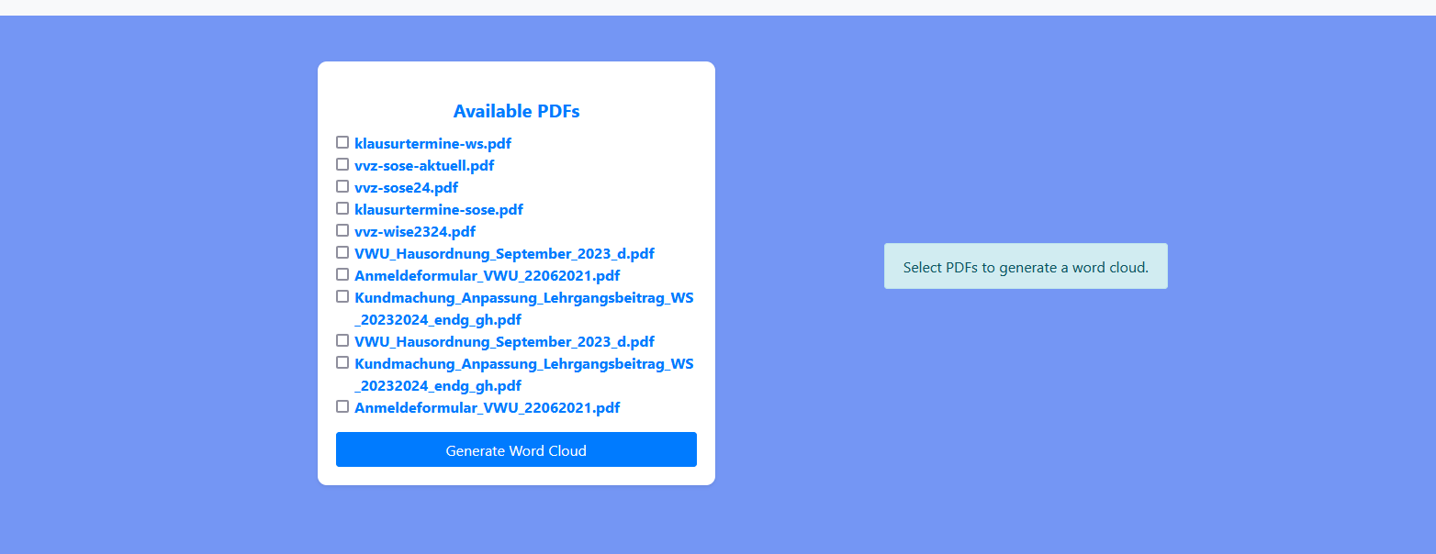
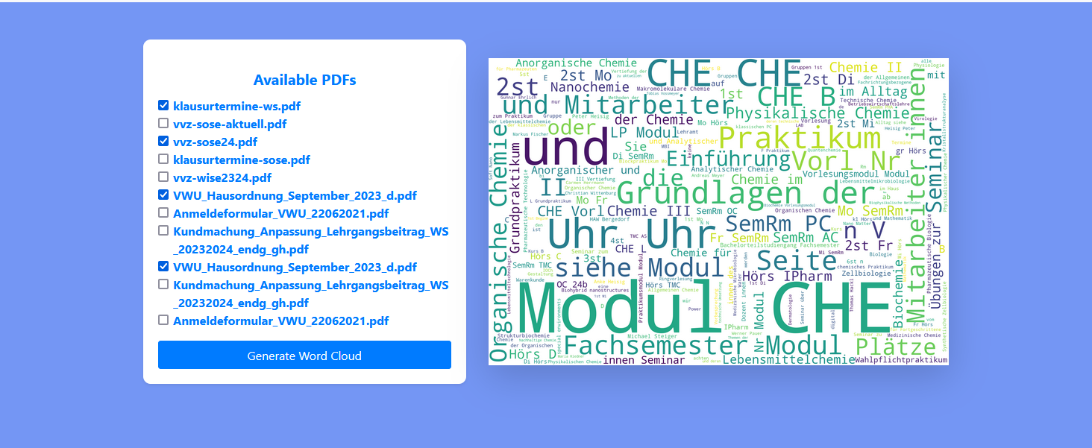
Generating of Word Clouds

Slide 12
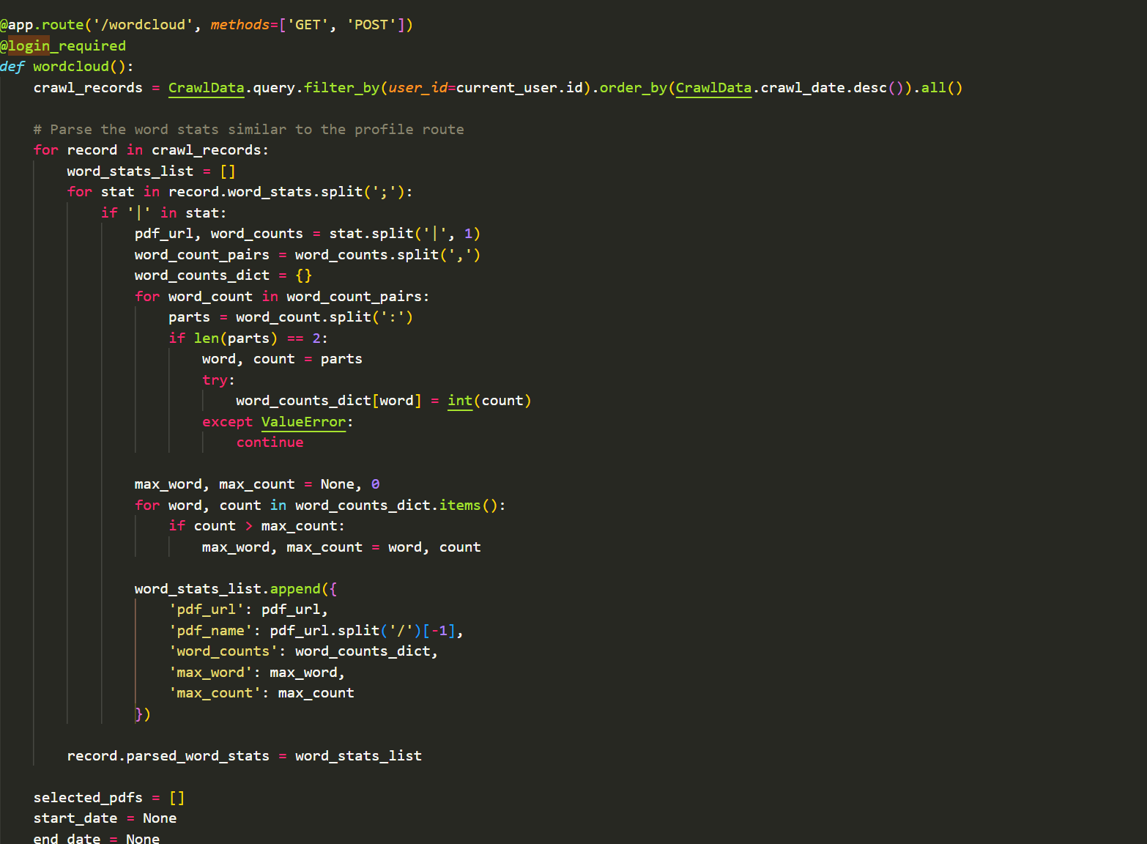
Generating of Word Clouds

