Slide 1

Computer Engineering Department
A.P. Shah Institute of Technology
G.B.Road,Kasarvadavli, Thane(W), Mumbai-400615
UNIVERSITY OF MUMBAI
Academic Year 2020-2021

Slide 2
A Project Report on
PC VOICE ASSISTANT Submitted in partial fulfillment of the degree of
Bachelor of Engineering(Sem-7)
in
Computer Engineering
By
Deepak Yadav(17102054)
Jash Vora(17102042)
Ronak Jain(17102028)
Under the Guidance of
Prof. Jaya Gupta

Slide 3
1.Project Conception and Initiation

Slide 4
1.1 Abstract
The project aims to develop a personal-assistant for Computer
Users can interact with the assistant through voice commands.
It assists the end-user with day-to-day activities like general human conversation, searching queries, reading latest news, translating words, live weather conditions, sending mail through voice.
The software uses a device’s microphone to receive voice requests while the voice output takes place at the speaker.

Slide 5
1.2 Objectives
To Provide User hand-free experience.
To ease the work by providing user voice interface to exceute their query.
Traditional way of searching details online And opening an Application can be given a new touch with the help of Voice Assistant.

Slide 6
1.3 Literature Review
Speech synthesis is the artificial production of human speech. A computer system used for this purpose is called a speech synthesizer, and can be implemented in software or hardware products.
The most important qualities of a speech synthesis system are naturalness and intelligibility.
Naturalness describes how closely the output sounds like human speech, while intelligibility is the ease with which the output is understood.
Some popular speech recognition systems are Siri, Cortana, Google Now, etc

Slide 7
1.4 Problem Definition
We are all well aware about Cortana, Siri, Google Assistant and many other virtual assistants which are designed to aid the tasks of users in Windows, Android and iOS platforms
In this virtual assistant systems if user asks web query the system redirects the user to web page and user has to manually search thereafter this can be havoc sometimes, so our Pc Voice Assistant will solve this problem by answering the web query in user interface of our app itself.

Slide 8
1.5 Scope
Presently, Jarvis is being developed as an automation tool and virtual assistant. Among the Various roles played by Jarvis are:
1. Search Engine with voice interactions
2. Alarm.
3. Reminder and To-Do application.
4. Vocabulary App to show meanings and correct spelling errors.
5. Weather Forecasting Application.
6.Translating word or sentence from one language to another language.

Slide 9
1.6 Technology stack
Front End Framework(User Interface)
Tkinter
Pygame
Main FrameWork
Python
Machine learning

Slide 10
1.7 Benefits for environment & Society
User have a wealth of knowledge at their fingertips and can automate many time consuming activities with just a sentence or two.
Voice assistants can break down barriers for people with disabilities, whether sensory, physical or cognitive. Voice interaction is especially useful for those with visual impairments.
People genuinely enjoy speaking to home assistants, showing that a human-to-machine bond that can be created through voice.

Slide 11
2. Project Design

Slide 12
2.1 Proposed System
The Proposed system aims to simplify basic operations of user, users who might be busy to perform certain operations themselves, elderly people and even users with sight or motor disabilities
It responds to basic commands like, Open Applications, Close Applications, Connect Google Send Mail to respective person , Start various services like Hotspot, WiFi, Bluetooth, Music , Youtube and some other services.
The application also possesses speech synthesizing capabilities to give the user the impression that he is actually talking and working with an actual assistant.

Slide 13
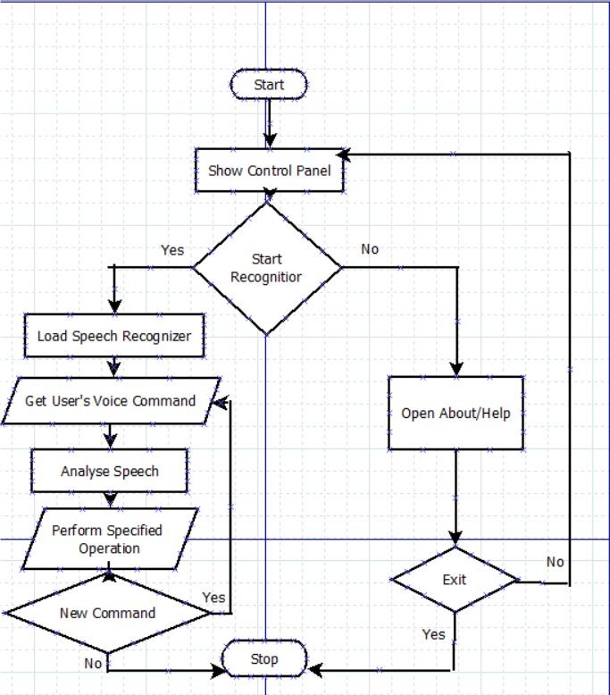
2.2 Design(Flow Of Modules)
Fig 1 : Flowchart of our Project

Slide 14
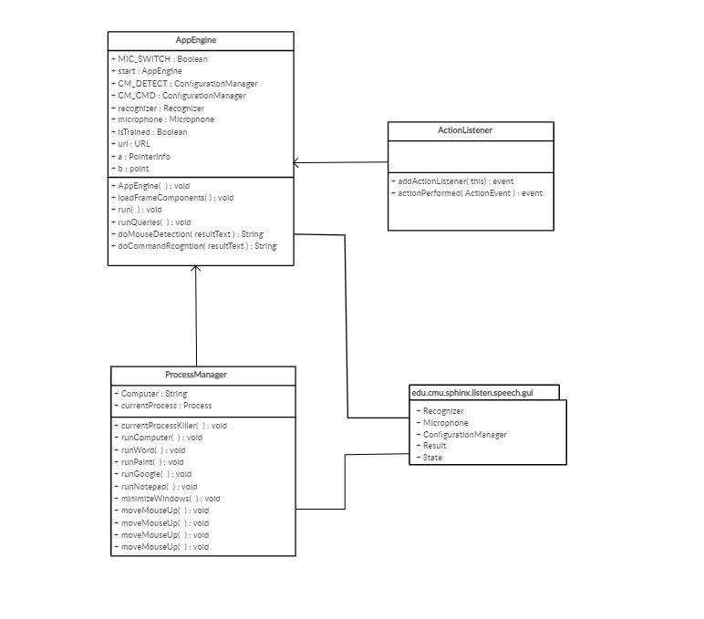
2.3 Class Diagram
Fig 2 : Class Diagram

Slide 15
2.4 Module-1
Speech Recognition
Speech recognition , or speech-to-text, is the ability for a machine or program to identify words spoken aloud and convert them into readable text.
Since we’re building an Application of voice assistant, one of the most important things in this is that your assistant recognizes your voice so for that Speech Recognition module is important

Slide 16
Module-2
Wikipedia Module
Wikipedia is a Python library that makes it easy to access and parse data from Wikipedia.
As we all know Wikipedia is a great source of knowledge ,we have used Wikipedia module to get information from Wikipedia or to perform Wikipedia search.

Slide 17
Module-3
Subprocess Module
Subprocess module is used for getting system subprocess details which are used in various commands i.e Shutdown, Sleep, etc

Slide 18
Module-4
Pyttsx3 Module
Pyttsx3 module is used for conversion of text to speech in a program and it works offline.
An application invokes the pyttsx3.init() factory function to get a reference to a pyttsx3.
Engine instance. it is a very easy to use tool which converts the entered text into speech.
The pyttsx3 module supports two voices first is female and the second is male which is provided by “sapi5” for windows.

Slide 19
2.5 References
https://www.analyticsvidhya.com/blog/2019/07/learn-build-first-speech-to-text-model-python/
https://www.smartsheet.com/voice-assistants-artificial-intelligence
https://medium.com/the-era-of-apis/how-to-use-an-api-the-complete-guide-d701e32c7c9f

Slide 20
3.Planning for next semester

Slide 21
Planning
Implementation
Reminder(To-do-list)
Opening Application
Accessing Youtube Video
Creating User Interface

Slide 22
Thank You

