Slide 1
Robotics in the tourism
Team North Robotics

Slide 2
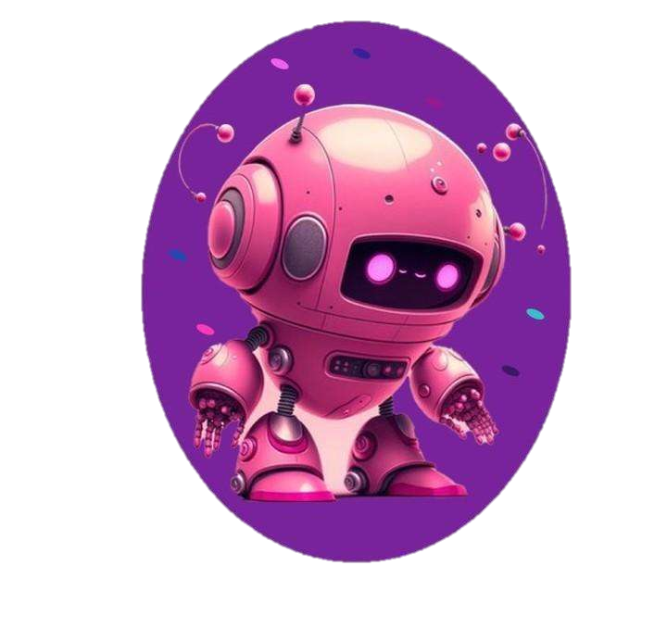
Introduction to the task
We were given the task to make a project which consists of a website, a documentation and a presentation on the theme “Robotics”. Our team chose to make it about “Robotics in the tourism”.

Slide 3
Team members
Dimitar Dimitrakov | Front-end developer | DPDimitrakov22@codingburgas.bg
Yoana Georgieva | Designer | YTGeorgieva22@codingburgas.bg
Kristiyana Hristova | Front-end developer | KIHristova22@codingburgas.bg
Dariq Kartalova | SCRUM trainer | DYKartalova22@codingburgas.bg
NORTH ROBOTICS

Slide 4
Team
Dimitar Dimitrakov
Yoana Georgieva
Kristiyana Hristova
Dariq Kartalova

Slide 5





Technologies we used for making our project :
Teams and Discord- for communicating.
Figma- to make our design.
Visual Studio Code- for html and css codes, also README and SECURITY.md files.

Slide 6
How did we proceed?
Roles
We started by choosing team members and their roles.
Theme
We continued with deciding on the theme we will be working on.
Issues
Then, Daria made issues and labels so we could all work on our parts.
Documentation and presentation
Meanwhile everyone was working on their part, Daria made the documentation and presentation.
Closing issues
When we all were ready with our work, we closed the issues and made our repo public.

Slide 7
Now let’s see the project

