Slide 1
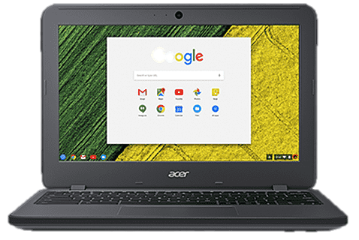


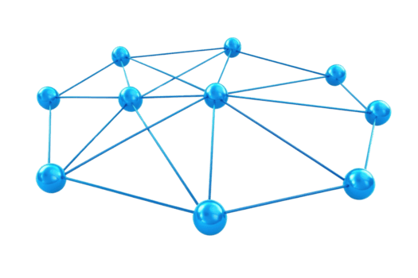

How Does the Web Work?
DNS Server
1-first the request goes to dns server to resolve the DNS (code,com) to IP
2- response contain the adresse IP of Code,com
Locate the IP address within the database.
client
NETWORK
User enter URL Code,com on his browser
3- A browser (like Google Chrome) sends a request
This happens using HTTP/HTTPS
4- The server sends back a response (HTML, CSS, JS)
Request → Server → Response → Display
Server at
IP 10,10,10,10
CODe,com

Slide 2







What we Need to Be a Web Developer?
Core skills
Tools
Code editor
Internet connection
Browser
structure
design
interactivity
Problems Solving
Most important skill: Learning how to learn

Slide 3
Why Did I Choose Web Development?
I chose web development because:
I like building real projectsIt
allows me to create online businesses
It’s a high-demand skillI can work freelance or remotely
For me, it’s not just learning code — it’s building solutions.

