Slide 1
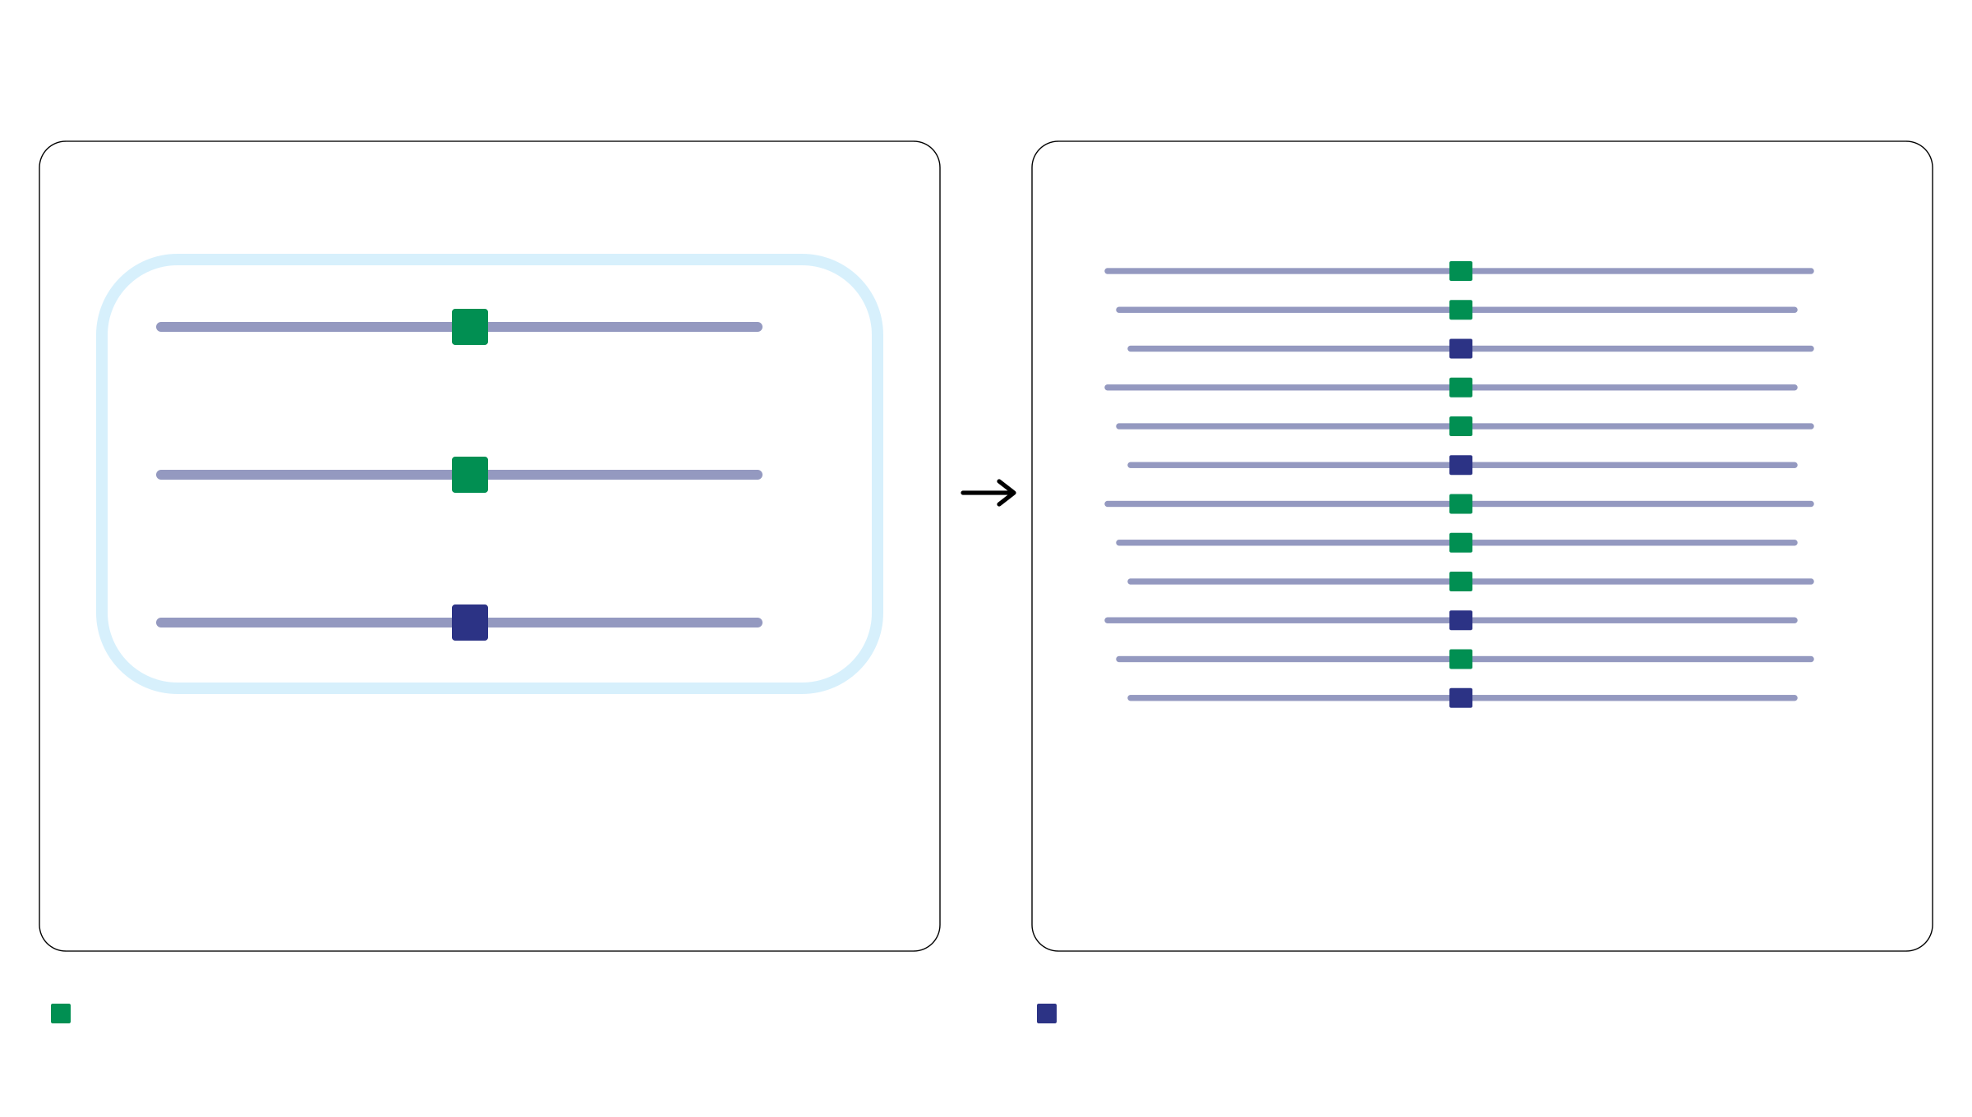
DNA copies vs. sequencing reads
Per tumor cell: copies at locus i
Pooled tumor DNA: reads at locus i
M
M
M
W
M
M
M
W
M
M
M
W
W
M
W
kᵢ = 3 total DNA copies
dᵢ = 12 total reads
mᵢ = 2 mutant DNA copies
rᵢ = 8 mutant reads
Mutant fraction: mᵢ / kᵢ = 2/3
Observed VAF: rᵢ / dᵢ = 8/12 = 2/3
M: specified mutation
W: no specified mutation
i: mutation locus
VAF: variant allele fraction
Notes:
讲解约一分钟。左侧定义 k、m，右侧定义 d、r。说明拷贝数与测序读数属于不同层面，随后再引入细胞组成与纯度。数字保持(3,2)与(12,8)。比例相同是本例选择，不是普遍规律，该说明留给口头讲解。展示页仅用标题32 pt和正文18 pt，图例和M/W标签也是18 pt。

