Slide 1
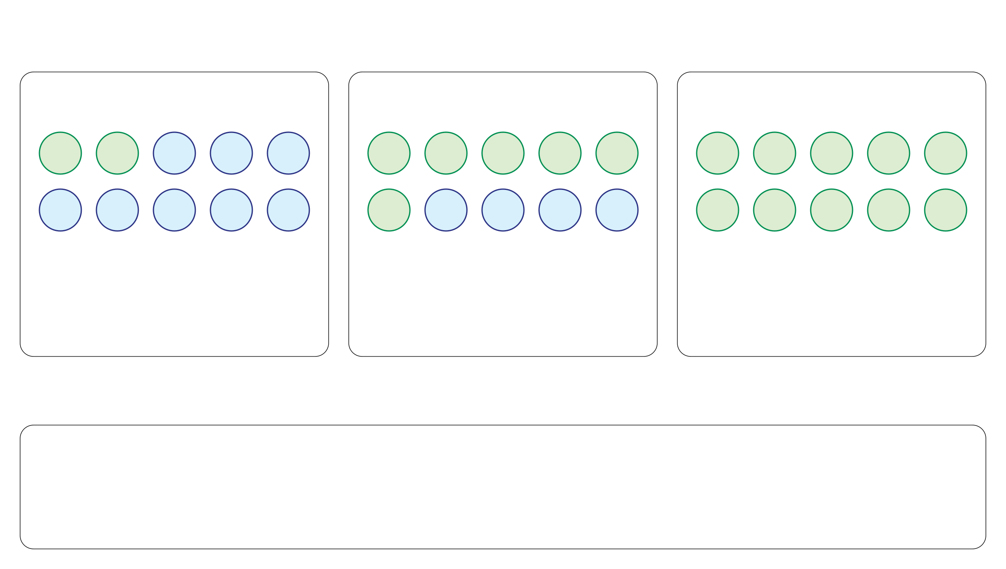
π: the fraction of tumor cells in a sample
Low purity
Intermediate purity
Pure tumor sample
T
T
N
N
N
T
T
T
T
T
T
T
T
T
T
N
N
N
N
N
T
N
N
N
N
T
T
T
T
T
2 tumor + 8 normal cells
6 tumor + 4 normal cells
10 tumor + 0 normal cells
π = 2/10 = 0.2
π = 6/10 = 0.6
π = 10/10 = 1.0
T: tumor cell
N: normal cell
π: tumor-cell fraction to infer
π₀: pathology estimate used to inform the purity prior

