Slide 1
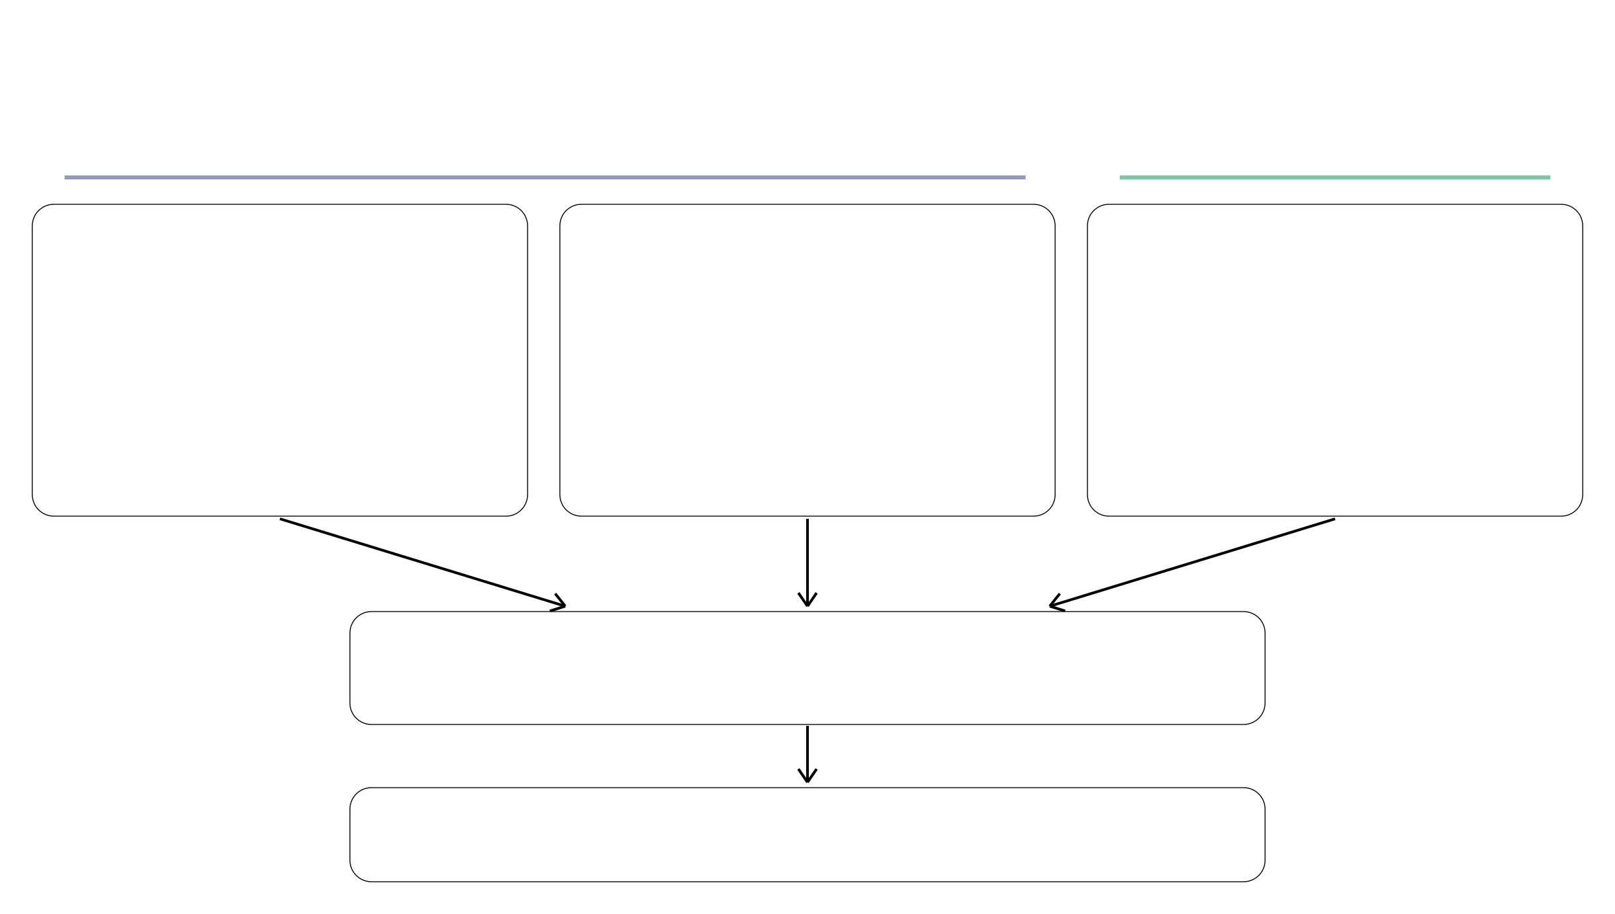
INCOMMON: three sources of input information
Current sample
Historical cohorts
Sequencing read counts
Pathology purity estimate
Copy-number prior
For each called mutation i:
π₀: estimated tumor fraction
Whole-genome sequencing
(WGS) cohorts
dᵢ: total reads
Example: π₀ = 0.60
rᵢ: mutant reads
Informs the prior for π
Prior over (k, m) states
Joint Bayesian inference
Posterior estimates of π, η and (kᵢ, mᵢ)
Notes:
约一分钟。前两类信息来自当前样本：每个已检出突变的总读数与突变读数，以及病理纯度估计。第三类来自历史WGS队列，为拷贝配置提供经验先验，不是要求当前患者另做WGS。三类信息进入联合贝叶斯推断，得到参数的联合后验；图中后验估计不是仅指单个最优值。具体似然、各先验、η先验的内部校准和后验到剂量分类的步骤留给后续页。本页三类指信息来源，并非完整软件参数清单。INCOMMON全称为 inference of copy number and mutation multiplicity for oncology。

