Slide 1
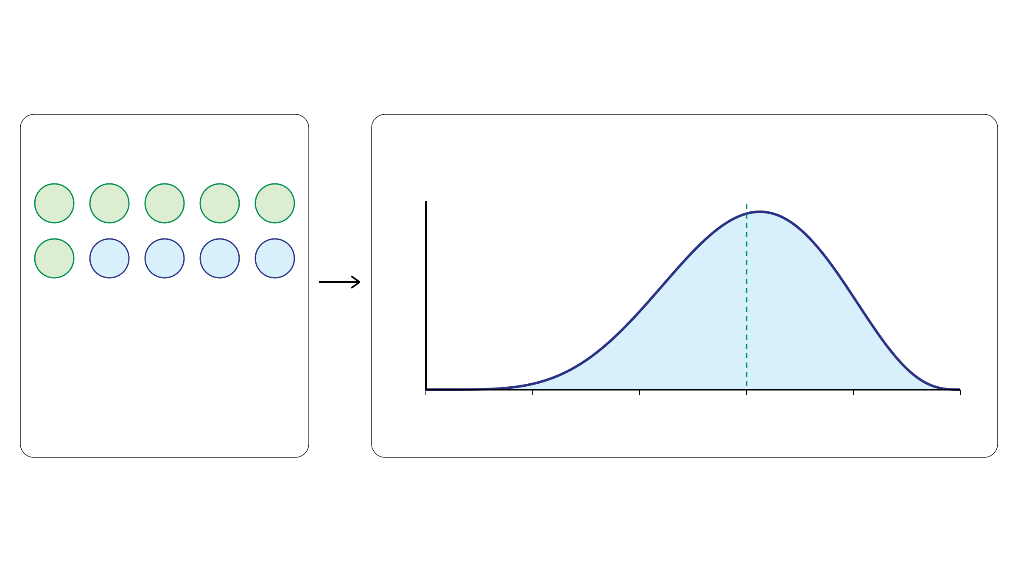
Tumor purity prior
A Beta distribution represents uncertainty in tumor purity.
Pathology estimate
Beta prior over unknown π
Density
Mean = π₀
T
T
T
T
T
T
N
N
N
N
π₀ = 0.60
Estimated tumor-cell fraction
T: tumor cell
0.0
0.2
0.4
0.6
0.8
1.0
N: normal cell
Possible tumor purity π
Mean: pathology estimate
Spread: uncertainty
Notes:
约一分钟。承接第二页：病理提供当前样本的纯度估计π₀=0.60，用它设定未知纯度π的Beta先验均值，而非固定π为0.60。曲线宽度表示对纯度的不确定性，不是同一样本真实纯度随时间波动。此图沿用原图Beta(6,4)教学示例，均值0.6，众数0.625，不代表论文实际的先验数值设定。论文由π₀与预设方差计算Beta形状参数。六个T和四个N只是病理估计的示意。

