Slide 1
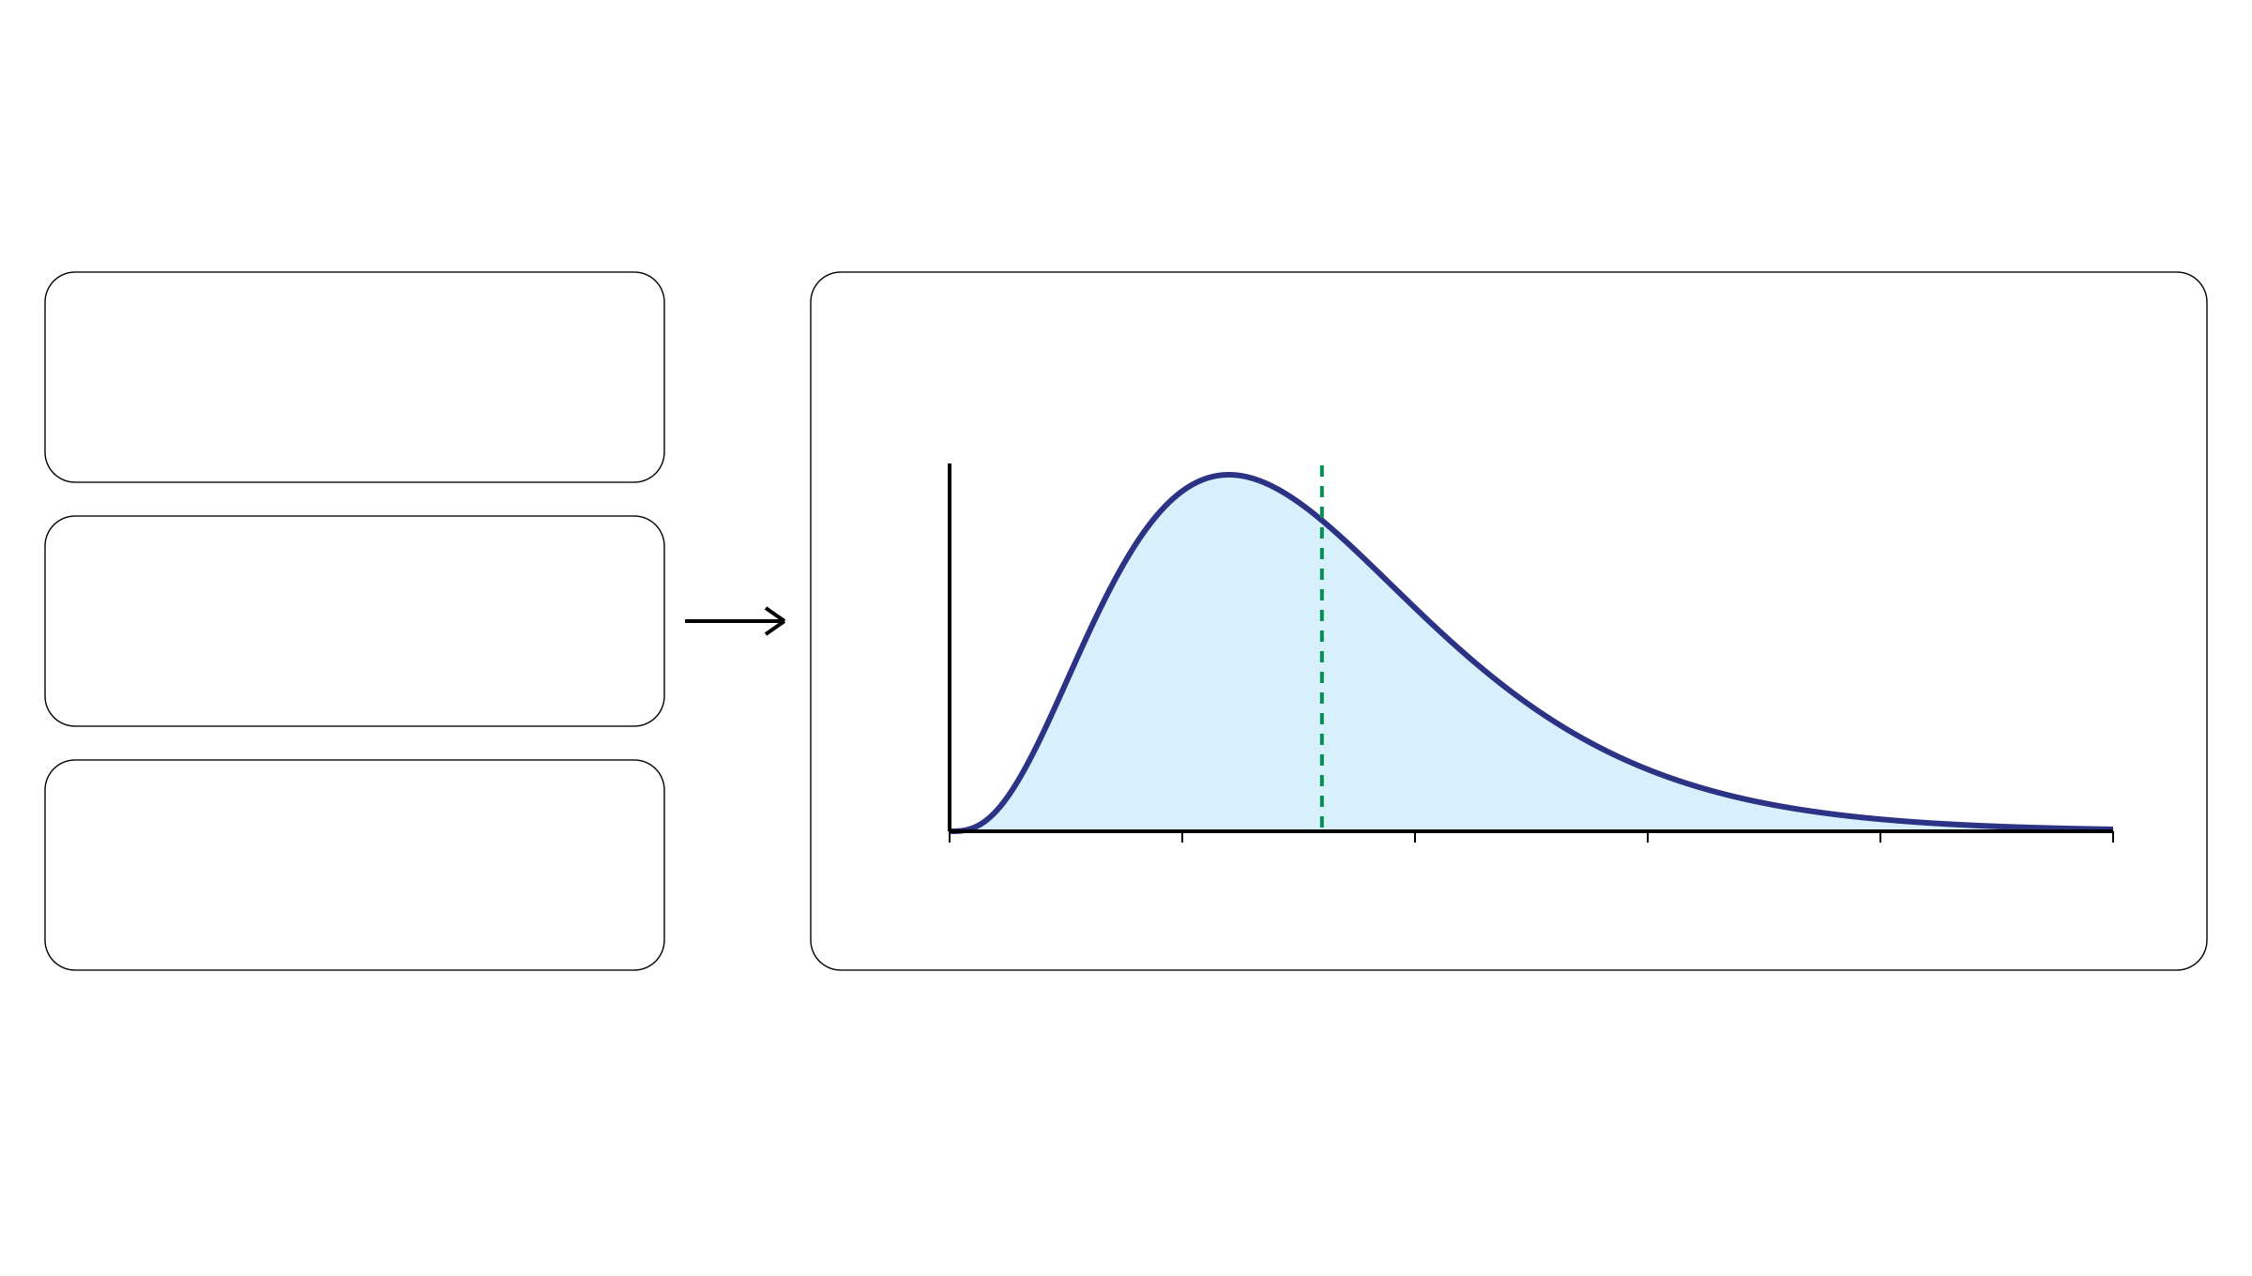
η prior: calibrating the sequencing scale
An empirical Gamma prior for the read rate per DNA copy
Observed depths
Gamma prior over unknown η
d₁, d₂, …, dₙ
Density
Mean = η̃
Pathology estimate
π₀: supplied purity estimate
Copy-number prior
0
50
100
150
200
250
pᵢ(k): prior weights over k
Possible read rate per copy, η
For each candidate k: dᵢ / [2(1 − π₀) + π₀k]
Weight by pᵢ(k) → Average across loci → Empirical estimate η̃
Notes:
约一分钟。η先验根据观测深度、输入病理纯度估计以及拷贝数先验权重进行经验校准。对每个位点和候选k，用dᵢ除以2(1−π₀)+π₀k，按pᵢ(k)加权再跨位点平均，得到经验估计η̃。pᵢ(k)由该位点(k,m)先验对m求和得到；n是输入突变位点数。原文Methods Eq.12至15用经验均值和数据集中的经验方差确定Gamma先验。曲线沿用原图Gamma(shape=4, rate=0.05)，均值80，属于教学图示而非本文实际先验设置，也不是第三页η=5或10示例的继续拟合。密度在250之后仍有尾部。

