Slide 1
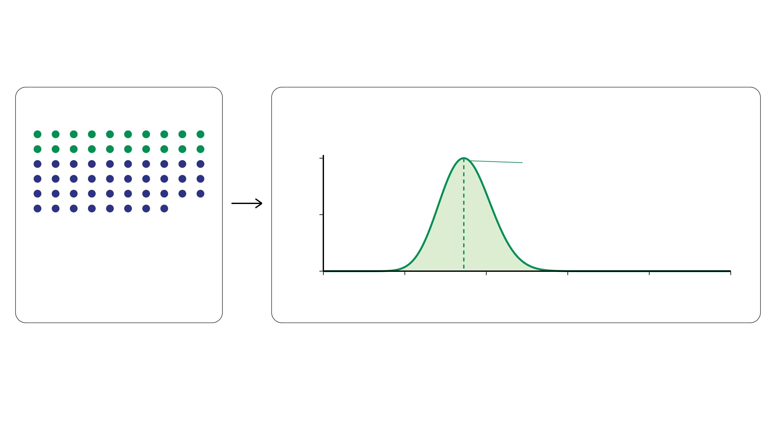
Binomial likelihood: mutant read counts
Fix total and mutant counts. Compare candidate mutant-read probabilities.
Observed data
L(φᵢ) = P(rᵢ = 20 | dᵢ = 58, φᵢ)
Relative likelihood
1
Peak: φᵢ = 20/58
0.5
dᵢ = 58 total reads
rᵢ = 20 mutant reads
0
Observed VAF = 20/58
0
0.2
0.4
0.6
0.8
1
1 dot = 1 read
Candidate mutant-read probability φᵢ
(π, kᵢ, mᵢ) → φᵢ = πmᵢ / [2(1 − π) + πkᵢ] → Likelihood
φᵢ: probability that a read at locus i carries the mutation
Notes:
约一分钟。与上一页共用dᵢ=58，本页同时固定rᵢ=20。58个点中20个深绿为突变读数，38个藏青为非突变读数。观察到的变异等位基因频率VAF为20/58约0.345；φᵢ是模型中单条read携带该突变的概率，不是位点是否存在突变的概率。对不同候选φᵢ计算二项似然，并除以峰值使最大值为1。横轴是参数φᵢ而非读数rᵢ。参数组合通过φᵢ影响这一项，同样φᵢ产生同样似然。

