Slide 1
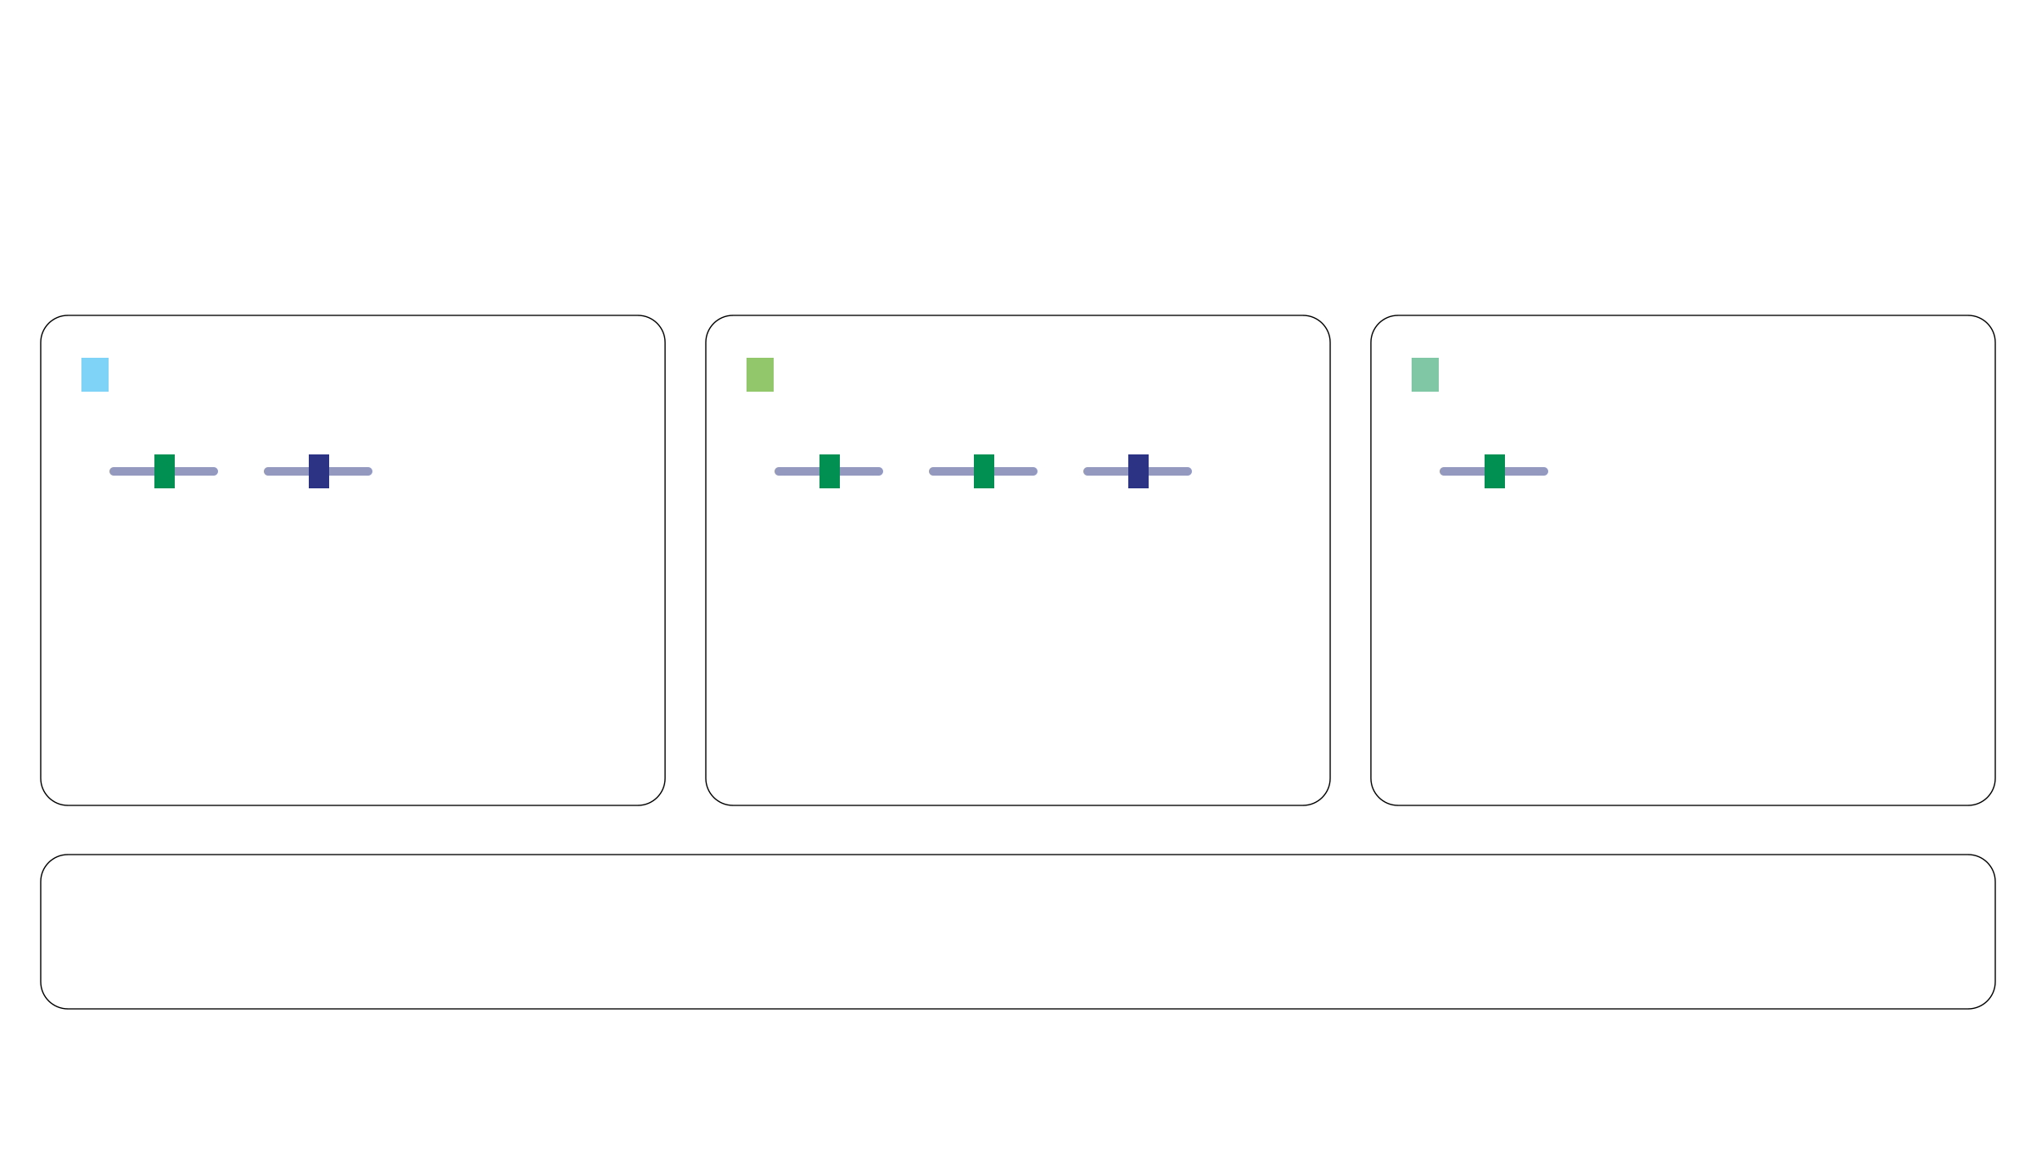
FAM: average ratios weighted by the posterior
Fraction of alleles with the mutation (FAM): m/k
Posterior mean: E[mᵢ/kᵢ | X] = Σ₍ₖ,ₘ₎ (m/k) P(kᵢ = k, mᵢ = m | X)
A: (2,1)
B: (3,2)
C: (1,1)
M
W
M
M
W
M
Ratio m/k = 1/2
Ratio m/k = 2/3
Ratio m/k = 1
Posterior weight = 18.75%
Posterior weight = 75%
Posterior weight = 6.25%
1/2 × 18.75% = 0.09375
2/3 × 75% = 0.50000
1 × 6.25% = 0.06250
Sum the weighted contributions
0.09375 + 0.50000 + 0.06250 = 0.65625 = 65.625%
M: specified mutation
W: no specified mutation
Notes:
约一分钟。延续第12页同一组三配置及其后验概率。对每一种配置先计算m/k，再乘以该配置的后验权重，最后求和。三项为0.09375、0.5和0.0625，总和0.65625，即65.625%。这是FAM的后验均值，并非MAP配置(3,2)的比值2/3，也不是E[m|X]/E[k|X]。后验权重描述配置的不确定性，不是细胞比例。此图为三状态教学示例；实际推断对模型全部候选状态求和，位点配置后验已对共享参数边缘化。

