Slide 1
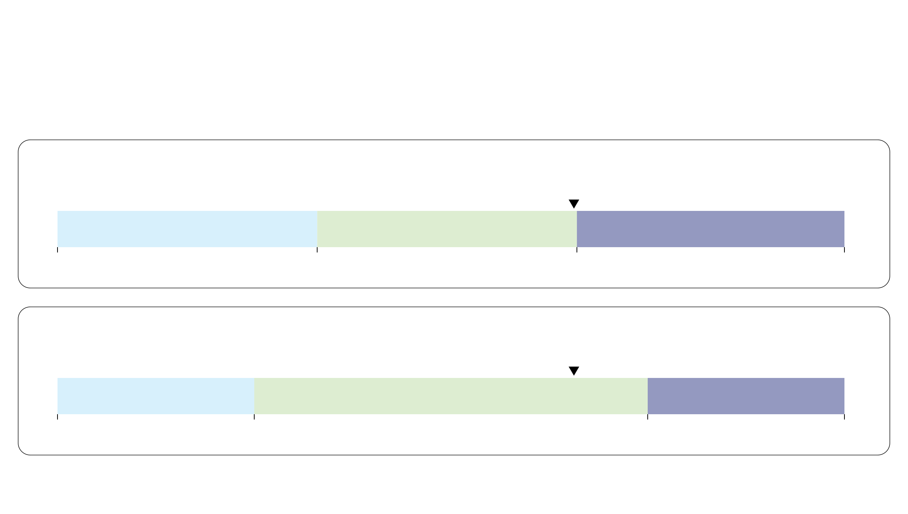
From posterior mean FAM to three GMD classes
Gene mutant dosage (GMD): Low, Balanced, High
Previous example: posterior mean FAM = 0.65625
Oncogenes
0.65625: Balanced
Low
Balanced
High
0
0.33
0.66
1
Tumor suppressor genes (TSGs)
0.65625: Balanced
Low
Balanced
High
0
0.25
0.75
1
Low: FAM ≤ lower cutoff
High: FAM ≥ upper cutoff
Notes:
约一分钟。承接上一页后验均值FAM=0.65625，按基因类别阈值进行剂量分类。致癌基因低类≤0.33，高类≥0.66；抑癌基因低类≤0.25，高类≥0.75，其间为Balanced。0.65625小于0.66，不能先四舍五入再分类，因此两类基因均为Balanced。阈值位置按真实数值比例绘制。高剂量指较高的突变等位基因比例，不必然是很多绝对突变拷贝。原文Methods Classification based on FAM cutoffs和Eq.16。该页只用前页教学例子，不增加0.70例子。

