Slide 1
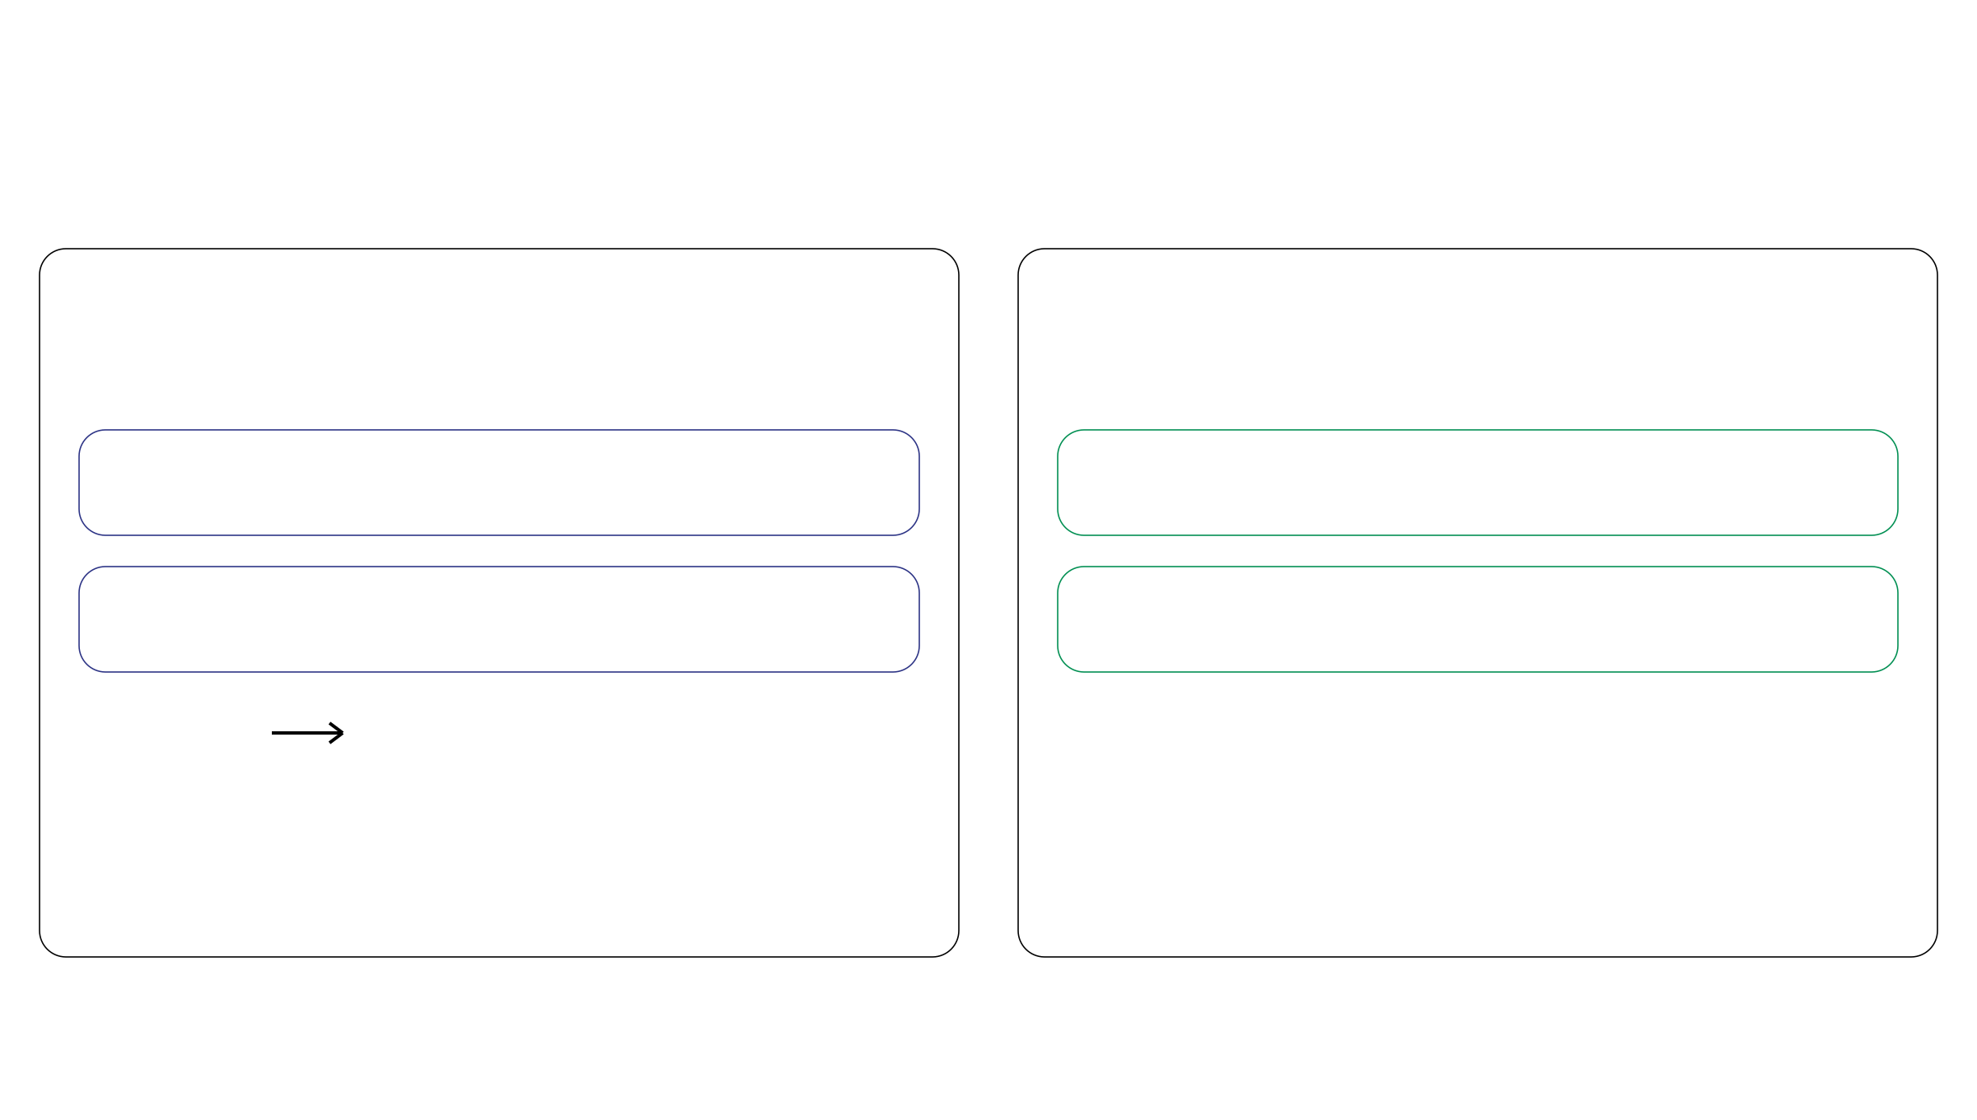
Model checks: four targets, two approaches
Starting point: the fitted posterior
Posterior predictive checks (PPCs)
Prior versus posterior discrepancy
Per mutation locus
Per sample
dᵢ
Total read count
π
Tumor purity
rᵢ
Mutant read count
η
Read rate per DNA copy
Posterior
Simulated reads
Prior draws ↔ Posterior draws
Compare with observed reads.
Compare distances from the prior mean.
Do predicted reads fit the observations?
How far does the posterior shift?
Notes:
约一分钟。本页总览四个检查对象与两种方法。dᵢ、rᵢ在每个突变位点做后验预测检查，比较观测与模拟读数相对预测中心的偏离，见Eq.17。π、η为样本级参数，通过先验和后验抽样相对先验均值的距离作比较，原文称Bayesian P value，见Eq.18至20；不是对读数的PPC。右侧shift是偏离的直观说法，检查不仅取决于均值移动，也受分布宽度等影响。这里是四类检查对象，不是四个独立检验。模型与数据相容不证明k和m正确；先验后验差异也可能是有用更新，不一定是模型失败。这些限制口头说明，具体统计量留给后续两页。

