Slide 1
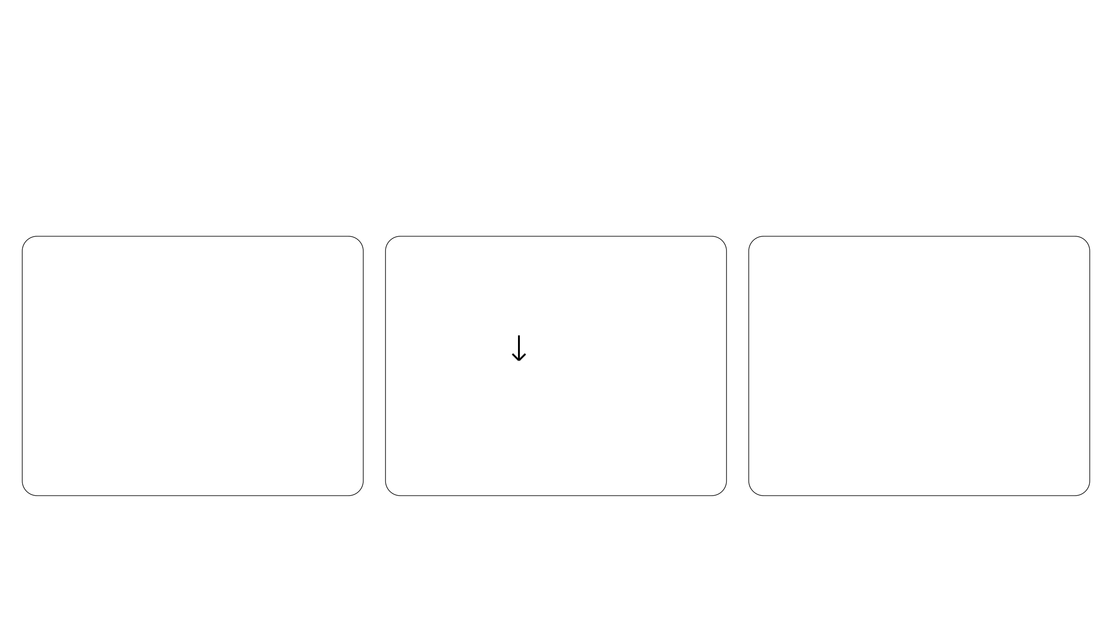
INCOMMON: why this paper matters to our lab
Gene mutant dosage is associated with prognosis and metastatic tropism
in 60,000 clinical cancer samples
Calonaci et al. · Nature Genetics (2026) · 58: 1906 to 1917
INCOMMON: inference of copy number and mutation multiplicity for oncology
Our work: Webb et al.
What this paper adds
Proposed use in our lab
Loss of heterozygosity (LOH)
Validate against our DNA
Mutation presence
reference annotations
Spatial allelic imbalance
Mutant copy dosage
Test dosage associations
Tumor/normal DNA
with expression and
From clinical read counts
+ bulk and spatial RNA
spatial heterogeneity
No matched normal required
Can mutant dosage help interpret the allelic imbalance we observe?
Lab reference: Webb et al. · Nature Communications 16, 5290 (2025)
Notes:
开场约一分钟。Calonaci等Nature Genetics 2026，https://doi.org/10.1038/s41588-026-02666-z 。本组依据Webb等Nature Communications 16,5290 (2025)，https://doi.org/10.1038/s41467-025-59805-z ，正文Introduction、Hallmark molecular alterations和空间LOH分析：整合配对tumor/normal DNA、bulk RNA及空间转录组，研究胶质瘤等位基因失衡和空间亚克隆异质性。这里不展开扩增方向。INCOMMON在已检出的突变位点推断样本层面拷贝配置与突变剂量，不是直接从空间RNA推断DNA剂量，也不是LOH/克隆性分析的替代工具。潜在用途是以已有DNA参考注释验证其配置与剂量估计，再在样本层面关联剂量、表达及空间异质性指标；空间定位仍依赖本组已有数据与方法。DNA剂量与RNA等位基因比例不等同，不能直接互作真值。右栏为研究提议，并非两篇论文已经验证的组合流程。不需要配对normal指INCOMMON推断阶段，可靠体细胞突变输入仍然必要。

