Slide 1
Power BI automatically updated interactive Report
Customer activity on cloud-native platform

Slide 2
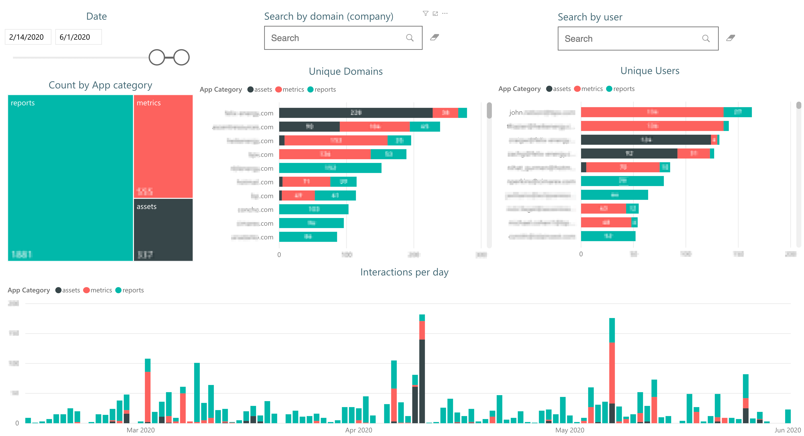
Clicks analytics

Slide 3
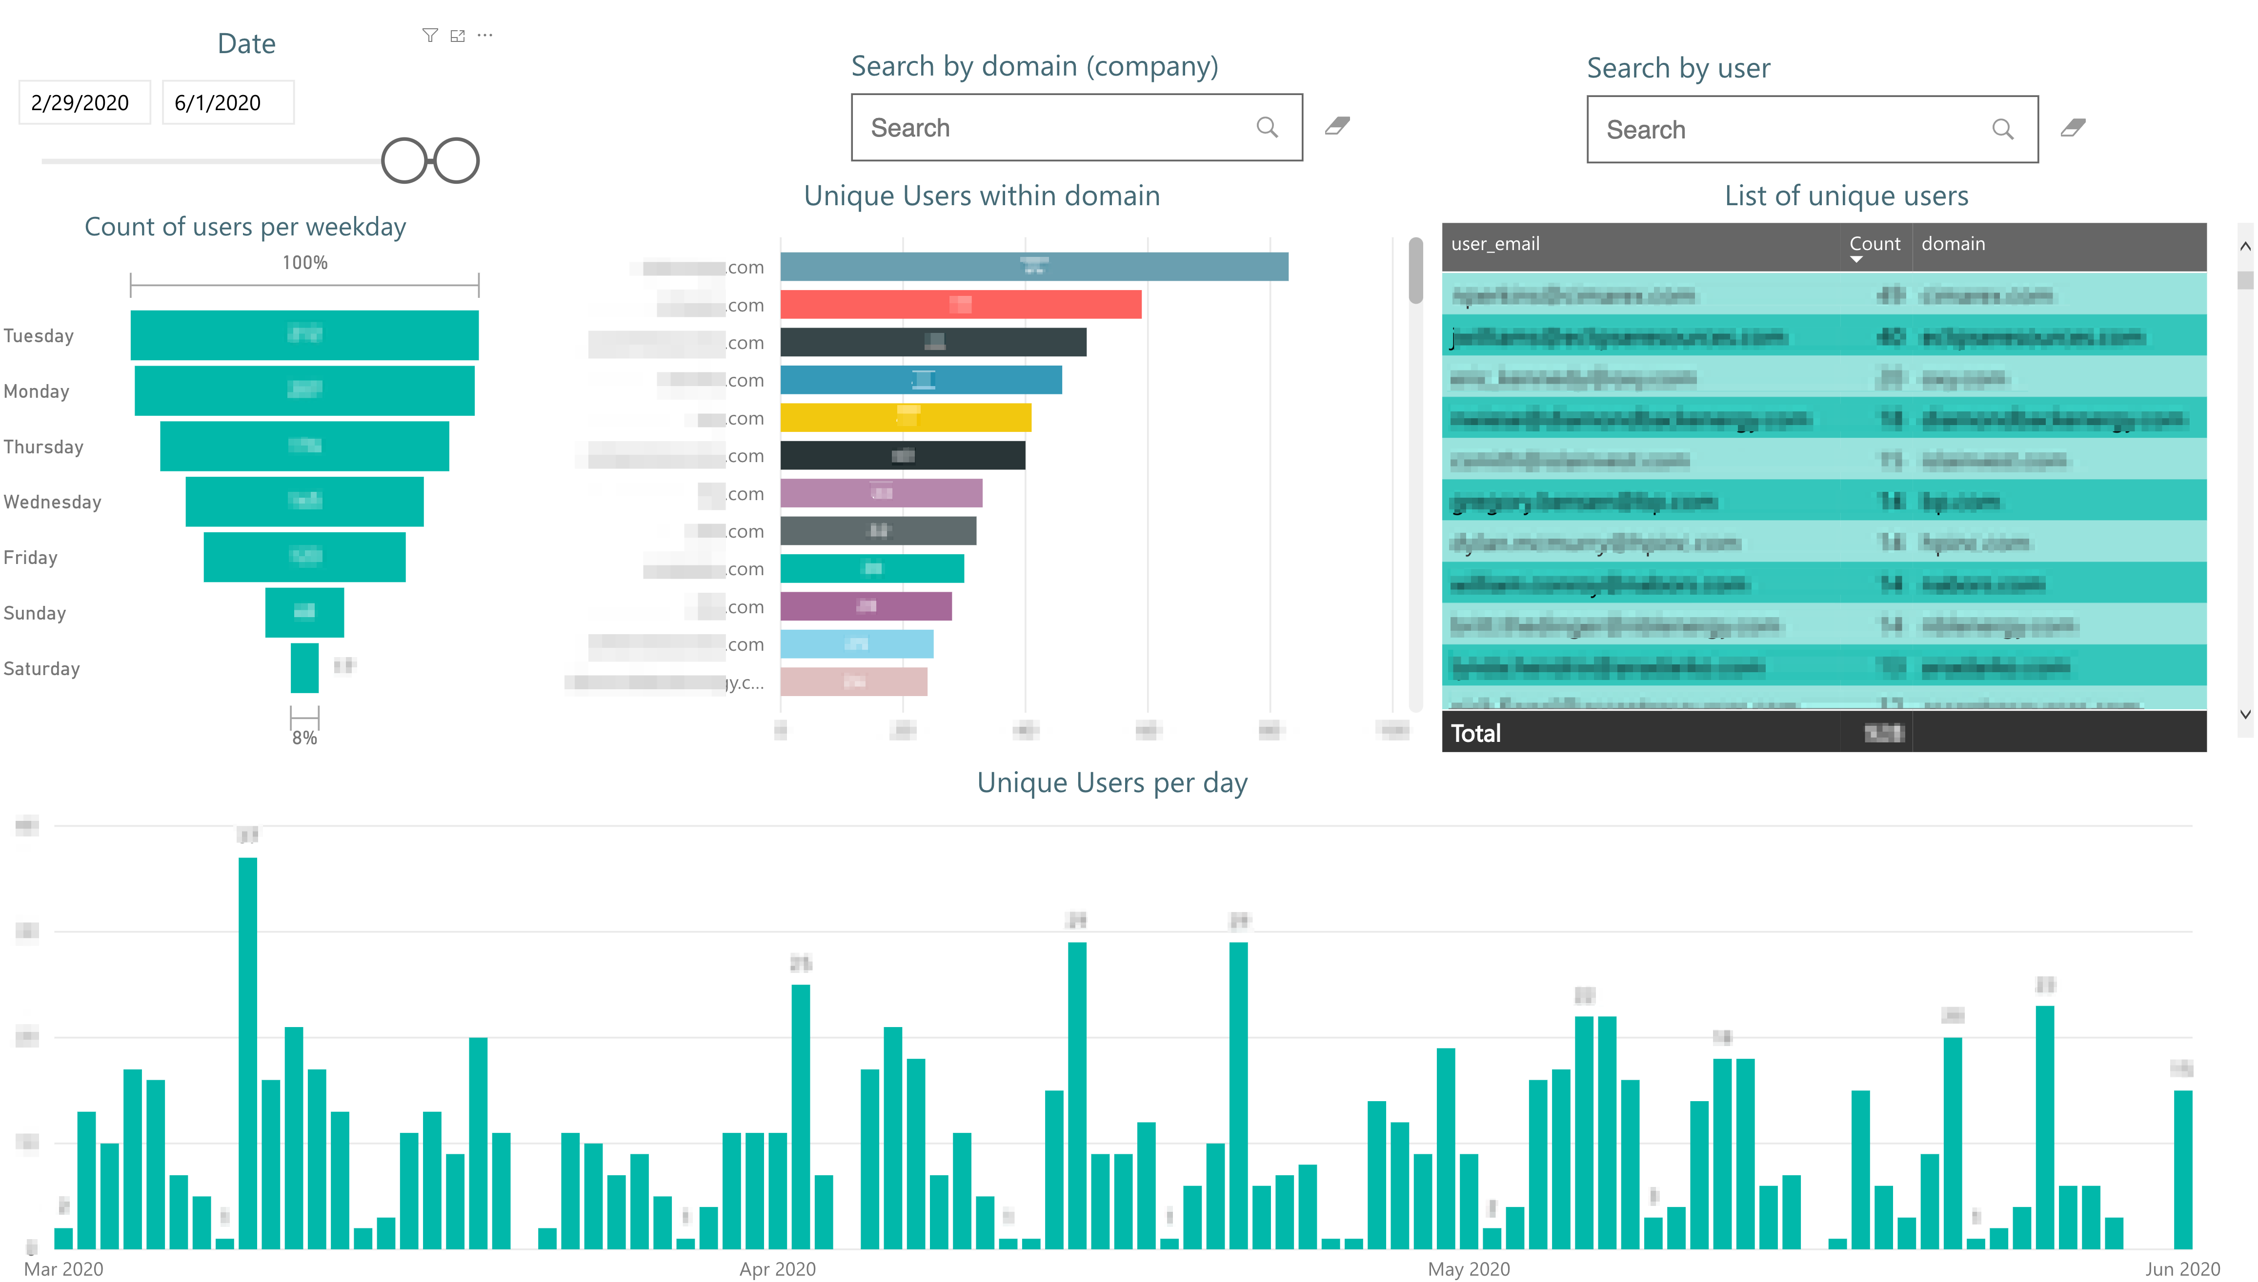
Unique users' analytics

Slide 4
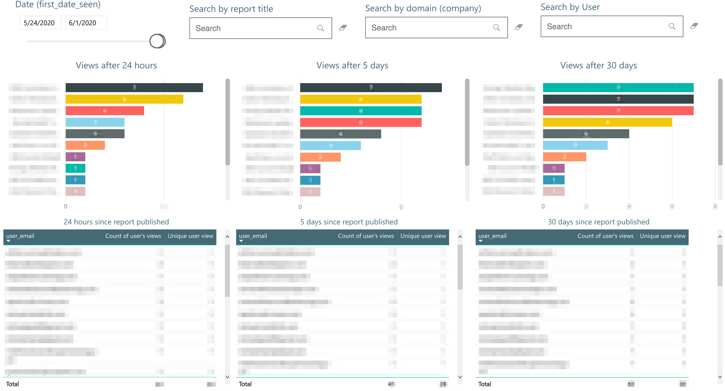
Segmented views

Slide 5
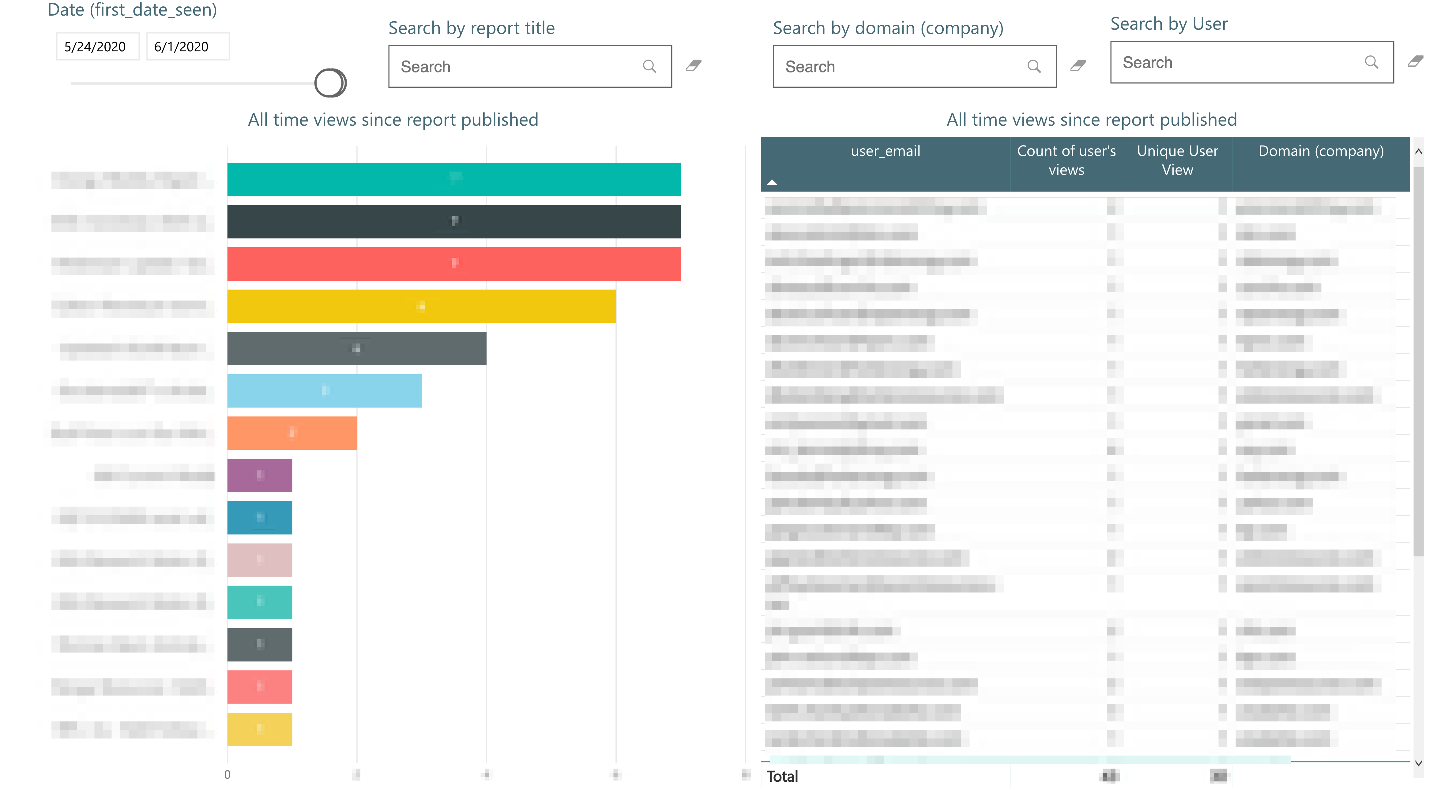
All Time views

