Slide 1

The influence of Temperature and a Lightguide on the Crosstalk Probability of a SiPM
Author: Dominik Zürcher
Supervisor: Dominik Neise

Slide 2
Goals
General Measurment Information
Investigate:
  Temperature dependence of optical crosstalk probability
  Influence of a lightguide on optical crosstalk probability
SiPM: Hamamatsu’s MPPC S10362-33-100C
Measurements in climate chamber (from 5 to 25 C)
Temperature measurement: PT-1000
Bias Voltage supply: Agilent N5770A
Bias Voltage measurement: Solatron Schlumberger 7081 precision voltmeter (+/- 0.0001 V)

Slide 3
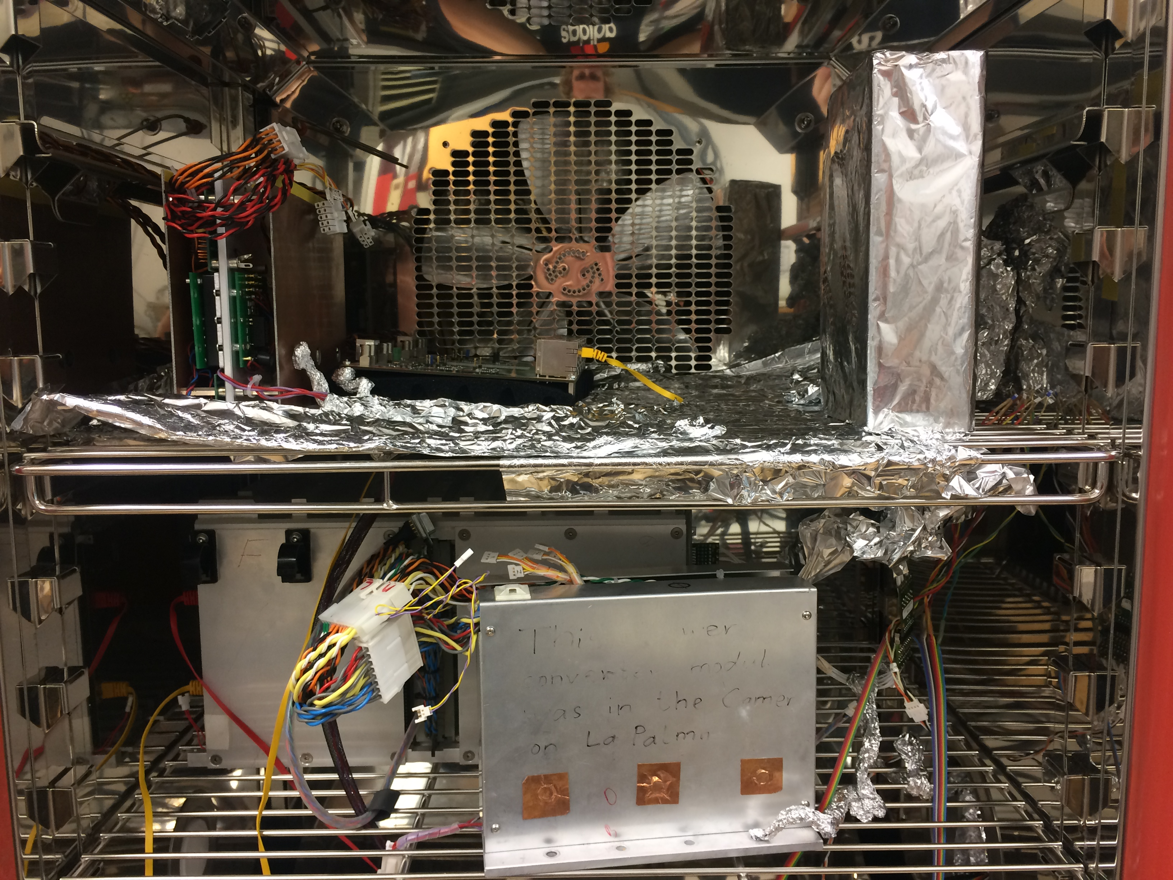

Slide 4
Analysis Procedure
(i) Event selection:
  Convolve raw signal with pulse shaped kernel
  Search for flanks with large derivative (steep) and a minimum amplitude
  Throw away events having other events shortly after them
  Throw away “pile-ups”
  Biggest Problem: Ringing
(ii) Integration:
  Perform baseline fit
  Use nummerical integration
(iii) Produce Fingerplots and readout parameters

Slide 5
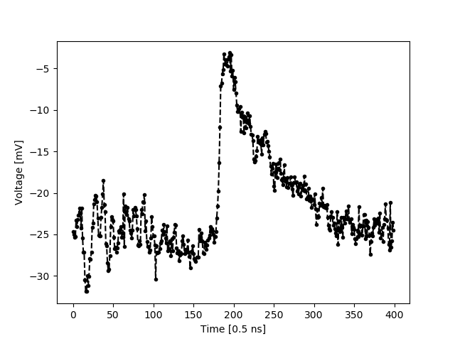

Slide 6
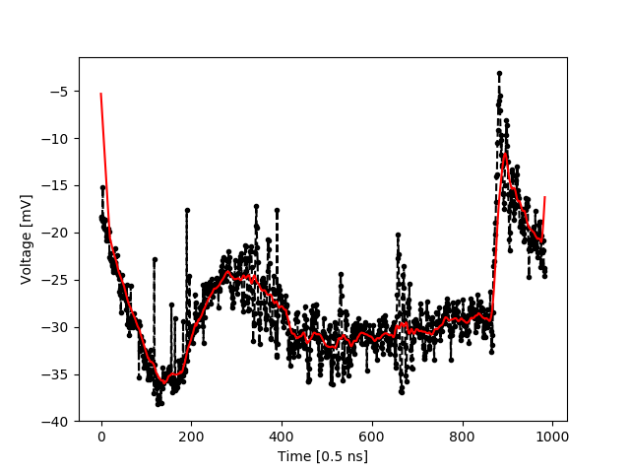

Slide 7
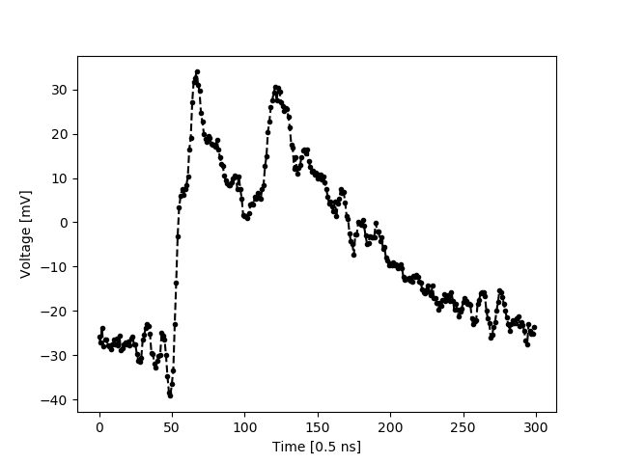
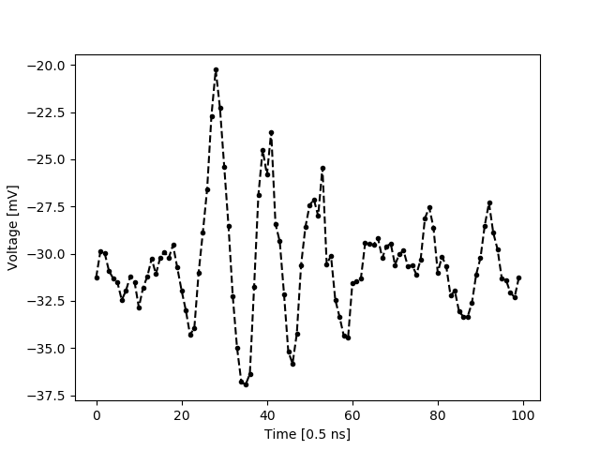
Ringing
Double but not a pile-up

Slide 8
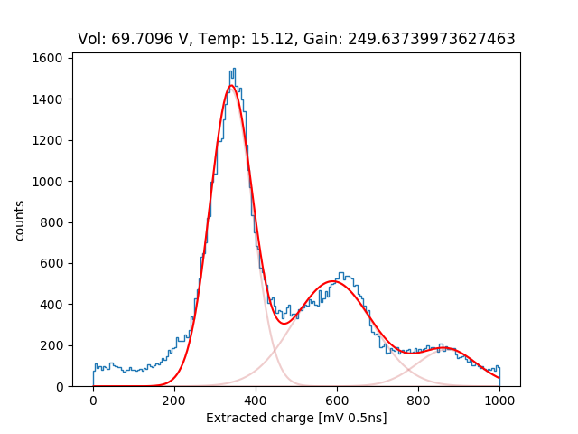
Gain:
Difference of 2nd and 1st peak
Crosstalk Probability:
Area of peak 2+3 / Total area

Slide 9
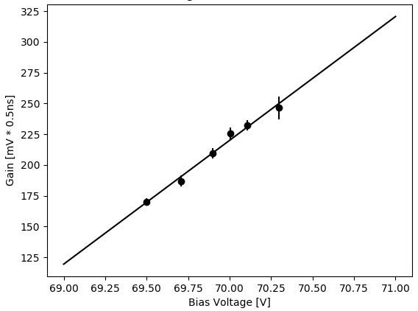
1.) Determination of the Breakdown Voltage
6 Measurements at 25 C
Recorded 10’000 timeslines each
Breakdown voltage:
67.8 +/- 0.117 V
Bias voltage for further measurements:
70.2 V at 25 C
High over voltage due to noise

Slide 10
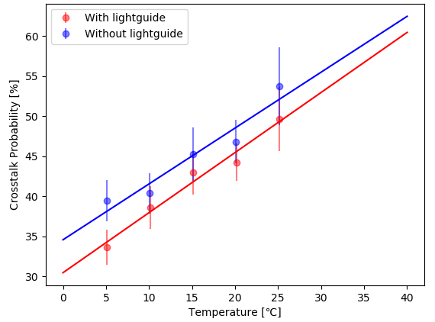
2.) Temperature and lightguide influence
10 Measurements in total
30’000 timelines each
Temperature dependence!
Indications for decrease by lightguide

Slide 11
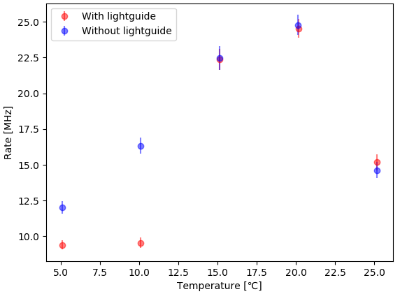
Controls
Selection algorithm fails!

Slide 12
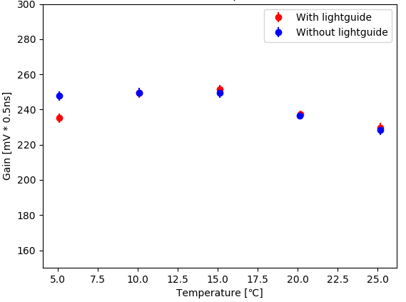
Controls
Gain fluctuations too low to explain temperature dependence!

Slide 13
Conclusions:
Conclusions:
Next steps:
Setup, method and algorithm working basically
Clear temperature dependence
Indications for decrease of crosstalk probability by lightguide
Reduce noise in setup
Understand and improve selection algorithm (simulation)
Theory for influence of the lightguide (maybe also simulation)
Test more SiPMs (inhomogeneities)

