Slide 1
MoodUp - Mental Health Analyzer
BY : Navneeth Suresh
Anirudh Sowrirajan

Slide 2
What does Mental Health Analyzer do ?
Mental Health Analyzer is an application that helps to track user’s mental health and deal with the same. The application provides plausible solutions to the user problem which could include - stress, depression, anxiety, demotivation etc.
Approach :

Slide 3
Tech Stakcs
Frontend : Streamlit , streamlit player , streamlit lottie
Machine Learning Model :

Slide 4
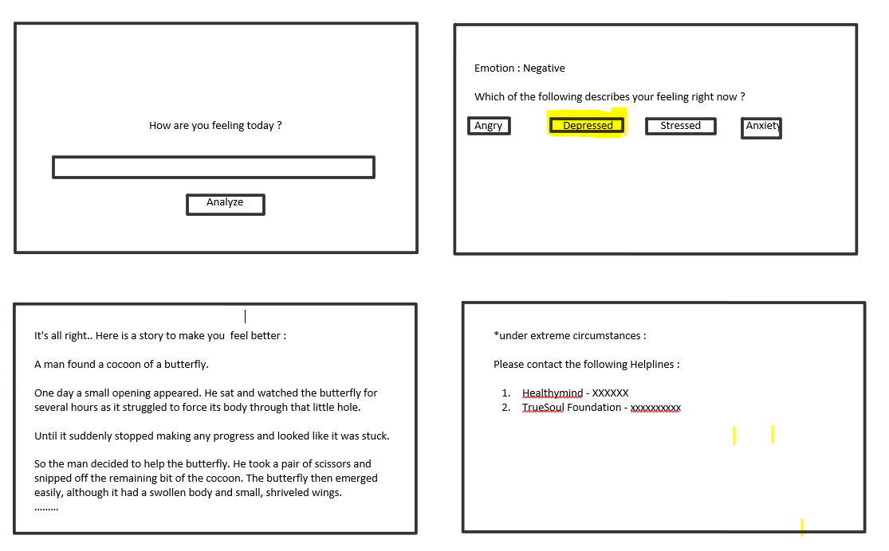
Flow of the process

Slide 5
Scope for improvements
Use of facial detection to determine the mood of user
Ability to asses the user solely based on text
Gamify the process – Eg : ASMR games

