Slide 1

SOAR
security orchestration, automation and response
NETWORK & INFORMATION SECURITY AUTOMATION

Slide 2
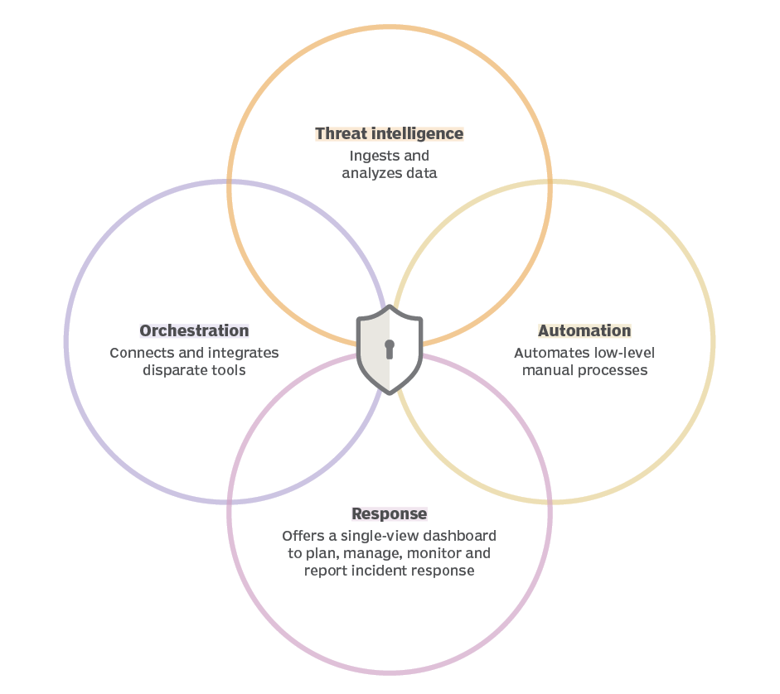
SOAR
Security orchestration, automation and response, or SOAR, is a stack of compatible software programs that enables an organization to collect data about security threats and respond to security events with little or no human assistance.
Detail information
Security orchestration
Security automation
Security response
Threat intelligence

Slide 3
Benefits of SOAR
SOAR system has many advantages.
Faster incident detection and reaction times
Simplified management
Consistency - SOAR never sleeps
Efficiency
Integration - Subsystems integration
Threat Intelligence Utilization - Reduced false positive
Lowered costs
Metrics and Reporting
Reduced Dwell Time

Slide 4
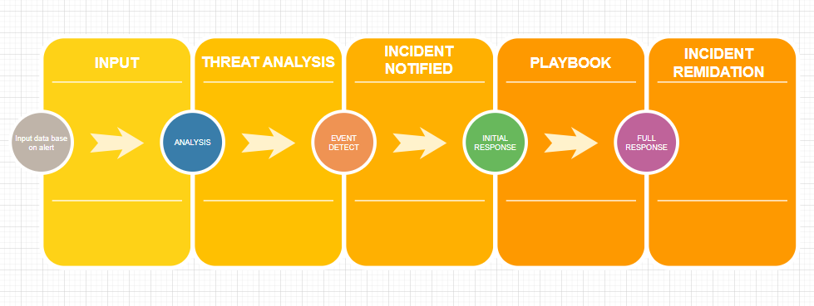
Soar typical incident workflow
Playbooks are your tasks and workflows that function according to rules, events, triggers you set.

Slide 5
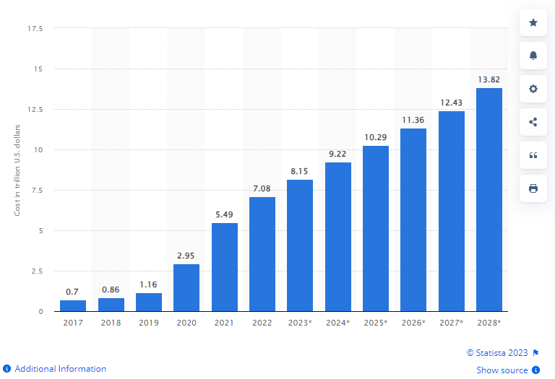
Why we need to SOAR
Why do we need SOAR system?
Between 2023 and 2028, the global estimated cost of cyber crime was forecast to increase by 5.7 trillion U.S. dollars in total. This represents an increase of 69.94 percent. According to the latest estimates, by 2028, the cost of cybercrime worldwide will reach 13.82 trillion U.S. dollars.Aug 9, 2023. A large percentage of this attack is carried out by automating
https://www.statista.com/forecasts/1280009/cost-cybercrime-worldwide#:~:text=Between%202023%20and%202028%2C%20the,reach%2013.82%20trillion%20U.S.%20dollars.

Slide 6
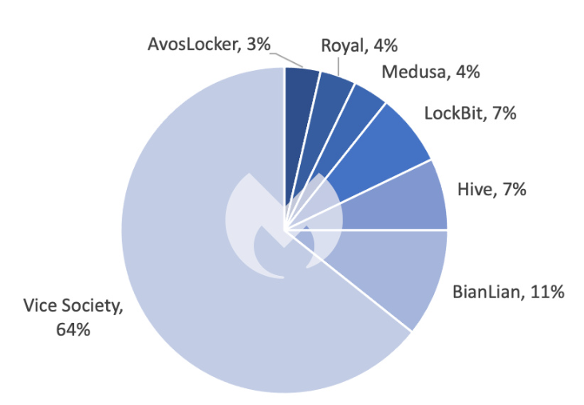
Type of CaaS
Cybercrime-as-a-Service is an umbrella term that includes multiple varieties.
These are the most common types of CaaS:
Ransomware-as-a-Service (RaaS)
DDoS-as-a-Service
Phishing-as-a-Service (PhaaS)
Malware-as-a-Service (MaaS)
REvil
REvil, also known as Sodinokibi, was identified as the ransomware behind one of the largest ransom demands on record: $10 million. It is sold by criminal group PINCHY SPIDER, which sells RaaS under the affiliate model and typically takes 40% of the profits.
https://malwarebytes.com

Slide 7
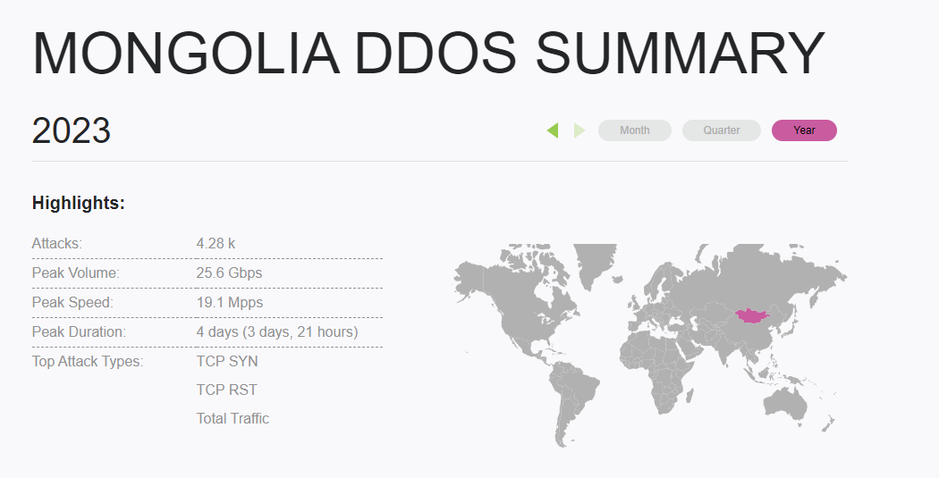
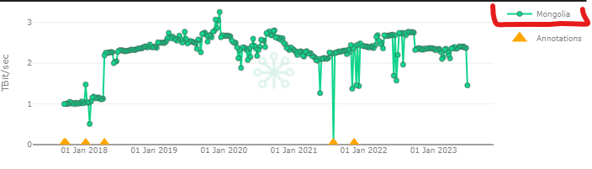
Type of CaaS
Cybercrime-as-a-Service is an umbrella term that includes multiple varieties.
These are the most common types of CaaS:
Ransomware-as-a-Service (RaaS)
DDoS-as-a-Service
Phishing-as-a-Service (PhaaS)
Malware-as-a-Service (MaaS)
https://stats.cybergreen.net/country/mongolia/https://horizon.netscout.com/?atlas=summary&filters=destination.region.MN&y=2023
https://stats.cybergreen.net/country/mongolia/

Slide 8
Implemented reasons
We have a lot of systems we need to monitor, and we don't have the ability to do 24-hour regular monitoring and problem-solving on a case-by-case basis.
For example, the following problems arise:
nighttime cyber-related attack
Some systems are not the responsibility of the Cyber ​​Security team. Therefore, there is a delay in working with the network team.
When the review is done by people, there is the problem of accidental omissions.
So, Let's show a few examples of how we try to solve the problem.

Slide 9
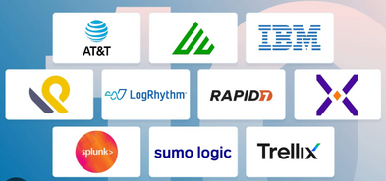
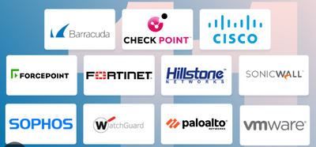
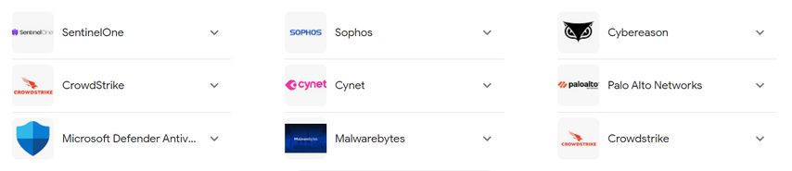
Preventive measures for technology
There are solutions that can mitigate security incidents. But these devices all work individually.
SIEM
Firewall
WAF
Security information and event management, SIEM for short, is a solution that helps organizations detect, analyze, and respond to security threats before they harm business operations.
A firewall is a network security solution that protects your network from unwanted traffic. Firewalls block incoming malware based on a set of pre-programmed rules
Web traffic analysis

Slide 10
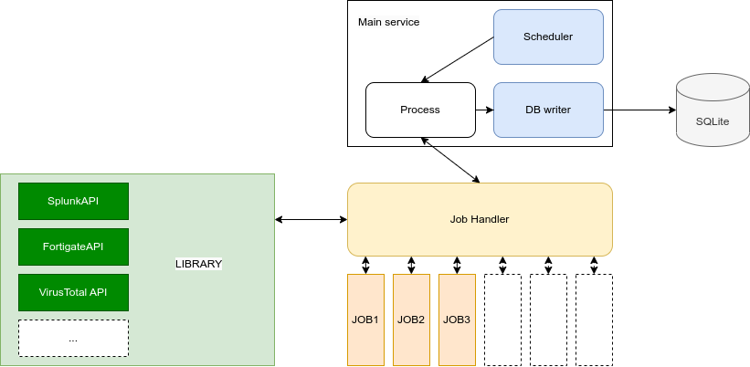
Automation section
The architecture of the code is as follows. Securely run multiple microservices and manage network device APIs in a unified manner.

Slide 11
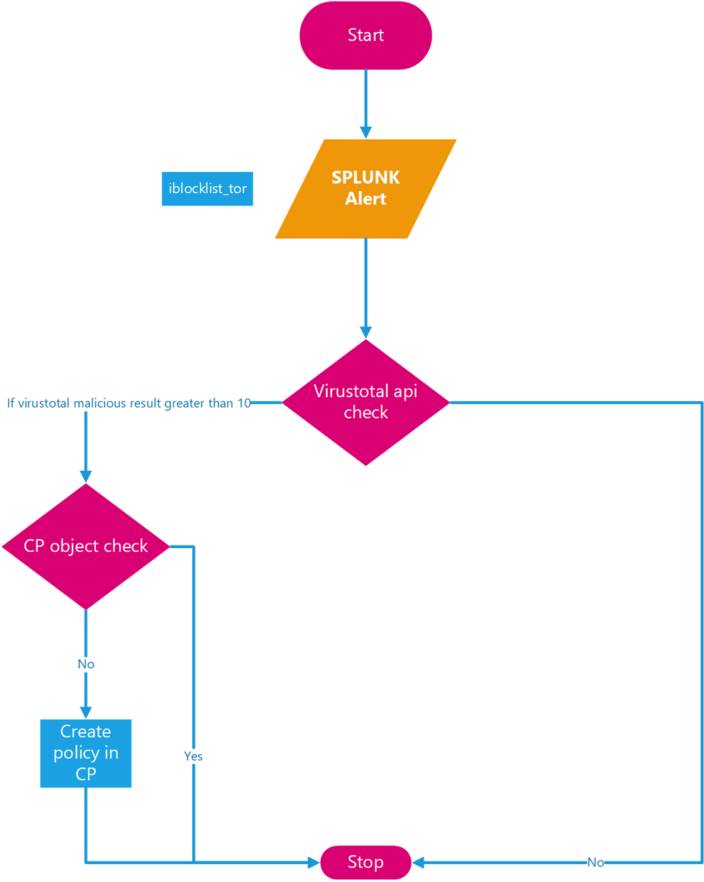
Example
We have the following example of solutions:
Threat intelligence
SIEM
Firewall
Virustotal
SOC engineers prepare use cases as alerts, based on suspicious things. This is usually done in a SIEM, which is a LOG collection monitoring tool.

Slide 12
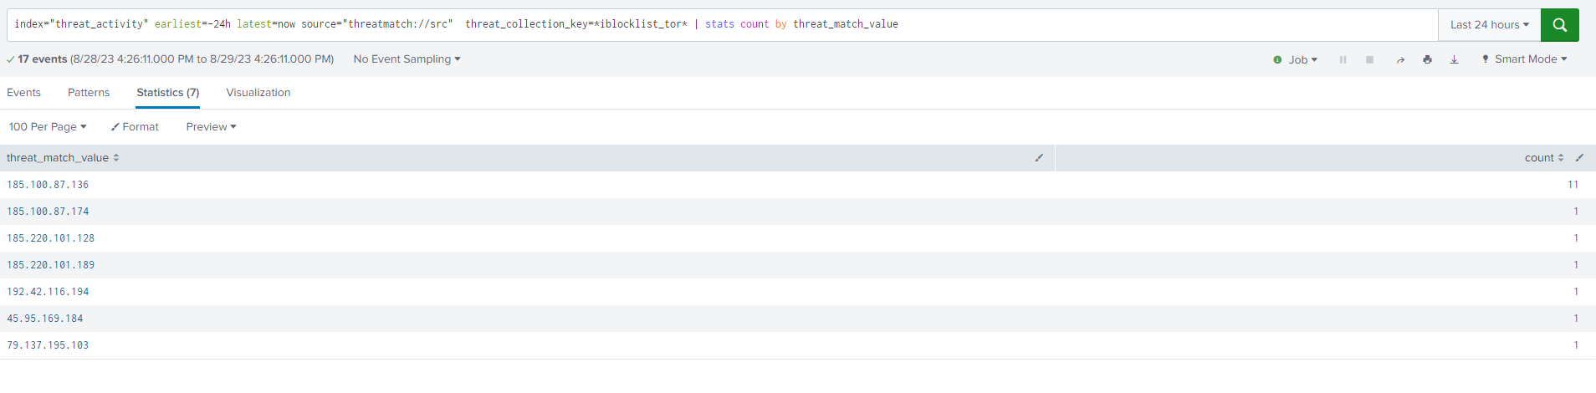
Example 1: threat incident response
We consider that event to be an attack based on our threat intel and use case. That means the address list is suspicious. We used the API to get the information about the event that was considered suspicious.

Slide 13
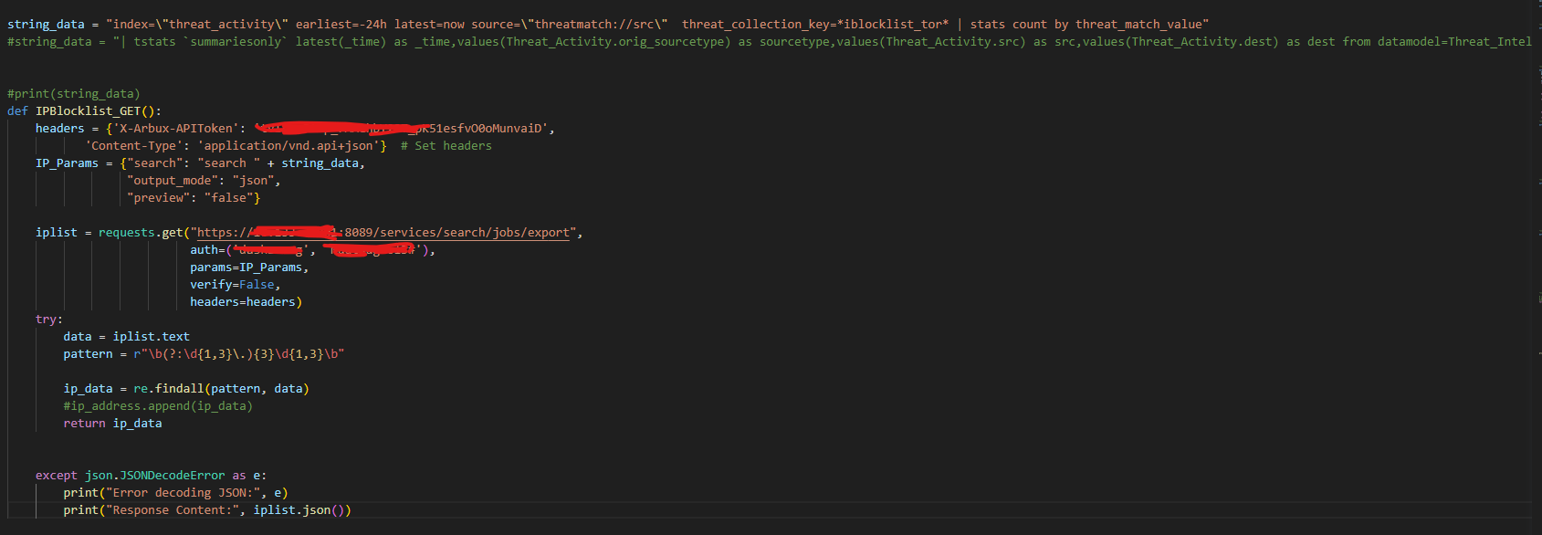
Example 1
We consider that event to be an attack based on our threat intel and use case. That means the address list is suspicious. We used the API to get the information about the event that was considered suspicious.

Slide 14
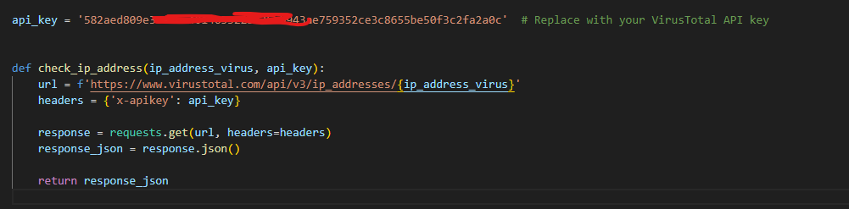
Example 1
We then used 3rt party threat intel to confirm the attack. Virustotal was used for this.

Slide 15
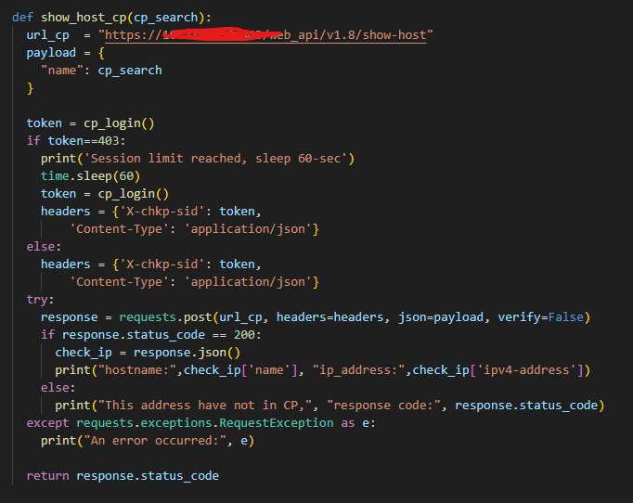
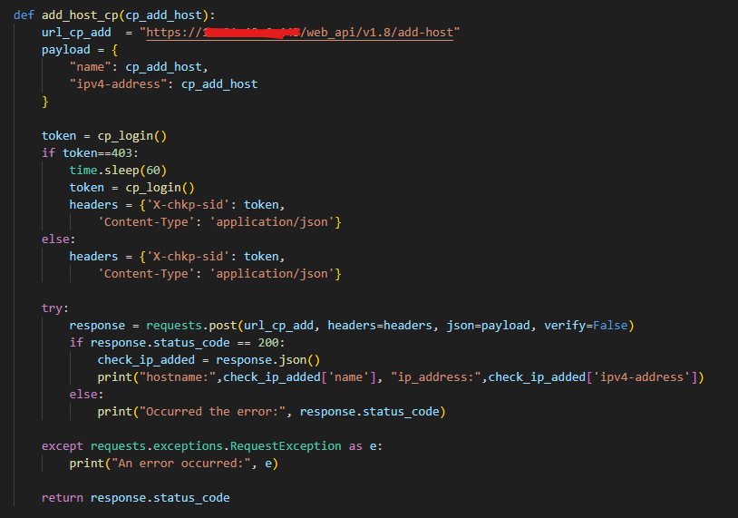
Example 1
After confirming the attack, we need to block it in our system. For this we used firewall’s API.

Slide 16
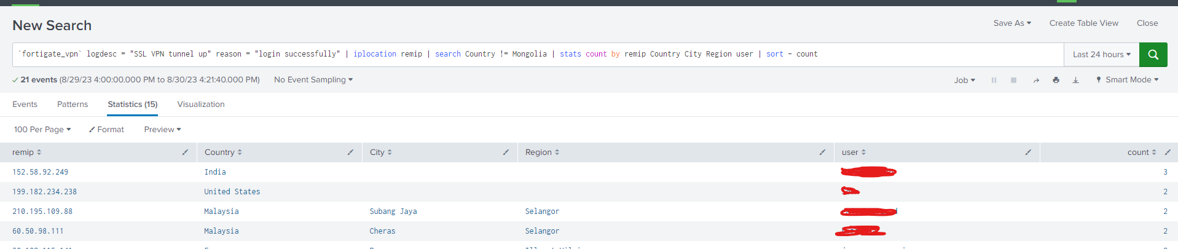
Example 2: VPN restriction
There are VPN users who can access the internal network. We can detect this when an attempt is made to access from a non-approved country.

Slide 17
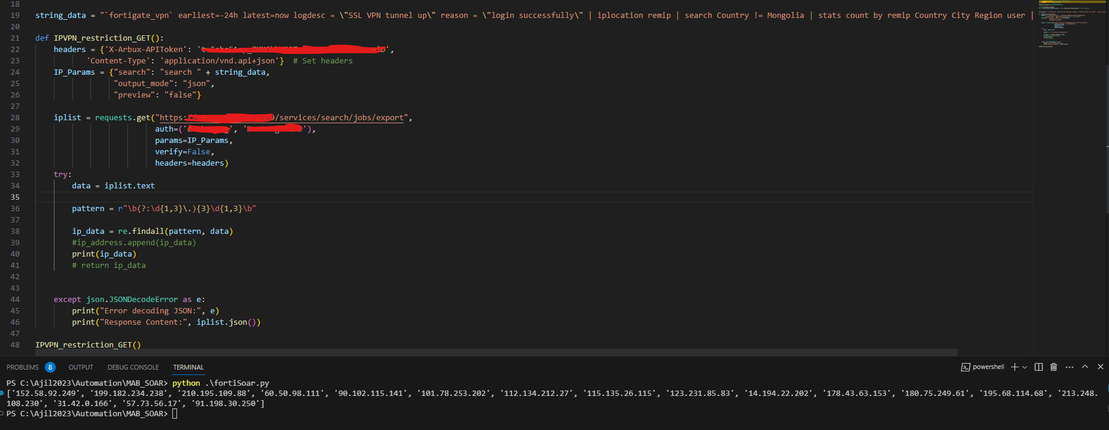
Example 2
We can get conflicting address lists with schedule.

Slide 18
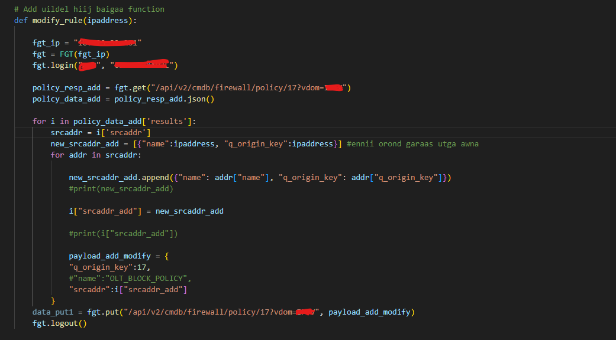
Example 2
We automatically block that source address to VPN firewall fortigate and set it to check once every 24 hours.

Slide 19
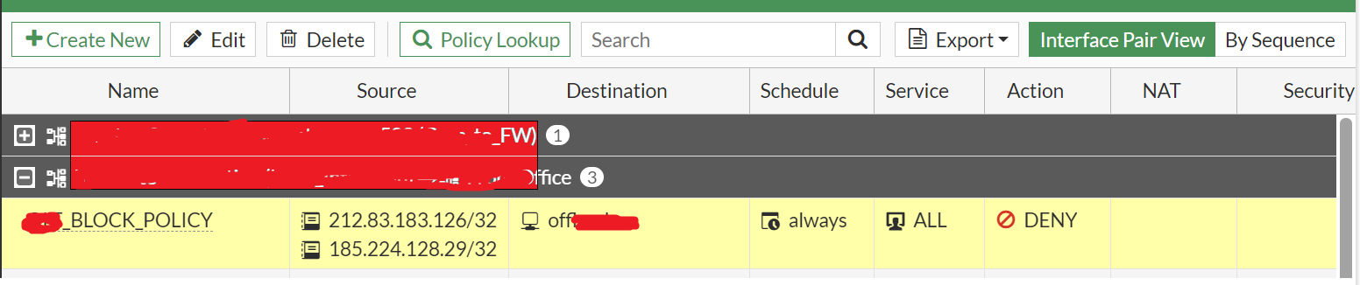
Example 2
As a result, we are able to immediately resolve issues such as suspicious activity during non-working hours.

Slide 20
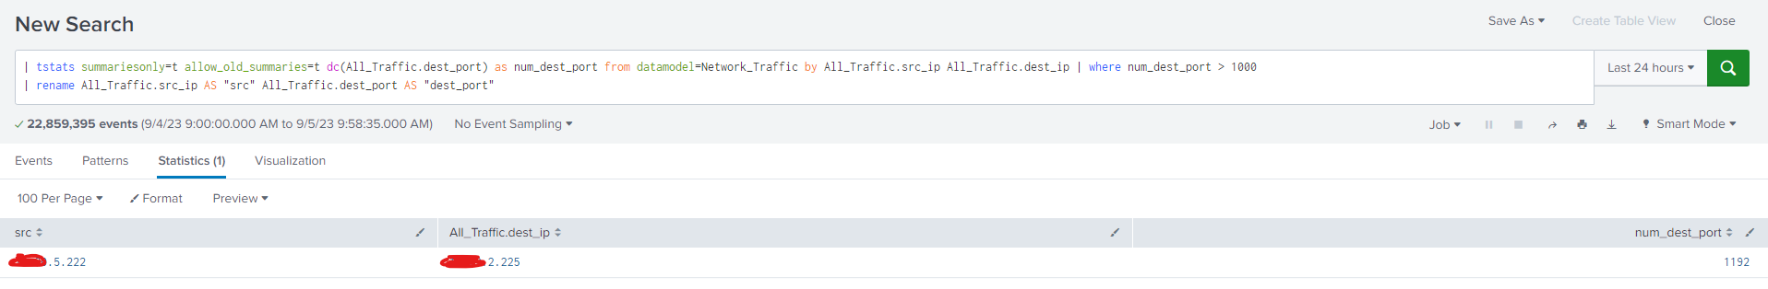
Example 3: Port scan detection and response
When trying to access ports greater than 1000, it is considered a port scan.

Slide 21
Example 3
We double-check it with threat intel and then block it.

Slide 22
Attention
It must be confirmed because it will automatically block.
Need regular monitoring
Avoid getting too big structure

