Slide 1
PENN RESIDENTIAL SERVICES
Shift
One app for desk staffing across all 13 houses.
ANDREW CHELIMO | HARNWELL COLLEGE HOUSE
1

Slide 2
WHAT IT IS
One live schedule that fills its own empty desks
Every house shares it. It updates the moment anything changes, it reminds people so shifts are not forgotten, and it finds coverage before a desk goes empty.
No more inbox. No more spreadsheet. No more group chat lottery.
2

Slide 3
WHY I BUILT IT
I work these desks
I have dropped shifts, picked them up, floated to other houses, and watched the same handful of failures repeat every single week.
This is not a product looking for a problem. It is our problem, solved.
3

Slide 4
THE PROBLEM
Seven things that go wrong today
Every one of these still runs on an inbox, a group chat, or someone's memory.
01
02
03
04
Drops turn into an email negotiation
Pickups are a group chat lottery
Picked up, then forgotten
Floating runs on email and trust
05
06
07
Paged for what experience already answers
The pages that matter arrive incomplete
Schedules are built by hand
Seven problems. One cause. Stop me on any of them.
4

Slide 5
THE CAUSE
There is no system
There are people, inboxes, a group chat, and memory. Everything that follows is one fix applied seven times: put the truth in one place, and make it reach the person who needs it.
5

Slide 6
TODAY'S TOOLKIT
Four tools, none of them talking
None of them is live. None of them reminds anyone. The manager is the glue holding it together.
Email
Excel
GroupMe
Phone
Drops, swaps, float requests, hours paperwork
Building and holding the schedule
Cross-house pickups, last-minute cover
Confirming who is actually coming
Easy to miss. Never a live picture. Everyone is cc'd, nobody is responsible.
Stale the moment anything changes. Reminds no one of anything.
Buried in replies. First come first served. No record.
Only works if you have the number and they answer.
6

Slide 7
PROBLEM 01
Drops turn into an email negotiation
A worker cannot make a shift. What happens next depends on who reads the email first.
PROBLEM 1 OF 7
7

Slide 8
DROPPING A SHIFT
Where the authority runs out
THE DESK STILL HAS SOMEONE
THE DESK WOULD BE EMPTY
The student manager can approve it and edit the sheet. This case is fine.
The student manager can see it and can do nothing about it. It comes to you. You fill the desk yourself, or you pay for outside coverage.
The person closest to the problem is the one who cannot solve it.
PROBLEM 1 OF 7
8

Slide 9
DROPPING A SHIFT, AFTER HOURS
One drop, four communications
Three of them exist only because the first one might not be read in time.
01
Email the student manager and the RSM.
02
Call the desk anyway, because email is not fast enough.
03
If you are not at Harnwell, call Harnwell too.
04
Harnwell pages the manager on duty.
Every step is a person compensating for a system that cannot tell anyone anything.
PROBLEM 1 OF 7
9

Slide 10
WHAT HAPPENS NOW
Drop it in the app. That is the whole process.
✓
The seat reopens instantly, visible to everyone who could fill it.
✓
Swaps and handoffs are agreed between the two workers, with no manager in the middle.
✓
The system checks whether the desk would actually be empty.
✓
It only goes looking for coverage when it truly would be.
THE QUIET PART
A Harnwell desk dropping from two workers to one is still covered, so nobody is paged. The system stays silent until a desk would have nobody on it.
PROBLEM 1 OF 7
10

Slide 11
PROBLEM 02
Pickups are a group chat lottery
This is the one where the current process actively teaches people to stop trying.
PROBLEM 2 OF 7
11

Slide 12
HOW A SHIFT GETS OFFERED TODAY
The entire mechanism is one message
Summer IC Workers group chat · 11:25 AM
Hi everyone! The following shifts are available at Rodin this week and for the week of 7/27 to 8/2. If you're interested please send me your name, phone number, email, and the IC you work at. Please ensure you specify the dates and times of the shift you pick up and make sure you are not exceeding 40 hours. Wednesday 7/22 5pm to 8pm Sunday 7/26 5:30am to 8am (NO COVERAGE) 8am to 12pm Monday 7/27 4pm to 8pm Tuesday 7/28 8am to 12pm (NO COVERAGE) 12pm to 4pm Thursday 7/30 4pm to 8pm (NO COVERAGE) Friday 7/31 4pm to 8pm Saturday 8/1 5:30am to 8am 8am to 12pm 12pm to 4pm 8pm to 12am
To claim one three-hour block, you file a small application.
PROBLEM 2 OF 7
12

Slide 13
WHAT HAPPENS UNDERNEATH IT
The claims land in the replies, not in the list
Five people, five different slots, each acknowledged with a thumbs up. Nothing marks the original message as out of date.
Grace
I'll take Friday 7/31 4pm to 8pm
👍
Jamia
i can pick up saturday 12-4pm
👍
Grace
Sunday 8/2 8pm-12am too
👍
Sunny
I can do 8/1 8am-12pm
👍
Joy
Ik can do Monday 4-8
👍
A sixth person cannot tell what is left without reading every reply.
PROBLEM 2 OF 7
13

Slide 14
PICKING UP A SHIFT
I claimed a shift. It was already gone.
Direct message · from a Harrison student manager · 3:32 PM
Hi Andrew, this is Adailia from Harrison! I made an error on my end and listed Mon 5-9pm as an available shift, it was taken by someone else prior. My apologies for that, but please let me know if you'd like any of the remaining shifts in the main gc!
The shifts are not unfillable. People have learned not to bother.
PROBLEM 2 OF 7
14

Slide 15
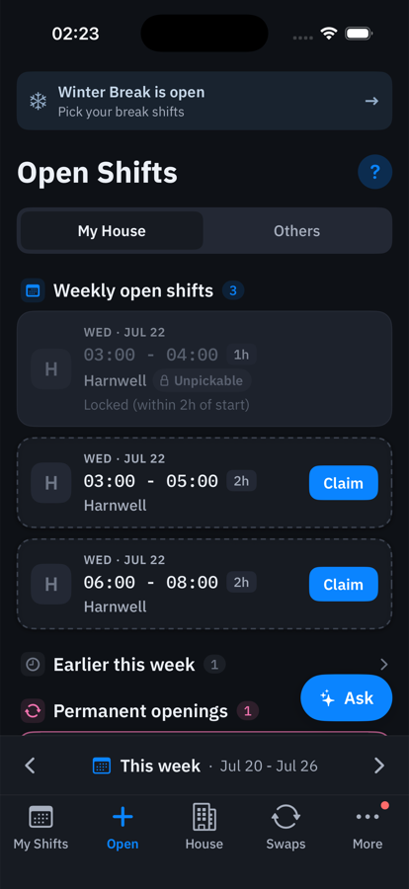
WHAT HAPPENS NOW
One feed. Claimed means gone.
✓
Your house and every other house, in one list.
✓
Claim with one tap. It disappears for everyone.
✓
Take part of a shift, not just all of it.
✓
No name, phone, or email. It knows who you are.
PROBLEM 2 OF 7
15

Slide 16
PROBLEM 03
Picked up, then forgotten
The most common way a desk ends up empty is not malice. It is memory.
PROBLEM 3 OF 7
16

Slide 17
WHY IT HAPPENS
The shift lives nowhere
01
You agree to a shift in a group chat or an email.
02
Now you have to remember to add it to your own calendar.
↓
It is not part of your routine, so often it does not happen.
03
The shift exists in a message and in your intention. Nowhere else.
Nobody finds out until the desk is empty.
PROBLEM 3 OF 7
17

Slide 18
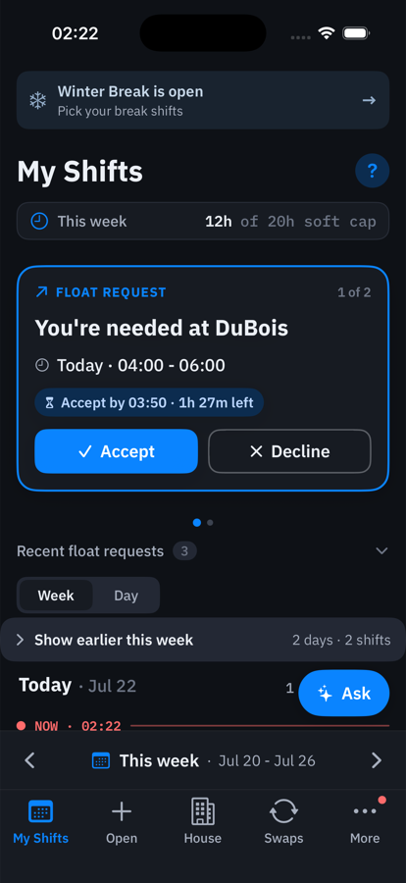
WHAT HAPPENS NOW
It is already on your schedule
✓
Claiming it put it there. Nothing to add.
✓
A home screen widget, so it is in front of you.
✓
Notifications about your own shifts cannot be silenced.
✓
Change anything and it updates everywhere at once.
PROBLEM 3 OF 7
18

Slide 19
PROBLEM 04 · THE BIG ONE
Floating runs on email and trust
Sending a worker from one house to cover another. It matters most in fall and spring, and it fails in five different ways.
PROBLEM 4 OF 7
19

Slide 20
FLOATING TODAY
Three people. Two calls. One hour of cover.
Email thread · Sunday · 12:44 PM to 12:56 PM
Andrew, 12:44 PM Rodin just called requesting a floater from 1:00 PM to 2:00 PM. I initially told them to call the Quad first, but they currently have Allied coverage and are unable to check. She later called back, and I asked her to call again 20 minutes before 1:00 PM. However, she mentioned she will be unavailable from 11:30 AM onward. Since we have two workers scheduled at that time, I wanted to pass this along to see whether Jing can float to the Rodin desk for that hour. Abraham, 12:56 PM Thanks for the heads up. Jing can float to Rodin from 1:00 to 2:00 PM. Also, I did call her and she mentioned you texted her, which is okay, but for future reference please use the desk phone to call the scheduled worker directly. Calls are preferred since they get an immediate yes or no, whereas a text might be seen late or ignored.
PROBLEM 4 OF 7
20

Slide 21
READ THAT LAST LINE AGAIN
We already know the channel is unreliable
A text might be seen late or ignored, especially for time sensitive coverage like this.
The correct instinct, written down by a manager. The problem is that a phone call is the only tool available that gives a yes or no.
The app makes the answer part of the request, so nobody has to chase it.
PROBLEM 4 OF 7
21

Slide 22
FLOATING
Five ways it fails
1
They never saw the email. So they never knew they were meant to float at all.
2
They saw it, agreed, and forgot. They go to their home desk on autopilot. The desk they were covering sits empty.
3
They never replied. Nobody knows whether anyone is coming, so the reply gets assumed.
4
Nobody can reach them en route. The desk waits five minutes, panics, and pages for paid coverage.
5
The rota can be dodged. A house says it has no floater. There is no way to check, so the burden lands on Harnwell.
PROBLEM 4 OF 7
22

Slide 23
FAILURE 2, THE WORST VERSION
The partial float
SCHEDULED
Harnwell 12:00 to 18:00
FLOATED
DuBois 12:00 to 16:00
Harnwell 16:00 to 18:00
You are working either way, so nothing feels wrong. You show up at Harnwell. Two desks are now wrong at once: the one you left uncovered, and the one you are standing at.
PROBLEM 4 OF 7
23

Slide 24
FAILURE 3, WITH A REAL NUMBER
Nobody knows if the floater is coming
5h45m
3:20 PM
The float request goes out by email.
…
No reply. No status anywhere. Nobody can tell whether the desk is covered.
TO CONFIRM ONE HOUR OF COVER
9:05 PM
The worker replies to acknowledge.
Real dates, one of my own floats to Mayer Hall.
PROBLEM 4 OF 7
24

Slide 25
WHAT HAPPENS NOW
The float finds them, and answers back
✓
Accept or decline with one tap.
✓
A visible deadline, counting down.
✓
Reminders at 6h, 2h, 1h, 30m, and 5m.
✓
You see who has answered, at a glance.
Answered in seconds, not five hours and forty five minutes.
PROBLEM 4 OF 7
25

Slide 26
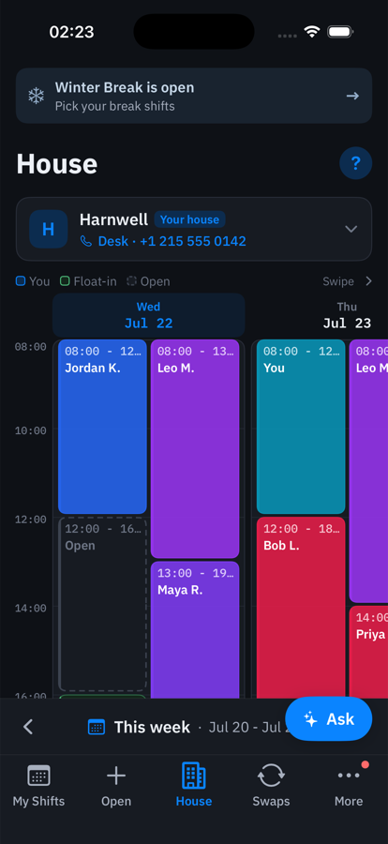
WHAT HAPPENS NOW
And the desk can reach them
✓
One screen showing who is on every desk, right now.
✓
Tap anyone to see their details and call them.
✓
Cross-house cover is colour coded and labelled.
✓
That kills the panic page while a floater is two minutes away.
PROBLEM 4 OF 7
26

Slide 27
FAILURE 5
The rota is enforced, not trusted
TODAY
WITH THE APP
A house says it has no floater available. There is no way to verify it, so the burden quietly moves to whoever will say yes.
The system picks the floater from the real staffing picture. A desk can never be left below one worker, and Harnwell is never a destination.
You stop being the person who has to push back.
PROBLEM 4 OF 7
27

Slide 28
PROBLEM 05
Paged for what experience already answers
The manager on duty is the first stop for questions that should never have reached them.
PROBLEM 5 OF 7
28

Slide 29
THE PATTERN
The answer exists. It is just not findable in the moment.
Does this group get access to this room?
My PAN card is not working and I have tried the obvious things.
A contractor is asking to be let in. Do I?
The alarm is going off in one room. Is that a building thing?
TWO HIDDEN COSTS
New workers take a long time to get up to speed, and hard-won knowledge leaves when people graduate. The binder exists. Long documents do not get read at the moment of need.
PROBLEM 5 OF 7
29

Slide 30
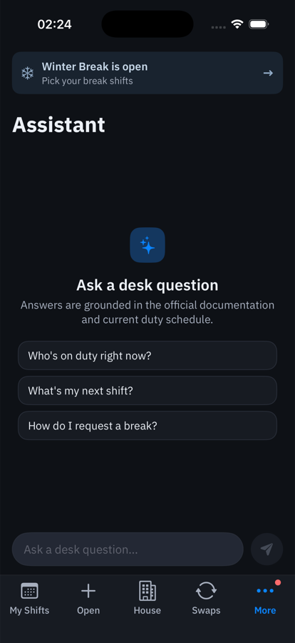
WHAT HAPPENS NOW
Ask first. Page only if you still need to.
✓
Grounded strictly in the official documentation.
✓
It cites the document it answered from.
✓
It knows who is actually on duty right now.
✓
Scoped by role and house, so answers fit the asker.
Built and working. Whether it reduces pages is exactly what a pilot would measure.
PROBLEM 5 OF 7
30

Slide 31
PROBLEM 06
The pages that matter arrive incomplete
When a page is genuinely warranted, it often lands without the one fact that decides the response.
PROBLEM 6 OF 7
31

Slide 32
THE MISSING FACTS
Every call-back costs the same time twice
WHAT ARRIVES
WHAT IS NEEDED TO ACT
"There is a water leak."
Which building and room. One room or building wide. What was already tried. When the desk shift ends. Whether anyone is on the way.
So the manager on duty calls back, and resolution slows down.
PROBLEM 6 OF 7
32

Slide 33
WHAT HAPPENS NOW
Paging becomes a guided form, not a blank box
✓
It asks for the specific facts that this kind of situation needs.
✓
It categorises and routes to the right tier, not always straight to the top.
✓
The person still reviews and edits everything before it sends.
✓
Often the flow surfaces the answer before a page is needed at all.
WHERE THIS CAME FROM
This one is not my observation. It came from the Harnwell housing manager, who named incomplete pages as the thing that slows her down most.
PROBLEM 6 OF 7
33

Slide 34
PROBLEM 07
Schedules are built by hand
Every build cycle, a student manager reconciles everyone's availability across a pile of spreadsheets.
PROBLEM 7 OF 7
34

Slide 35
THE BUILD WEEK TODAY
Hours of manual reconciliation
01
Collect everyone's preferences and target hours.
02
Open several spreadsheets side by side.
03
Reconcile by hand against coverage, hours, and who cannot work when.
↓
The result is only as good as one person's patience at 1am.
And if someone transfers or drops out, much of it is done again.
PROBLEM 7 OF 7
35

Slide 36
WHAT HAPPENS NOW
It drafts the schedule. You still decide.
✓
Generates a full draft for the house from everyone's submitted preferences.
✓
The student manager reviews it and edits anything they like.
✓
It is a first draft that removes the tedious pass, not an autopilot.
✓
Coverage always wins over preference. It will not leave a fillable seat empty to make someone happier.
THE GUARANTEE THAT MATTERS
A block someone marked "cannot work" is not a preference the system weighs. It is a hard rule. A draft that assigns anyone to a blocked slot is rejected as invalid before it is ever shown.
PROBLEM 7 OF 7
36

Slide 37
HOW WE WOULD MEASURE IT
Judge it on what actually matters
Comparing it to the schedule we happened to build is a weak test. A different schedule can be a better one.
MEASURE | BUILT BY HAND | DRAFTED | GOOD IS
Workers who hit their target hours | to fill | to fill | Higher
"Cannot work" violations | to fill | 0 by design | Must be zero
Share of shifts that were preferred | to fill | to fill | Higher
Fairness spread, hours against target | to fill | to fill | Lower
Coverage gaps left unfilled | to fill | to fill | Lower
Numbers go in as soon as I have the summer records. I would rather show you the real result, including where it loses, than a number you cannot check.
PROBLEM 7 OF 7
37

Slide 38
WHERE THIS ACTUALLY IS
None of this is a mockup
✓
One live schedule shared by all 13 houses
✓
Drops, claims, and partial claims in app
✓
Swaps and one-way handoffs, agreed peer to peer
✓
Automatic float assignment with tap to acknowledge
✓
Escalating reminders at 6h, 2h, 1h, 30m, 5m
✓
Automatic coverage search, paid cover as last resort
✓
Home screen widgets for your next shift
✓
Push notifications you cannot miss
✓
Tap any worker to see details and call them
✓
Hours split into home, floated, and cross-house
✓
A grounded assistant that cites its sources
✓
iPhone, Android, and a web view for managers
38

Slide 39
WHAT I AM ASKING FOR
Let me prove it in one house
Harnwell is the natural place to start. It carries the most floating complexity, and I work there.
01
02
03
A defined trial window
Your blessing
A point of contact
Run real staffing through the app for a few weeks, alongside the current process.
Nothing changes for anyone who does not want it to. If we stop, nothing breaks.
For real worker and schedule data, so the pilot runs on the truth.
39

Slide 40
THE TAKEAWAY
Today, the desks stay covered because of your inbox and everyone's memory.
This makes the schedule live, reminds people so shifts are not forgotten, lets workers reach each other, and fills empty desks automatically and fairly.
40

