Slide 1

Drive Share
Aldo Medina
Rania Dayekh

Slide 2
Overview
Peer to peer car rental platform
Users can list or rent cars
Supports booking, messaging, and payments

Slide 3
Design Pattern Used
Builder
Chain of Responsibility
Mediator
Observer
Proxy
Singleton

Slide 4
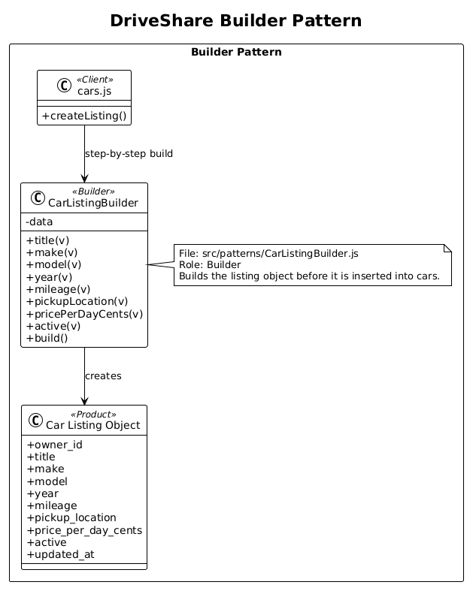
Builder Pattern
Builds car listings step by step.
Avoids complex constructors .
Improves flexibility.

Slide 5
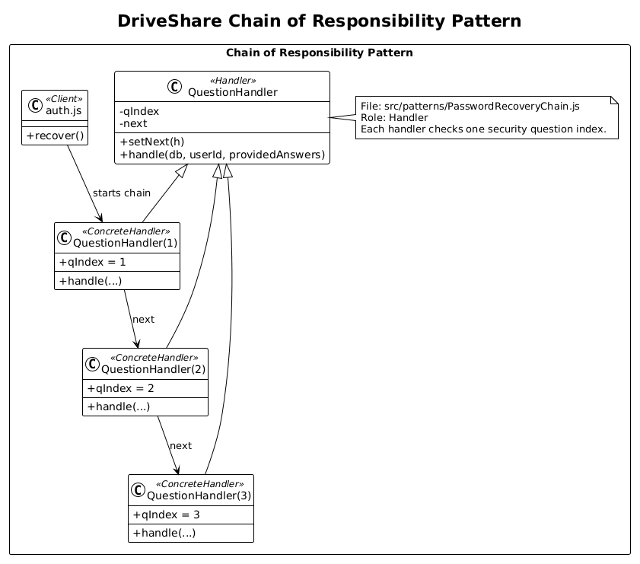
Chain of Responsibility
Used for password recovery.
Each handler checks on question.
Easy to extend validation.

Slide 6
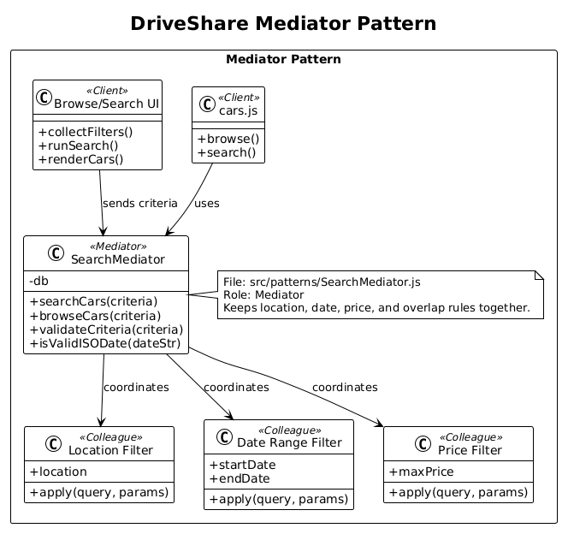
Mediator Pattern
Coordinates search filters.
Reduces component dependency.
Centralized logic.

Slide 7
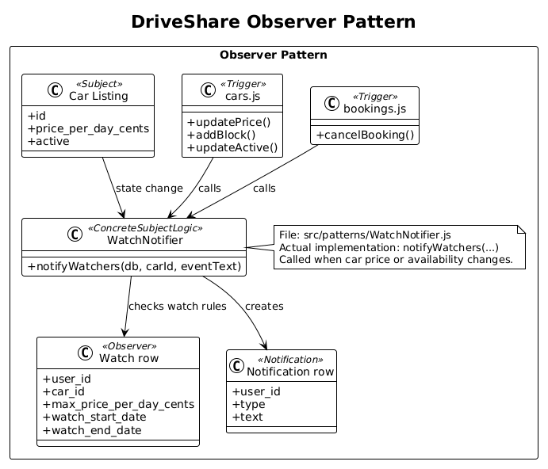
Observer Pattern
Used for notifications.
Users get updates automatically.
Supports watch feature.

Slide 8
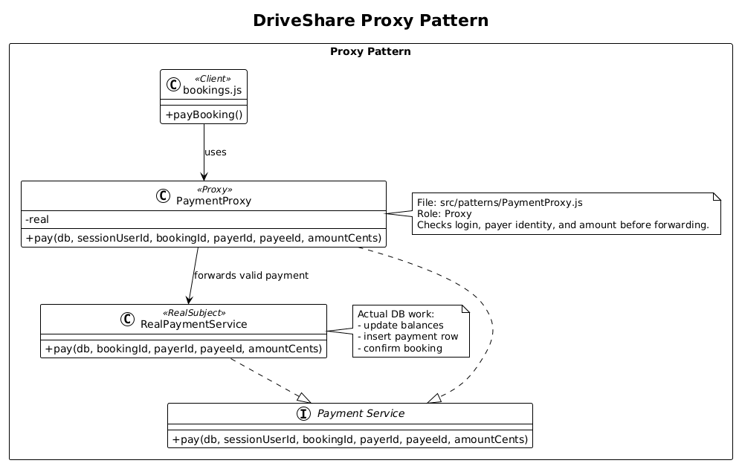
Proxy Pattern
Validates payment requests.
Adds security layer.
Controls access to real service.

Slide 9
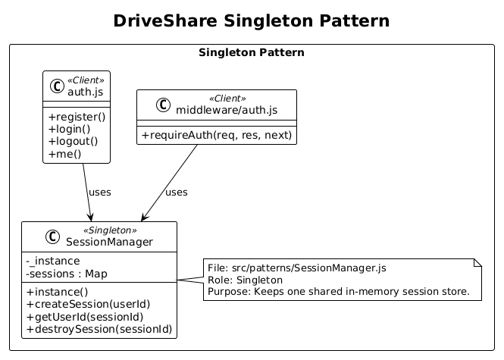
Singleton Pattern
Manages sessions.
Ensures one instance.
Shared across system.

Slide 10
Team Contributions
Rania:
User Interface design and implementation
Messaging system
Notifications system
Presentation and report
Aldo:
Booking system
Database design and integration
Payment system
Authentication and session management

