Slide 1
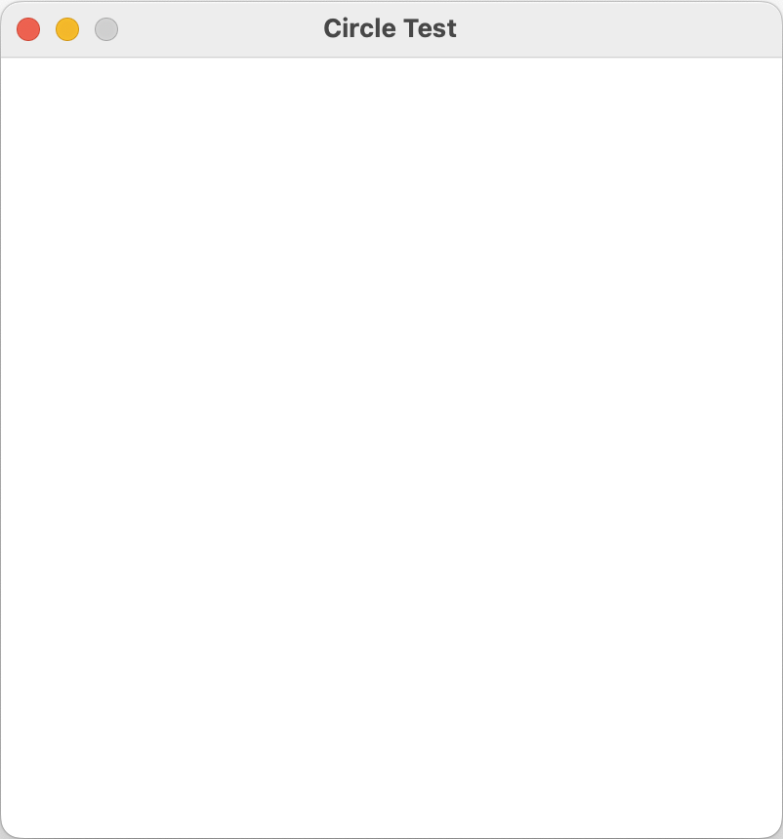
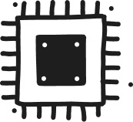
Memory
using static SplashKitSDK.SplashKit;
OpenWindow("Circle Test", 400, 400);
ClearScreen(ColorYellow());
while (!QuitRequested())
{
FillCircle(RandomColor(), Rnd(ScreenWidth()), Rnd(ScreenHeight()), Rnd(50));
RefreshScreen();
ProcessEvents();
}
Program
Counter
1,2
3
CPU

Slide 2
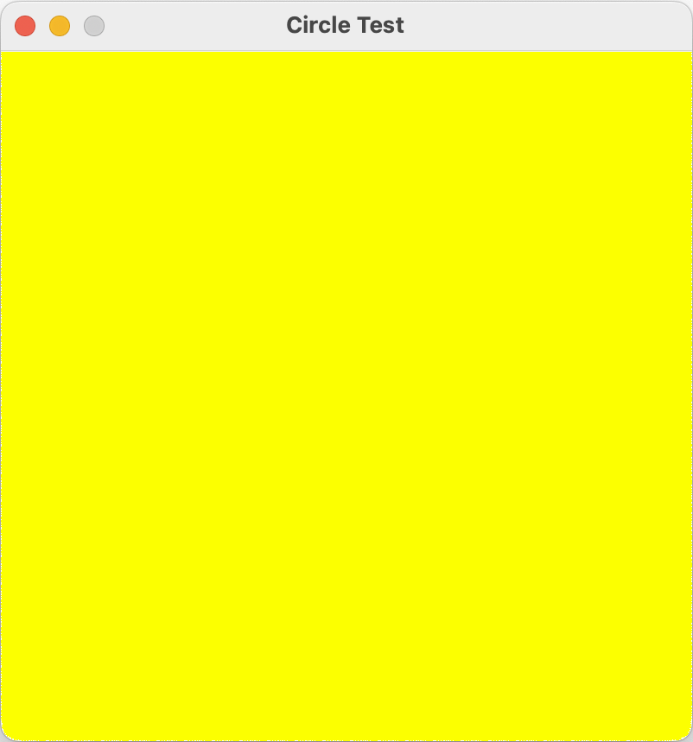
Memory
using static SplashKitSDK.SplashKit;
OpenWindow("Circle Test", 400, 400);
ClearScreen(ColorYellow());
while (!QuitRequested())
{
FillCircle(RandomColor(), Rnd(ScreenWidth()), Rnd(ScreenHeight()), Rnd(50));
RefreshScreen();
ProcessEvents();
}
Program
Counter
3
4
CPU

Slide 3
Memory
using static SplashKitSDK.SplashKit;
OpenWindow("Circle Test", 400, 400);
ClearScreen(ColorYellow());
while (!QuitRequested())
{
FillCircle(RandomColor(), Rnd(ScreenWidth()), Rnd(ScreenHeight()), Rnd(50));
RefreshScreen();
ProcessEvents();
}
Program
Counter
4
5,6
CPU

Slide 4
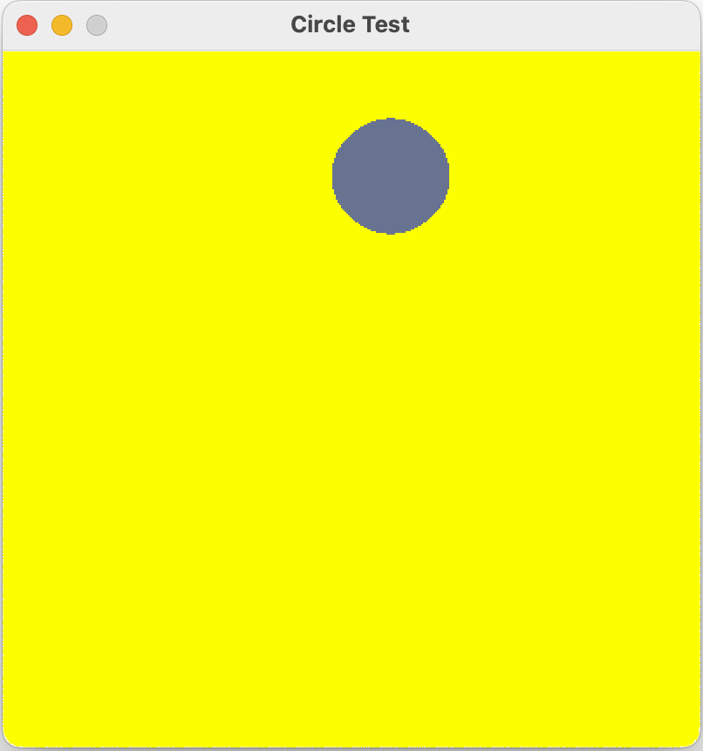
Memory
using static SplashKitSDK.SplashKit;
OpenWindow("Circle Test", 400, 400);
ClearScreen(ColorYellow());
while (!QuitRequested())
{
FillCircle(RandomColor(), Rnd(ScreenWidth()), Rnd(ScreenHeight()), Rnd(50));
RefreshScreen();
ProcessEvents();
}
Program
Counter
5,6
7
CPU

Slide 5
Memory
using static SplashKitSDK.SplashKit;
OpenWindow("Circle Test", 400, 400);
ClearScreen(ColorYellow());
while (!QuitRequested())
{
FillCircle(RandomColor(), Rnd(ScreenWidth()), Rnd(ScreenHeight()), Rnd(50));
RefreshScreen();
ProcessEvents();
}
Program
Counter
7
8
CPU

Slide 6
Memory
using static SplashKitSDK.SplashKit;
OpenWindow("Circle Test", 400, 400);
ClearScreen(ColorYellow());
while (!QuitRequested())
{
FillCircle(RandomColor(), Rnd(ScreenWidth()), Rnd(ScreenHeight()), Rnd(50));
RefreshScreen();
ProcessEvents();
}
Program
Counter
8
4
CPU

Slide 7
Memory
using static SplashKitSDK.SplashKit;
OpenWindow("Circle Test", 400, 400);
ClearScreen(ColorYellow());
while (!QuitRequested())
{
FillCircle(RandomColor(), Rnd(ScreenWidth()), Rnd(ScreenHeight()), Rnd(50));
RefreshScreen();
ProcessEvents();
}
Program
Counter
4
5,6
CPU

Slide 8
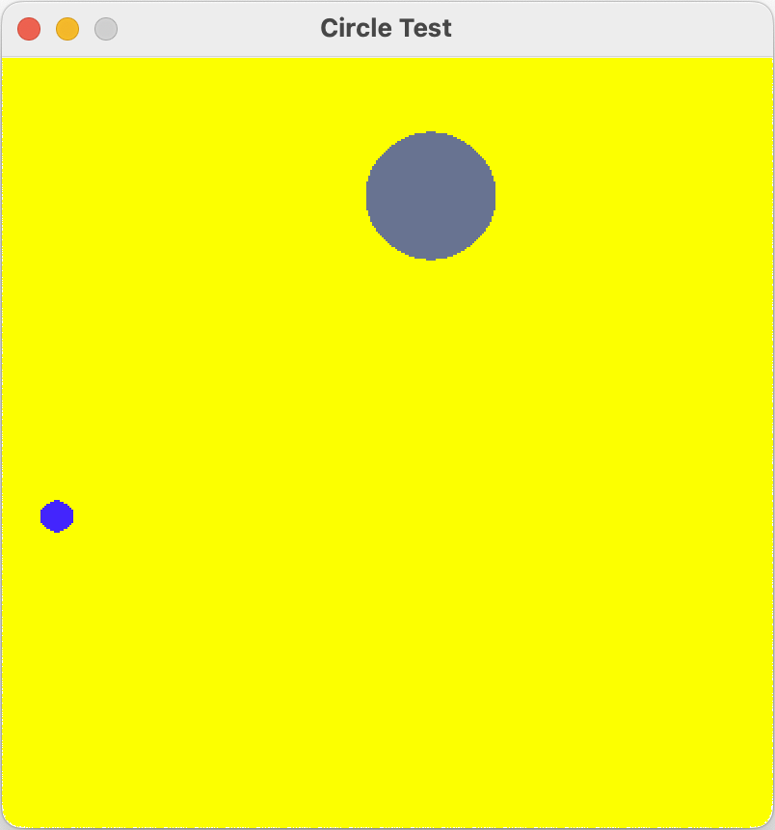
Memory
using static SplashKitSDK.SplashKit;
OpenWindow("Circle Test", 400, 400);
ClearScreen(ColorYellow());
while (!QuitRequested())
{
FillCircle(RandomColor(), Rnd(ScreenWidth()), Rnd(ScreenHeight()), Rnd(50));
RefreshScreen();
ProcessEvents();
}
Program
Counter
6
7
CPU

Slide 9
Memory
using static SplashKitSDK.SplashKit;
OpenWindow("Circle Test", 400, 400);
ClearScreen(ColorYellow());
while (!QuitRequested())
{
FillCircle(RandomColor(), Rnd(ScreenWidth()), Rnd(ScreenHeight()), Rnd(50));
RefreshScreen();
ProcessEvents();
}
Program
Counter
7
8
CPU

Slide 10
Memory
using static SplashKitSDK.SplashKit;
OpenWindow("Circle Test", 400, 400);
ClearScreen(ColorYellow());
while (!QuitRequested())
{
FillCircle(RandomColor(), Rnd(ScreenWidth()), Rnd(ScreenHeight()), Rnd(50));
RefreshScreen();
ProcessEvents();
}
Program
Counter
8
4
CPU

Slide 11
Memory
using static SplashKitSDK.SplashKit;
OpenWindow("Circle Test", 400, 400);
ClearScreen(ColorYellow());
while (!QuitRequested())
{
FillCircle(RandomColor(), Rnd(ScreenWidth()), Rnd(ScreenHeight()), Rnd(50));
RefreshScreen();
ProcessEvents();
}
Program
Counter
4
5,6
CPU

Slide 12
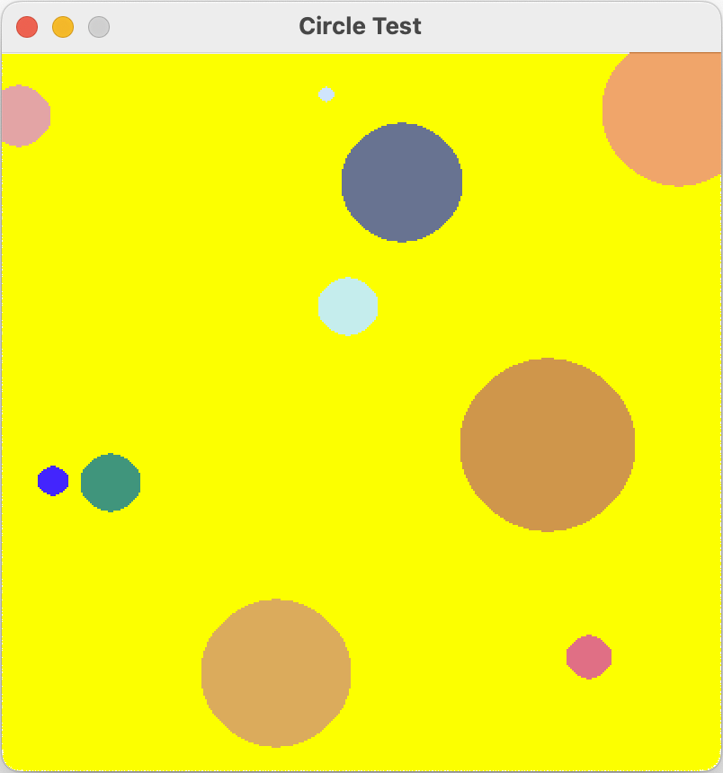
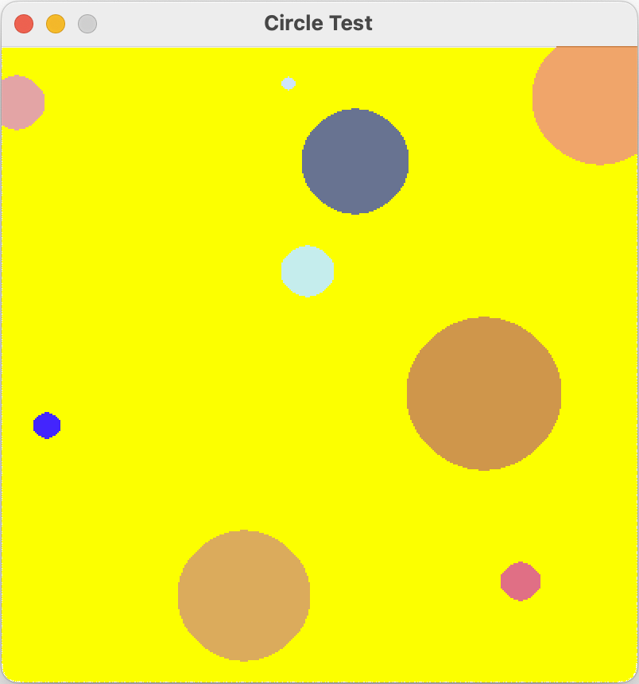
Memory
using static SplashKitSDK.SplashKit;
OpenWindow("Circle Test", 400, 400);
ClearScreen(ColorYellow());
while (!QuitRequested())
{
FillCircle(RandomColor(), Rnd(ScreenWidth()), Rnd(ScreenHeight()), Rnd(50));
RefreshScreen();
ProcessEvents();
}
Add 10th circle
The user clicks the quit button
Program
Counter
5,6
7
9 circles in window
CPU

Slide 13
Memory
using static SplashKitSDK.SplashKit;
OpenWindow("Circle Test", 400, 400);
ClearScreen(ColorYellow());
while (!QuitRequested())
{
FillCircle(RandomColor(), Rnd(ScreenWidth()), Rnd(ScreenHeight()), Rnd(50));
RefreshScreen();
ProcessEvents();
}
Program
Counter
7
8
10 circles in window
CPU

Slide 14
Memory
using static SplashKitSDK.SplashKit;
OpenWindow("Circle Test", 400, 400);
ClearScreen(ColorYellow());
while (!QuitRequested())
{
FillCircle(RandomColor(), Rnd(ScreenWidth()), Rnd(ScreenHeight()), Rnd(50));
RefreshScreen();
ProcessEvents();
}
The user had previously clicked the quit button
Program
Counter
8
4
CPU

Slide 15
Memory
using static SplashKitSDK.SplashKit;
OpenWindow("Circle Test", 400, 400);
ClearScreen(ColorYellow());
while (!QuitRequested())
{
FillCircle(RandomColor(), Rnd(ScreenWidth()), Rnd(ScreenHeight()), Rnd(50));
RefreshScreen();
ProcessEvents();
}
The user had previously clicked the quit button
Program
Counter
4
9
CPU

Slide 16
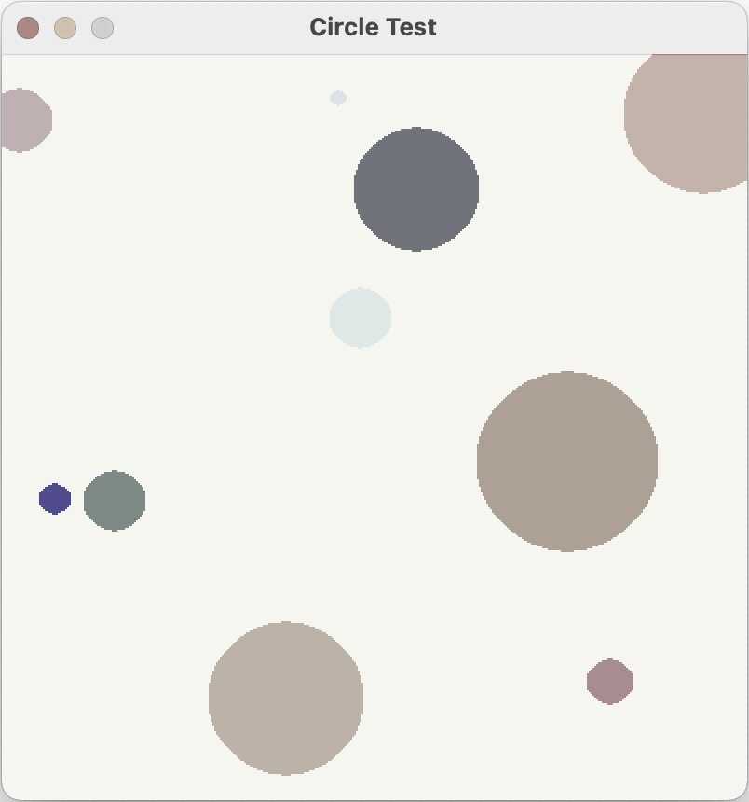
Memory
using static SplashKitSDK.SplashKit;
OpenWindow("Circle Test", 400, 400);
ClearScreen(ColorYellow());
while (!QuitRequested())
{
FillCircle(RandomColor(), Rnd(ScreenWidth()), Rnd(ScreenHeight()), Rnd(50));
RefreshScreen();
ProcessEvents();
}
Free memory
Program
Counter
9
END
Close window
CPU

