Slide 1
Single-Area OSPF
By: Arnav Kadam
Notes:
Imagine that it is time for your family to visit your grandparents. You pack your bags and load them into the car. But this takes a bit longer than you planned for and now you are running late. You pull out your map. There are three different routes. One route is no good because there is a lot of construction on the main road and it is temporarily closed. Another route is very scenic, but it takes an additional hour to get to your destination. The third route is not as pretty but it includes a highway, which is much faster. In fact, it is so much faster that you might actually be on time if you take it.
In networking, packets do not need to take the scenic route. The fastest available route is always the best. Open Shortest Path First (OSPF) is designed to find the fastest available path for a packet from source to destination. This module covers the basic concepts of single-area OSPFv2. Let’s get started!

Slide 2
What is single-area OSPF?
Open Shortest Path First (OSPF)
Link-state routing protocol
Uses the concept of areas
Has significant advantages over RIP → Routing Information Protocol
Offers faster convergence and scales to larger network implementations
Routing domain can be divided into distinct areas to help control traffic
Link is an interface on a router
Includes network prefix, prefix length, and cost
Notes:
This topic is a brief overview of Open Shortest Path First (OSPF), which includes single-area and multiarea. OSPFv2 is used for IPv4 networks. OSPFv3 is used for IPv6 networks. The primary focus of this entire module is single-area OSPFv2.
OSPF is a link-state routing protocol that was developed as an alternative for the distance vector Routing Information Protocol (RIP). RIP was an acceptable routing protocol in the early days of networking and the internet. However, the RIP reliance on hop count as the only metric for determining best route quickly became problematic. Using hop count does not scale well in larger networks with multiple paths of varying speeds. OSPF has significant advantages over RIP in that it offers faster convergence and scales to much larger network implementations.
OSPF is a link-state routing protocol that uses the concept of areas. A network administrator can divide the routing domain into distinct areas that help control routing update traffic. A link is an interface on a router. A link is also a network segment that connects two routers, or a stub network such as an Ethernet LAN that is connected to a single router. Information about the state of a link is known as a link-state. All link-state information includes the network prefix, prefix length, and cost.

Slide 3
Components of OSPF
Routers exchange messages using 5 different packets
Hello Packet
Database description packet
Link-state request packet
Link-state update packet
Link-state acknowledgement packet
Three OSPF Databases
Adjacency Database
show ip ospf neighbor
Link-state Database
show ip ospf database
Forwarding Database
show ip route
Notes:
Routers running OSPF exchange messages to convey routing information using five types of packets. These packets, as shown in the figure, are as follows:
Hello
This is used to establish and maintain adjacency with other OSPF routers
Database Description (DBD)
This contains an abbreviated list of the LSDB of the sending router and is used by receiving routers to check against the local LSDB. The LSDB must be identical on all link-state routers within an area to construct an accurate SPF tree.
Link-State Request (LSR)
Receiving routers can then request more information about any entry in the DBD by sending an LSR.
Link-State Update (LSU)
This is used to reply to LSRs and to announce new information. LSUs contain several different types of LSAs.
Link-State Acknowledgment (LSAck)
When an LSU is received, the router sends an LSAck to confirm receipt of the LSU. The LSAck data field is empty.
Adjacency Database
Neighbor Table
List of all neighbor routers to which a router has established bidirectional communication.
This table is unique for each router.
Can be viewed using the show ip ospf neighbor command.
Link-state Database
Topology Table
Lists information about all other routers in the network.
This database represents the network topology.
All routers within an area have identical LSDB.
Can be viewed using the show ip ospf database command.
Forwarding Database
Routing Table
List of routes generated when an algorithm is run on the link-state database.
The routing table of each router is unique and contains information on how and where to send packets to other routers.
Can be viewed using the show ip route command.

Slide 4
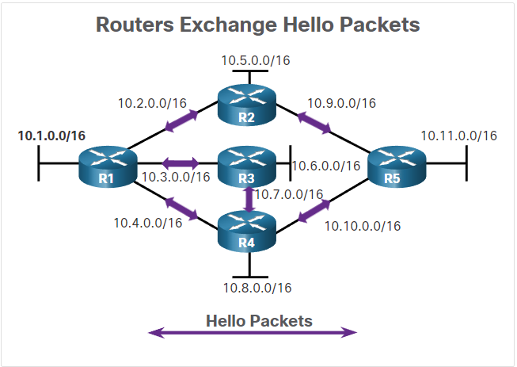
Establish Neighbor Adjacencies
OSPF-enabled routers must recognize each other
They send Hello packets to determine if neighbors are present on those links
Notes:
OSPF-enabled routers must recognize each other on the network before they can share information. An OSPF-enabled router sends Hello packets out all OSPF-enabled interfaces to determine if neighbors are present on those links. If a neighbor is present, the OSPF-enabled router attempts to establish a neighbor adjacency with that neighbor.

Slide 5
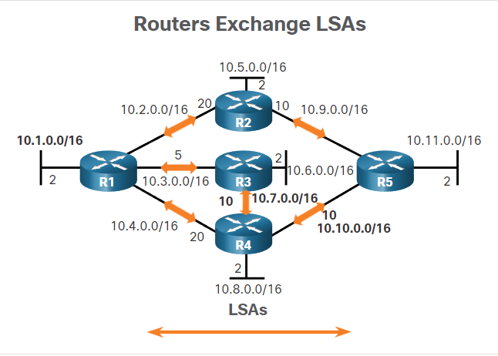
2. Exchange Link-State Advertisements
Routers then exchange link-state advertisements (LSA)
These contain the state and cost of each directly connected link
Routers floods LSA’s to adjacent neighbors
Notes:
After adjacencies are established, routers then exchange link-state advertisements (LSAs). LSAs contain the state and cost of each directly connected link. Routers flood their LSAs to adjacent neighbors. Adjacent neighbors receiving the LSA immediately flood the LSA to other directly connected neighbors, until all routers in the area have all LSAs.

Slide 6
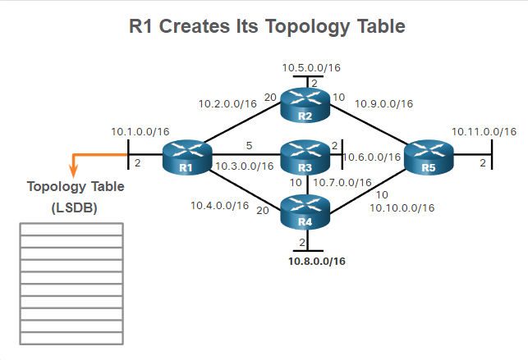
3. Build the Link State Database
OSPF routers than build a topology table (LSBD)
Database holds all the information about the topology of the area
Notes:
After LSAs are received, OSPF-enabled routers build the topology table (LSDB) based on the received LSAs. This database eventually holds all the information about the topology of the area.

Slide 7
4. Execute the SPF Algorithm
Routers execute the SPF algorithm
The SPF tree is created using calculations based on the Dijkstra shortest-path first algorithm (SPF)
Notes:
Routers then execute the SPF algorithm. The gears in the figure for this step are used to indicate the execution of the SPF algorithm. The SPF algorithm creates the SPF tree.

Slide 8
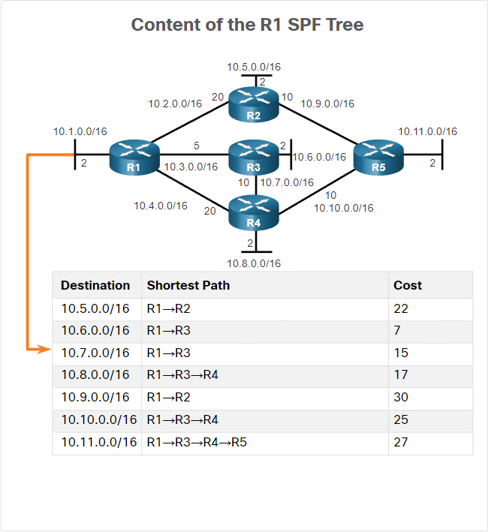
5. Choose the Best Route
The best paths to each network are offered to the IP routing table
Routing decisions are mashed based on the entries in the routing table
Notes:
After the SPF tree is built, the best paths to each network are offered to the IP routing table. The route will be inserted into the routing table unless there is a route source to the same network with a lower administrative distance, such as a static route. Routing decisions are made based on the entries in the routing table.

Slide 9
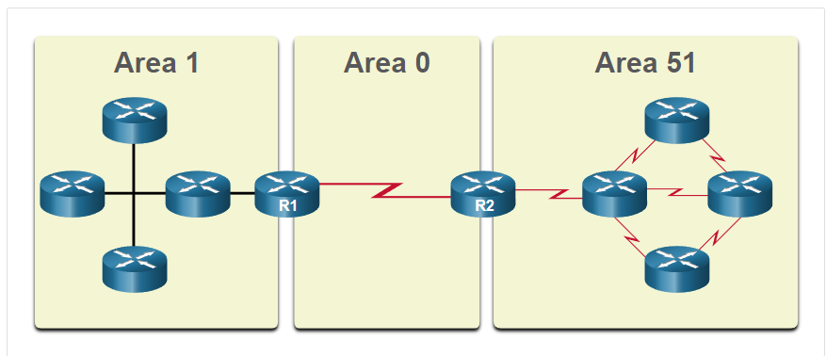
Single vs Multi Area
Single-Area OSPF → All routers are in one area
Multiarea OSPF → Is implemented using multiple areas, in a hierarchical fashion
Notes:
Single-Area OSPF - All routers are in one area. Best practice is to use area 0.
Multiarea OSPF - OSPF is implemented using multiple areas, in a hierarchical fashion. All areas must connect to the backbone area (area 0). Routers interconnecting the areas are referred to as Area Border Routers (ABRs).

Slide 10
OSPF Operation States
Down State → No Hello packets received
Init State → Hello packet are received
Contain the sending router ID
Two-Way State → Communication is bidirectional
Routers elect a DR and a BDR
ExStart State → Routers decide which router will initiate the DBD packet exchange
Exchange State → Routers exchange DBD packets
Loading State → Routers are processed using the SPF algorithm
Full State → The link-state database of the router is fully synchronized
Notes:
State
Description
Down State
No Hello packets received = Down.
Router sends Hello packets.
Transition to Init state.
Init State
Hello packets are received from the neighbor.
They contain the Router ID of the sending router.
Transition to Two-Way state.
Two-Way State
In this state, communication between the two routers is bidirectional.
On multiaccess links, the routers elect a DR and a BDR.
Transition to ExStart state.
ExStart State
On point-to-point networks, the two routers decide which router will initiate the DBD packet exchange and decide upon the initial DBD packet sequence number.
Exchange State
Routers exchange DBD packets.
If additional router information is required then transition to Loading; otherwise, transition to the Full state.
Loading State
LSRs and LSUs are used to gain additional route information.
Routes are processed using the SPF algorithm.
Transition to the Full state.
Full State
The link-state database of the router is fully synchronized.

Slide 11
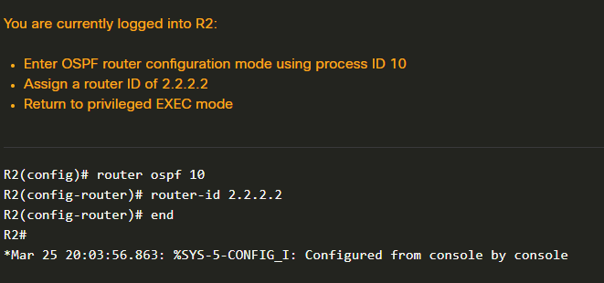
Configure OSPF
OSPFv2 is enabled using the router ospf process-id command
OSPF router ID → 32 bit value representing an IPv4 address
Needed to participate in an OSPF domain
Notes:
OSPFv2 is enabled using the router ospf process-id global configuration mode command, as shown in the command window for R1. The process-id value represents a number between 1 and 65,535 and is selected by the network administrator. The process-id value is locally significant, which means that it does not have to be the same value on the other OSPF routers to establish adjacencies with those neighbors. It is considered best practice to use the same process-id on all OSPF routers.
An OSPF router ID is a 32-bit value, represented as an IPv4 address. The router ID is used to uniquely identify an OSPF router. All OSPF packets include the router ID of the originating router. Every router requires a router ID to participate in an OSPF domain. The router ID can be defined by an administrator or automatically assigned by the router. The router ID is used by an OSPF-enabled router to do the following:

