Slide 1
Routers
By: Arnav Kadam

Slide 2
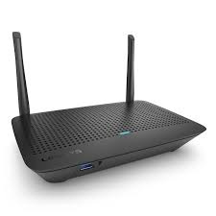

What is a router?
Routers guide and direct network data via packets
Packets contain various kinds of data
Packet has several layers/sections but only one is important
Contains sender, data type, size, destination IP
Router reads this layer and chooses the best route for transmission
Uses a routing table → contains a list of known network address and where to forward the packet
Router uses the “best” matching route entry
Notes:
The data packets have several layers, or sections, one of which carries identifying information such as sender, data type, size, and most importantly, the destination IP (Internet protocol) address. The router reads this layer, prioritizes the data, and chooses the best route to use for each transmission.
If the destination host is on a remote network, the packet is forwarded to the default gateway, which is usually the local router.
What happens when a packet arrives on a router interface?
The router examines the destination IP address of the packet and searches its routing table to determine where to forward the packet. The routing table contains a list of all known network addresses (prefixes) and where to forward the packet. These entries are known as route entries or routes. The router will forward the packet using the best (longest) matching route entry.

Slide 3
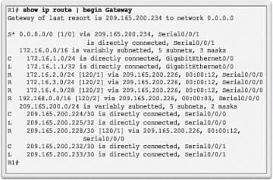
What is an IP Router Routing Table?
Contains network route entries listing possible known network destinations
Stores 3 types of entries:
Directly-connected networks → active router interfaces
Remote networks → connected to other routers
Default route → a gateway of last resort
Router learns about remote networks in two ways
Manually
Dynamically
Notes:
The routing table of the router contains network route entries listing all the possible known network destinations.
The routing table stores three types of route entries:
Directly-connected networks - These network route entries are active router interfaces. Routers add a directly connected route when an interface is configured with an IP address and is activated. Each router interface is connected to a different network segment. In the figure, the directly-connected networks in the R1 IPv4 routing table would be 192.168.10.0/24 and 209.165.200.224/30.
Remote networks - These network route entries are connected to other routers. Routers learn about remote networks either by being explicitly configured by an administrator or by exchanging route information using a dynamic routing protocol. In the figure, the remote network in the R1 IPv4 routing table would be 10.1.1.0/24.
Default route – Like a host, most routers also include a default route entry, a gateway of last resort. The default route is used when there is no better (longer) match in the IP routing table. In the figure, the R1 IPv4 routing table would most likely include a default route to forward all packets to router R2.
A router can learn about remote networks in one of two ways:
Manually - Remote networks are manually entered into the route table using static routes.
Dynamically - Remote routes are automatically learned using a dynamic routing protocol.

Slide 4
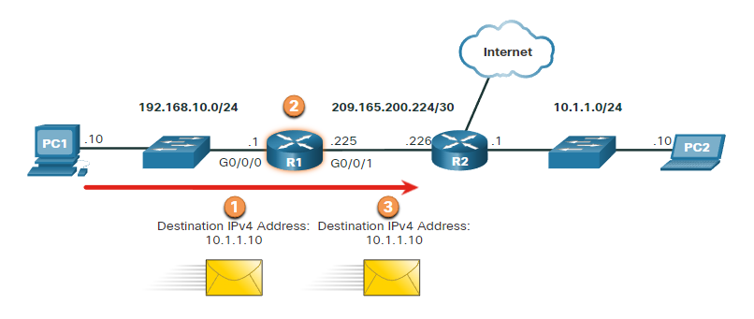
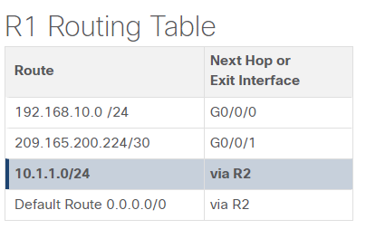
Demonstration
Notes:
Packet arrives on the Gigabit Ethernet 0/0/0 interface of router R1. R1 de-encapsulates the Layer 2 Ethernet header and trailer.
Router R1 examines the destination IPv4 address of the packet and searches for the best match in its IPv4 routing table. The route entry indicates that this packet is to be forwarded to route R2.
Router R1 encapsulates the packet into a new Ethernet header and trailer, and forwards the packet to the next hop router R2.

Slide 5
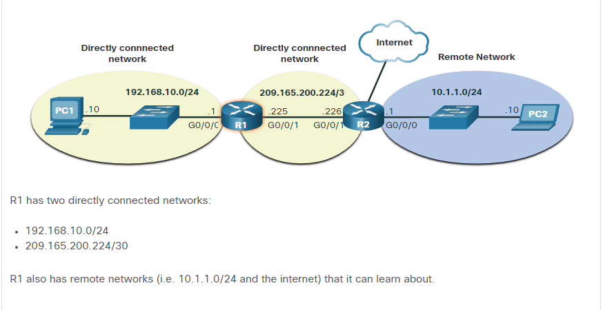
Topology

Slide 6
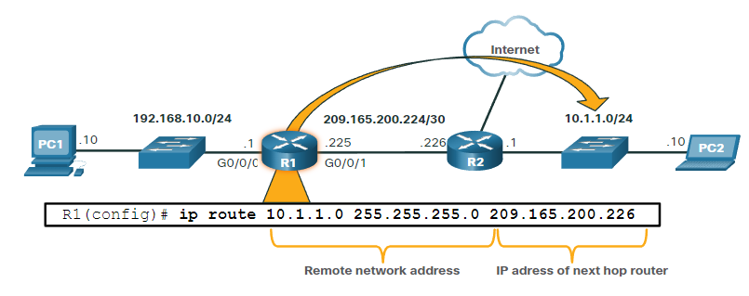
Static Routing
Are manually configured
The “static route” includes the remote network address and the IP address of the next hop router
Notes:
Static routes are route entries that are manually configured. The figure shows an example of a static route that was manually configured on router R1. The static route includes the remote network address and the IP address of the next hop router.
Static routing has the following characteristics:
A static route must be configured manually.
The administrator needs to reconfigure a static route if there is a change in the topology and the static route is no longer viable.
A static route is appropriate for a small network and when there are few or no redundant links.

Slide 7
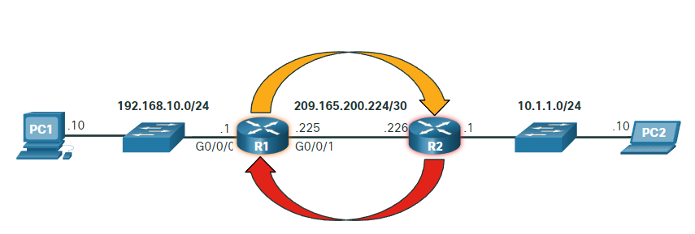
Dynamic Routing
Allows the routers to automatically learn about remote networks
Dynamic routing protocols include OSPF and Enhanced Interior Gateway Routing Protocol
Notes:
A dynamic routing protocol allows the routers to automatically learn about remote networks, including a default route, from other routers. Routers that use dynamic routing protocols automatically share routing information with other routers and compensate for any topology changes without involving the network administrator. If there is a change in the network topology, routers share this information using the dynamic routing protocol and automatically update their routing tables.
Dynamic routing protocols include OSPF and Enhanced Interior Gateway Routing Protocol (EIGRP). The figure shows an example of routers R1 and R2 automatically sharing network information using the routing protocol OSPF.
Basic configuration only requires the network administrator to enable the directly connected networks within the dynamic routing protocol. The dynamic routing protocol will automatically do as follows:
Discover remote networks
Maintain up-to-date routing information
Choose the best path to destination networks
Attempt to find a new best path if the current path is no longer available
When a router is manually configured with a static route or learns about a remote network dynamically using a dynamic routing protocol, the remote network address and next hop address are entered into the IP routing table.

Slide 8
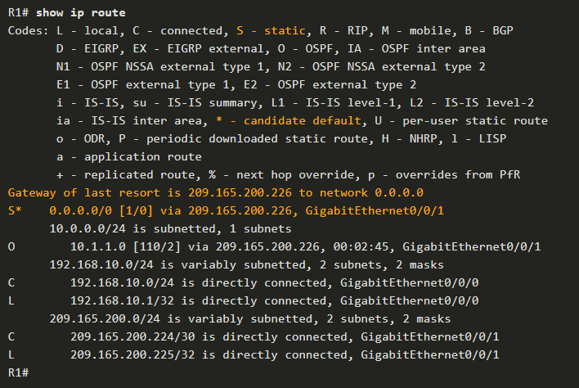
IPv4 Routing Table
L - Directly connected local interface IP address
C – Directly connected network
S – Static route was manually configured by an administrator
O - OSPF
D - EIGRP
Notes:
The show ip route privileged EXEC mode command is used to view the IPv4 routing table on a Cisco IOS router. The example shows the IPv4 routing table of router R1. At the beginning of each routing table entry is a code that is used to identify the type of route or how the route was learned. Common route sources (codes) include these:
L - Directly connected local interface IP address
C – Directly connected network
S – Static route was manually configured by an administrator
O - OSPF
D - EIGRP
The routing table displays all of the known IPv4 destination routes for R1.
A directly connected route is automatically created when a router interface is configured with IP address information and is activated. The router adds two route entries with the codes C (i.e., the connected network) and L (i.e., the local interface IP address of the connected network). The route entries also identify the exit interface to use to reach the network. The two directly connected networks in this example are 192.168.10.0/24 and 209.165.200.224/30.
Routers R1 and R2 are also using the OSPF dynamic routing protocol to exchange router information. In the example routing table, R1 has a route entry for the 10.1.1.0/24 network that it learned dynamically from router R2 via the OSPF routing protocol.
A default route has a network address of all zeroes. For example, the IPv4 network address is 0.0.0.0. A static route entry in the routing table begins with a code of S*, as highlighted in the example.

