Slide 1
Evolution by Natural Selection
Genetic & Trait Variations exists within a population.
Overpopulation leads to Competition for resources.
Due to the competition for resources, only those born with traits well suited to the current environment survive and bear offspring.
Survivors pass their successful traits to their offspring and those successful traits accumulate in the population
This leads to a population that is well adapted to its current environment
LS4-2

Slide 2
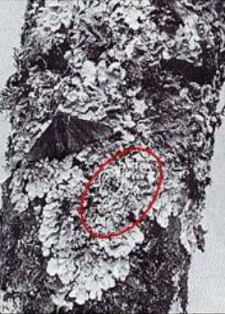
Two peppered moths on a birch tree before the industrial revolution added dark soot to the bark.
Draw a histogram with these traits.

Slide 3
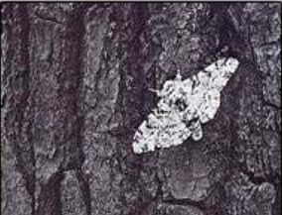
Environmental Change: Soot made tree bark dark
How did this environmental change the selective pressure?
How would the histogram look different after the environment changed?

Slide 4


Peppered Moth Investigation 1885
N=21

Slide 5
Variation exists. This environment selects against dark variants.
N=21

Slide 6
Soot changed the tree bark color
N=21

Slide 7

This new environment selects against white variants by 1900 the population was mostly dark
Recalculate the proportions

Slide 8
One extreme of the variation was selected against until the population’s traits shifted
Change in environment: soot & tree color
Preferential predation: Predators preferred the easy to see light colored moths
The darker moths were born with the best adaptation to survive in the new environment
The population shifted in the Dark Direction on the histogram and now the population is well adapted to its new environment

