Slide 1
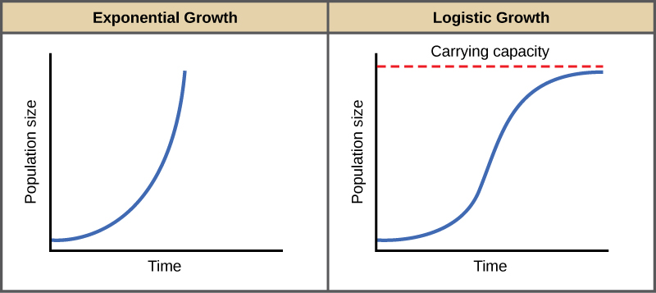
Two Models of Population Growth
High Reproductive Capacity
Takes into account carrying capacity slowing growth rate
r – strategists who reproduce quickly but whose populations crash periodically
K – strategists who reproduce slowly but survive and whose populations stabilize near carrying capacity

Slide 2
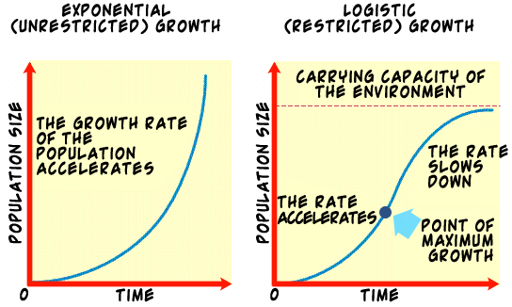

Slide 3
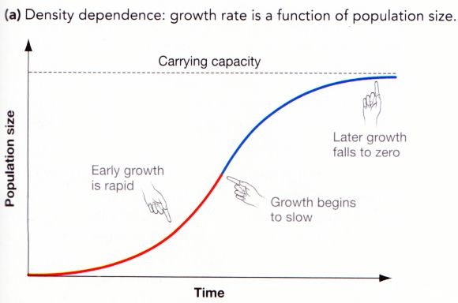

Slide 4
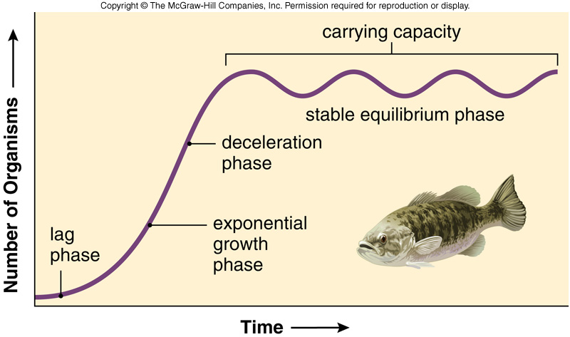

Slide 5
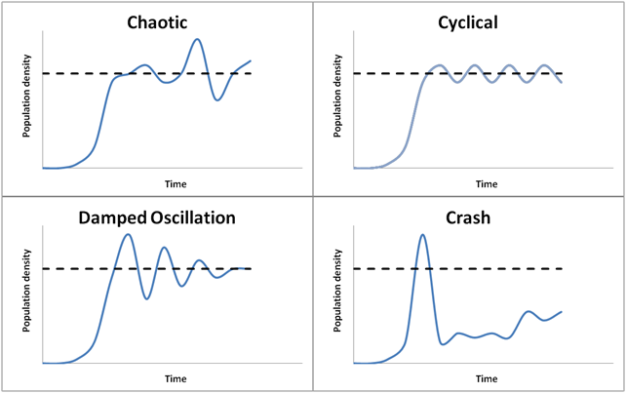

Slide 6
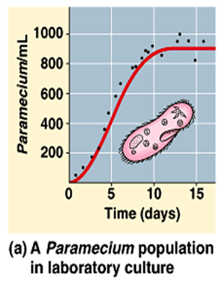

Slide 7
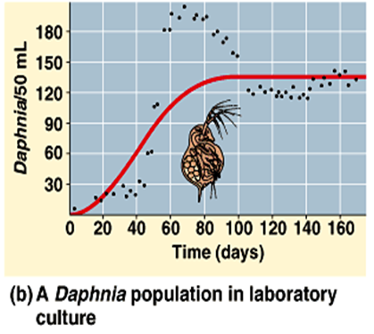

Slide 8
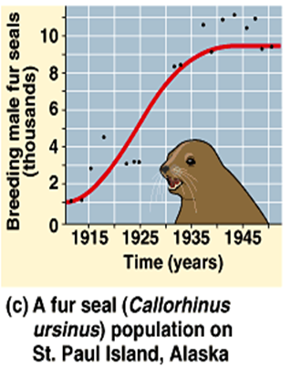

Slide 9
Population Growth
As populations expand their range and move into a new area, they may grow exponentially for a short time.
With climate changes, populations may expand their range
After mass extinctions, the survivors may expand their range

Slide 10
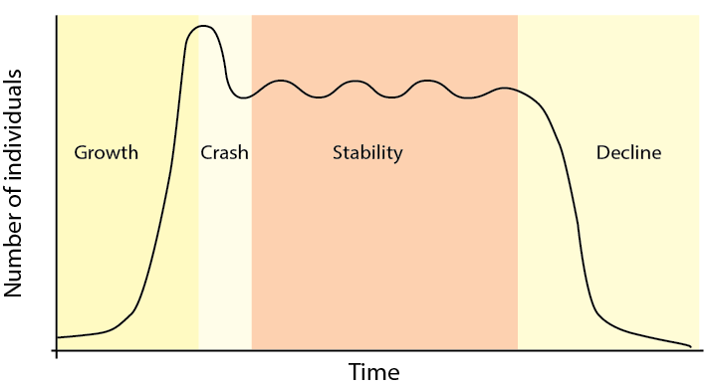
Stable populations fluctuate about the carrying capacity
Above carrying capacity faster disease spread and increased starvation reduce the population size.
Below carrying capacity slower disease spread and extra resources encourage population growth.
NEGATIVE FEEDBACK stabilizes population size near carrying capacity
(see notes on the diagram)

Slide 11
Population Stability
Population Size relatively constant
When the biotic and abiotic factors are relatively constant.
Longest phase

Slide 12
Population Decline
Unfavorable change in biotic or abiotic factors
Leads to decrease in population size
Small populations lose genetic diversity
Loss of genetic diversity reduces adaptability of the population (e.g. reduced disease resistance)
May lead to local population extinction

Slide 13
Survivorship curves reveal these “Life Strategies” (Life Strategies are the result of natural selection)
r-strategists Reproduce rapidly when environment favorable | K-Strategists Live near carrying capacity (K)
Many young | Few young
Little to no parenting | Intensive parenting
Rapid Maturation | Slow maturation
Small young | Large young
Reproduce once | Reproduce many times

Slide 14
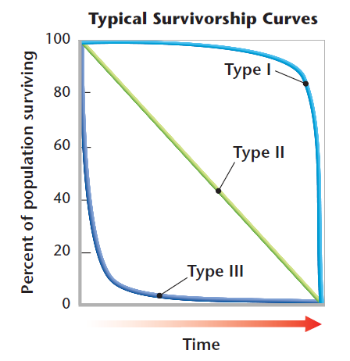
Survivorship curves
Type I
Most individuals live to old age
Type II
Death rate is the same no matter what the age
Type III
Most individuals die at young age

Slide 15
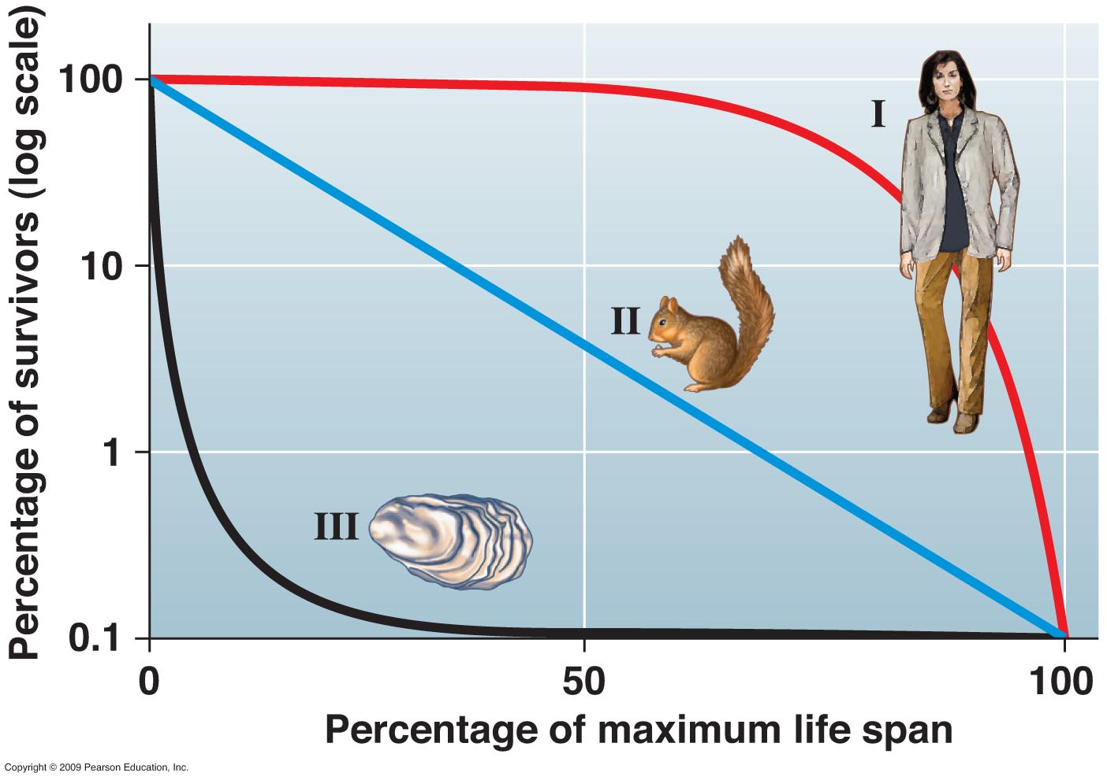
Survivorship curves
Type I
Few offspring
Internal Fertilization
High Parental Care
Humans
Type II
Prey species
Reptiles, Rodents
Type III
Many eggs
External Fertilization
No parental care
Fish, Insects

Slide 16
LIMITING FACTORS set CARRYING CAPACITY
(the maximum population size the ecosystem can support)

Slide 17
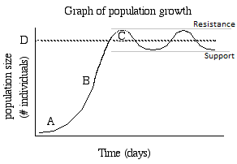
Negative feedback mechanisms within the ecosystem stabilize population sizes.

Slide 18
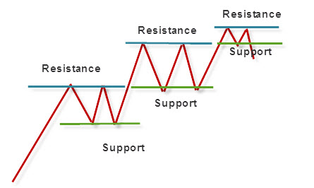
Changes in the abiotic or abiotic environment may change K. The population may then stabilize at a new level.

Slide 19
LIMITING FACTORS
Density Dependent:
Competition for food/territory
Predation
Disease
Reproduction rate (stress reduces)

Slide 20
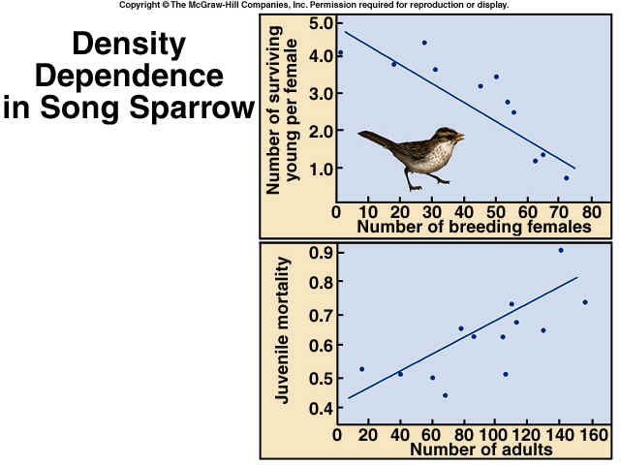

Slide 21
LIMITING FACTORS
Density Independent:
Climate & Weather
Temperature
Precipitation (drought)
Catastrophe
Wind Storms
Rain Storms (Floods)
Fires

Slide 22
Let’s Practice the Math

Slide 23
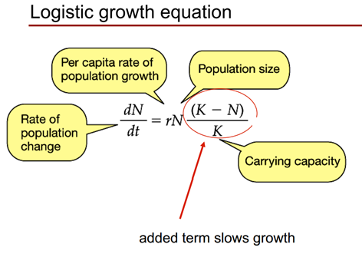

Slide 24
