Slide 1
Water Level Gauge
David Kuehnert EEET 221 Final
Notes:
Hi, My name is David Kuehnert
and for my final project, I designed a
water level gauge to monitor river levels in remote areas

Slide 2
Background
The only thing that matters in whitewater kayaking are the water levels
United States Geological Survey (USGS) have there own system of measuring river levels, though they are expensive
Lock 32 whitewater park is the only recreational, man made whitewater park in the north east, and relies on the Erie canal system to provide water
Features in the whitewater park are optimal between certain water levels
All kayakers have there own preference though of “optimal level”
If not enough water is running through the park, the features are considered unplayable, and you will not want to go out kayaking

Slide 3
Problem: Inconsistency in water levels
Many customers will drive several hours to kayak, as this is usually the only place in NY state to paddle during summer . They are in hopes of when they arrive, they will see a consistent “playable” level
A lot of times though our levels have high rates of fluctuation, and usually by noon, our levels are considered un-playable
This is caused by boat traffic on the canal, when a boat must traverse the adjacent lock to our park, the whitewater park level will fluctuate, typically downwards. If this is not properly compensated by the next lock upstream, the level in the park will slowly drop through out the day.
I am an instructor for the kid’s camps, as well as some adult classes
These inconsistent levels make it extremely difficult to teach
The kids who are here to have a good time in the summer end up suffering due to the low levels

Slide 4
Solution: Water Level Gauge
How can this be fixed?
A simple solution would be to install a water level monitoring system that
Reads level once every 1 – 5 min
Broadcasts the level to twitter, website, facebook, and hydrologists
How does this fix the problem?
Water level correction:
If the Erie Canal hydrologists have a constant stream of data, they can mitigate the swing of levels dramatically
If water is consistently running low, we do not need to try and get in contact with hydrologists, they can see it themselves, and average our levels up to desired amount
Customer satisfaction:
Customers will no longer have to deal with high fluctuation, nor would instructors, making both much happier
Customers will be able to remotely view the level data to check if the park is at a playable level/ at their ideal level for kayaking

Slide 5
Design
Multiple Options already out there to measure water levels
Floats (simple mechanical, or variable based on changing resistance
Capacitive sensors
Magnetic sensors
Ultrasonic/Laser (measuring time of flight)
Pressure Transducer
Load Cells

Slide 6
Design
Some of these level measuring systems though however can only work in a contained environment, which would not work in this situation
Mechanical measuring systems won’t work as the digital representation will not give us accuracy, we want an analog device
This narrows down the selection to using a pressure, capacitive, or radar based system

Slide 7
Design
Pressure
Radar
Capacitive
A pressure transducer is submerged to the bottom of the river
OR
A pressure transducer is left in air, reading the pressure from a tube that runs to the bottom of the river
Pros:
Simplest Design
Great Accuracy
Cons:
Water proof transducers can be pricy
Cleaning of either fully submerged or dry system would need constant maintenance
A radar sensor is attached to a pole and is hovered over top of the river
Pros:
Easy Design
Cons:
Surface roughness of river causes for inconsistent tin coming signals
A home made capacitor could be designed at a length of the expected change in river data
Pros:
Most accurate
Cons:
Complex Design
Cleaning of the capacitor would be incredible difficult
Moderate cost

Slide 8
Design The original
After doing some research, I landed on designing a gauge based on radar measurements.
This system would broadcast a signal, and said signal would then reflect of the surface of the water
The time of flight of this signal is calculated and translated into a “distance from sensor”
This value is subtracted from the measured distance of surface to river floor, and the result is the river level
The Problem?
The surface roughness would cause extreme ranges in the time of flight value, because of this, the system was incredible inaccurate.
Though it was a great design if being held over “flat” water

Slide 9
Design
Now what?
This system needs to be more accurate, so I could design my own capacitive measuring system, or design on based on pressure transducers
While researching more on how pressure transducers work to see if I could create a cheap design using the dry method (as these transducers tend to be exponentially cheaper) I stumbled upon Archimedes’ Principle

Slide 10
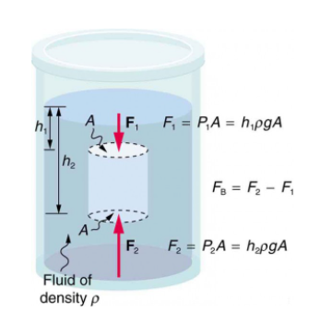
Archimedes’ Principle
States that the buoyant force on an object is equal to the weight of the fluid is displaces
What if a system was created to measure the buoyant force of a float in the river? This measurement could then be directly translated into the river height

Slide 11
Design Archimedes’
If a float is made so it is the length from the bottom of the river (almost touching but not quite) all the way up to a fix point on dry land. Then the top float can be attached to a load cell
As the water level increases, based on Archimedes principle, the buoyancy of the float will increase, as it is not allowed to move any substantial amount in the x direction, and the float is now displacing more water
The load cell at the top is fixed, as to read the sum of the forces on the y axis

Slide 12
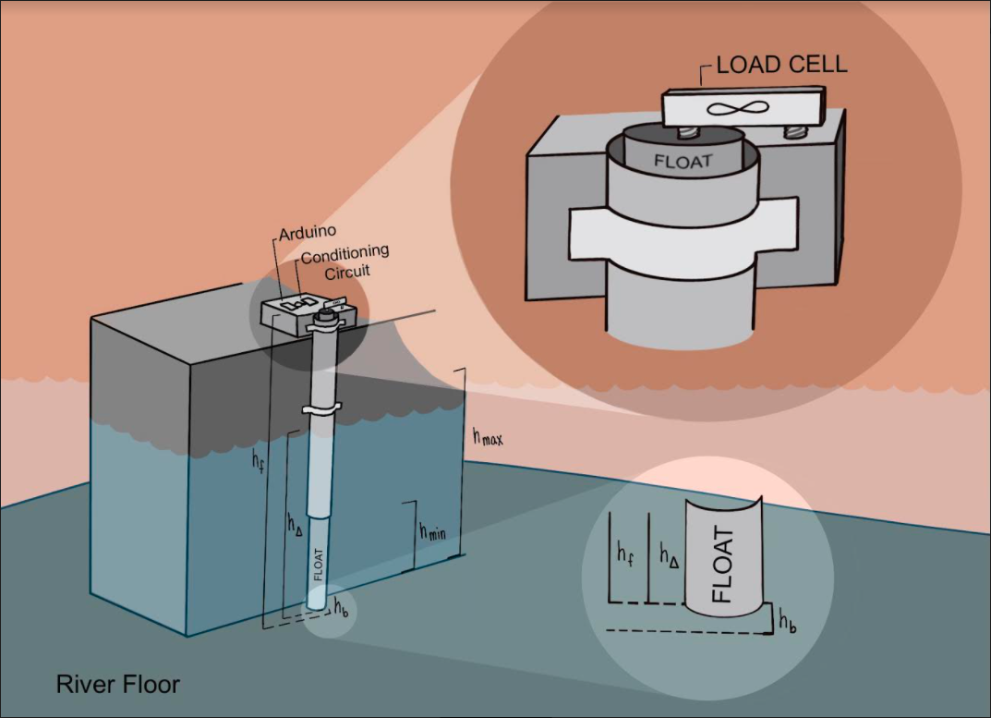

Design Overview
Variables:
$h_{f}$ = height of float
$h_{∆}$ = length of float submerged
$h_{b}$ = distance from bottom of float to the river floor
$h_{f}$ = height of float
$h_{max}$ = highest level the water can reach
$h_{f}$ = lowest level the water can reach
This amazing diagram was done by my little sister Tamsyn Kuehnert, who is currently attending school for the arts. Check out her work on insta (@artbytamsyn) or her website ( Tamsyn-Kuehnert.squarespace.com)

Slide 13
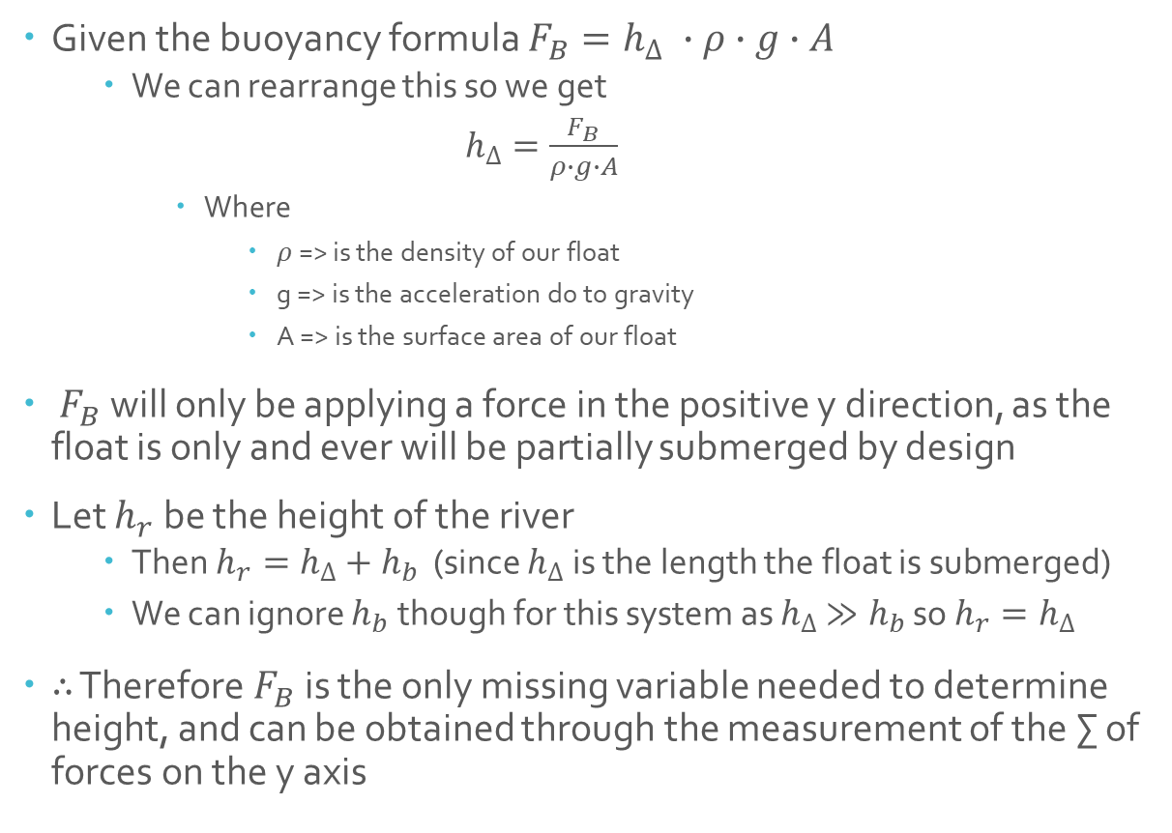
Design Calculations
Given the buoyancy formula $F_{B}=h_{∆} ∙ρ∙g∙A$
We can rearrange this so we get
$h_{∆}=\frac{F_{B}}{ρ∙g∙A}$
Where
$ρ$ => is the density of our float
g => is the acceleration do to gravity
A => is the surface area of our float
$F_{B}$ will only be applying a force in the positive y direction, as the float is only and ever will be partially submerged by design
Let $h_{r}$ be the height of the river
Then $h_{r}=h_{∆}+h_{b}$ (since $h_{∆}$ is the length the float is submerged)
We can ignore $h_{b}$ though for this system as $h_{∆}$ $≫h_{b}$ so $h_{r}=h_{∆}$
$∴$ Therefore $F_{B}$ is the only missing variable needed to determine height, and can be obtained through the measurement of the ∑ of forces on the y axis

Slide 14
Design Calculations
The float is a 2.5” PVC pipe, that is capped flat on both ends with PVC, and epoxy sealing it completely
The sheath is a 3” PVC pipe that will remain uncapped, as to allow the float to move freely. The sheath will remain fixed to the shore in a way that limits the floats movement to only the y axis
In order to determine the next step, we will need to calculate the area, solid volume, and weight of our float

Slide 15

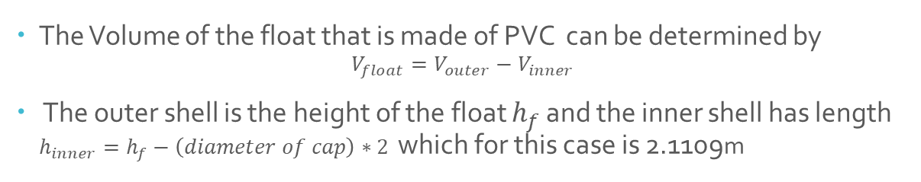

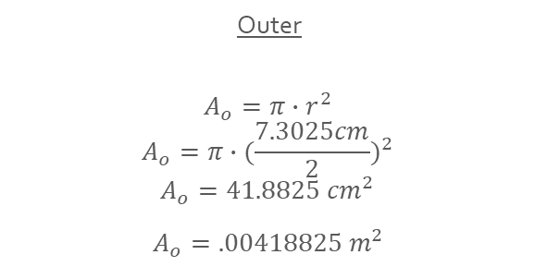
Design Float Calculations
The float is restricted to motion in the y axis which eases the calculations. The surface area for the formula A, is now the area of a circle
We will calculate the outer area as well as the inner area using average dimensions pulled from the internet
Outer
$$A_{o}=π∙r^{2}$$
$$A_{o}=π∙{(\frac{7.3025cm}{2})}^{2}$$
$$A_{o}=41.8825{ cm}^{2}$$
$A_{o}=.00418825{ m}^{2}$
Inner
$$A_{i}=π∙r^{2}$$
$$A_{i}=π∙{(\frac{6.2103cm}{2})}^{2}$$
$$A_{i}=30.2911{ cm}^{2}$$
$A_{i}=.00302911{ m}^{2}$
The Volume of the float that is made of PVC can be determined by
$$V_{float}=V_{outer}−V_{inner}$$
The outer shell is the height of the float $h_{f}$ and the inner shell has length $h_{inner}=h_{f}−\left(diameter of cap\right)∗2$ which for this case is 2.1109m
$$V_{float}=A_{o}∙h_{f}−A_{i}∙h_{inner}$$
$$V_{float}=0.00418825{ m}^{2}∙2.13m−0.00302911{ m}^{2}∙2.1109m$$
$$V_{float}=.0024 m^{3}$$

Slide 16
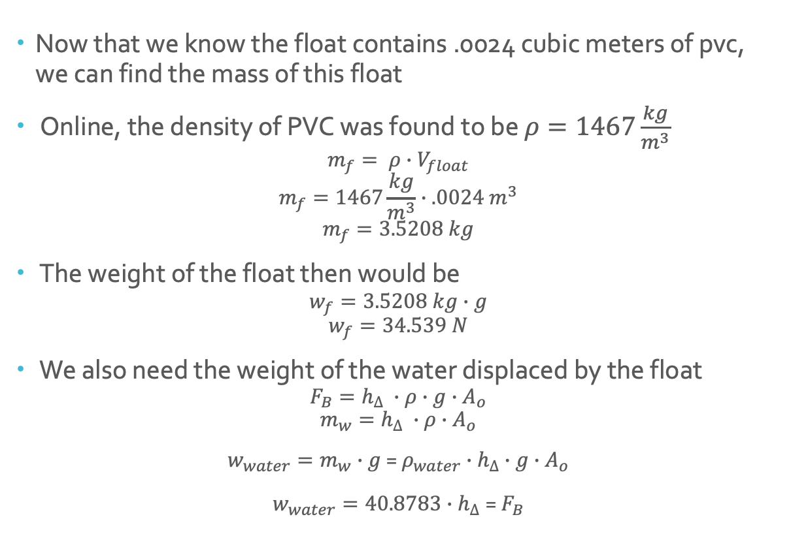
Design Float Calculations
Now that we know the float contains .0024 cubic meters of pvc, we can find the mass of this float
Online, the density of PVC was found to be $ρ=1467\frac{kg}{m^{3}}$
$$m_{f}= ρ∙V_{float}$$
$$m_{f}=1467\frac{kg}{m^{3}}∙.0024 m^{3}$$
$$m_{f}=3.5208 kg$$
The weight of the float then would be
$$w_{f}=3.5208 kg∙g$$
$$w_{f}=34.539 N$$
We also need the weight of the water displaced by the float
$$F_{B}=h_{∆} ∙ρ∙g∙A_{o}$$
$$m_{w}=h_{∆} ∙ρ∙A_{o}$$
$w_{water}=m_{w}∙g$ = $ρ_{water}{∙h}_{∆} ∙g∙A_{o}$
$w_{water}=40.8783{∙h}_{∆}$ = $F_{B}$

Slide 17
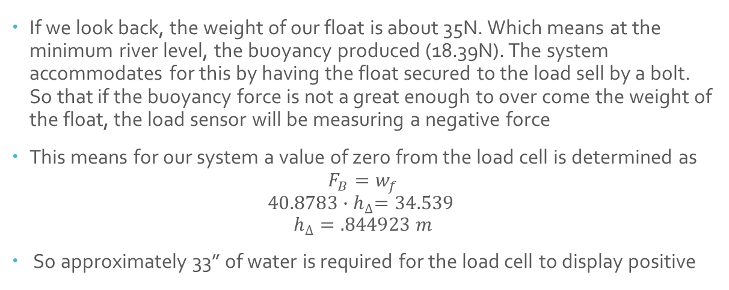



Design Sum of Forces
We can now find the expected range of forces in on the y axis
For this application $h_{max}$ = 72” (1.828 m) and $h_{min}$= 18” (.45m)
Max level
$F_{B}=$ $40.8783{∙h}_{∆}$
$F_{B}=$ $40.8783∙1.828$
$F_{B}=$ $+74.7338N$
Min Level
$F_{B}=$ $40.8783{∙h}_{∆}$
$F_{B}=$ $40.8783∙.45$
$F_{B}=$ $+18.39N$
If we look back, the weight of our float is about 35N. Which means at the minimum river level, the buoyancy produced (18.39N). The system accommodates for this by having the float secured to the load sell by a bolt. So that if the buoyancy force is not a great enough to over come the weight of the float, the load sensor will be measuring a negative force
This means for our system a value of zero from the load cell is determined as
$$F_{B}=w_{f}$$
$$40.8783{∙h}_{∆}=34.539$$
$$h_{∆}=.844923 m$$
So approximately 33” of water is required for the load cell to display positive

Slide 18
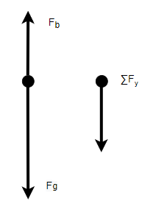
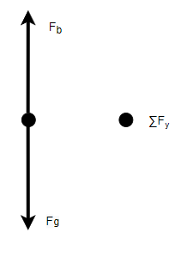
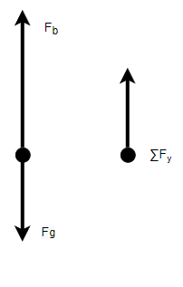
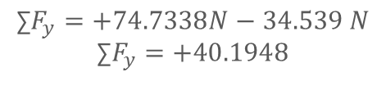

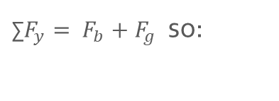
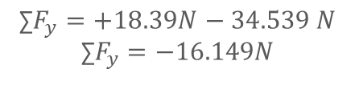
Design Free Body Diagrams
Minimum Water Level
Minimum Float
Maximum Water Level
$\text{∑}F_{y}= F_{b}+F_{g}$ so:
$$\text{∑}F_{y}=+18.39N−34.539 N$$
$$\text{∑}F_{y}=−16.149N$$
$$F_{b}=F_{g}$$
$$\text{∑}F_{y}=0$$
$$\text{∑}F_{y}=+74.7338N−34.539 N$$
$$\text{∑}F_{y}=+40.1948$$

Slide 19
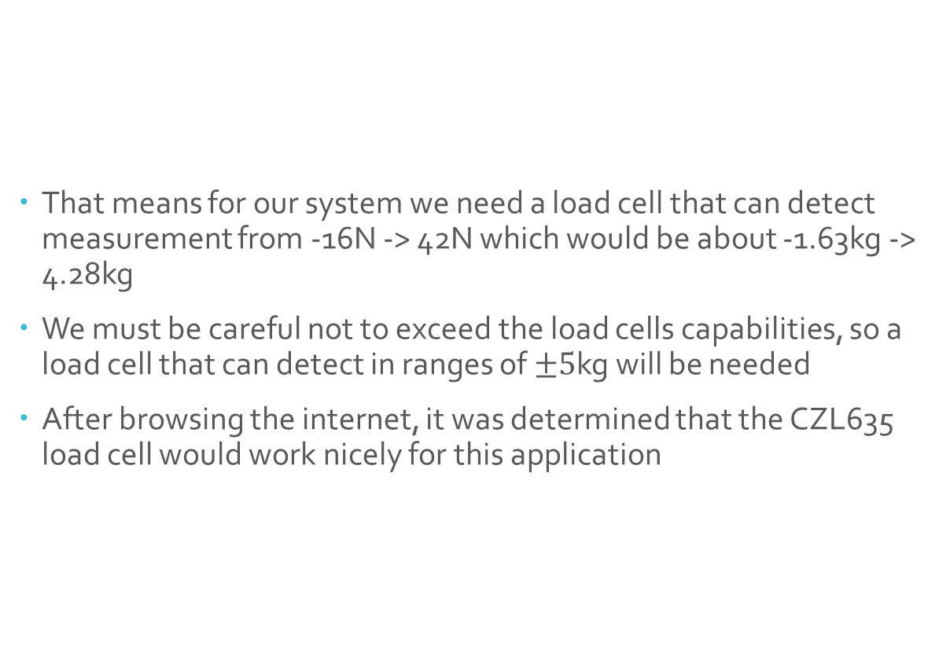
Design Load Cell
That means for our system we need a load cell that can detect measurement from -16N -> 42N which would be about -1.63kg -> 4.28kg
We must be careful not to exceed the load cells capabilities, so a load cell that can detect in ranges of $±5$kg will be needed
After browsing the internet, it was determined that the CZL635 load cell would work nicely for this application

Slide 20
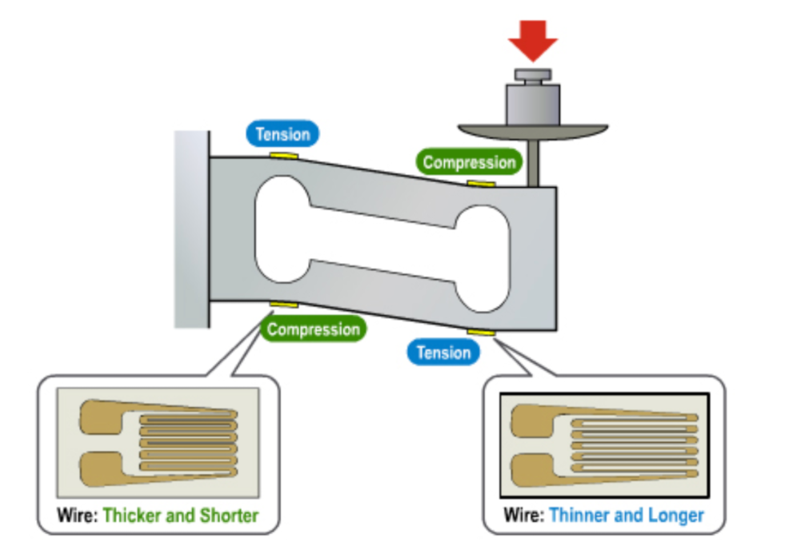
Load Cells
In order to go further, an understanding of load cells is needed
The typical load cell contains four force sensors on a bar of metal
Metal is capable of bending (shearing) a very small amount before becoming completely deformed, so you can in theory bend a piece of metal and determine how much it bent.
The degree it was bent is measured with force sensor arranged as shown in the diagram. If no pressure is applied, the tension and compression will all be equal, and the voltage across the strain gauge is 2.5vs. As force is increased, these strain gauges will become longer or shorter, ever so slightly increasing or decreasing the resistance. That means as stress is applied, the strain gauge will have very small increases and decreases in voltage

Slide 21
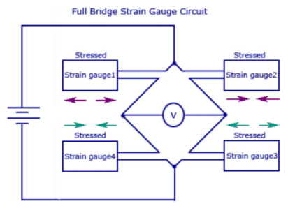
Load Cells
We could in theory determine the weight with one strain gauge, the problem is when you go to measure the change in voltage over the gauge, you will be looking for change in the hundredth and thousands place (aka a very small change)
This is fixed by wiring the strain gauges in a Wheatstone bridge array
The Wheatstone bridge is a double voltage divider, that when the strains are set up like this, will allow the voltage V, to be the voltage relating to the force applied to the load cell
As force is increased in one direction the compression will increase and tension will decrease on one side, and vice versa on the other. This results in a difference at the V node, and what we want to measure

Slide 22
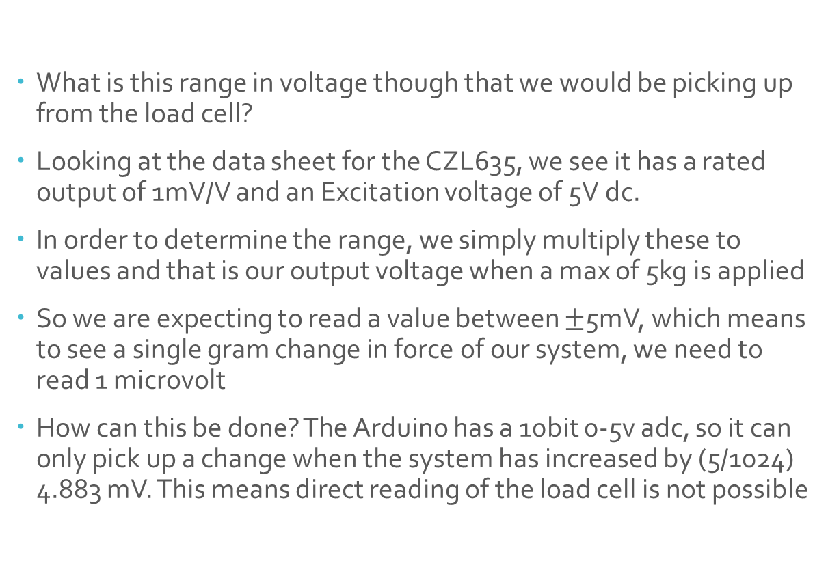
Load Cells
What is this range in voltage though that we would be picking up from the load cell?
Looking at the data sheet for the CZL635, we see it has a rated output of 1mV/V and an Excitation voltage of 5V dc.
In order to determine the range, we simply multiply these to values and that is our output voltage when a max of 5kg is applied
So we are expecting to read a value between $±$5mV, which means to see a single gram change in force of our system, we need to read 1 microvolt
How can this be done? The Arduino has a 10bit 0-5v adc, so it can only pick up a change when the system has increased by (5/1024) 4.883 mV. This means direct reading of the load cell is not possible

Slide 23
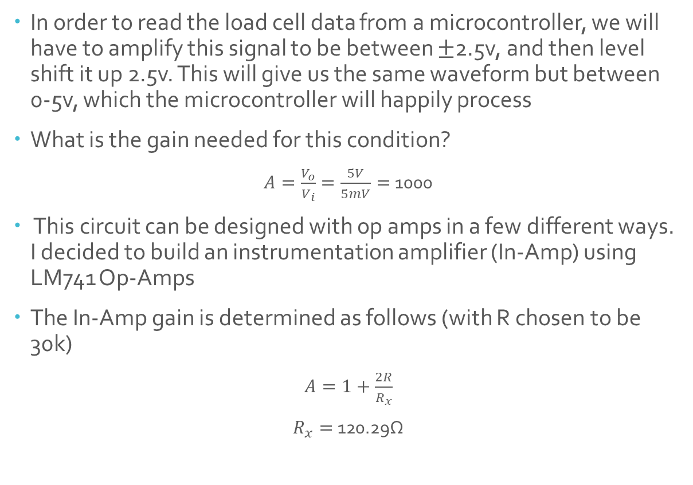
Design Conditioning Circuit
In order to read the load cell data from a microcontroller, we will have to amplify this signal to be between $±$2.5v, and then level shift it up 2.5v. This will give us the same waveform but between 0-5v, which the microcontroller will happily process
What is the gain needed for this condition?
$A=\frac{V_{o}}{V_{i}}=\frac{5V}{5mV}=$1000
This circuit can be designed with op amps in a few different ways. I decided to build an instrumentation amplifier (In-Amp) using LM741 Op-Amps
The In-Amp gain is determined as follows (with R chosen to be 30k)
$A=1+\frac{2R}{R_{x}}$
$R_{x}=$ 120.29Ω

Slide 24
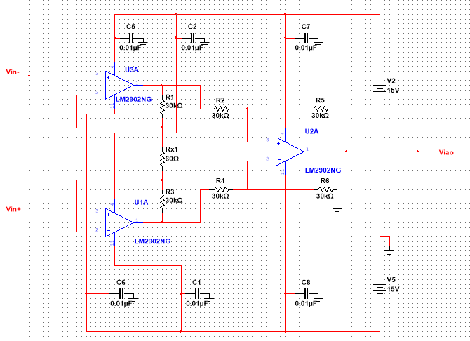
Design The In Amp
The benefit of the In Amp is that designing is very straight forward, the gain of the system is based on Rx, and the rest of the resistor values are set equal to each other. This allows for ease in modifying the gain down the line as I had to do

Slide 25
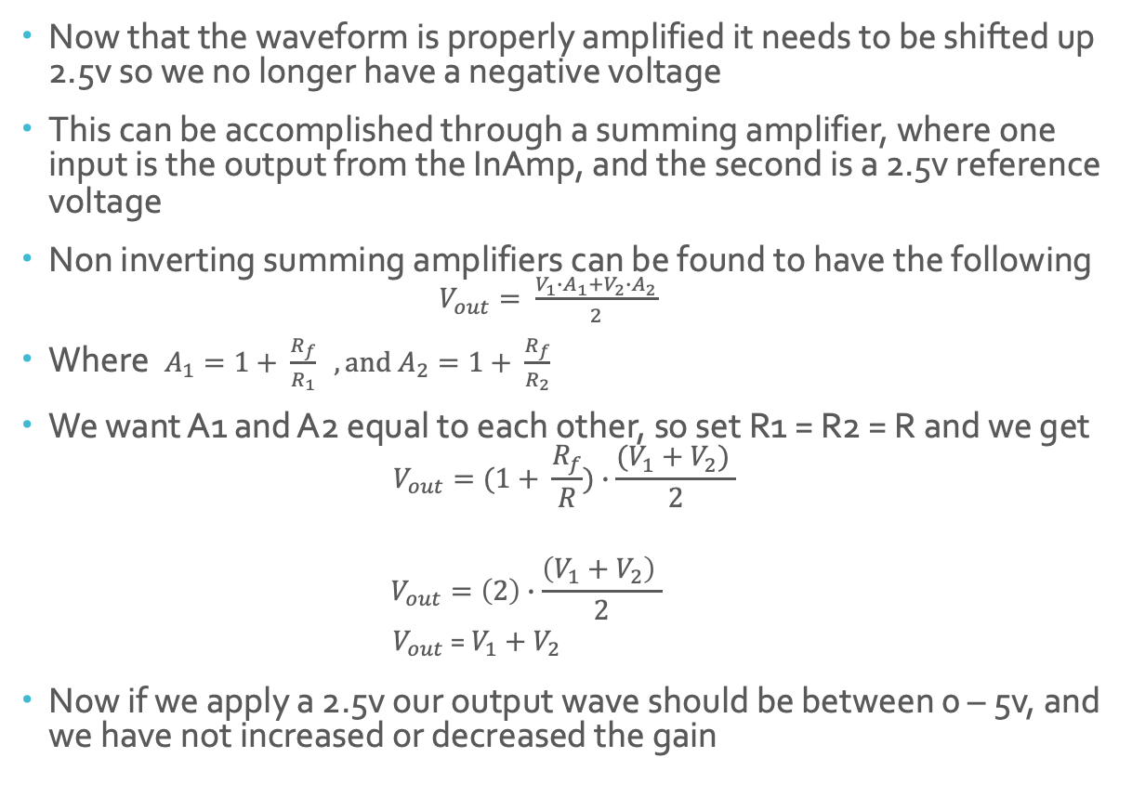
Design Level Shifter
Now that the waveform is properly amplified it needs to be shifted up 2.5v so we no longer have a negative voltage
This can be accomplished through a summing amplifier, where one input is the output from the InAmp, and the second is a 2.5v reference voltage
Non inverting summing amplifiers can be found to have the following $V_{out}= \frac{V_{1}∙A_{1}+V_{2}∙A_{2}}{2}$
Where $A_{1}=1+ \frac{R_{f}}{R_{1}}$ $, and A_{2}=1+ \frac{R_{f}}{R_{2}}$
We want A1 and A2 equal to each other, so set R1 = R2 = R and we get
$$V_{out}=(1+ \frac{R_{f}}{R})∙\frac{(V_{1}+V_{2}) }{2}$$
$$V_{out}=\left(2\right)∙\frac{\left(V_{1}+V_{2}\right) }{2}$$
$V_{out}$ = $V_{1}+V_{2}$
Now if we apply a 2.5v our output wave should be between 0 – 5v, and we have not increased or decreased the gain
And if we set Rf = R as well

Slide 26
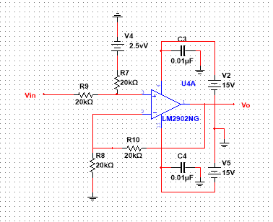
Design Level Shifter
Below is my design for the level shifter for my conditioning circuit. A value of 20k ohms was chosen for R, and V2 was directly wired to a 2.5v voltage supply.
When I attach this to my In-Amp I do not want to have unnecessary inputs, so I will determine my 2.5v reference level based off of the power rails

Slide 27
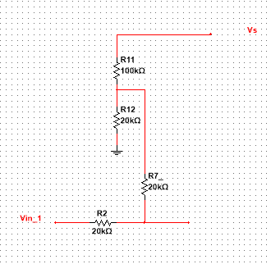
Design Level Shifter
In order to define a reference from a +15v power rail, I will need to create a voltage divider so that I can read 2.5v. I initially chose resistors of 100k ohm and 40k ohm, as running a voltage divider like this would give me a Vout of my wanted 2.5v.
The issue though is my input to the level shifter has a 20k ohm (R7) resistor
Because of this, I need to account for R7 in my calculations, and putting R7 in parallel with my second voltage divider resistor gives me a value of 20k.

Slide 28
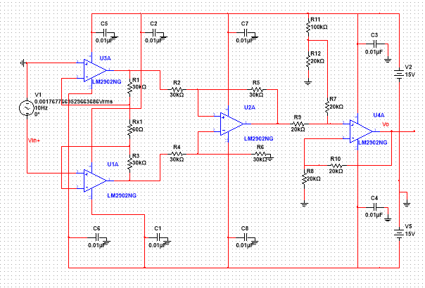
Design Conditioning Circuit
All put together I had something that looked like this

Slide 29
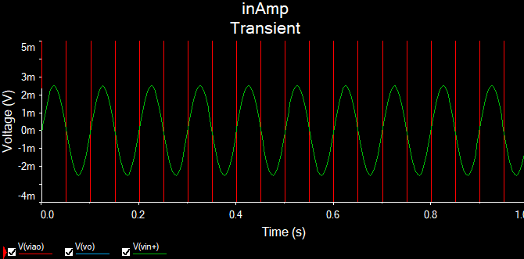
Testing
Note that after the first test I realized I had messed up on my gain calculations, and adjusted my circuit so Rx was 120. As mentioned before, one of the many benefits of op amps is that the gain is determined by one resistor. So I had to adjust one value, instead of several!
The testing on the circuit was completed using transient analysis. At first a 5mVpkpk signal is pumped into the in amp shown below. We should expect to see a 1.25-3.75v sinusoidal of same phase on our output.
Later down the line mat lab was used to generate sinusoidal with noise to see how the circuit would react

Slide 30
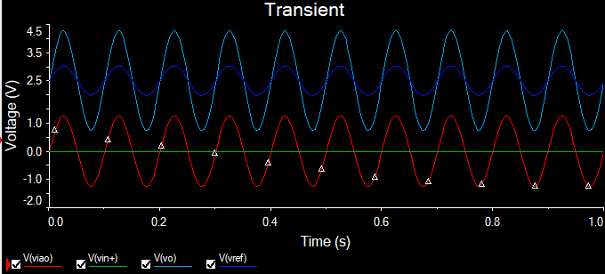
Testing
At first I was unsure of why my Vo was being amplified. It should only be shifted. Looking closer it had the right max value of 3.75, but the bottom of the output was being amplified so my min range was about .75v.
I re ran the simulation, this time including Vref (the 2.5v input into the level shifter). To my surprise instead of DC being inputted a sinusoidal was being pumped in.
I came to realize that a filter would need to be placed onto the voltage divider in a similar manner as the rest of the op amps

Slide 31
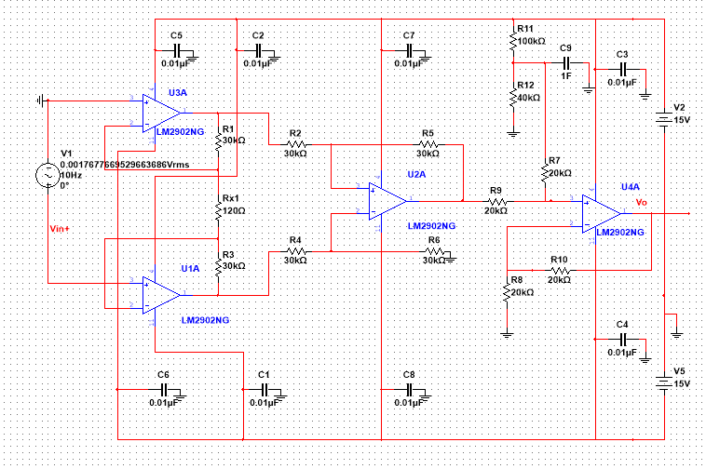
Testing
The resulting circuit came about after attaching a 1 farad cap as to filter out any AC noise that might come about in my Voltage reference

Slide 32
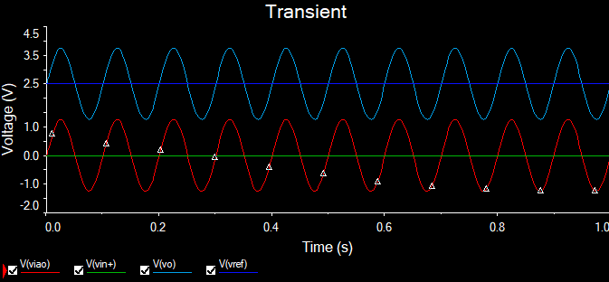
Testing
The circuit was then simulated again, and the voltage reference this time can be seen as being a 2.5v DC value, instead of an AC value. The output is as expected. So far this circuit should work fine for our load cell

Slide 33
Testing
Upon researching deeper into why AC noise was coming in off the power rails, I discovered a fun feature, and yet another benefit to In-Amps
The grounding of the third op amp in an instrumentation amplifier can be used as a reference voltage input. Deeper analysis of the circuit can be done to show this
The new circuit conditioning circuit can be made with out the level shifting amp, as we will apply 2.5v as a reference for the In-Amp
This time to achieve a proper voltage divider, as we would have to worry about R6 in the In-Amp, a value of 100k and 30k were chosen to produce the reference

Slide 34
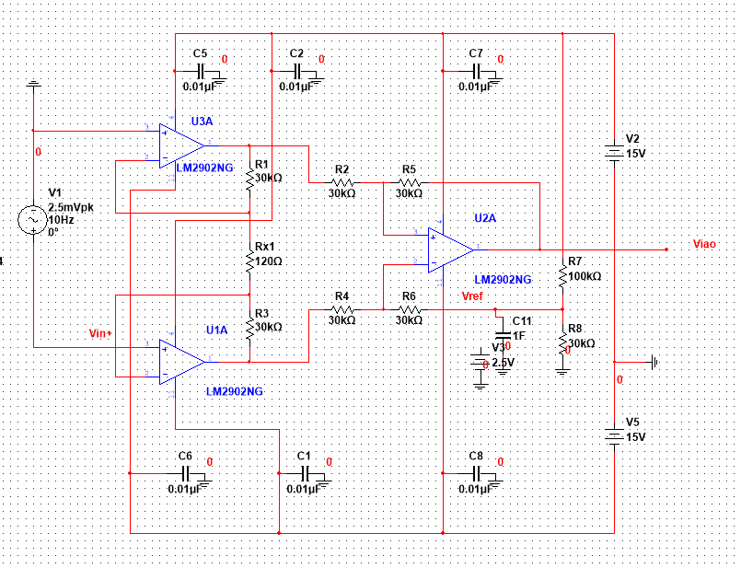
Testing
Single Instrumentation Amp Conditioning Circuit

Slide 35
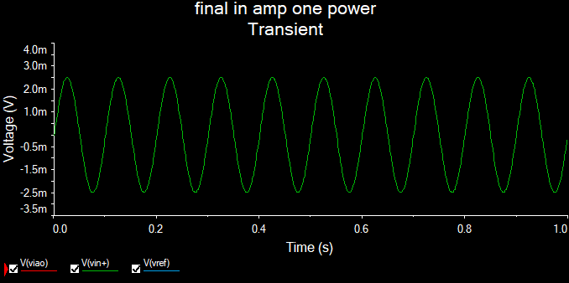
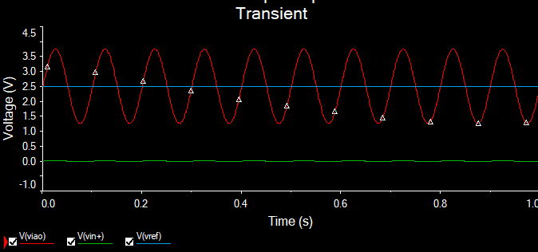
Testing
The results came out as expected for the 3 Amp circuit, having the input signal properly amplified and shifted

Slide 36
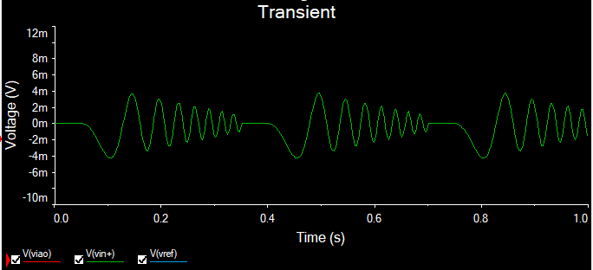
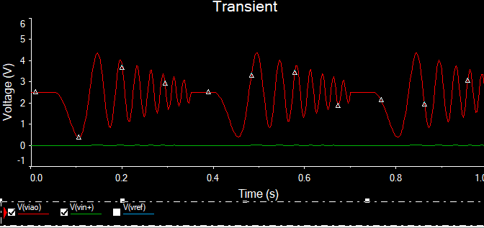
Testing 3 amp circuit with chirp voltage

Slide 37
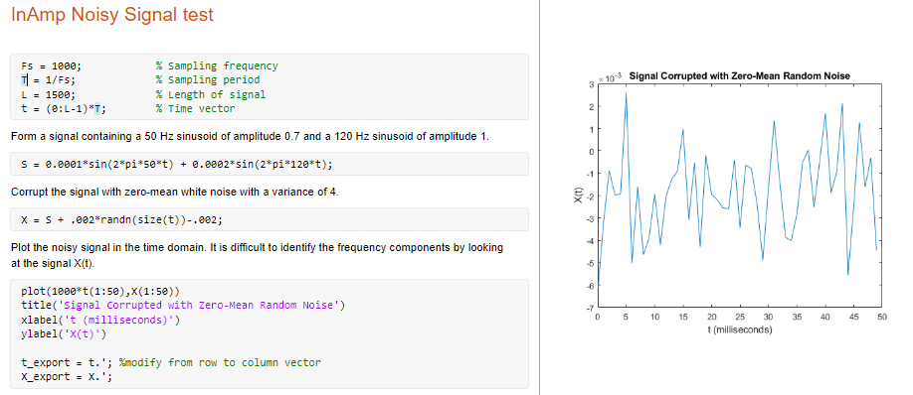
Testing Noisy Signals
Using Matlab, a high frequency and low frequency random noise was generated
Using a piecewise signal generator, the values from Matlab were copied in, and my signal was simulated on the three amp circuit

Slide 38
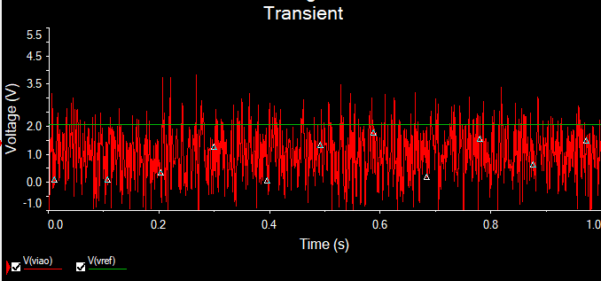
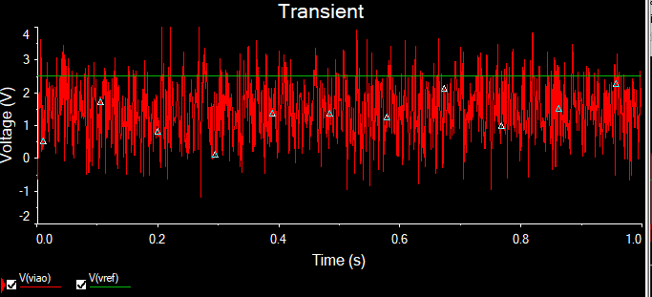
Testing
The first graph shows the initial results of the high frequency signal. My voltage reference was no longer at 2.5v, and was closer to 2. This is due to the filter I have (the single cap) on my voltage reference of the In-Amp. With a deeper analysis, this filter could be modified to allow for the higher frequencies, but won’t be needed for this system, as this is a bit of an extreme on the frequency aspect
Changing the voltage reference to a 2.5v DC that isn’t powered off the In-Amp power rails resulted in a proper reference voltage, and a properly generated amplified, shifted, signal shown on the bottom right
It should be noted that I messed up and did not realize there were several values greater than |5mV| and as a result I had a signal that dropped lower than 0 on the output

Slide 39
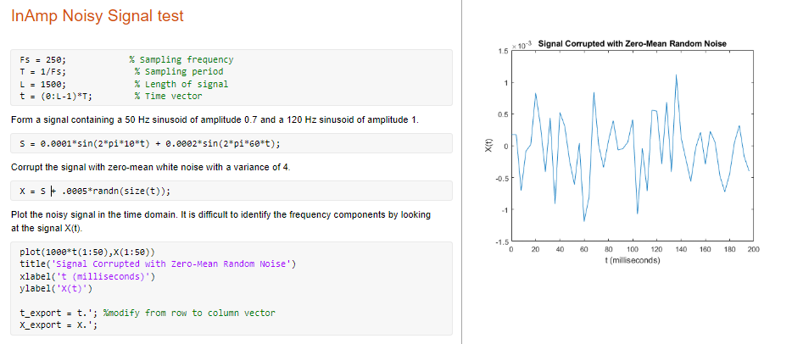
Testing
Our system is more realistically going to see a lower frequency range of incoming data, so a new signal was generated from the following matlab code

Slide 40
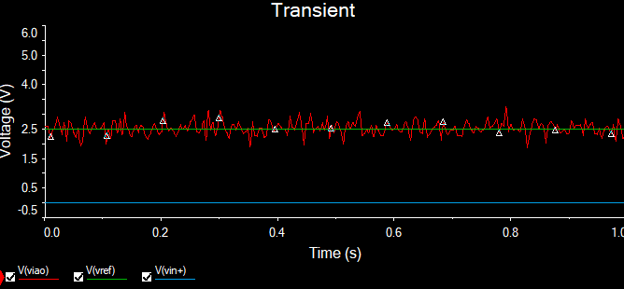
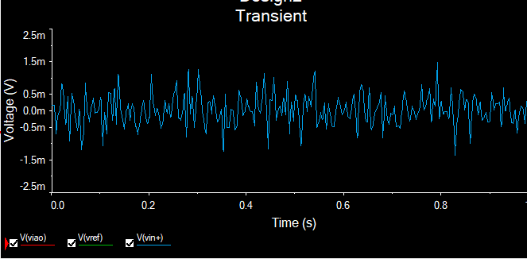
Testing Low Frequency Noisy Signal
The results of the low frequency signal are as follows. Note this time I went to the extreme on the formula as to make sure no value greater than |5mV| was generated
With the lower frequency, the filter for the 2.5v reference works fine

Slide 41
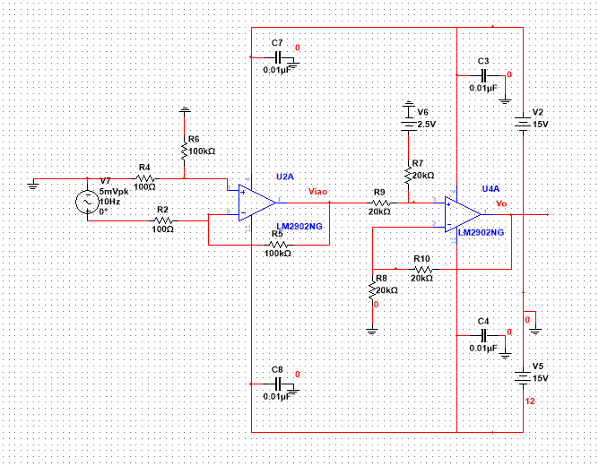
Analysis Can we reduce it further?
As of right now 3 op amps are used in such a way that we amplify and shift a DIFFERENCE of two inputs
So why not just use an op amp set up to take a difference, and then use a second one to shift are results?
I took the level shifting op amp from earlier and combined it with a difference op amp that would have a gain of 1000. We want equal gain on both inputs, so this makes calculations easier and the resulting circuit had R5 and R6 equivalent and set at 100k, and, R2 and R4 equivalent with a value of 100

Slide 42
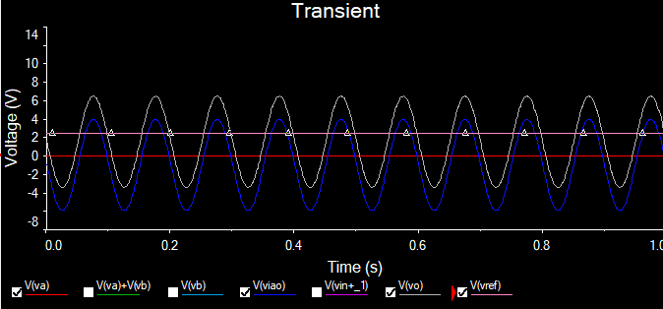
Analysis
The transient sweep of the differential circuit started to show the biggest reason a differential amp was avoided
We should be seeing an output from the difference amplifier of -2.5v to 2.5v, instead a range of -5.9v to 4v is seen
We are now seeing a gain of 1030, instead of 1000, additionally we are seeing a shift in the waveform, as we would expect magnitude of highs and lows out of the difference amplifier to be equal

Slide 43
Analysis
So where does the shift come from?
To understand this problem the Op Amp must be broken down a bit further
In ideal situations, there is zero current flowing into the inputs of the op amp, as the impedance is calculated to be infinite. The issue with ideal situations, is that is not always the case
A measurement was taken at the input terminal of the difference amplifier and displayed on the transient sweep
A sinusoidal with magnitude of 8.21 uV was detected on the negative terminal, and about - .92 mV was detected on the positive terminal
The summation of these two values give -.91179mV. If we subtract .91179 mV from our 5mV before we amplify, then our output signal would now be between -5.91179V and 4.088V
These signals are referred to as the common-mode signal and are the reason the circuit is shifted

Slide 44
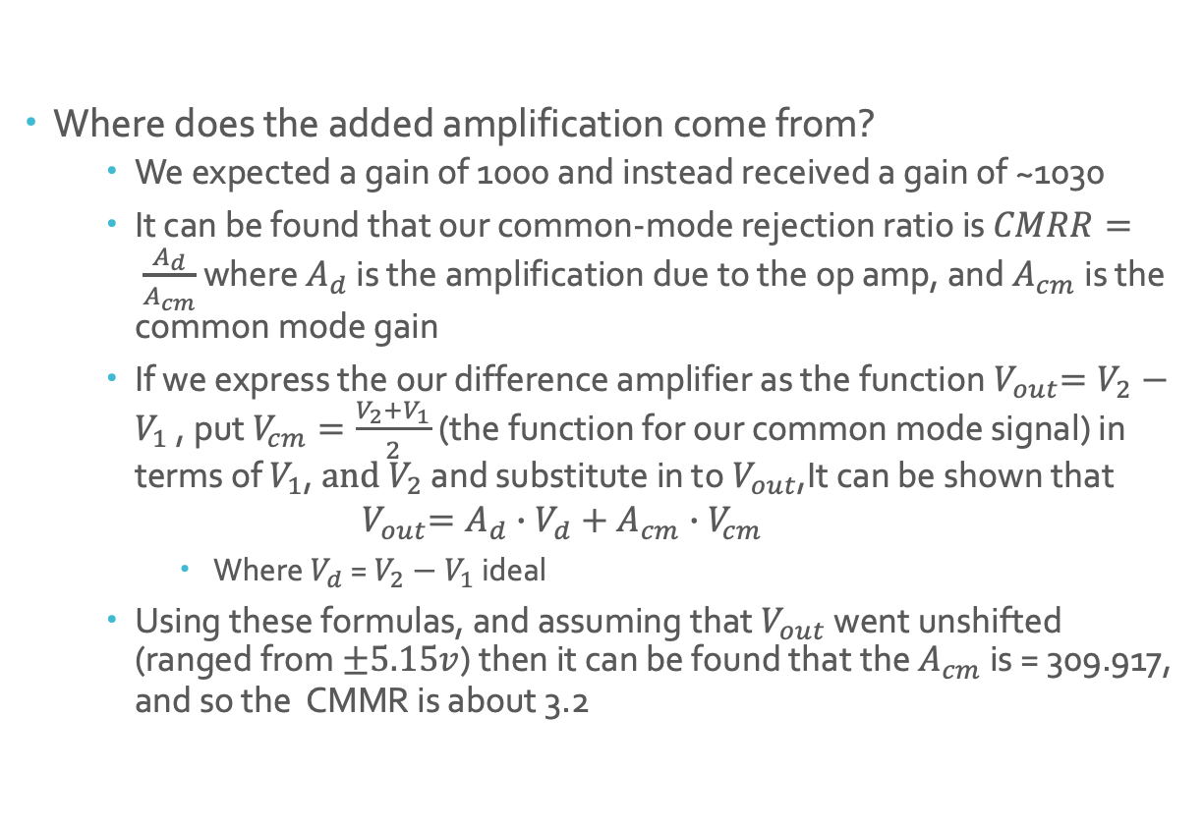
Analysis
Where does the added amplification come from?
We expected a gain of 1000 and instead received a gain of ~1030
It can be found that our common-mode rejection ratio is $CMRR= \frac{A_{d}}{A_{cm}}$ where $A_{d}$ is the amplification due to the op amp, and $A_{cm}$is the common mode gain
If we express the our difference amplifier as the function${ V}_{out}=V_{2}−V_{1}$ , put $V_{cm}=\frac{V_{2}+V_{1}}{2}$(the function for our common mode signal) in terms of $V_{1}$, $and V_{2}$ and substitute in to${ V}_{out}$,It can be shown that
$${ V}_{out}=A_{d}∙V_{d}+A_{cm}∙V_{cm}$$
Where $V_{d}$ = $V_{2}−V_{1}$ ideal
Using these formulas, and assuming that $V_{out}$ went unshifted (ranged from $±5.15v$) then it can be found that the $A_{cm}$ is = 309.917, and so the CMMR is about 3.2

Slide 45
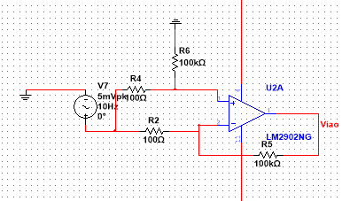
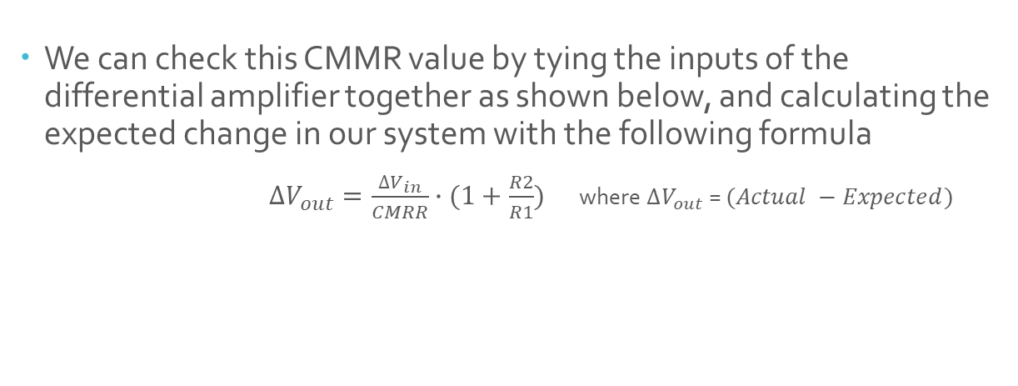
Analysis
We can check this CMMR value by tying the inputs of the differential amplifier together as shown below, and calculating the expected change in our system with the following formula
$∆V_{out}=\frac{∆V_{in}}{CMRR}∙(1+\frac{R2}{R1})$ where $∆V_{out}$ = $(Actual −Expected)$

Slide 46
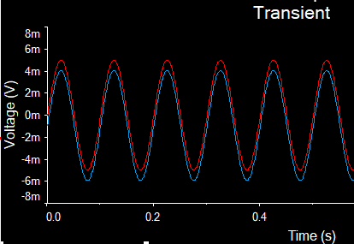
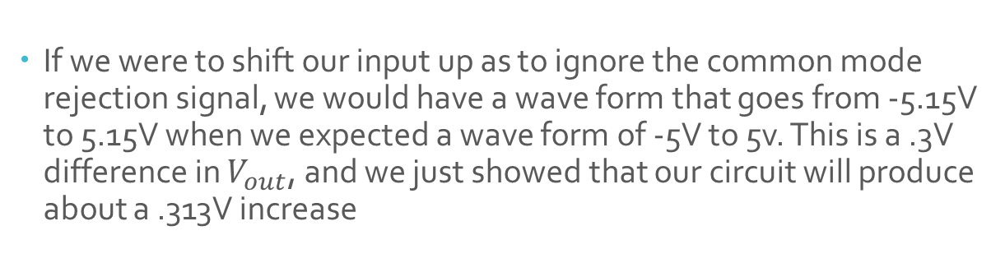
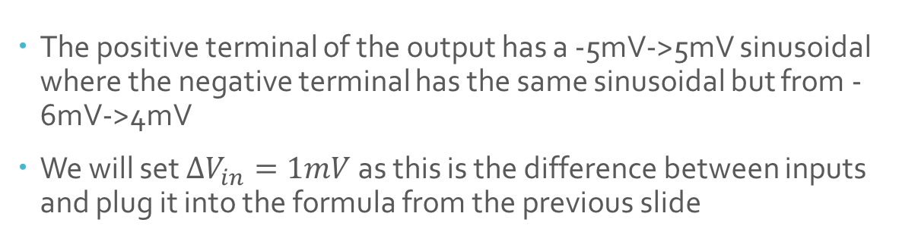

Analysis
The positive terminal of the output has a -5mV->5mV sinusoidal where the negative terminal has the same sinusoidal but from -6mV->4mV
We will set $∆V_{in}=1mV$ as this is the difference between inputs and plug it into the formula from the previous slide
$$∆V_{out}=\frac{.001V}{3.2}∙\left(1+\frac{1ook}{100}\right)$$
$=0.00313∙\left(1001\right)$
$=.31283V$
If we were to shift our input up as to ignore the common mode rejection signal, we would have a wave form that goes from -5.15V to 5.15V when we expected a wave form of -5V to 5v. This is a .3V difference in $V_{out}$, and we just showed that our circuit will produce about a .313V increase

Slide 47
Analysis
We know how much the common mode signal is going to affect our signal, why can’t the level shifter handle the correction?
Instead of shifting plus 2.5v, shift plus 3.41V
Instead of a gain of 1, have a gain of .970874 to shrink it down a bit
Though this is doable, and would work just fine, the issue arises when we step away from ideal cases. Resistors have a tolerance, so if any of these resistors were even slightly different, our CMRR decreases dramatically, causing an even larger impact on our output
The instructional amplifier eliminates the common mode signal via buffer amplifiers, which create an incredibly high impedance at the inputs, which decreases any noise at the inputs to zero

Slide 48

Analysis
Additionally the differential amplifier won’t react as well as the instructional amplifier, as the higher the frequency the more corrupted the wave form
If we introduce the differential amplifier the same high frequency input as before we receive the following at the output
Though we did not introduce the changes mentioned in slide 47 to compensate for the system, it is not needed to show the undesired output that we will be getting from the difference amplifier

Slide 49
Analysis
On the left is the same input but from the In-Amp design, and the right is our difference amplifier output
Comparing the two by sight it can be easily determined that they are not equal
So at higher frequencies our In-Amp holds up, where as our Difference Amp does not. Just another reason why the In-Amp was chosen, as we won’t know exactly if we will have high frequencies such as this

Slide 50
Conclusion
Though testing is yet to come on an actual circuit using the above method. As long as the output from the load cell is sent through an In-Amp conditioning circuit, our Arduino/microcontroller will be able to accurately detect minute changes in the system
At this point the sensor will need to be zeroed by attaching a known weight to the load cell, and determining the value of the read voltage, compared to the expected voltage
Once the zeroed value is adjusted in the code, the system can be installed
From there the microcontroller will read values from the load cell once every one to five minutes and broadcast the values to the internet

Slide 51
Works Cited
6. How to Use Load Cells - A&D Company. https://aandd.jp/products/weighing/loadcell/introduction/pdf/6-1.pdf.
“Datasheet 3134 - Micro Load Cell (0-20kg) - czl635 Contents: Manualzz.” Manualzz.com, https://manualzz.com/doc/17523942/datasheet-3134---micro-load-cell---0-20kg----czl635-contents.
“Intro to Amplifiers.” The MicroKit Resource Hub, UC, Berkeley, 21 Aug. 2020, https://microkit.berkeley.edu/intro-to-amplifiers/.
Maestre, Susie. “What Is Common-Mode Rejection Ratio in Op-Amps?” CircuitBread, 7 July 2021, https://www.circuitbread.com/ee-faq/what-is-common-mode-rejection-ratio-in-op-amps.
OpenStax. “Physics.” Lumen, https://courses.lumenlearning.com/physics/chapter/11-7-archimedes-principle/.
Rubio, Alfonso Parra. “Instruments Needed for a Slow Speed Wind Tunnel.” Fab Central, MIT, http://fab.cba.mit.edu/classes/865.21/people/alfonso/wt.html.
Stanley, William D. Operational Amplifiers with Linear Integrated Circuits. Prentice Hall, 2002.
Stiles, Jim. The Voltage Follower Lecture - ITTC. The University of Kansas Dept. of EECS, http://www.ittc.ku.edu/~jstiles/412/handouts/2.4%20Differnce%20Amplifiers/The%20Voltage%20Follower%20lecture.pdf.

