Slide 1
Bootcamp_Project
Datei erstellt am: 2/11/2022 11:01:03 AM

Slide 2
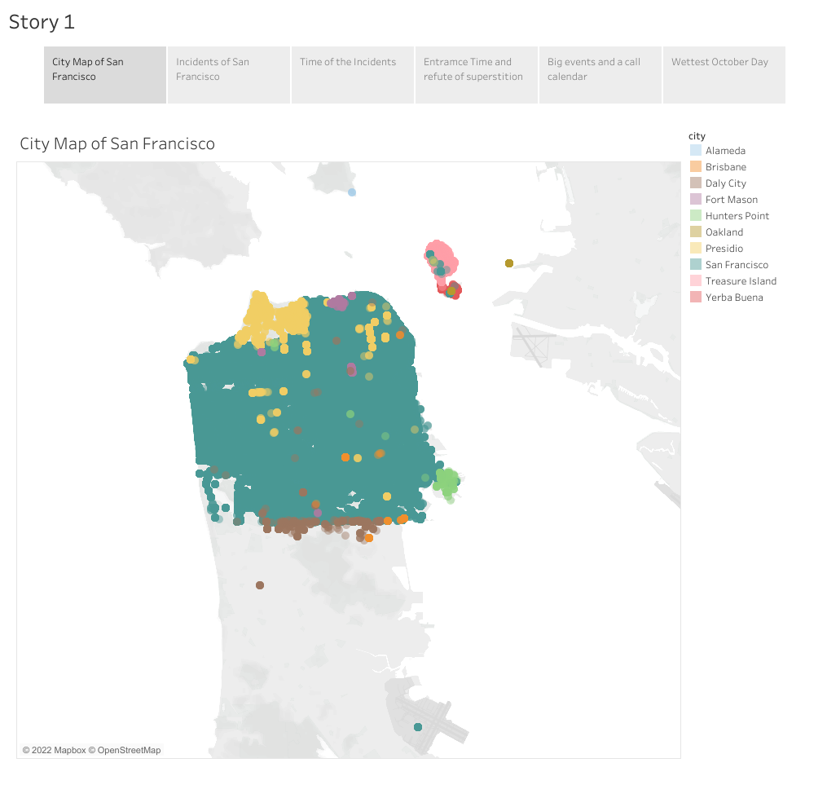
Angel Island

Slide 3
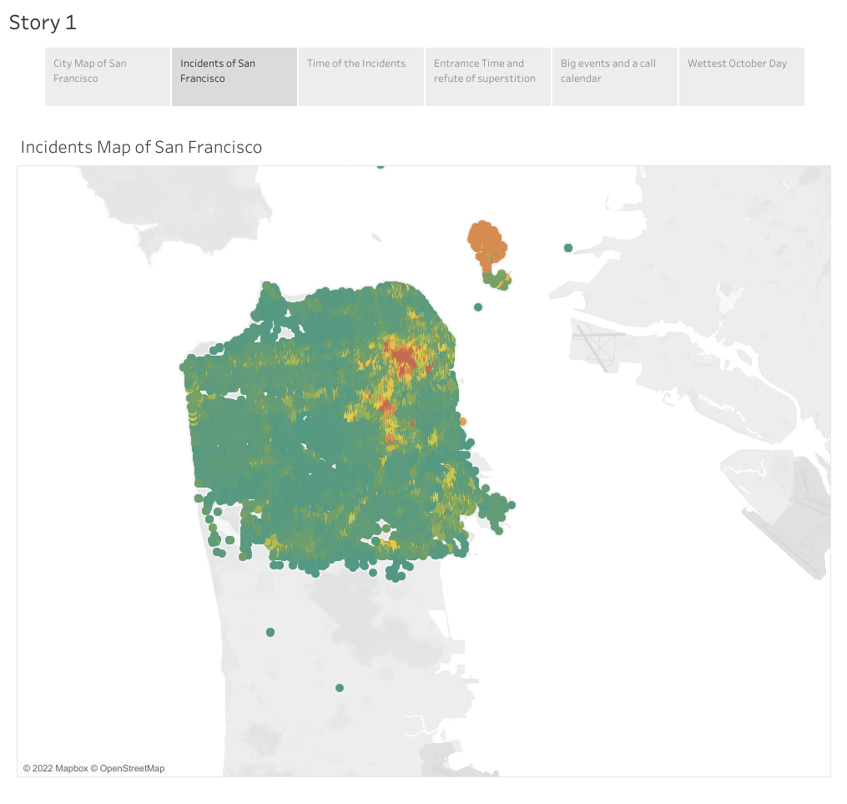

Slide 4
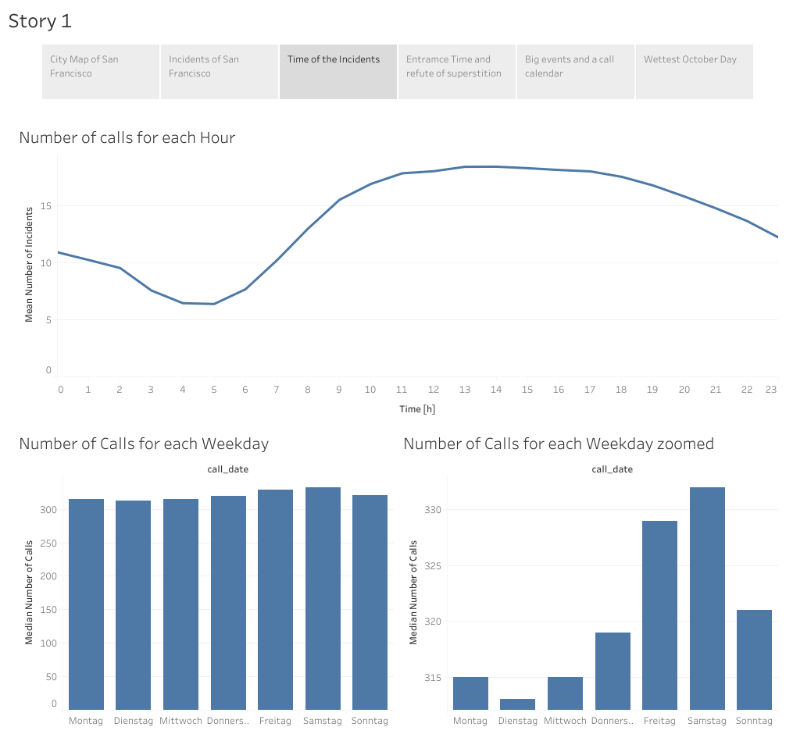
Monday Tuesday Wednesday Thursday Friday Saturday Sunday
Monday Tuesday Wednesday Thursday Friday Saturday Sunday

Slide 5
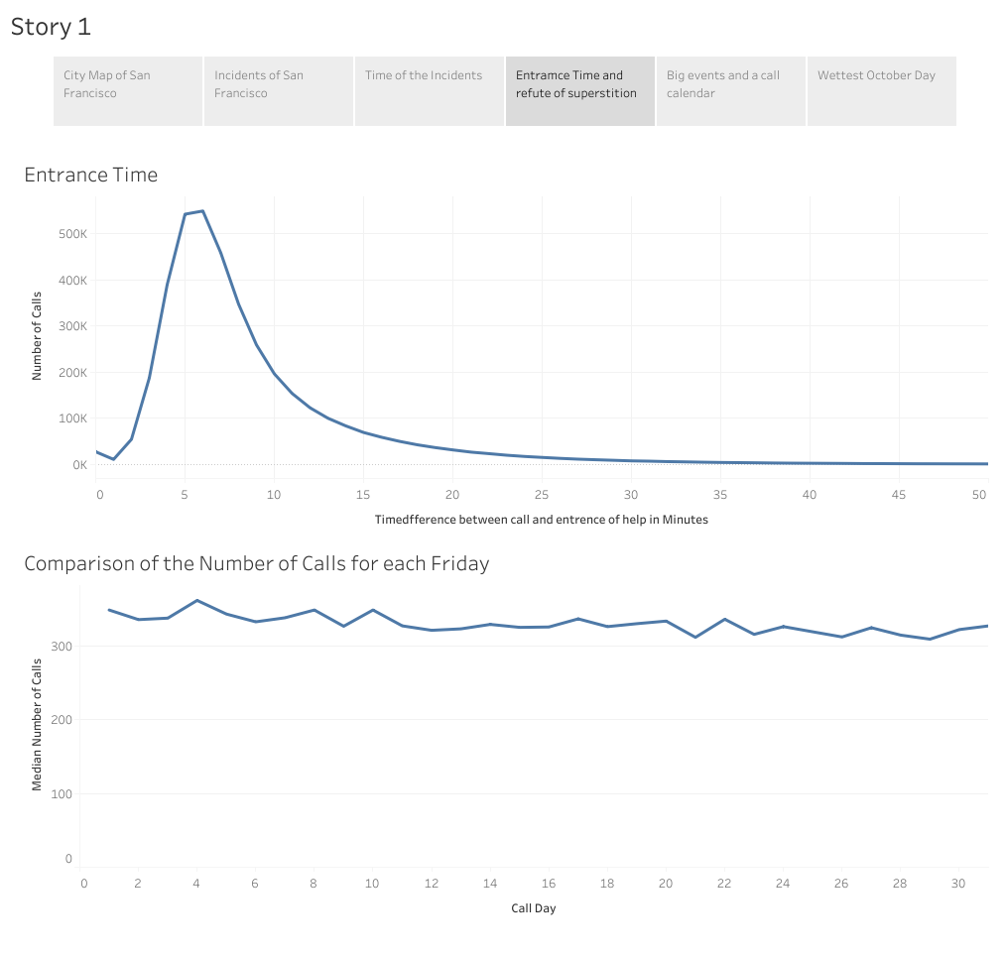

Slide 6
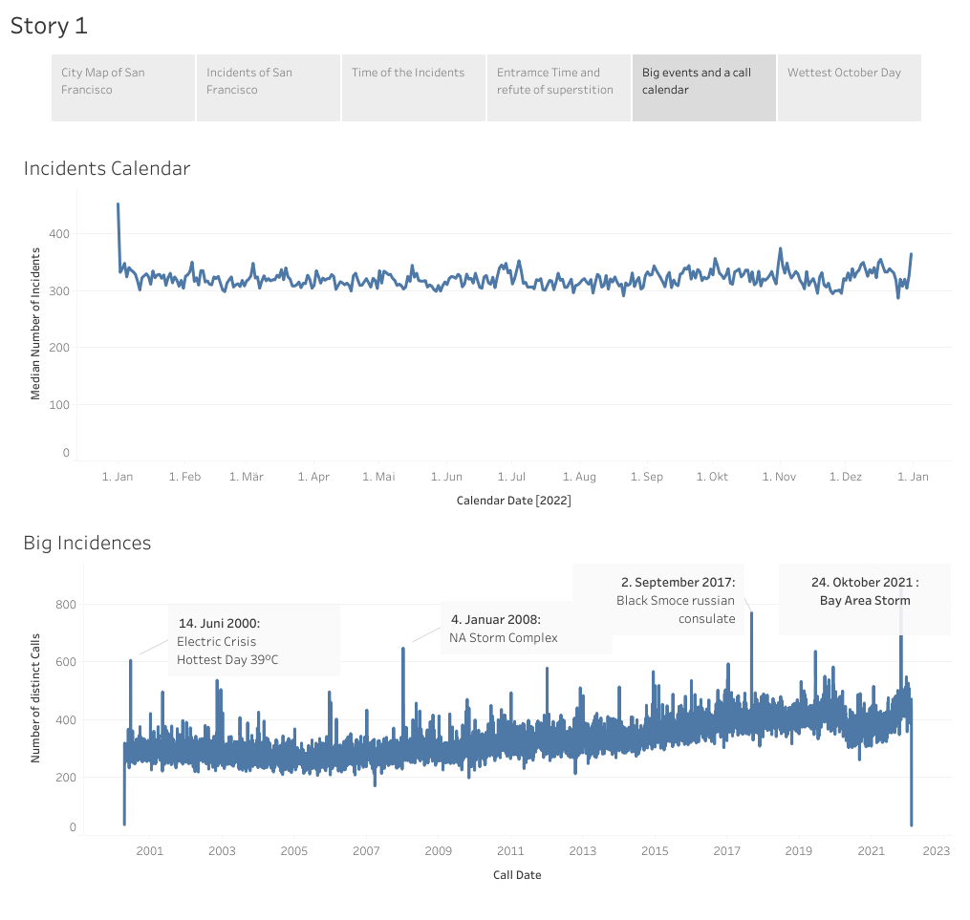

Slide 7
