Slide 1


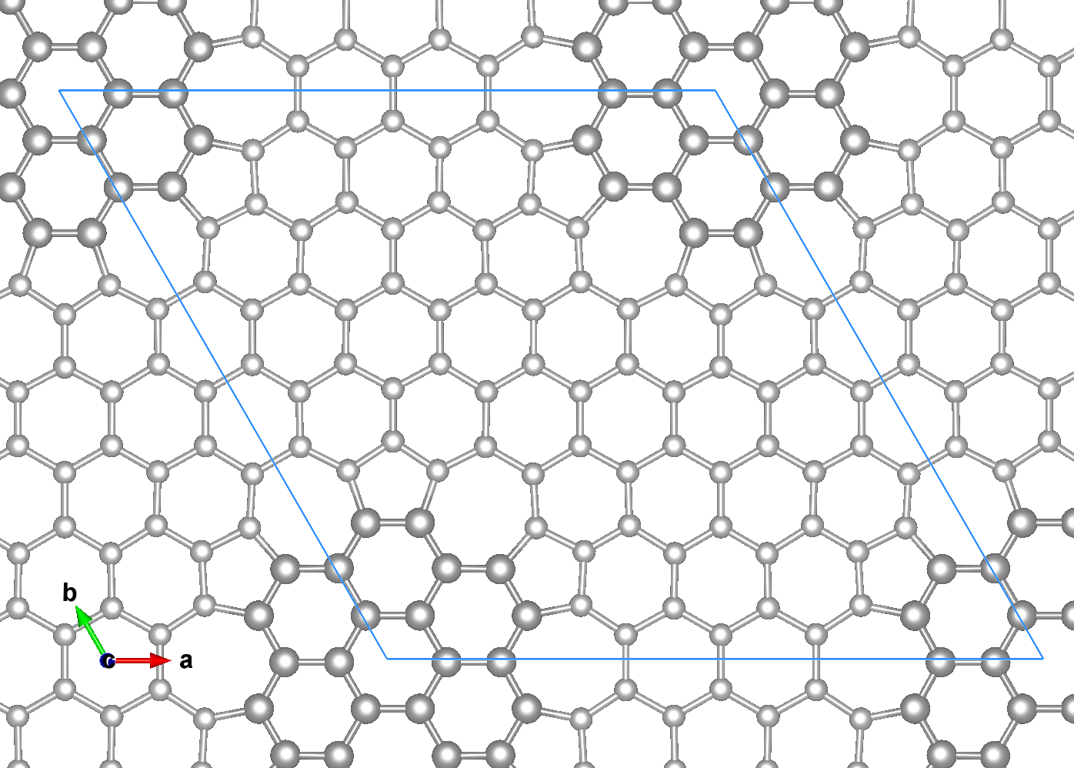

Presenter & Co-Authors:
Rolando S. Sánchez, Henry P. Pinto
Affiliation:
CompNano Group
School of Physical Sciences and Nanotechnology
Yachay Tech University
Urcuquí, Ecuador
First principles studies of 7x7 graphene superlattices with topological defects and transition metal adatoms
Contact Information:
Email: rolando.sanchez@yachaytech.edu.ec
For more information
Date: May 10, 2025

Slide 2
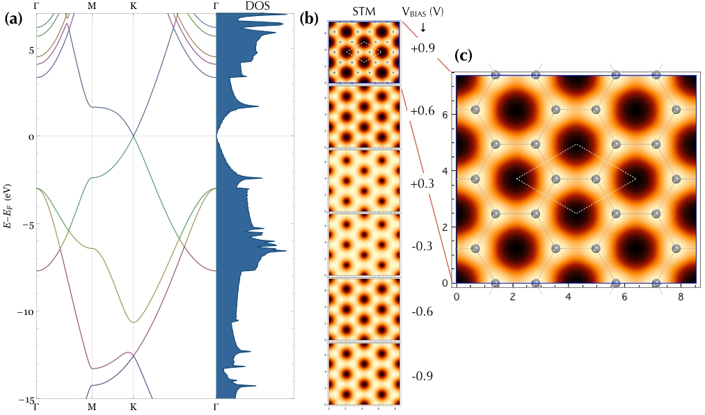
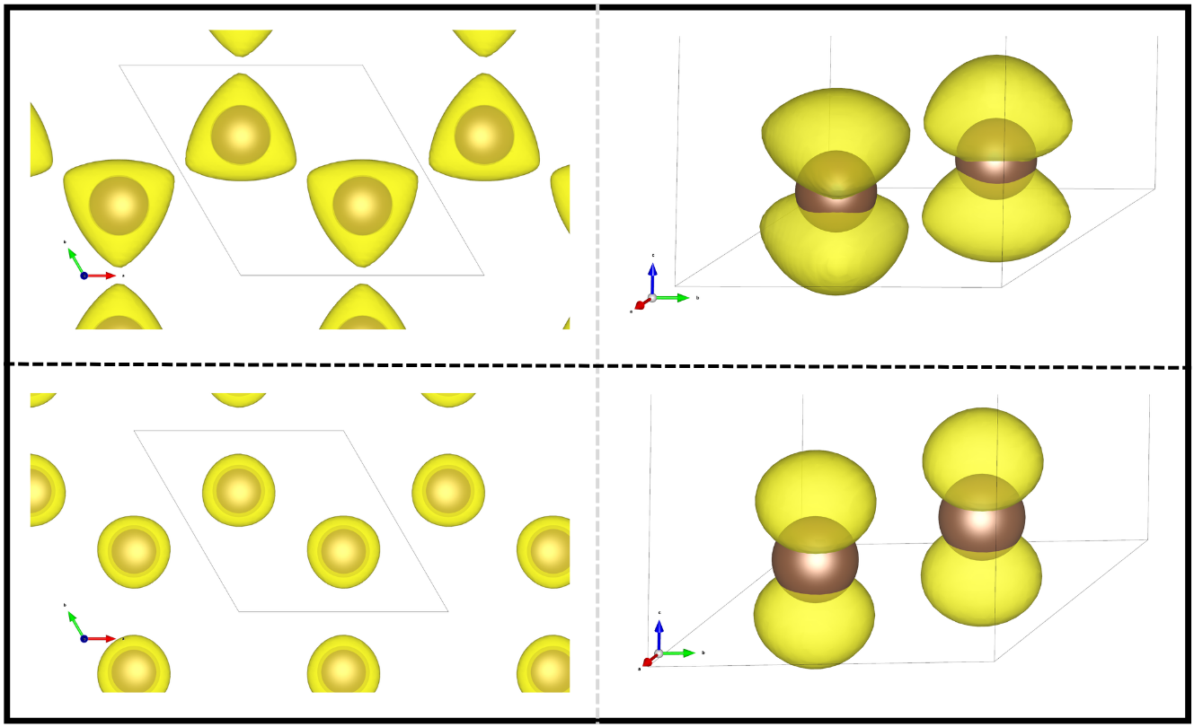
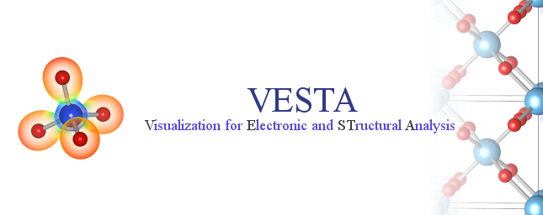

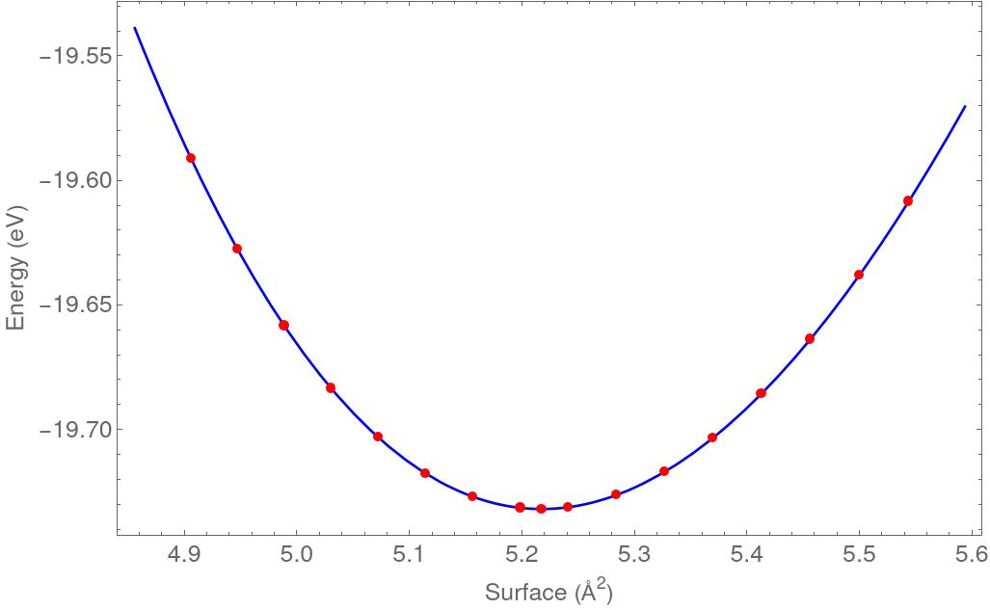
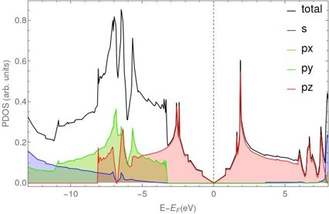
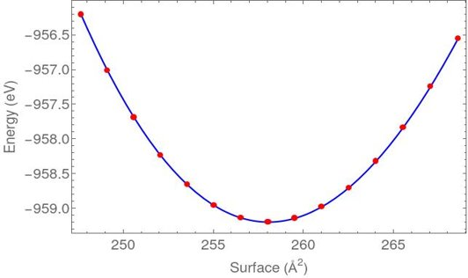
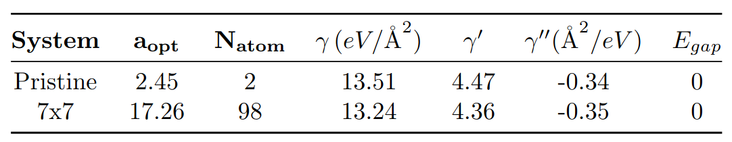
Introduction
Graphene's lack of a bandgap and magnetism limits its applications.
However, Topological defects, such as flower-like defects (FLDs) observed via STM [1], can modify its electronic and magnetic properties. Certain 1D extended defects also show unique behaviors like 1D conductivity [2].
A systematic study of graphene's structural, mechanical, electronic, and magnetic properties is thus crucial to overcome these limitations. Here, we propose and investigate a hexagonal array of FLDs forming a 7×7 superlattice.
Fig. 2. (a) Band Structure and Density of States (DOS) for pristine. (b, c) Simulated STM images for each corresponding V_{BIAS.}
(d.1, d.2) Isosurface images of partial charge density of last occupied band.
(d.3, d.4) Isosurface images of partial charge density of first unoccupied band.
Methodology
Calculations were performed using VASP [3], employing the R2SCAN+rvv10 functional [4]. Visualizations were generated using VESTA [5].
We used a 900 eV plane-wave cutoff and a k-point mesh spacing of 0.022 Å⁻¹ for both pristine graphene and the 7×7 FLD superlattice.
(d.1)
(d.2)
Pristine
(a)
(b)
(d.3)
(d.4)
Results
(a)
(b)
Fig. 1. (a) Energy equation of state (EOS) for pristine. (b) Partial density of states for pristine.
Fig. 3. (a) Results of calculations for pristine graphene and 7x7 arrangement using the EOS [4]. (b) Energy equation of state (EOS) for 7x7 arrangement.

Slide 3
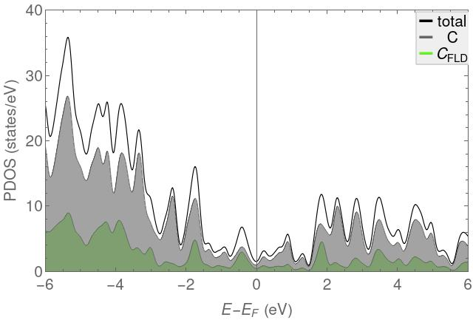
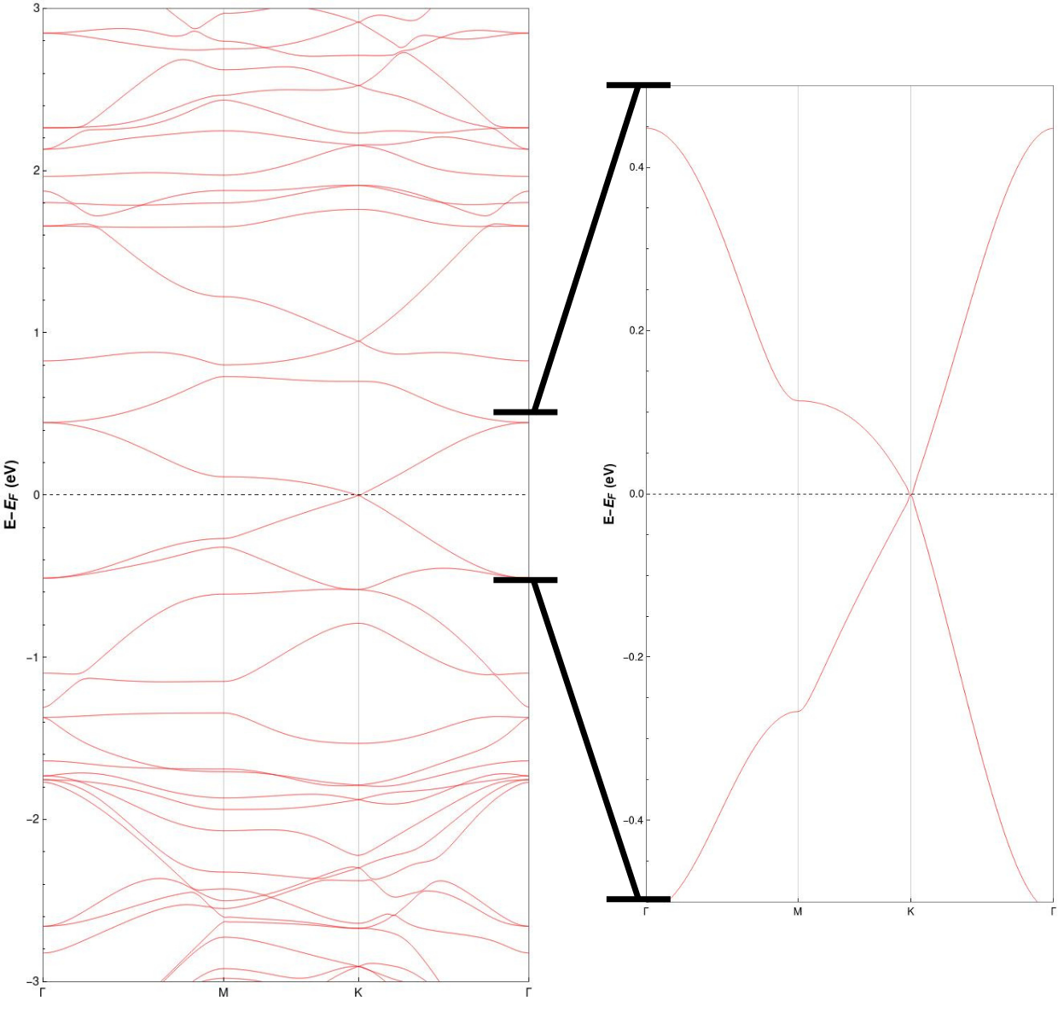
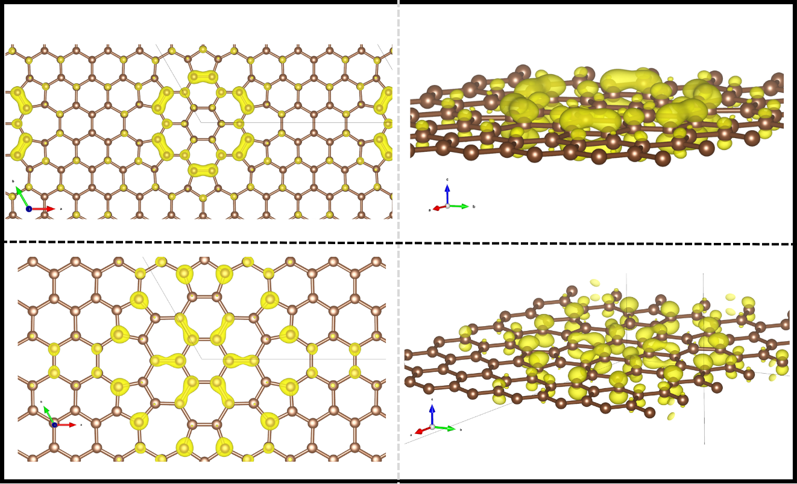
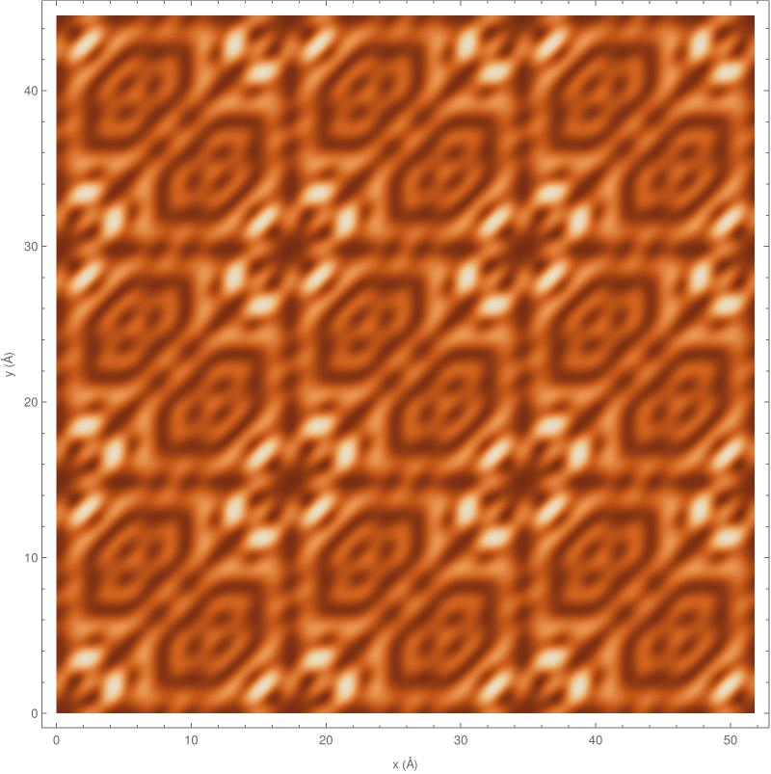
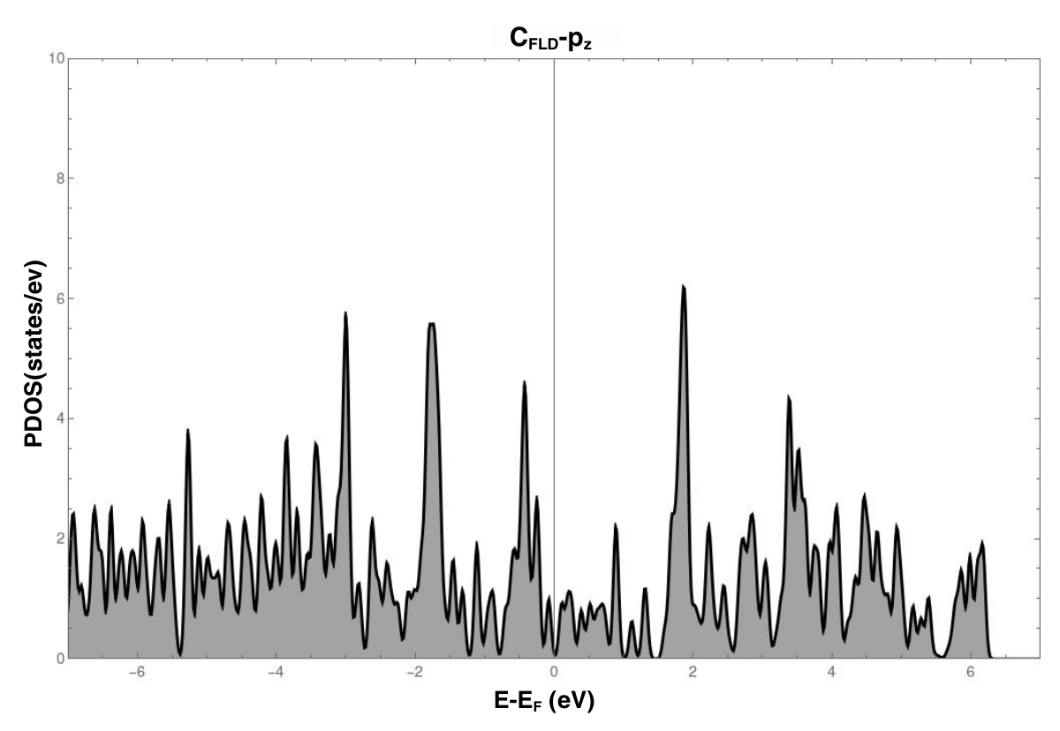
(b)
(a)
(d.1)
(d.2)
(e)
(c)
(d.3)
(d.4)
Fig. 4. (a) Band Structure of 7x7 superlattice. (b) Partial density of states (PDOS)of 7x7 superlattice. (c) PDOS of FLD constituent C atoms. (d.1, d.2) Isosurface images of partial charge density of last occupied band. (d.3, d.4) Isosurface images of partial charge density of first unoccupied band. (e) Computed STM for hexagonal array of defects with pattern 7x7 for V_{BIAS}=-0.3 eV.
Bibliography
Conclusion and future insights
[1] Cockayne, E., Rutter, G. M., Guisinger, N. P., Crain, J. N., First, P. N., & Stroscio, J. A. (2011). Grain boundary loops in graphene. Physical Review B - Condensed Matter and Materials Physics, 83(19), 195425. https://doi.org/10.1103/PhysRevB.83.195425
[2] Pinto, H. P., & Leszczynski, J. (2014). Fundamental properties of graphene. In F. D'Souza & K. M. Kadish (Eds.), Handbook of carbon nanomaterials: Volume 5. Graphene—Fundamental properties (pp. 1–37). World Scientific.
[3] Kresse, G., & Furthmüller, J. (1996). Efficiency of ab-initio total energy calculations for metals and semiconductors using a plane-wave basis set. Computational Materials Science, 6(1), 15–50. https://doi.org/10.1016/0927-0256(96)00008-0
[4] Furness, J. W., Kaplan, A. D., Ning, J., Perdew, J. P., & Sun, J. (2020). Accurate and Numerically Efficient r2SCAN Meta-Generalized Gradient Approximation. Journal of Physical Chemistry Letters, 11(19), 8208–8215. https://doi.org/10.1021/ACS.JPCLETT.0C02405/SUPPL_FILE/JZ0C02405_SI_001.PDF
[5] Momma, K., & Izumi, F. (2011). VESTA 3 for three-dimensional visualization of crystal, volumetric and morphology data. Urn:Issn:0021-8898, 44(6), 1272–1276. https://doi.org/10.1107/S0021889811038970
Future work will explore vacancies in the arrangement, incorporate transition metal adatoms at the different non-equivalent sites, and investigate the effects of adding a new layer in different non-equivalent configurations.

