Slide 1


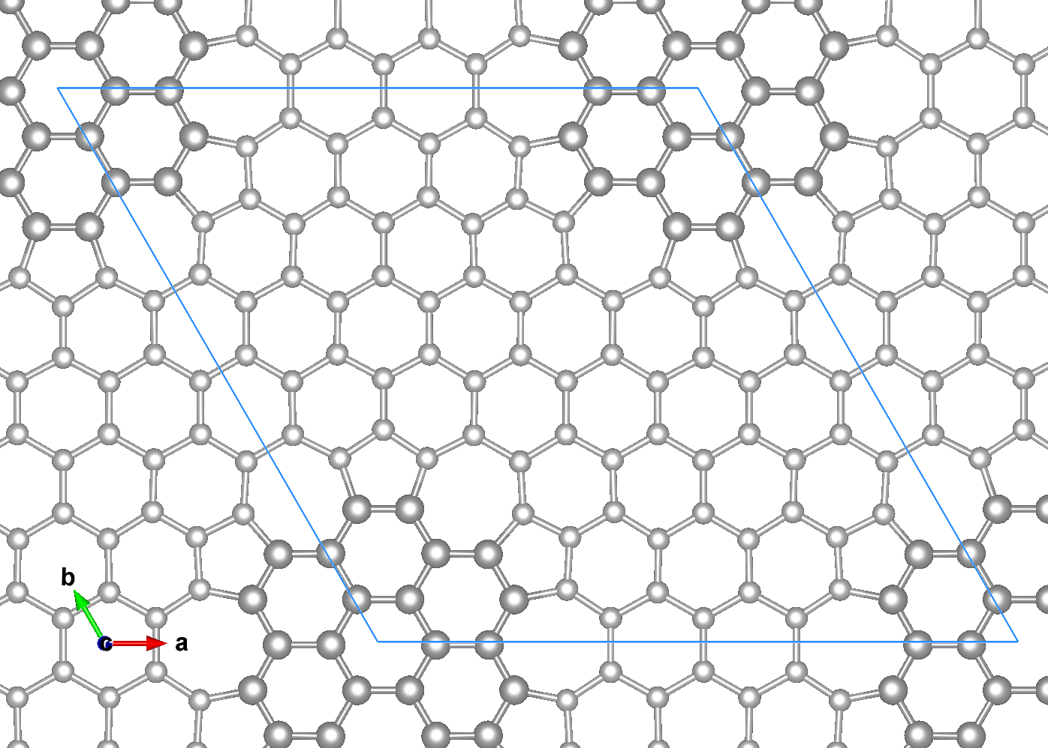

Presenter & Co-Authors:
Rolando S. Sánchez, Henry P. Pinto
Affiliation:
CompNano Group
School of Physical Sciences and Nanotechnology
Yachay Tech University
Urcuquí, Ecuador
First principles studies of 7x7 graphene superlattices with topological defects and transition metal adatoms
Contact Information:
Email: rolando.sanchez@yachaytech.edu.ec
Date: May 10, 2025

Slide 2
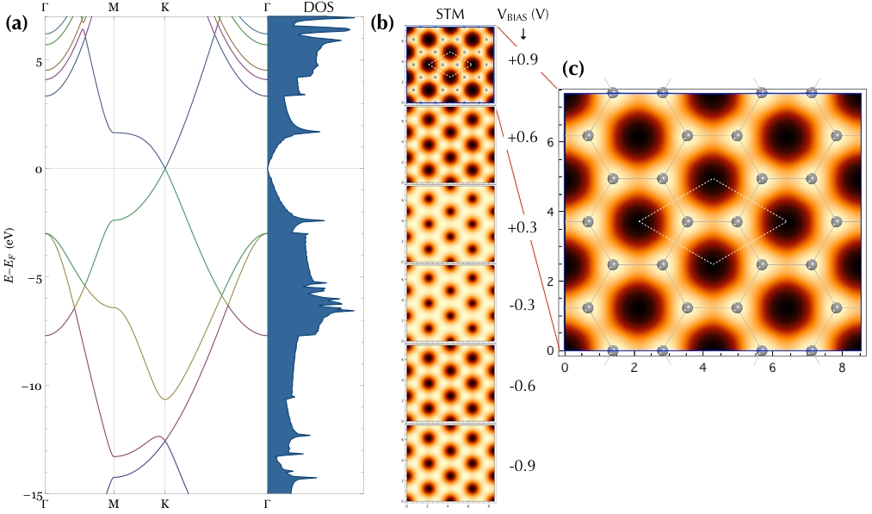
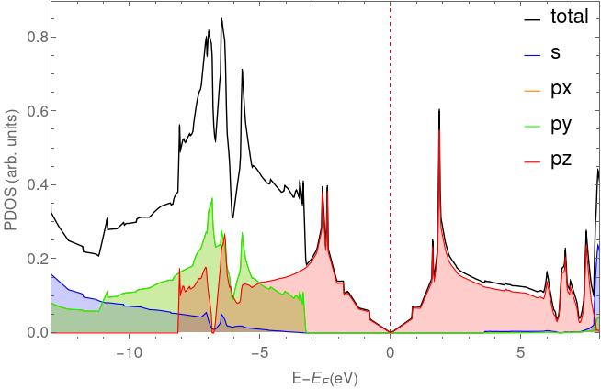
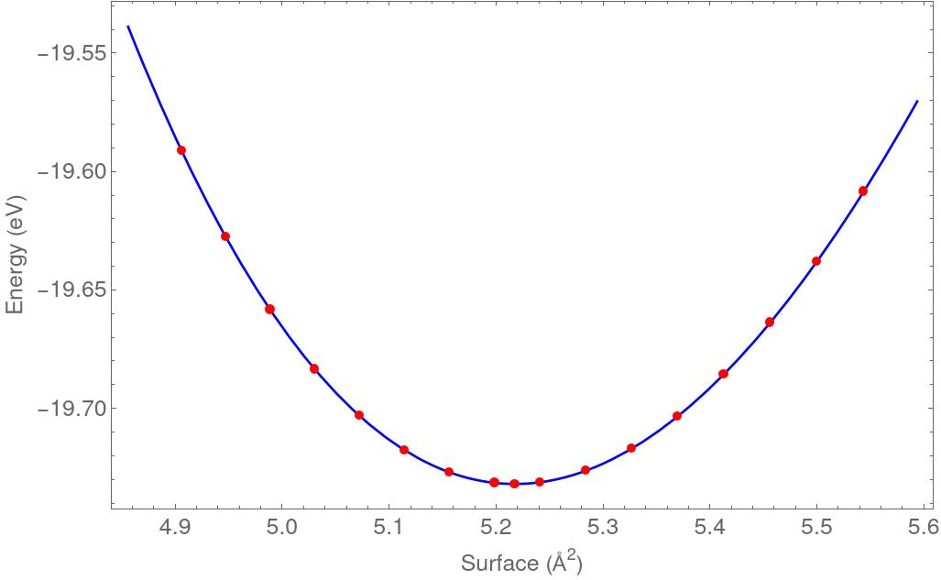

Introduction
Pristine
Graphene's lack of a bandgap and magnetism limits its applications in nanoelectronics and spintronics.
However, scanning tunneling microscopy (STM) studies have revealed flower-like defects (FLDs) [1]—topological defects that can tune its electronic and magnetic properties.
Measurements also suggest that certain one-dimensional extended topological defects exhibit unique electronic behavior, such as one-dimensional conductivity [2].
A systematic study of graphene's structural, mechanical, electronic, and magnetic properties is thus crucial to overcome these limitations. Here, we propose and investigate a hexagonal array of FLDs forming a 7×7 superlattice.
Methodology
(d)
(e)
Our first principles simulations were carried out using the Vienna ab initio Simulation Package (VASP) [3], employing the R2SCAN+rvv10 functional [?].
The plane-wave basis set was truncated at a kinetic energy cutoff of 900 eV, and a k-point mesh spacing of 0.022 Å-1 was used for Brillouin zone sampling in pristine and 7x7 superlattice which include the FLD.
VESTA
Fig. 2. (a) Band Structure and Density of States (DOS) for pristine. (b) Simulated STM images for each corresponding V_{BIAS} (c) Close-up on STM image for V_{BIAS} = +0.9. (d) Partial Density of States. (d) Partial density of states for pristine. (e) Energy equation of state (EOS) for pristine.

Slide 3
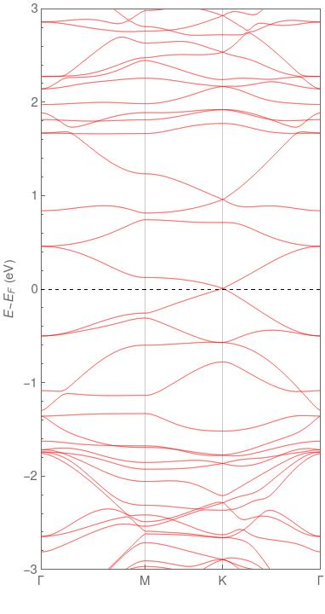
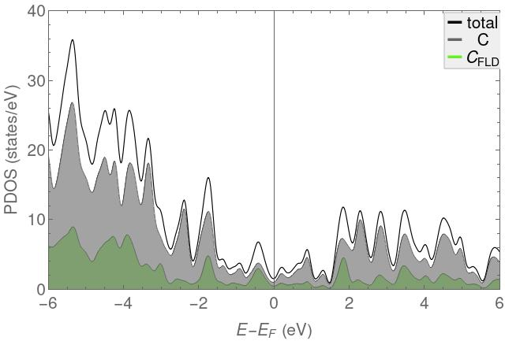
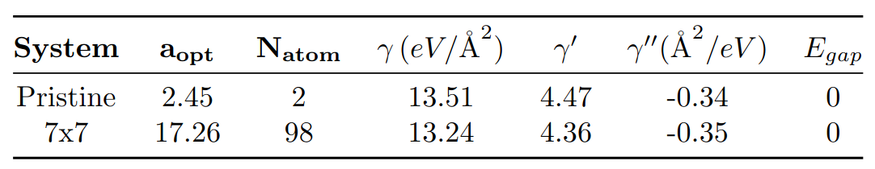
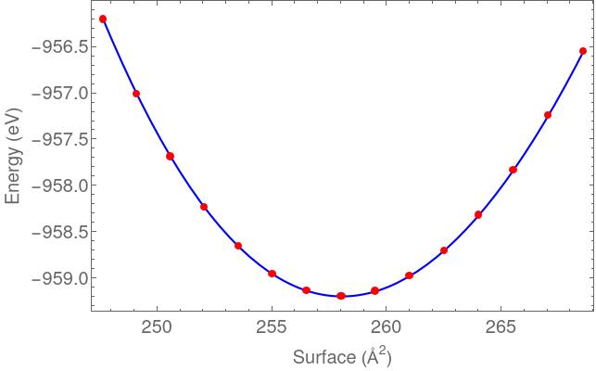
Results
(a)
(b)
Table 1. Results of calculations for pristine graphene and 7x7 arrangement using the EOS [4]. Here a_{opt} is the optimum separation, N_{atom} is the number of atoms in the cell, ɣ is the layer modulus, ɣ' is the force per unit length derivative and ɣ'' is the double force per unit length derivative.
(c)
Conclusion and future insights
Future work will explore vacancies in the arrangement, incorporate transition metal adatoms at the different non-equivalent sites, and investigate the effects of adding a new layer in different non-equivalent configurations.
Fig. 4. (a) Band Structure of 7x7 superlattice. (b) Partial density of states (PDOS)of 7x7 superlattice. (c) Energy equation of state (EOS) for 7x7 superlattice.
Bibliography
[1] Cockayne, E., Rutter, G. M., Guisinger, N. P., Crain, J. N., First, P. N., & Stroscio, J. A. (2011). Grain boundary loops in graphene. Physical Review B - Condensed Matter and Materials Physics, 83(19), 195425. https://doi.org/10.1103/PhysRevB.83.195425
[2] Pinto, H. P., & Leszczynski, J. (2014). Fundamental properties of graphene. In F. D'Souza & K. M. Kadish (Eds.), Handbook of carbon nanomaterials: Volume 5. Graphene—Fundamental properties (pp. 1–37). World Scientific.
[3] Kresse, G., & Furthmüller, J. (1996). Efficiency of ab-initio total energy calculations for metals and semiconductors using a plane-wave basis set. Computational Materials Science, 6(1), 15–50. https://doi.org/10.1016/0927-0256(96)00008-0
[4] Andrew, R. C., Mapasha, R. E., Ukpong, A. M., & Chetty, N. (2012). Mechanical properties of graphene and boronitrene. Physical Review B - Condensed Matter and Materials Physics, 85(12), 125428. https://doi.org/10.1103/PhysRevB.85.125428
[5]
[6]

