Slide 1
PCB Design Workshop w/ KiCad
Pranav Mehta (Technical Chair)

Slide 2


Attendance + Slides
Slides:
Sign in form (MUST FILL OUT):
https://bit.ly/4cCBIGm
https://bit.ly/4hMmVtW

Slide 3
Download KiCad for your platform
Please start this right away so that the download can happen while we go through some conceptual slides: https://www.kicad.org/download/

Slide 4
PCB Fundamentals

Slide 5
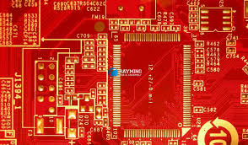
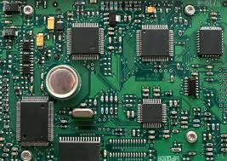
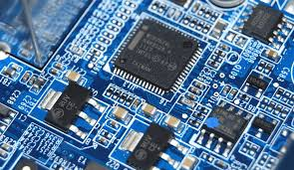
What is PCB design & Why is it important?
Printed circuit boards are a used to connect and support electronic components using conductive pathways, or "traces," made from copper and holds components like resistors, chips, and connectors in place using bonds created using a metallic substance called solder
PCB design is the art of applying circuits theory concepts, physics, and visual creativity to produce these printed circuit boards for applications such as personal projects or real life products
Very useful skill to have for your engineering projects and if you go into circuits in industry
All commercial electronic products use custom PCBs, modern PCBs look quite small!
Looks good on a resume! Tangential skills needed are circuits, soldering (through-hole and SMD) and reading datasheets!

Slide 6
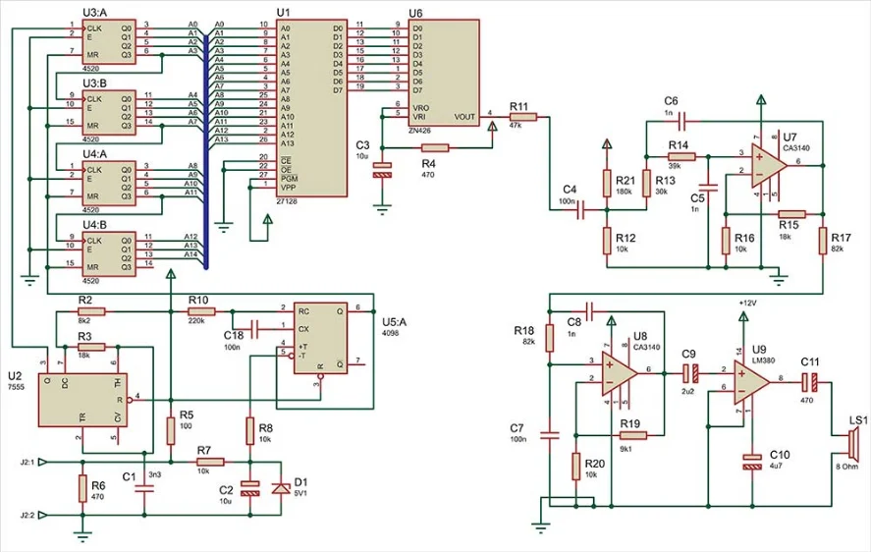
What is a PCB schematic?
A PCB schematic is made before laying out the PCB, and functions as a plan for which components are going to be used on the PCB, and how they will all connect up
Organize your PCB schematic into different sections based on functionality and use labels to wirelessly connect components so your schematic does not become a huge mess of wires - we will get into this in the walkthrough

Slide 7
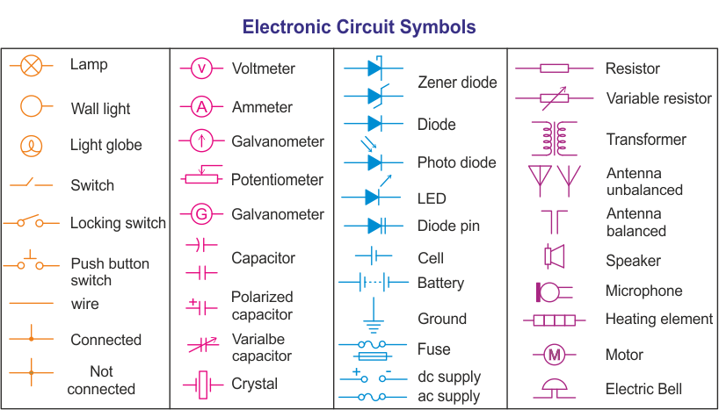
Common PCB Schematic Symbols

Slide 8
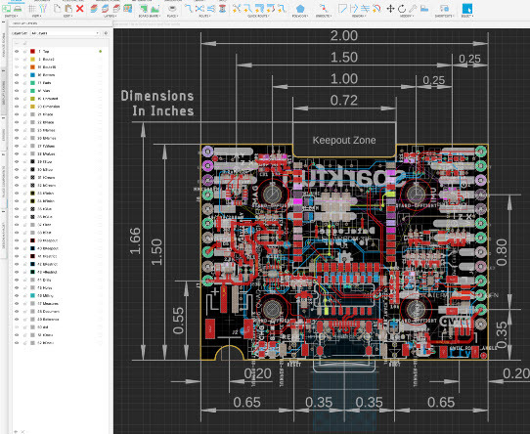
What is a PCB layout?
PCB layout gives you a physical view of the board with real dimensions. There are two stages when it comes to designing the PCB layout: place and route, which can be done separately but also simultaneously. Placing involves moving footprints of components that will eventually go on the PCB around on the board and intelligently determining the best place to put them. Routing involves connecting all the traces between the components. The placement of components may need to be changed depending on where traces need to be routed, which is why these may be done simultaneously. Vias and traces on the bottom layer should be used strategically where traces on the top layer would have otherwise been blocked by components. Vias are small conductive holes that provide an electrical connection between different layers of the board.
Layers:
- Silkscreen: Used for labels, names, component outlines, reference designators, logos - typically white in color
- Solder Mask: protective coating on top of traces
- Top Metal: copper layer for creating traces on the top of the board - Bottom Metal: copper layer for creating traces on bottom of board
-Middle Metal layers: used for power and ground planes/pours (+ and -) Vias can be used to connect routes between different layers!

Slide 9
Let's get some basic circuits background!*
*It is recommended that you take ECE 35, ECE 65, ECE 100 and other circuits classes for better understanding of these concepts

Slide 10
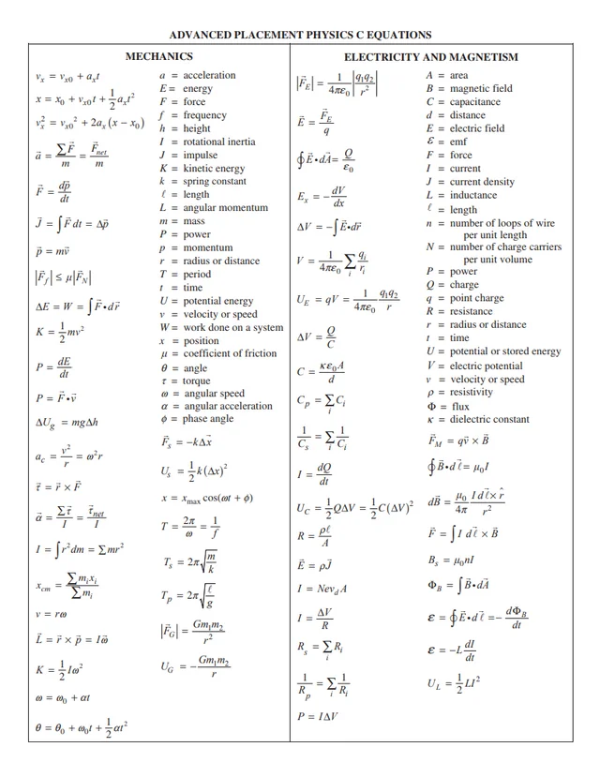
Physics 2B Review*
Current is the flow of charge in a circuit
Current flows from positive polarity to negative polarity in a circuit
Voltage can be described as the electric potential energy per unit charge - or the difference in electric potential at two points in an electric field
Resistance is the property of a substance that makes it resist current flow -> some of the energy that goes through a resistor is lost, dissipated as heat
Assuming PHYS2B knowledge, we will briefly cover resistors, inductors and capacitors
*Taking this course is highly recommended (and should have been taken if you are an engineering major) in order to understand the circuits concepts coming up

Slide 11
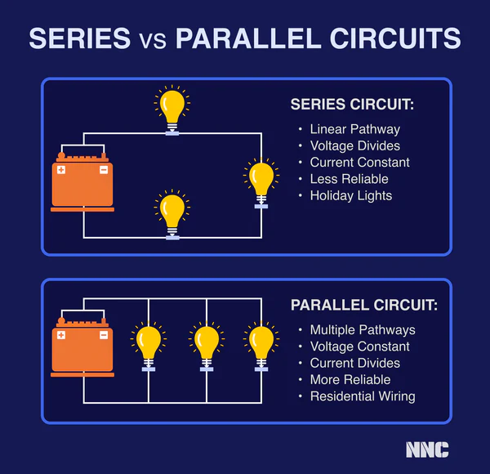
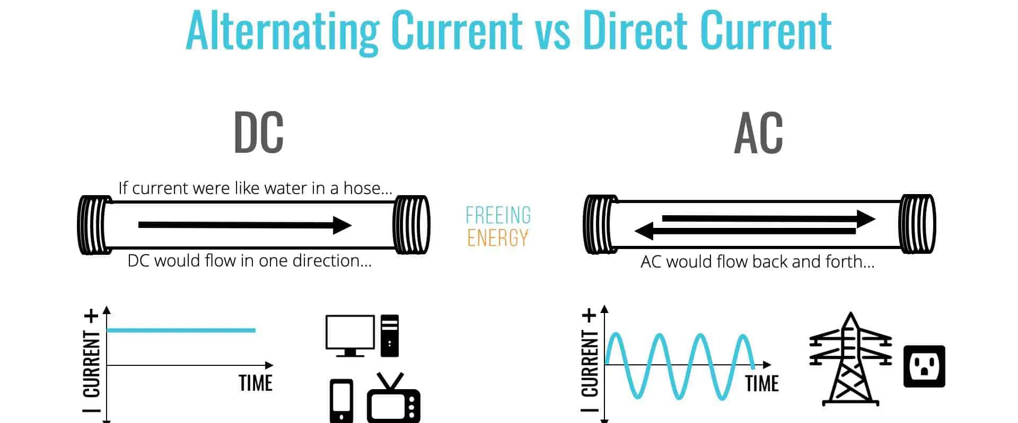
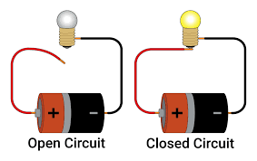
Short & Hole, Series vs Parallel Circuits and AC vs DC
A hole is any discontinuity that results in an open circuit, preventing current from flowing
A short circuit occurs when a low-impedance path is created in parallel with the intended load (which typically has higher impedance), causing current to preferentially flow through the low-impedance path
This can damage electronics which may have had impedance in place to reduce the input load, since the input load is now more than what those components were rated for
Example is a wire in parallel with a resistor -> the wire shorts the resistor so net resistance is 0
Kirchhoff's Current Law - sum of currents going in to a node junction is equal to sum of currents going out -> ∑I_{in} = ∑I_{out} -> used for parallel circuits - two branches in parallel have same voltage
Kirchhoff's Voltage Law - the sum of all voltage drops around any closed loop in a circuit is equal to zero -> this means that in a circuit with a power source (eg battery) and resistors in series, the total voltage drop across all the resistors is equal to the voltage supplied by the source -> used for series circuits - circuits in series share the same current

Slide 12
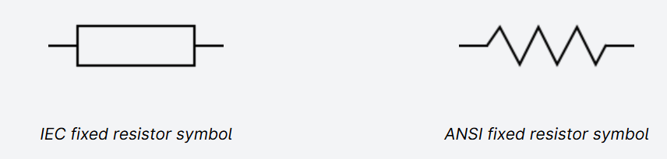
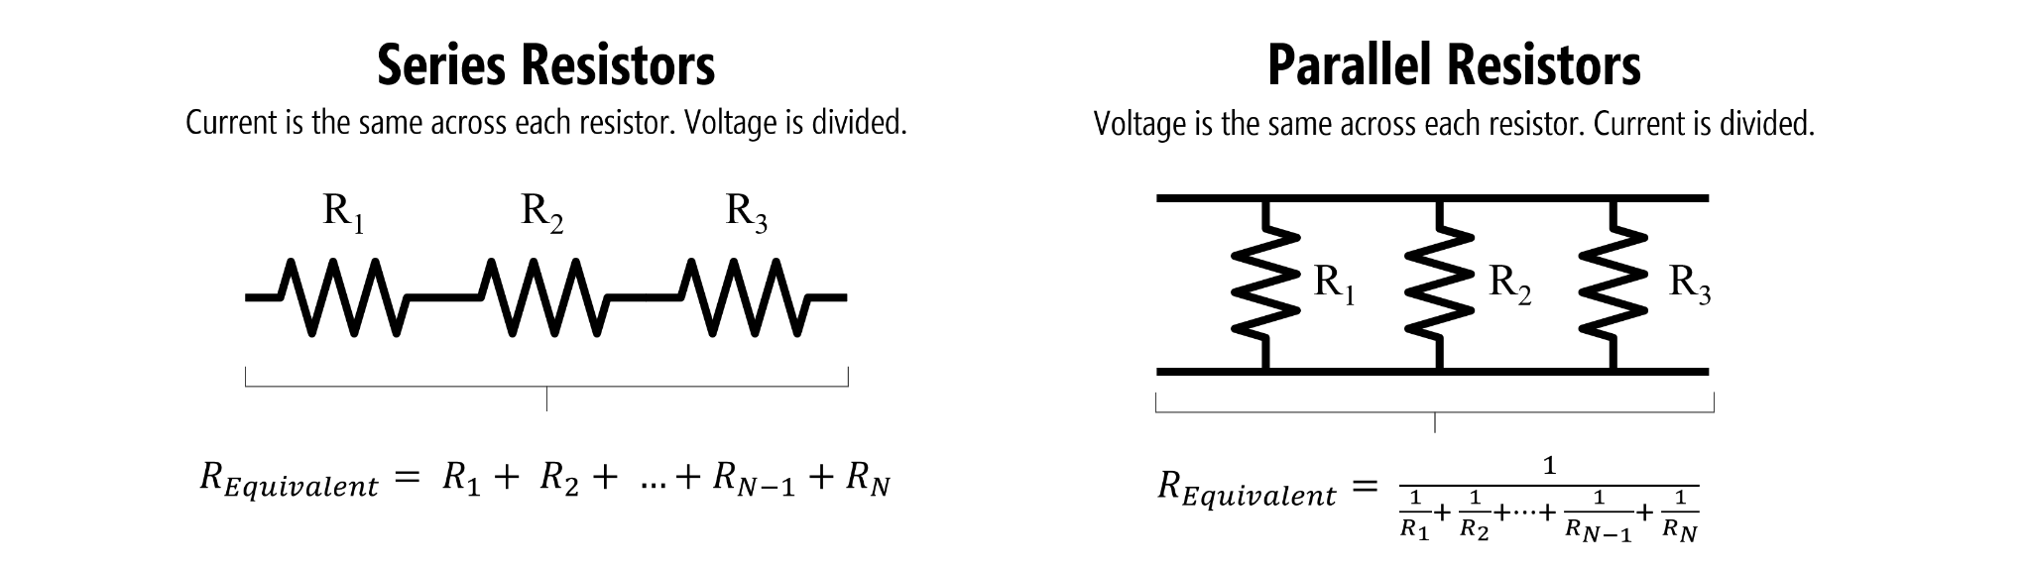
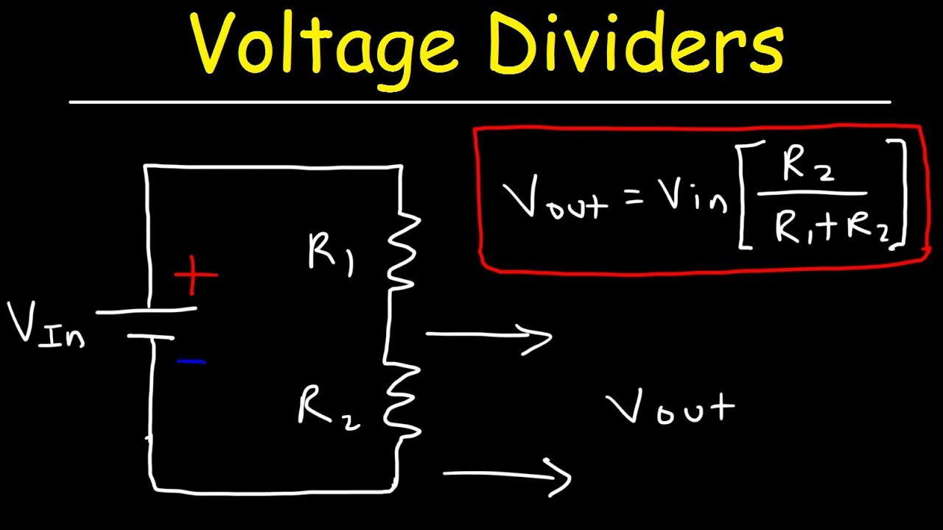
Resistors
Passive electrical components that create resistance in the flow of electric current - the resistance is measured in Ohms (Ω) -> Ohm’s law - V = IR, voltage is equal to current times resistance- this equation is the essential foundation for circuits theory!
Resistance adds in series, and resistors act the same in the AC and DC domain
Voltage dividers leverage Kirchhoff's Voltage Law to split an input voltage source by a desired ratio -> useful for applications such as a battery voltage measuring circuit\
Pull up resistor - used to pull up the input of digital gates (created using MOSFETs) to 5V
Can be used to boost / level-shift a 3.3V digital output to 5V
Pull down resistor - used to pull down the input of digital gates to GND or 0V

Slide 13
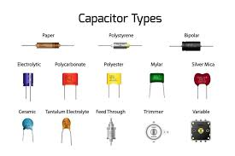
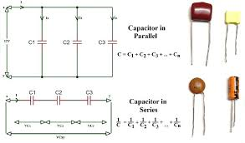
Capacitors
Composed of two metal plates separated by a dielectric and stores charge between them (remember physics?) - capacitance of a capacitor depends on the dielectric - units of capacitance is the Farad (F)
Current: i(t) = C(dV/dt)
Voltage: v(t) = v(t0) + 1/C ∫ i(t) dt
Voltage across a capacitor cannot instantaneously change - at t = 0, a capacitor acts like a short circuit allowing current to flow freely, while at t = infinity (steady state), a capacitor acts like a hole (open circuit) since the capacitor has fully charged and no more current flows
Capacitance adds in parallel

Slide 14
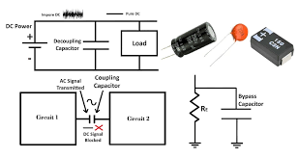
Capacitors cont.
Impedance in the AC/phasor domain -> Z = 1/j⍵C where C is the capacitance - very useful for deriving 1st order, 2nd order, etc circuit transfer functions -> used to design filters, integrators, differentiators and for other mathematical analog circuit applications
Coupling capacitors - filter out low frequency signals (DC) and allow high frequency signals to pass through (AC) - pass signals between different IC stages in analog signal processing without amplifying DC offsets
Decoupling capacitors - filter out high frequency signals (AC, noise) and allow low frequency signals to pass through (DC) - used near microcontrollers to filter out noise from power supply, mitigate voltage spikes due to rapid switching in digital circuits - smaller capacitors filter out higher frequencies while large capacitors work for lower frequencies
Bypass capacitor - provide low-impedance path for high frequency noise, bypassing it to ground
Capacitors are more commonly used over inductors in multi order circuit systems since its easier to get capacitors of different values than inductors

Slide 15
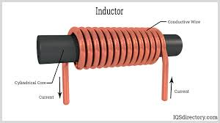
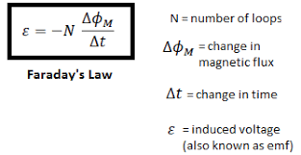
Inductors
Inductors - component that stores energy in a magnetic field when a current flows through it - characterized by inductance, which is ratio of voltage to ratio of change in current - unit of inductance is the Henry (H), symbol used to denote is L
Lenz’s law - current induced in a circuit due to change in magnetic field is directed to oppose the change in flux and to exert a mechanical force that oppose the motion
When current through the coil changes, the magnetic field induces a electromotive force described by Faraday’s law of induction -> this can result in torque used to drive a motor for example - the electromagnets inside a motor
Solenoids are a type of inductor - used in solenoid actuators (Robocup shoutout)
Voltage: v(t) = L (di/dt) where di/dt is change in current (slope)
Current: i(t) = i(t0) + 1/L ∫ v(t) dt
Inductance adds in series
Impedance in the AC/phasor domain -> Z = j⍵L where L is the inductance - used in multi order circuit systems like capacitors
Used for RF applications, NFC/RFID interfaces, sensors, power circuits

Slide 16
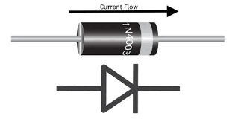
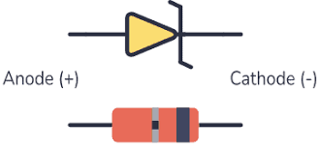
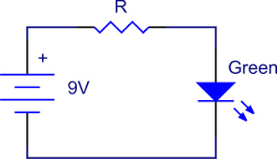
Diodes (this includes LEDs!)
Diodes are special circuit components that only allow current to flow through them in one direction and have a threshold voltage that must be met or exceeded to allow current flow
Great for protecting against accidental shorts, flyback current
When the voltage at the node at the front of the diode is less than this threshold, the diode is off and acts like a hole in the circuit
Zener diodes are a special type of diode that DO allow current to flow in both directions, basically act like regular diodes but if the voltage is below a certain NEGATIVE threshold, then current will flow in the opposite direction of the diode’s polarity -> negative current
LEDs are diodes, and have threshold voltage’s and current tolerances specified in their datasheets that you have to be aware of when designing your circuit -> need to supply a voltage higher than threshold, and should use resistors in series to induce a current that is safely below the tolerance current of the LED -> the current supplied will affect the power supplied to the LED -> which affects the intensity of the light emitted (physics!)

Slide 17
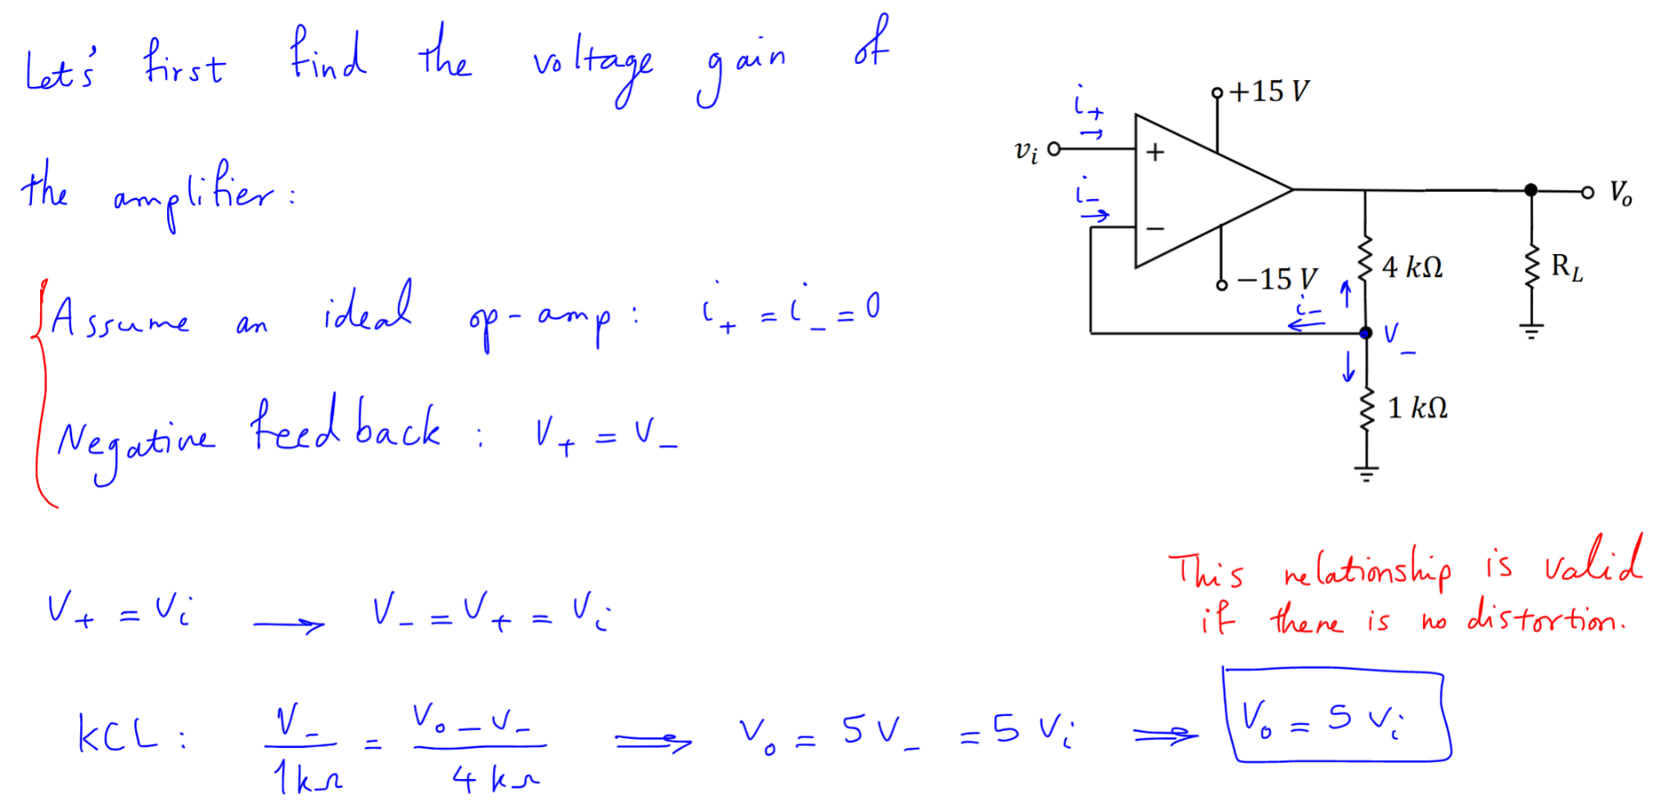
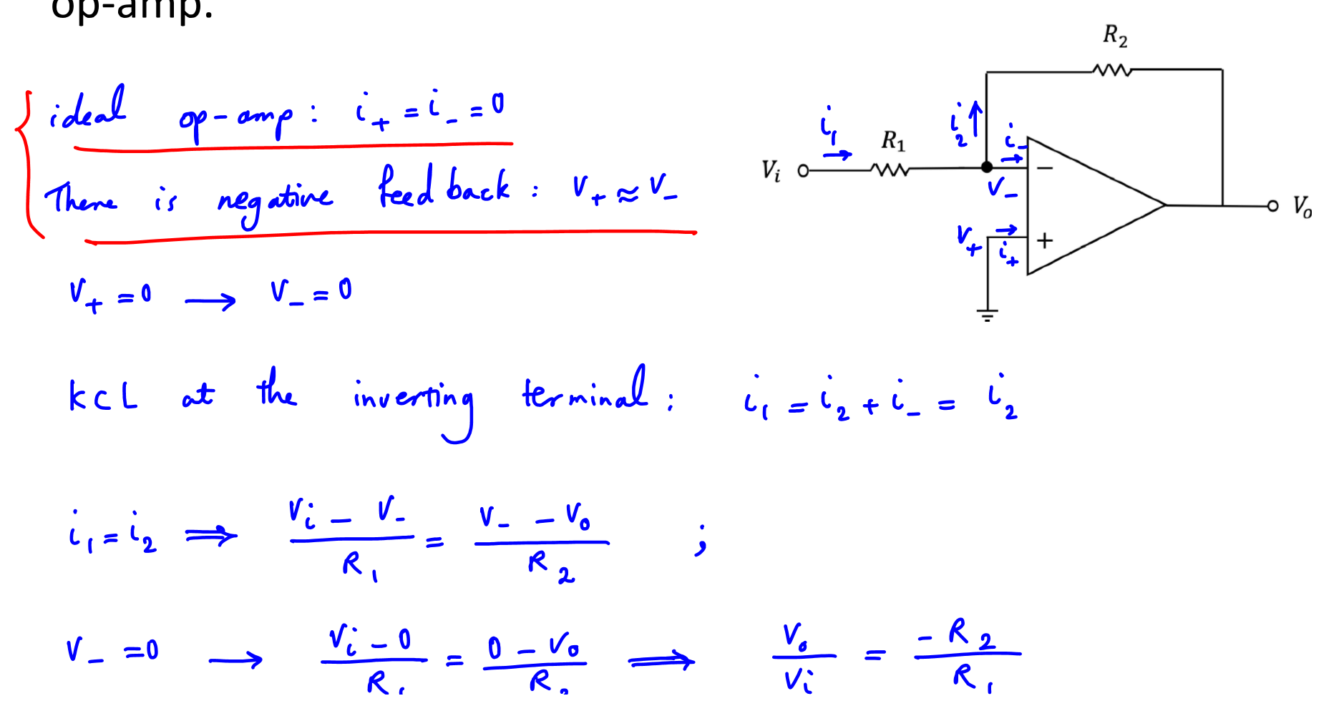
Op Amps
Operational amplifiers are complex ICs (integrated circuits) that can be used to design feedback systems and amplify DC signals
Have a differential input and a single output
Vo = A(V₊ - V₋) ; A = open-loop gain, usually in millions/thousands
A = V_{o}/V_{d}
Ideal op amps: i₋ = i₊ = 0
Virtual short principle: V_{d} ~~ 0, so V₊ ~~ V₋ ->0 current goes into inverting and non-inverting terminals (inverting terminal is labelled -, and non inverting is labelled +)
Limitations:
V_{s-} < Vo < V_{s+} ; The output will never reach the supply voltage, but will be limited by the saturation voltage.
All op-amps have a current limit from the output that can also limit the output voltage

Slide 18
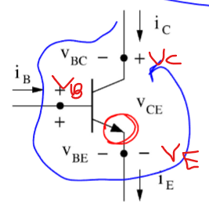
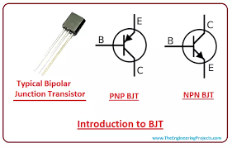
BJTs
Bipolar junction transistors are a type of transistor that uses both electrons and electron holes as charge carriers
Are useful for switches, amplifiers and oscillators
NPN:
KCL: i_{E} = i_{C} + i_{B} & KVL: V_{BC} = V_{BE} - V_{CE}
Controller: The circuit connects to positive and negative terminals of V_{BE} - must be forward biased (positive voltage at V_{B}) for i_{B} to not be 0 and transistor not to be cut off
Controlled part: i_{C} and V_{CE} are set based on i_{B} and state of transistor
Cutoff: i_{B} = i_{C} = i_{E} = 0, V_{BE} < V_{D0}
Active: V_{BE} = V_{D0}, V_{BC} <= 0, i_{B} >= 0, V_{CE} >= V_{D0}, i_{C} = i_{B}
Saturation: i_{B} >= 0, V_{BE} = V_{D0}, V_{CE} = V_{sat}, i_{C} < i_{B}

Slide 19
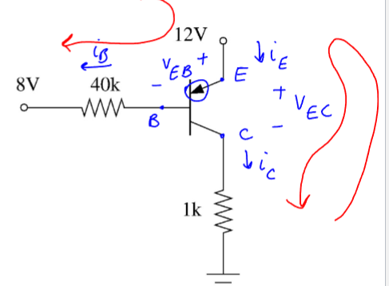
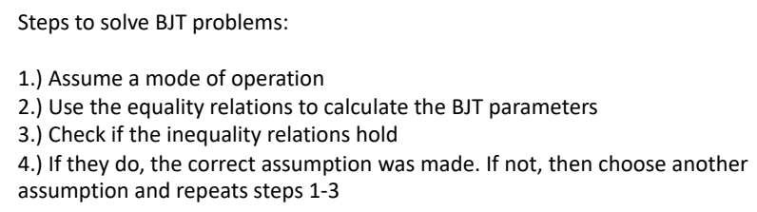
BJTs cont.
PNP:
KCL: i_{E} = i_{C} + i_{B}
KVL: V_{CB} = V_{EB} - V_{EC}
Cutoff: i_{B} = i_{C} = i_{E} = 0, V_{EB} < V_{D0}
Active: i_{B} >= 0, V_{EB} = V_{D0}, V_{EC} >= V_{D0}, , i_{C} = i_{B}
Saturation: i_{B} >= 0, V_{BE} = V_{D0}, V_{EC} = V_{sat}, i_{C} < i_{B}
Positive input voltage → assume NPN on, PNP off
Negative → assume NPN off, PNP on

Slide 20
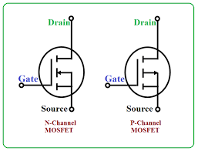
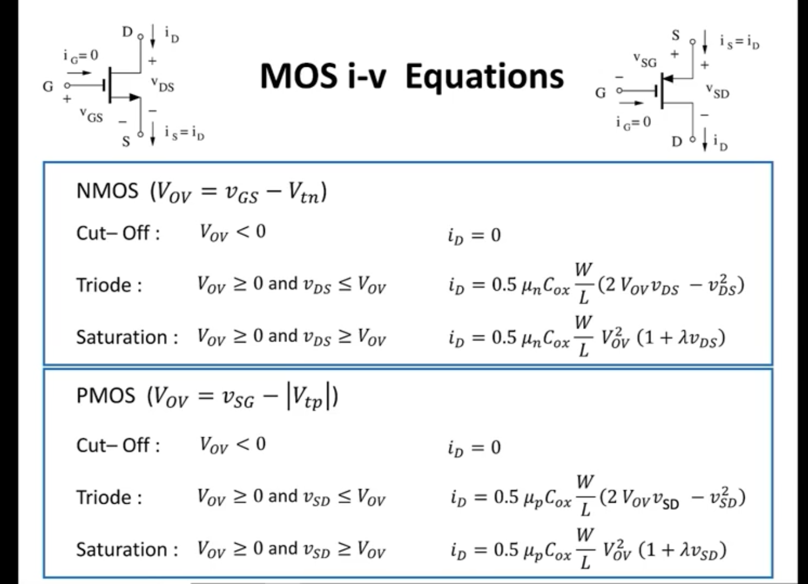
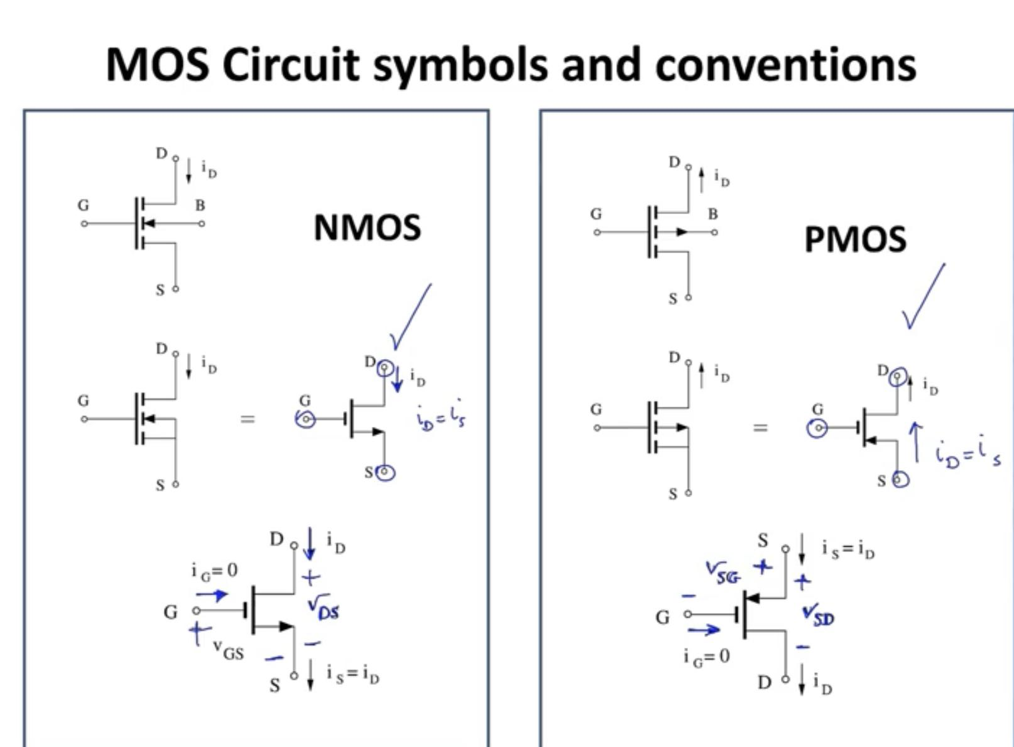
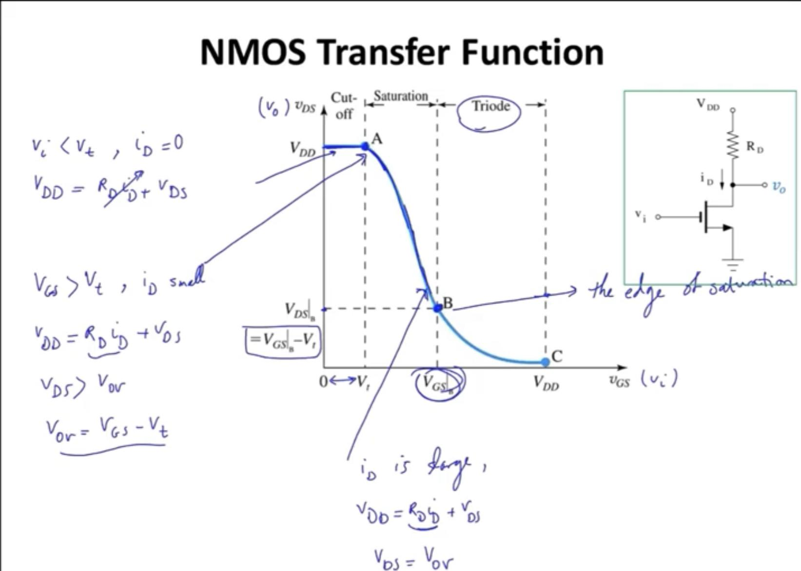
MOSFETs
Metal-oxide-semiconductor field-effect-transistor
Can either be used as an amplifier or a switch (switch is useful for digital logic gates and digital circuits)
When used as a switch - can take in a digital signal as output to the gate to determine whether current will flow through the MOSFET (on) or not (off) - used in motor driver circuits where PWM signal is used to drive the gate and determine if current flows through the motor circuit (powering the motor) or not (motor is unpowered), and the duration of time between pulses affects how fast the motor spins

Slide 21
KiCad Schematic + Layout Info

Slide 22
Important Schematic Shortcuts + Tips
X to flip selected component horizontally
Y to flip selected component vertically
R to rotate a component by 90 degrees
L to place a label -> this will help us keep everything organized and avoid a mess of wires by using wireless connections between the components instead
T to place a text box, useful for adding supplementary info and calculations
P to enter power symbol menu -> 3.3V, 5V, 9V and GND symbols will be used most often
A to place a symbol - can place symbols from existing libraries or from custom libraries
W to draw wires, B to draw buses, Z to place wire to bus entries, and J to place junctions
Q to place no connect flags - these need to be placed on pins not connected to anything in order to pass the electric rules check (ERC)
Use the highlight net tool and click on labelled nets to ensure that they are connected properly
Use the Electrical Rules Check (ERC) to make sure there are no issues with the schematic: all pins are connected properly for all components, etc
Tip: use rectangles and text boxes to neatly section off/group components
Conventions: power symbols point up while ground points down, components and wires should be aligned to 0.05 in grid

Slide 23
Layer Specific Shortcuts
Ctrl + Shift + M gets the measure tool, very useful for adding drawn measurements to your PCB layout as good design practice
Use view -> flip board view to get a better view of the back side of the board when routing
Use Ctrl +Shift + Z to draw filled zones in order to fill in the pours at their respective laeyrs
Use Ctrl + Shift + X to drop a via on the board
Use A to place footprints
Use Ctrl + Shift + T to add a text box
Use draw lines (Ctrl + Shift + L), draw arcs (Ctrl + Shift + A), draw rectangles, draw circles to create the shape/outline of the board

Slide 24
Important Layout Tips + Strategies
After the schematic is completed and all parts have footprints, click the update layout button to import all the footprints in to the drawing
Use a grid size of 0.5 mm, align parts ideally to 1 mm, can do 0.5 if necessary
Think about the size and shape of the PCB, then draw the outline of the board - good to have a rough idea to start with, this can always be changed later if needed
Leave sufficient space between components to make soldering easier later - 1 to 2 mm between parts is good
Use wider traces for parts that need more current, intuition is that wider traces have less resistance -> equation for resistance is R = ⍴L/A where ⍴ is the resistivity of the material the wire is made of, L is the length of the wire/trace and A is the cross sectional area (width times depth) -> use trace width calculator to determine how wide traces should be
For RF related components such as an antenna, try to keep them away from high frequency switching circuits to reduce noise that could affect performance
Use the Design Rule Check (DRC) to make sure that the board does not have any errors
Use the board setup -> board stackup -> physical stackup to add more layers to the board if needed
This is useful for adding power and ground planes, these should be nice large pours without being broken up much, also corners should be rounded in order to prevent current crowding - these pours should be wide in all regions to minimize resistance
Top and bottom layers should have a pour of GND

Slide 25
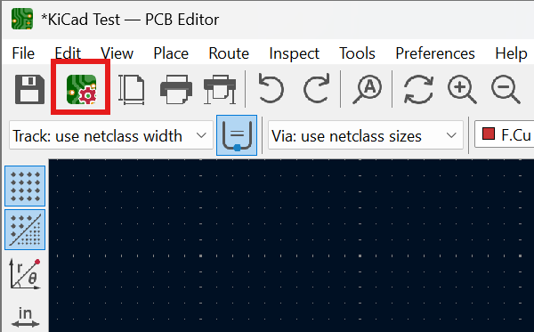
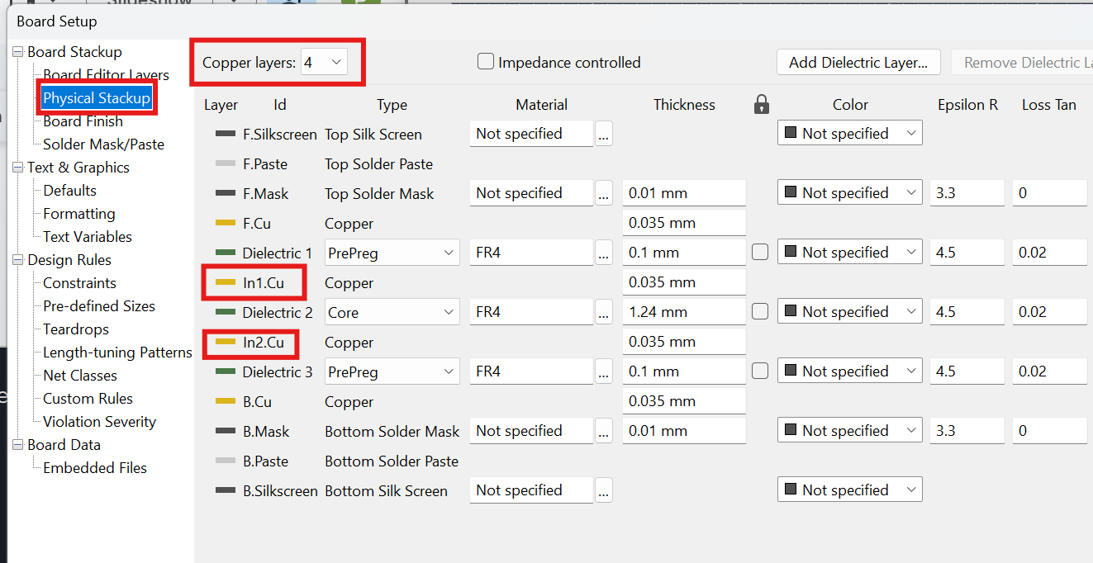
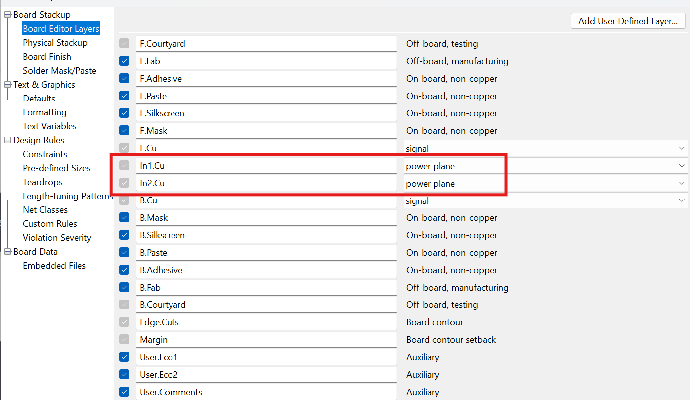
How to Add More Layers

Slide 26
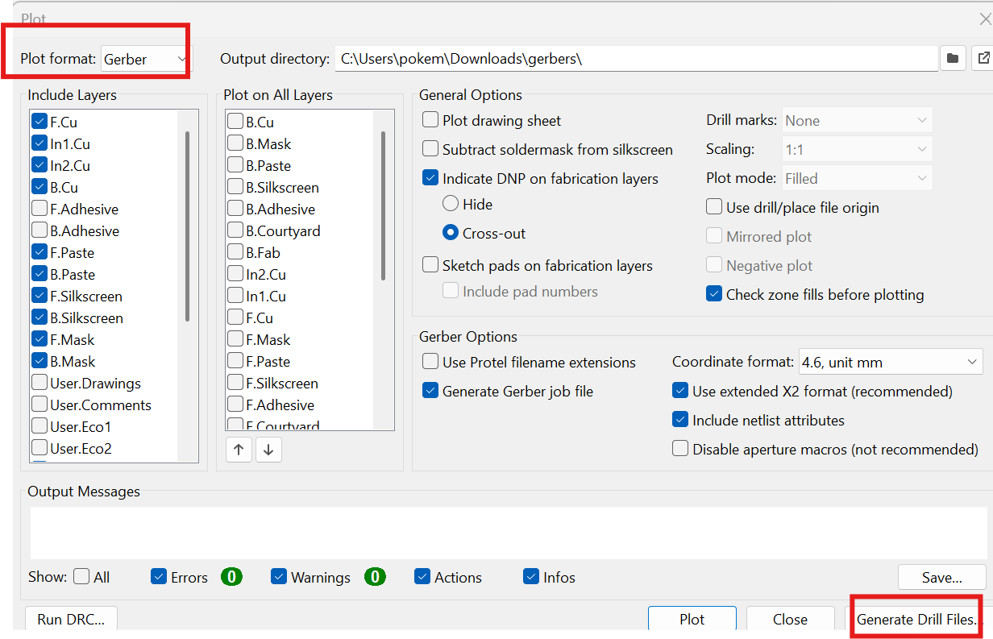
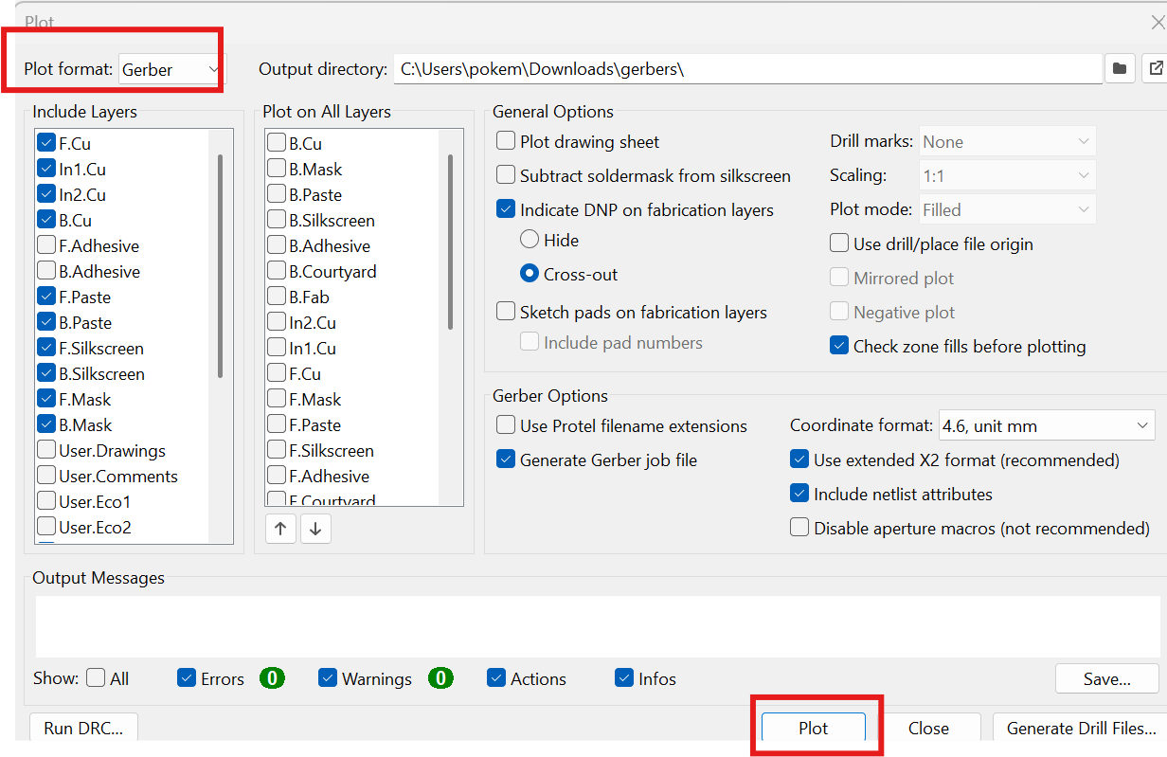
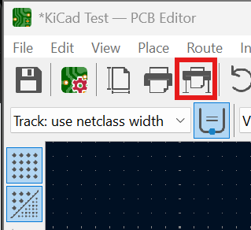
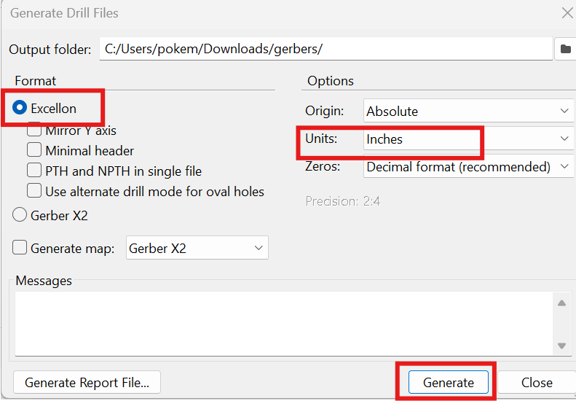
Manufacturing
Use the plot button in the layout view to generate Gerbers to be sent to the PCB manufacturer to get the board fabbed
Then zip the files together and send them to a PCB manufacturer

Slide 27
Designing your own PCB components

Slide 28
Designing Custom PCB components in KiCad
We will not be going into how to design custom components today, but here is a YouTube video if you would like: https://www.youtube.com/watch?v=pV-4ElYoXYU
Use Ctrl + Shift + K to draw rule areas (keepout) used to keep components away from each other or at a designated distance - if a component is within a rule area of another component, it will flag an error during the Design Rule Check
Draw keepout in alignment with 0.5 mm grid, then inset by 0.1 mm to avoid overlap between components - width of keepout lines should be 0.05 mm
Text for reference designators should be aligned to 0.1 mm grid
For polarized components, mark the distinguished terminal with a dot or symbol and make sure it is clearly visible - the distinguished terminal is the one marked in the drawing of the component on its datasheet (the actual device also has a mark in this location)

Slide 29
KiCad Walkthrough (making a RGB LED circuit)

Slide 30
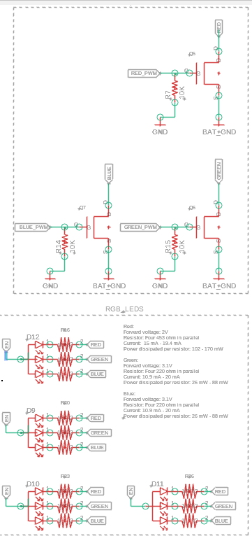
- Common Anode RGB LED - the + terminal is shared and fed with 5V input - Common Cathode RGB LED - the - terminal is shared and goes to GND
- A NMOS MOSFET with a pull down resistor at the gate is used to drive the LED brightness
https://github.com/AcheronProject/acheron_Components.pretty <- will need to be imported to footprint library https://www.snapeda.com/parts/SI2302DS/NXP%20Semiconductors/view-part/?welcome=home

Slide 31
Challenge: Make your own custom PCB!

