Slide 1
Systems Programming with Rust
Pranav Mehta and Ritoban Roy-Chowdhury

Slide 2

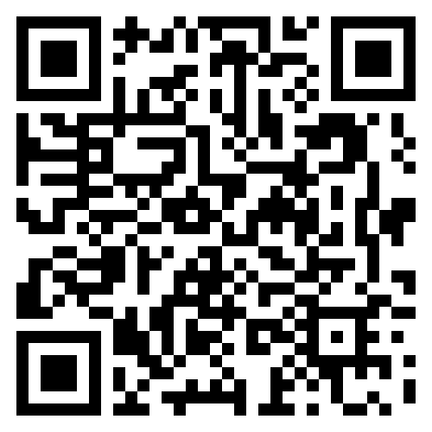
Link to the Slides
Attendance form (MUST FILL OUT):
https://bit.ly/4efHcWA
https://forms.gle/Hj5RwHoeHCRsvKhz5

Slide 3

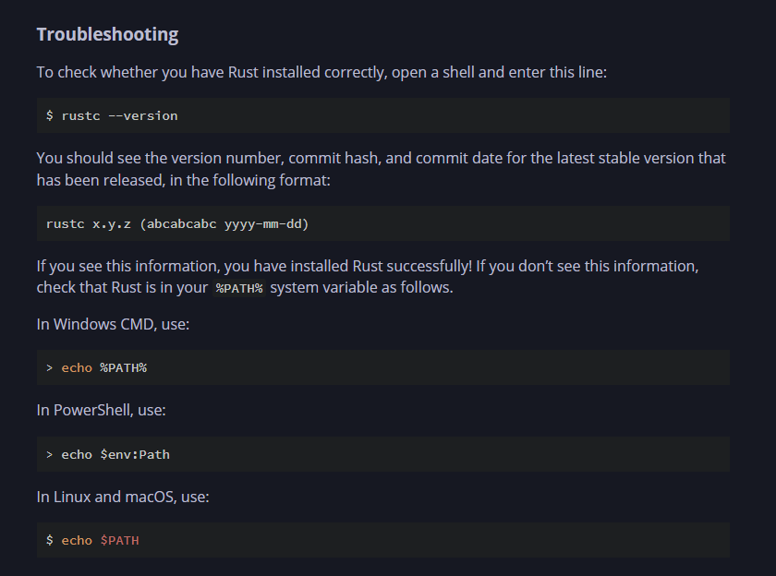
Installations needed today…
Rust book:
Windows: https://www.rust-lang.org/tools/install
Mac/Linux: Open a terminal and enter:
$ curl --proto '=https' --tlsv1.2 https://sh.rustup.rs -sSf | sh
If you get linker errors, download a C compiler, which has a linker included:
$ xcode-select --install
Also, you will need to install VSCode if you have not already:
https://code.visualstudio.com/download
Install the rust-analyzer and Rust Syntax extensions on VSCode
If you don’t want to or can’t install Rust, you can use Rust playground alternately. If you do, ignore the steps for VSCode: https://play.rust-lang.org/
This is the link to the Rust programming book, if you want more information: https://doc.rust-lang.org/book/ch01-01-installation.html
Notes:
Give people like 2 mins to get started on this slide

Slide 4
What is Systems Programming?
Systems programming is very important in our modern world!
Programming with hardware as the focus, using resources efficiently
Real time, performance critical, or resource constrained applications
Embedded Systems
Memory and compute constrained, power efficient
Robotics, IoT, Computer Networks, Radio/Telecommunications
Device drivers & firmware
Distributed Systems
Scale!
GPU clusters for Machine Learning
Video game servers
Financial systems
Languages used: Assembly, C, C++, Go, Rust

Slide 5

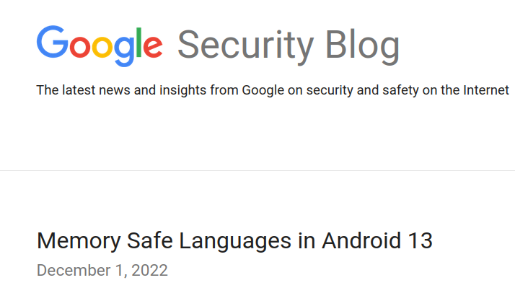
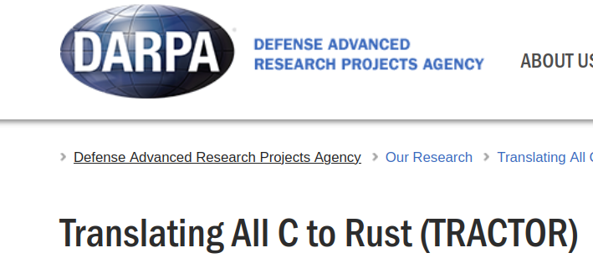
Why Rust?
Performance: As fast as C/C++
Reliability: No memory vulnerabilities, no undefined behavior!
Productivity: A modern language: package management, iterators, enums, traits, async
Everyone’s using it!

Slide 6
Let's get started with a Hello World
Open up a terminal. Run cargo new hello_world
cd hello_world
Look at src/main.rs (e.g. open it up in VSCode)
cargo run.

Slide 7
Basic Concepts: Variables
Defining a variable (also example of a comment):
let x = 5; // Setting x to 6 after this will result in an error
Variables in Rust are immutable be default, so their value cannot be reassigned. However, we can set them to be mutable, so we can change their value.
Defining a mutable variable:
let mut x = 5;
x = 6;

Slide 8
Basic Concepts: Variables cont.
Constants in Rust are always immutable, which means that the mut keyword cannot be used with them. They are declared using the const keyword, and the type of the variable must be included in the declaration. Constants are valid for the entire duration of the program within the scope they were declared. They are useful for naming hardcoded values used in the program, and storing them in one place if they need to be changed later (no magic numbers!)
Constant declaration (data type is unsigned 32 bit integer):
const THREE_HOURS_IN_SECONDS: u32 = 60 * 60 * 3;

Slide 9
Basic Concepts: Variables cont.
New variables can be declared using the same name as a variable that already exists in the program. This is called shadowing, because the declaration of the second variable overshadows the declaration of the original, taking any later uses of the variable name to itself until it is shadowed or the scope ends. By using let in shadowing, we can perform transformations on a value, but the variable itself will remain immutable.
Shadowing example:
fn main() {
let x = 5;
let x = x + 1;
{
let x = x * 2;
println!("The value of x in the inner scope is: {x}");
}
println!("The value of x is: {x}");
}
Output:
The value of x in the inner scope is: 12
The value of x is: 6

Slide 10
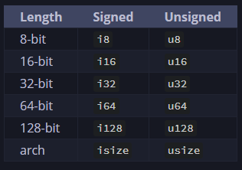
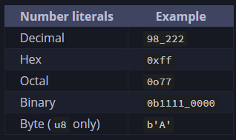
Basic Concepts: Data Types
Scalar types (single value):
Integer:
Boolean: let f: bool = false;
Character: let z: char = ‘Z”
Floating point:
let y: f32 = 3.0; //32 bit float
let x: f64 = 2.0; //64 bit float

Slide 11
Basic Concepts: Data Types cont
Compound types (multiple values):
Tuples are a way of grouping values of multiple different types into a single compound type. They have a fixed length, so they cannot grow or shrink once declared.
Tuple example:
let tup: (i32, f64, u8) = (500, 6.4, 1);
let (x, y, z) = tup; // Uses destructuring to access tuple elements
// OR
let x = tup.0; // Index-based element access
let y = tup.1;
let z = tup.2;

Slide 12
Basic Concepts: Data Types cont
Arrays can hold multiple values, like a tuple, but all values must be of the same type. Array are fixed length and statically allocated on the stack, they are best used when the number of elements is known.
Array declaration:
let a = [1, 2, 3, 4, 5];
// OR
let a: [i32; 5] = [1, 2, 3, 4, 5]; //OR
let a = [3; 5];
Accessing array elements:
let first = a[0];

Slide 13
Basic Concepts: Functions
Functions are snippets of code that perform a specific task. Functions are used to write clean code by breaking a program down into subtasks. They are especially useful when a code snippet needs to be run more than once. Functions are declared using the fn keyword. Parameters are special variables in a function’s signature used for passing in data to a function that it may need to perform the task. The data type of each parameter must be specified.
Functions example:
Output:
The value of x is: 5
fn main() {
another_function(5);
}
fn another_function(x: i32) {
println!("The value of x is: {x}");
}

Slide 14
Basic Concepts: Functions cont
Statements are instructions that perform an action and do not return a value. For example, creating a variable and assigning it a value. Expressions evaluate to a resultant value. Calling a function or a macro is an expression, so are math operations and scope blocks created using curly braces. Expressions do not have a semicolon at the end. Functions that return a value return the last expression inside them by default.
Example of function that returns a value, notice how the return type is specified in Rust
fn five() -> i32 {
5
}
fn main() {
let x = five();
println!("The value of x is: {x}");
}
Example expression using scope block:
let y = {
let x = 3;
x + 1
};

Slide 15
Basic Concepts: Control Flow
Conditional statements (only boolean values can be passed in):
fn main() {
let number = 6;
if number % 4 == 0 {
println!("number is divisible by 4");
} else if number % 3 == 0 {
println!("number is divisible by 3");
} else if number % 2 == 0 {
println!("number is divisible by 2");
} else {
println!("number is not divisible by 4, 3, or 2");
}
}

Slide 16
Basic Concepts: Control Flow cont
Loop:
fn main() {
let mut count = 0;
'counting_up: loop {
println!("count = {count}");
let mut remaining = 10;
loop {
println!("remaining = {remaining}");
if remaining == 9 {
break;
}
if count == 2 {
break 'counting_up;
}
remaining -= 1;
}
count += 1;
}
println!("End count = {count}");
}
While:
fn main() {
let mut number = 3;
while number != 0 {
println!("{number}!");
number -= 1;
}
println!("LIFTOFF!!!");
}
For:
fn main() {
let a = [10, 20, 30, 40, 50];
for element in a {
println!("the value is: {element}");
}
for number in (1..4).rev() {
println!("{number}!");
}
}

Slide 17
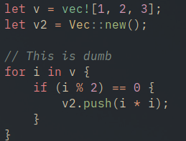
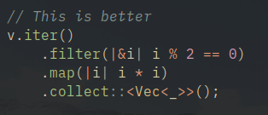
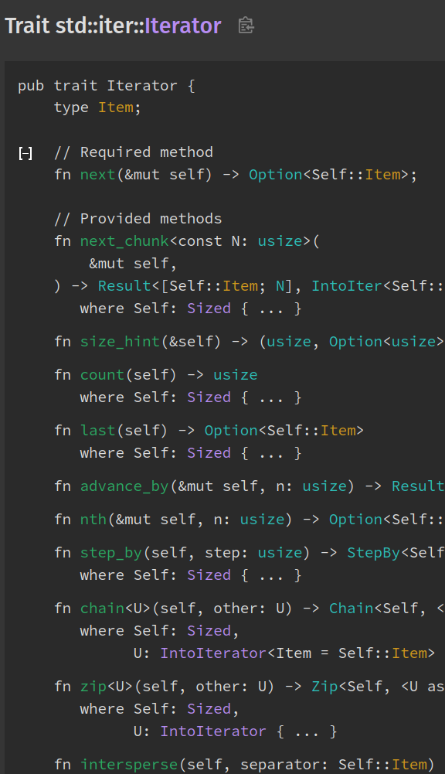
Iterators
Under the hood (for experts):
For loops can be verbose, with complex control flow
Iterators make the flow of data very clear
Functions like “map” and “filter” take in closures
They can be more efficient (no bounds checks!)
Iterators are lazy: nothing happens until you call collect
You could use sum instead! Or prod!
Under the hood:
Iterator is trait – any object just has to implement “next”
And dozens of other functions will be provided

Slide 18
Basic Concepts: Structs
Struct example:
struct User {
active: bool,
username: String,
email: String,
sign_in_count: u64,
}
fn main() {
let mut user1 = User {
active: true,
username: String::from("someusername123"),
email: String::from("someone@example.com"),
sign_in_count: 1,
};
user1.email = String::from("anotheremail@example.com");
}
fn build_user(email: String, username: String) -> User {
User {
active: true,
username,
email,
sign_in_count: 1,
}
}
fn main() {
// --snip--
let user2 = User {
email: String::from("another@example.com"),
..user1
};
}

Slide 19
Basic Concepts: Structs & Methods
#[derive(Debug)]
struct Rectangle {
width: u32,
height: u32,
}
impl Rectangle {
fn area(&self) -> u32 {
self.width * self.height
}
}
fn main() {
let rect1 = Rectangle {
width: 30,
height: 50,
};
println!(
"The area of the rectangle is {} square pixels.",
rect1.area()
);
}
Methods are like functions, but declared within the context of a struct or enum, and their first parameter is always self (this is similar to class methods in Python).
Example of a constructor method:
impl Rectangle {
fn square(size: u32) -> Self {
Self {
width: size,
height: size,
}
}
}
fn main() {
let sq = Rectangle::square(3);
}

Slide 20
Basic Concepts: Enums
enum IpAddrKind {
V4,
V6,
}
struct IpAddr {
kind: IpAddrKind,
address: String,
}
let home = IpAddr {
kind: IpAddrKind::V4,
address: String::from("127.0.0.1"),
};
let loopback = IpAddr {
kind: IpAddrKind::V6,
address: String::from("::1"),
};
enum IpAddr {
V4(u8, u8, u8, u8),
V6(String),
}
let home = IpAddr::V4(127, 0, 0, 1);
let loopback = IpAddr::V6(String::from("::1"));
There is no null in Rust. Instead, there is the Option enum that encodes the concepts of a value being present or absent.
enum Option<T> {
None,
Some(T),
}
let some_number = Some(5);
let some_char = Some('e');
let absent_number: Option<i32> = None;

Slide 21
Basic Concepts: Match
Can be used for state machines like enum + switch case design pattern in C/C++. Can also be used for pattern matching, an important concept in Rust. For example, implementing behavior based on the type of an input.
#[derive(Debug)] // so we can inspect the state in a minute
enum UsState {
Alabama,
Alaska,
// --snip--
}
enum Coin {
Penny,
Nickel,
Dime,
Quarter(UsState),
}
fn value_in_cents(coin: Coin) -> u8 {
match coin {
Coin::Penny => 1,
Coin::Nickel => 5,
Coin::Dime => 10,
Coin::Quarter(state) => {
println!("State quarter from {state:?}!");
25
}
}
}
fn plus_one(x: Option<i32>) -> Option<i32> {
match x {
None => None,
Some(i) => Some(i + 1),
}
}
let five = Some(5);
let six = plus_one(five);
let none = plus_one(None);

Slide 22
Basic Concepts: If Let
let mut count = 0;
match coin {
Coin::Quarter(state) => println!("State quarter from {state:?}!"),
_ => count += 1,
}
VS
let mut count = 0;
if let Coin::Quarter(state) = coin {
println!("State quarter from {state:?}!");
} else {
count += 1;
}

Slide 23
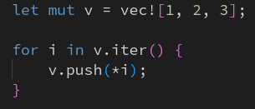
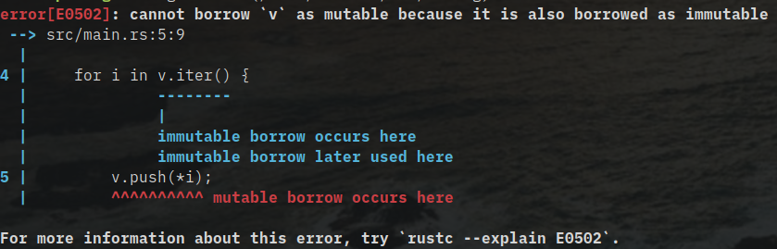
Borrow Checking: The problem it solves
Leads to impossible-to-find bugs in C++, Rust catches it at compile time.
The golden rule:
You can either have many immutable references, or one mutable reference.
This takes a while to get used to – but solves everything.

Slide 24
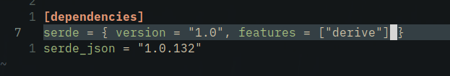
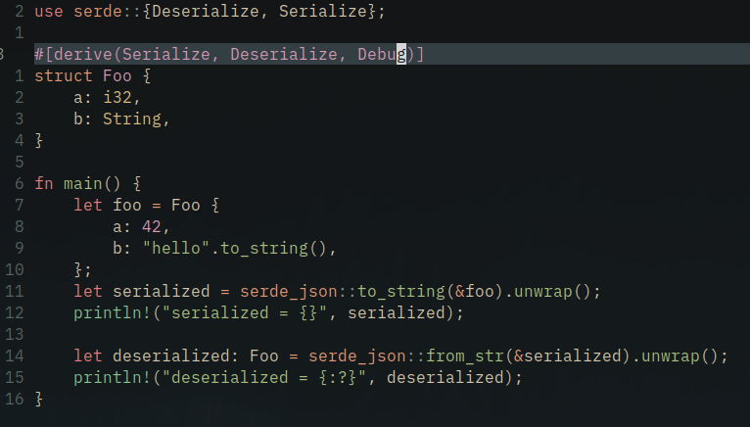
Package Management
It’s so easy – just add package_name = “version-number” to Cargo.toml
Side-note: Serde is so fucking cool
You write one line, #[derive(Serialize, Deserialize)]
And can convert basically any Rust struct to JSON, YAML, TOML, Pickle, like a dozen other formats in one line.
People spend hundreds of lines writing their own serializers in C++ – its 1 line in Rust

Slide 25

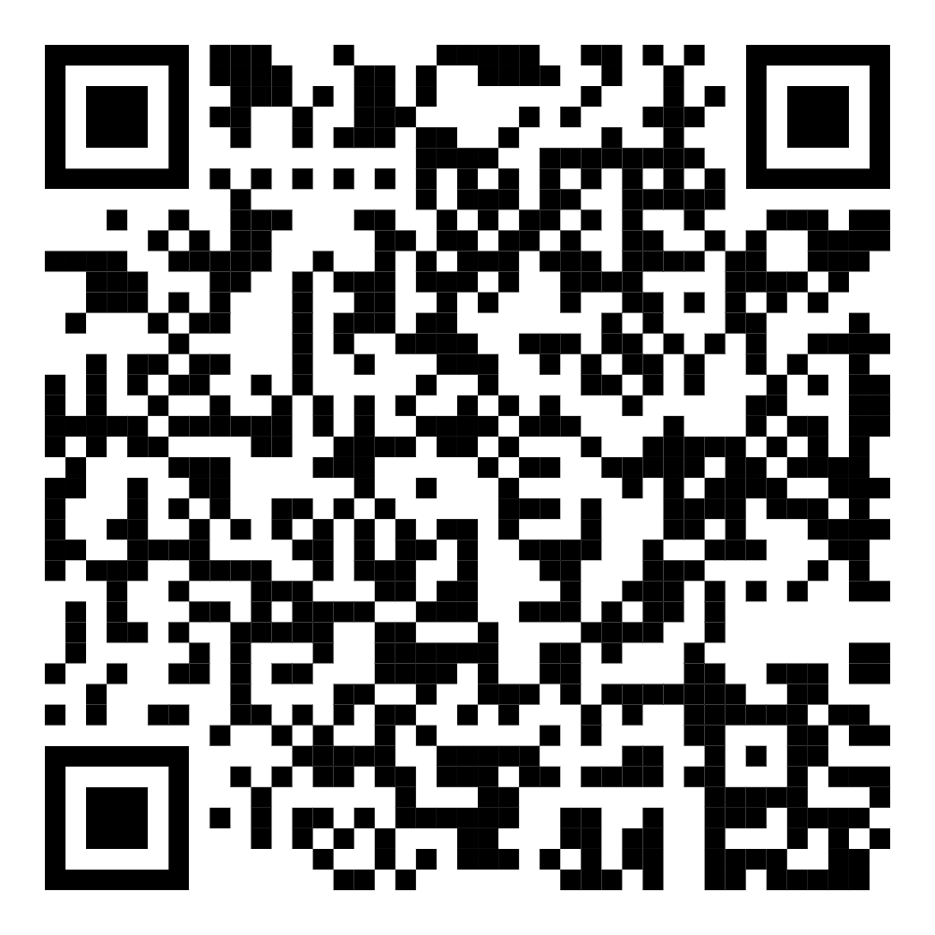
Lets Code!
Objective: Simulate and Visualize a Lorentz Attractor!
Head to https://github.com/ritobanrc/lorentz
Or Scan the QR Code:

Slide 26
Stay tuned for more from IEEE Supercomputing!
Notes:
Note: ask if there’s interest for a longer term rust project to more properly learn shit

Slide 27
Thank You
Check out the Rust book to learn more!

