Slide 1
Using the ManageIssues module
ManageIssues v1.0.2

Slide 2
Installation
Requires PowerShell 7.0 or higher – current version is 7.4.1
Runs on Windows, macOS, and Linux
Install PowerShell on Windows, Linux, and macOS
Choose the article for your operating system
Install the module (once per machine)
Run the following PowerShell command:
Install-Module ManageIssues –Repository PSGallery
Answer “yes” if prompted to trust PSGallery

Slide 3
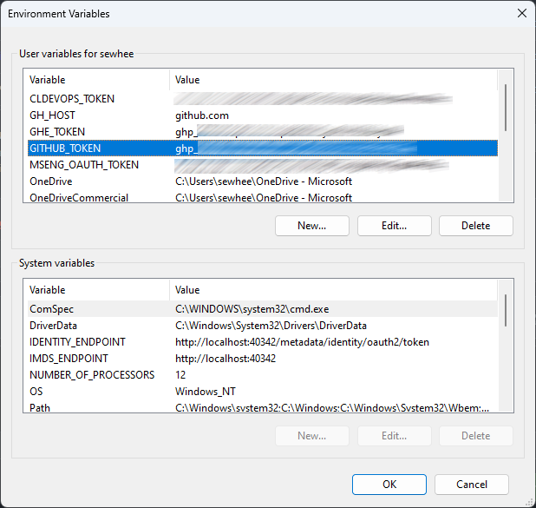
Configure your GitHub personal token
You must store your GitHub personal access token in the GITHUB_TOKEN environment variable.
On Windows 10, you can set this in the System Control Panel.
On Windows 11, search Settings for “Environment variable”
Make sure the token is configured for SSO for the target GitHub org (MicrosoftDocs).
To get the new environment variable, you must start a new PowerShell session. If you are using Windows Terminal, you must restart it.
Import the module (once per session)
Run the following PowerShell command:
Import-Module ManageIssues

Slide 4
Managing issues
Use Find-Issue to create a CSV list of issues to be triaged
Triage the issues
Open the CSV in Excel
Create new worksheets for issues that require different responses
E.g. For review with PM, close with response #1, close with response #2, etc.
Move rows from the main worksheet to the appropriate new worksheet
Save each worksheet to a new CSV file
Use Add-ClosingComment to add comments for issues in each CSV list of issues to be triaged

Slide 5
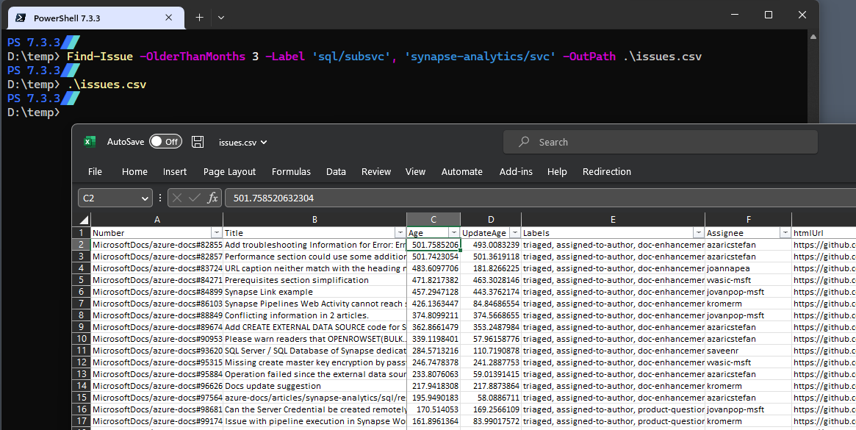
Finding issues
The Age and UpdateAge columns show how stale the issue is (in days)
The htmlUrl column has a link to the issue
You can add any columns you want for your own tracking
You can delete any columns except Number and apiUrl

Slide 6
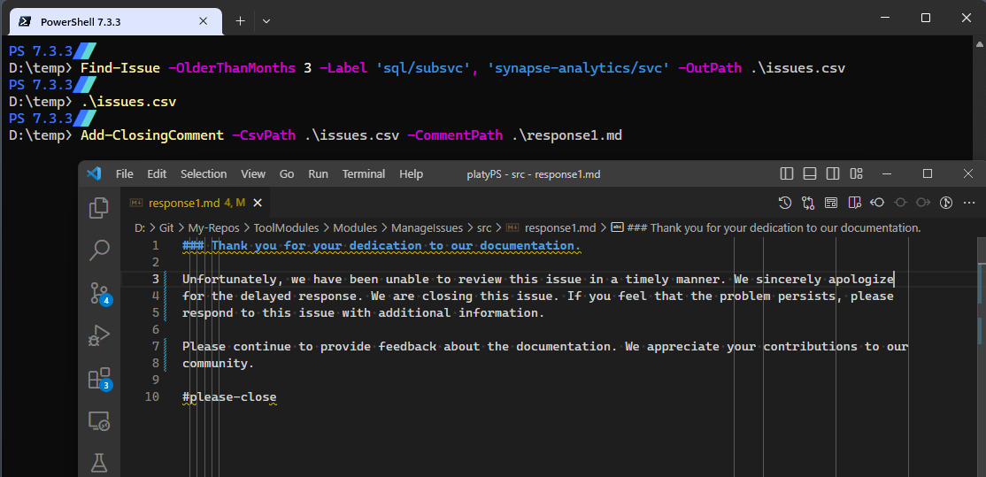
Add closing comments
All issues listed in a CSV file get the same response comment
Create a separate CSV file for each response
Responses are written in GFM
Create your own response files as needed

