Slide 1
Towards understanding retrosynthesis by
energy-based models
Ruoxi Sun, Hanjun Dai, Li Li, Steven Kearnes, and Bo Dai
presenter：Shen Yuan

Slide 2
Introduction

Slide 3
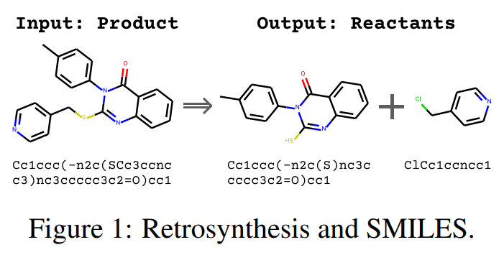
Introduction
Model
Experiments
Task
以数据类型分类，逆合成模型
主要分为两类，sequence-based 和
graph-based 。
sequence-based方法将分子作为一维序列，并将逆合成构造为 sequence-to-sequence问题。
graph-based方法将分子视为图结构，如果采用基于模板的方法，那么该方法实际上在解决graph matching任务。

Slide 4
Introduction
Model
Experiments
Task
sequence-based方法：
Retrosynthetic reaction prediction using neural sequence-to-sequence models
A model for uncertainty-calibrated chemical reaction prediction
Predicting retrosynthetic reactions using self-corrected transformer neural networks
graph-based方法：
（G2G）A graph to graphs framework for retrosynthesis prediction
Retroxpert: Decompose retrosynthesis prediction like a chemist
（GraphRETRO）Learning graph models for retrosynthesis prediction

Slide 5
Introduction
Model
Experiments
Contribution
提出了统一的energy-based model（EBM），其整合了sequence-based和graph-based方法。
提出了一个新的 generalized dual EBM variant，超越了的SOTA 4.3%

Slide 6
Model

Slide 7





Introduction
Model
Experiments
Energy-based model for Retrosynthesis
定义反应物与产物的联合分布为：
其中划分函数 是一个正规化常量
EBM框架分为两步：1）设计并训练一个能量函数 ；
2）使用 在逆合成任务中预测；

Slide 8
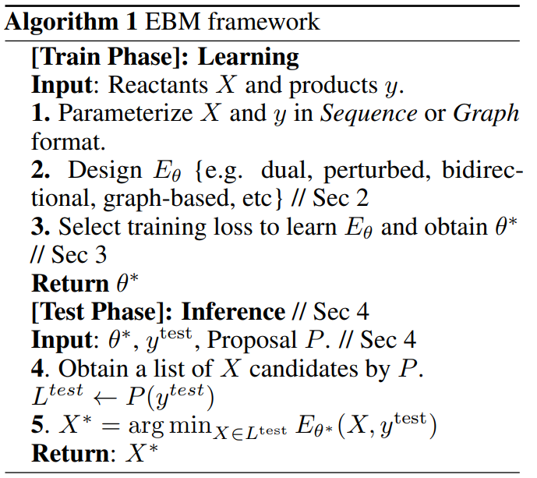
Introduction
Model
Experiments
Energy-based model for Retrosynthesis

Slide 9
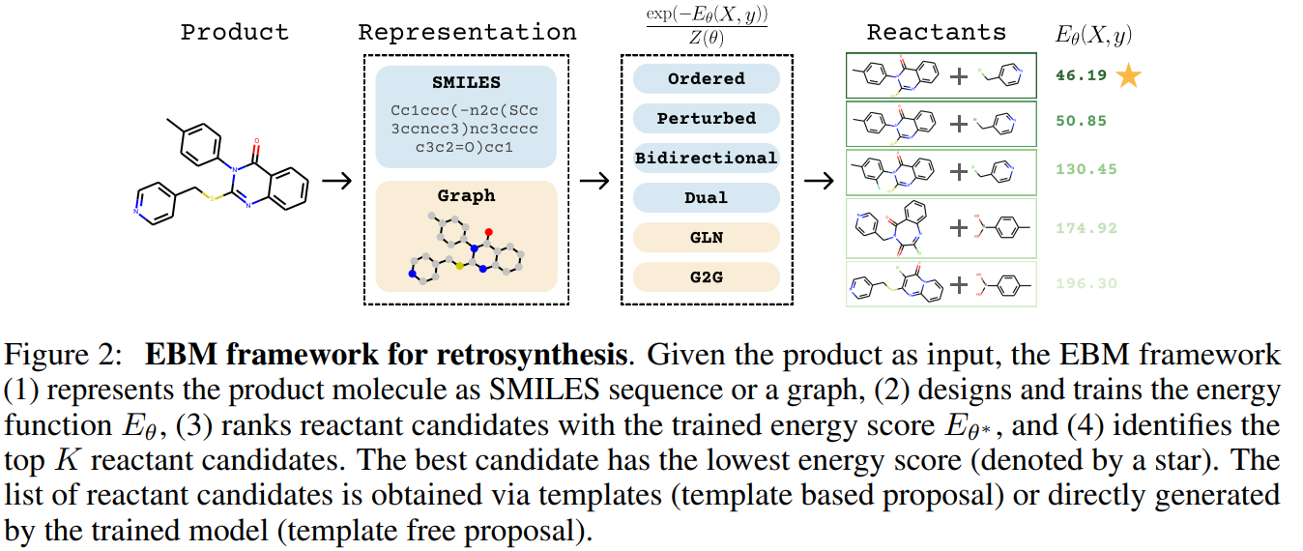
Introduction
Model
Experiments
Energy-based model for Retrosynthesis

Slide 10
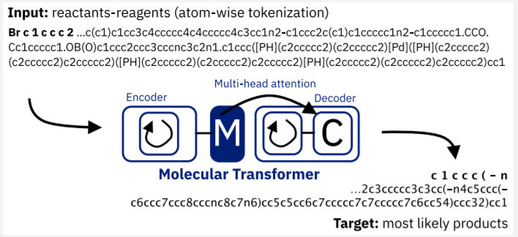
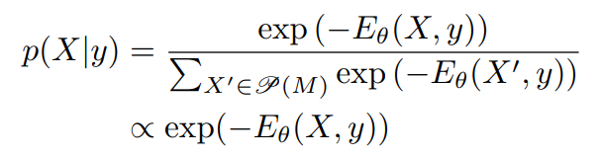
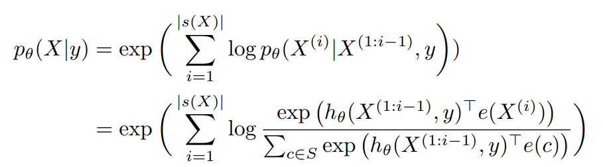


Introduction
Model
Experiments
Full energy-based model
Ordered model
其中Transformer ， 是一个vocabulary。 是one-hot向量，维度c设为1

Slide 11
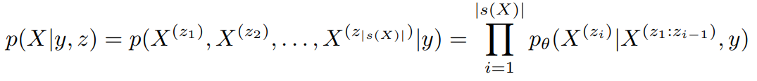
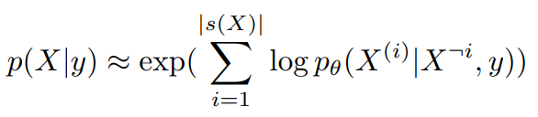
Introduction
Model
Experiments
Perturbed model
Bidirectional model

Slide 12



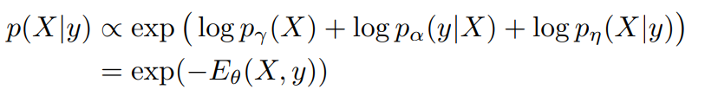
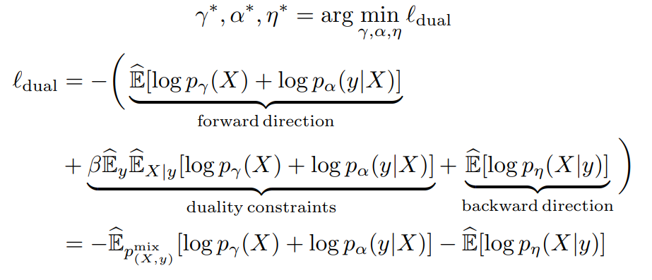
Introduction
Model
Experiments
Dual model
利用逆合成预测和反应预测的双重性。联合概率 可以分解为 或

Slide 13
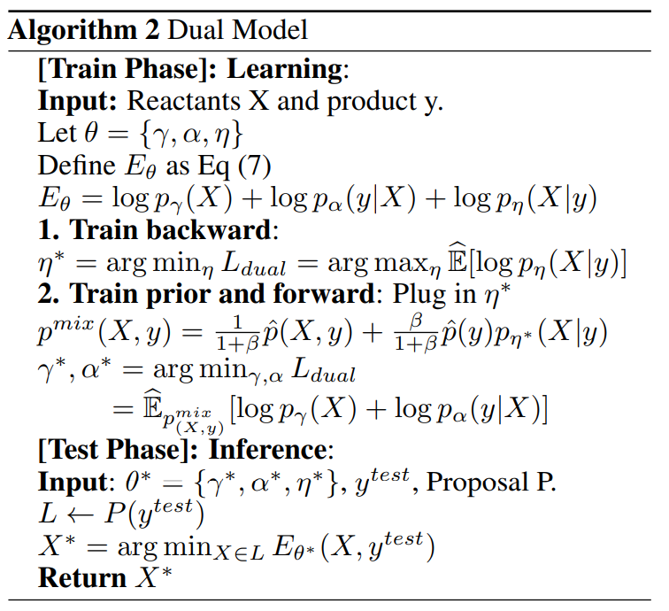
Introduction
Model
Experiments
Dual model

Slide 14


Introduction
Model
Experiments
Template prediction: NeuralSym multi-class classification
Graph-matching with template: GLN
Graph matching with reaction centers, G2G and GraphRETRO

Slide 15
Introduction
Model
Experiments
Inference
目标函数为
直接解上述公式较为困难，但是可以使用 用来排序

Slide 16
Experiments

Slide 17
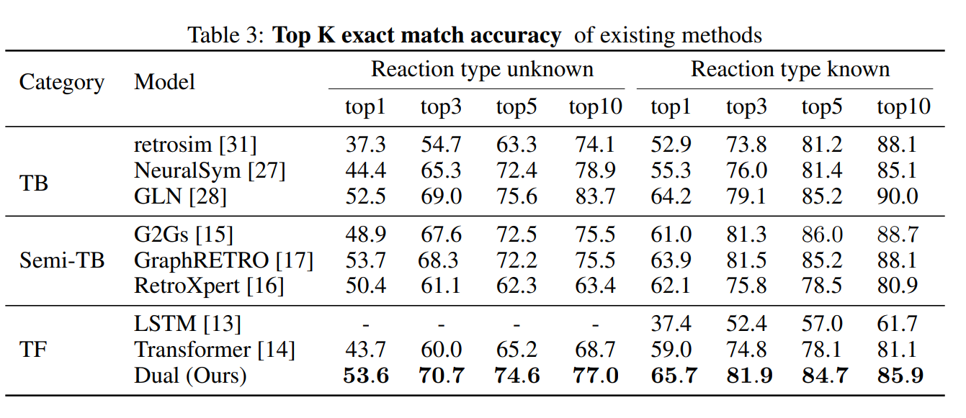
Introduction
Model
Experiments
Evaluation

Slide 18
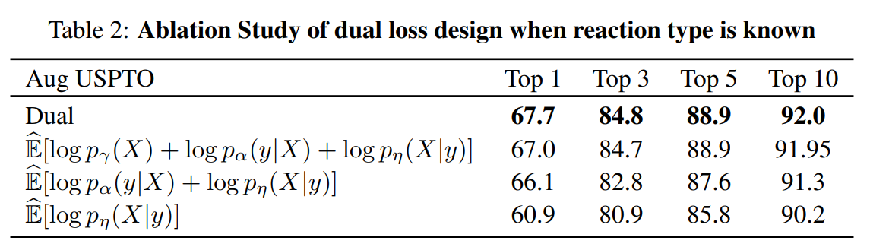
Introduction
Model
Experiments
Evaluation

Slide 19
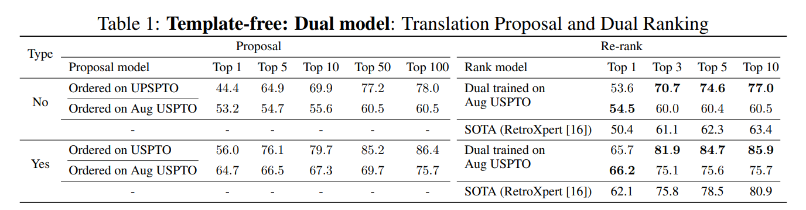
Introduction
Model
Experiments
Evaluation

Slide 20
Q & A

