Slide 1
From Transformer to Sliceformer:
Make Multi-Head Attention as Simple as Sorting
Shen Yuan Hongteng Xu
presenter：Shen Yuan

Slide 2
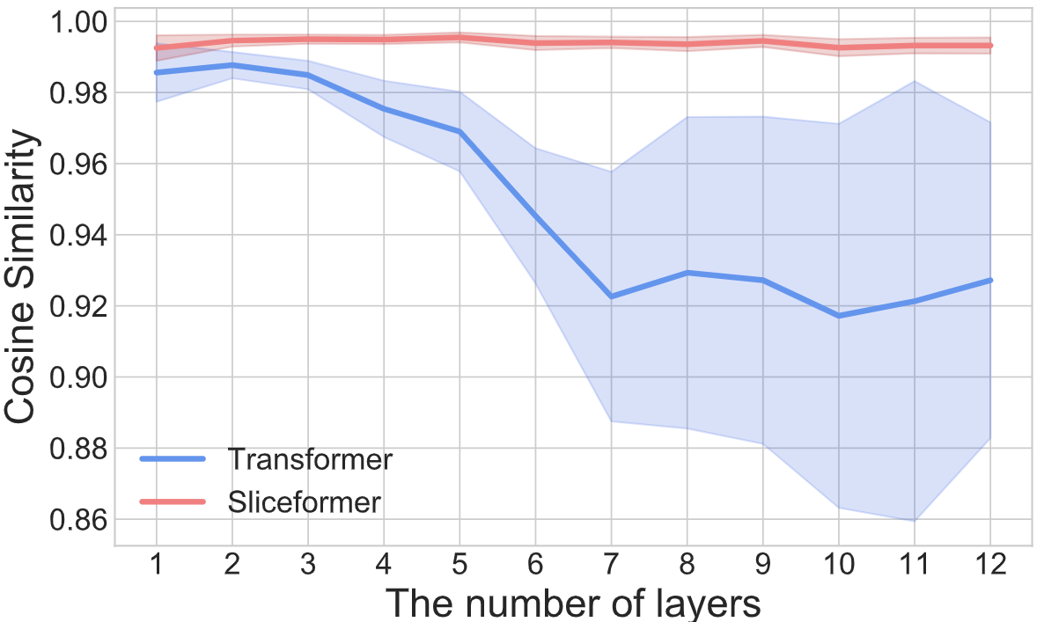
Transformer存在的问题
1. Long Sequence
2. Equvi-Perturbation

Slide 3
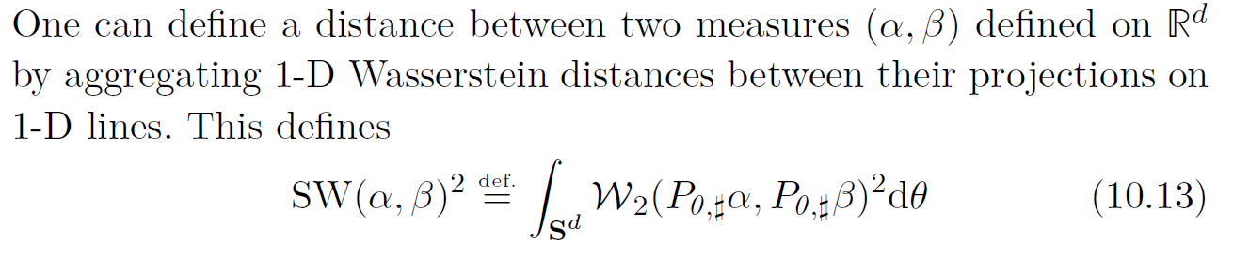
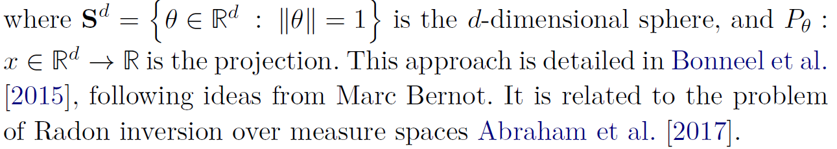
Sliced Wasserstein Distance

Slide 4




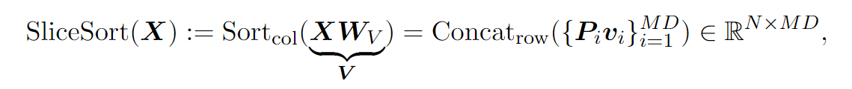
Sliceformer

Slide 5
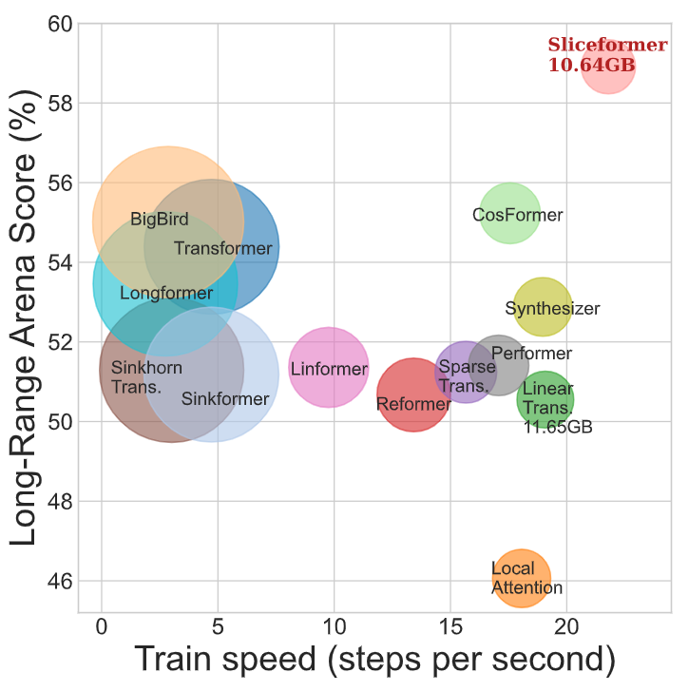
Experiments

Slide 6
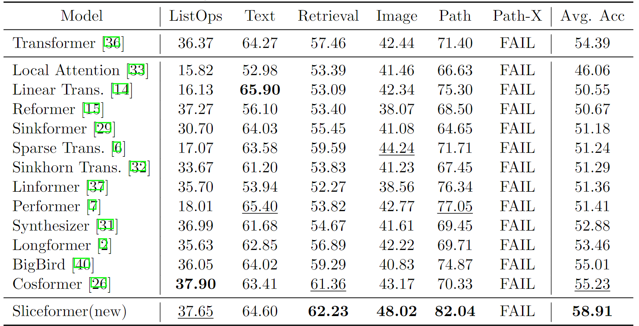
Experiments

Slide 7
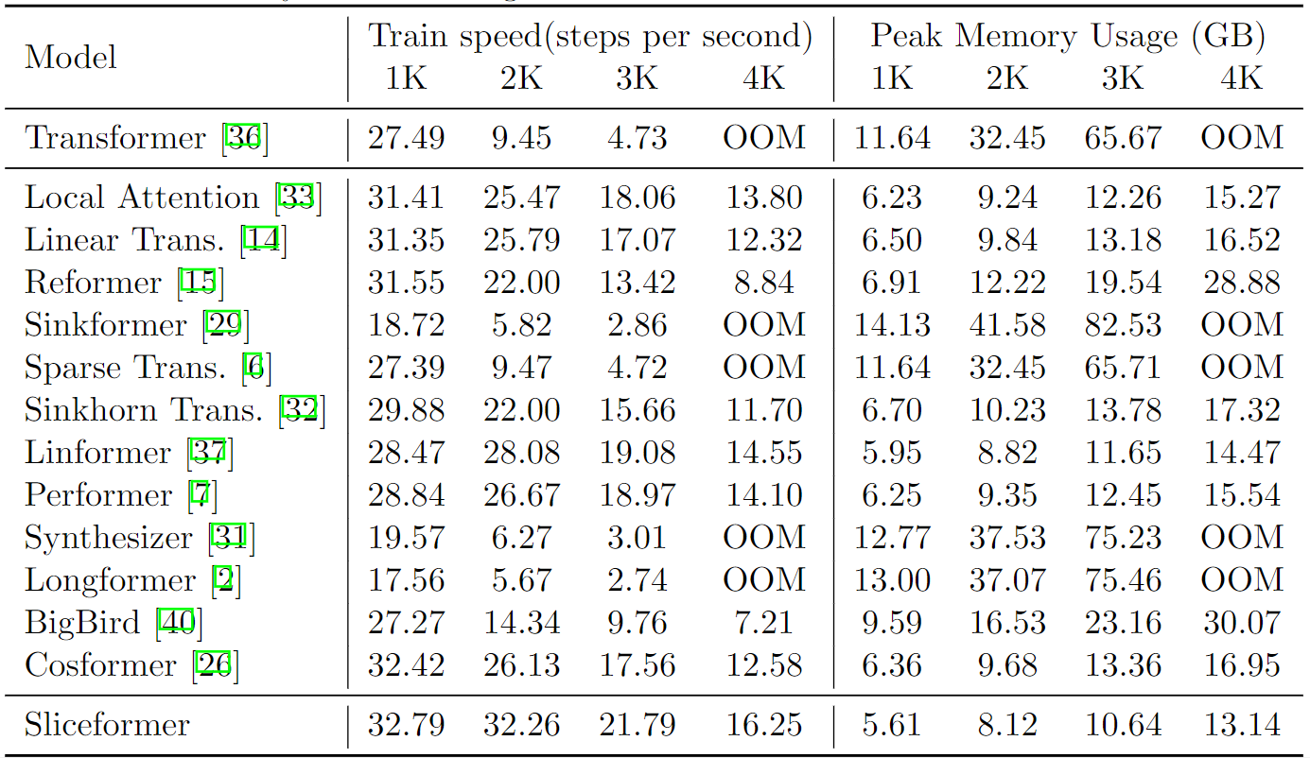
Experiments

Slide 8
Experiments

Slide 9
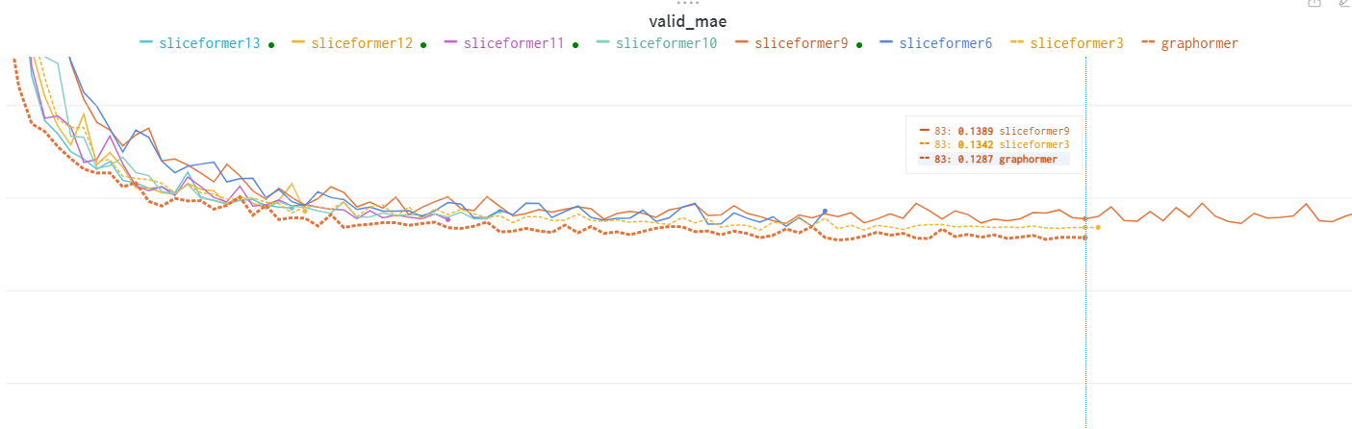
Experiments

