Slide 1
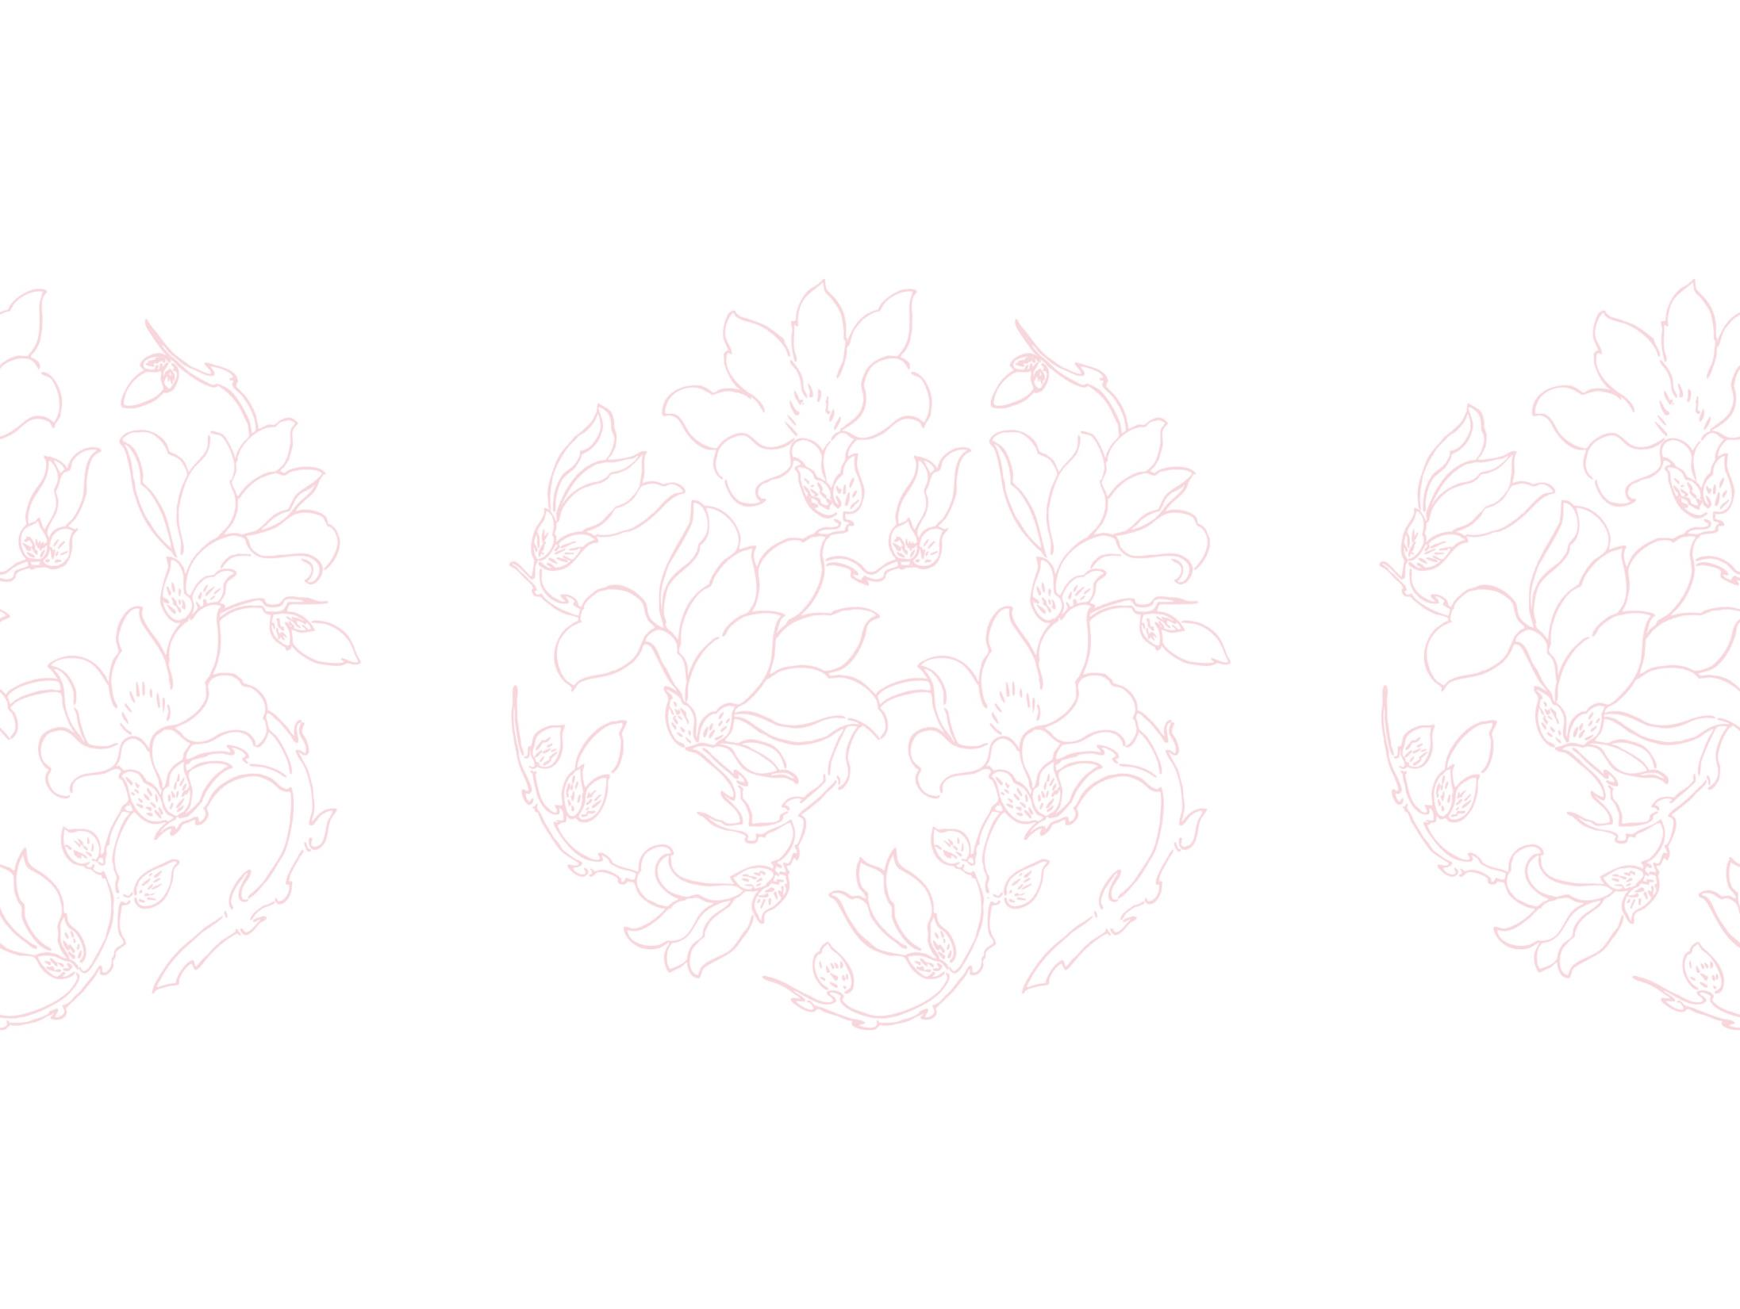


Improving Generative Flow Networks with Path Regularization
Anh Do, Duy Dinh, Tan Nguyen, Khuong Nguyen, Stanley Osher, Nhat Ho
University of Texas, Austin
University of California, Los Angeles
FPT Software AI Center
Fanmeng Wang
2023-7-5

Slide 2
Outline
Introduction
Background: GFlowNets & Optimal Transport Distance
Method: Path Regularization via Optimal Transport
Experiment
Conclusion

Slide 3
Introduction
Background: GFlowNets & Optimal Transport Distance
Method: Path Regularization via Optimal Transport
Experiment
Conclusion

Slide 4
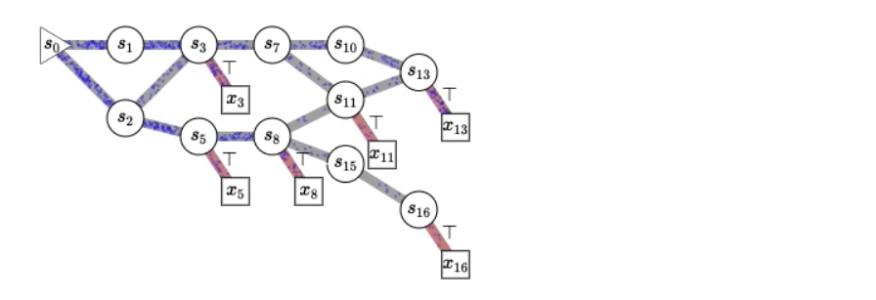
Introduction
Generative Flow Networks (GFlowNets) are recently proposed models for learning stochastic policies that generate compositional objects by sequences of actions with the probability proportional to a given reward function.
The central problems of GFlowNets are how to improve exploration and generalization.
In this paper, we propose to train the GFlowNets with an additional path regularization via OT to deal with above problems.

Slide 5
Introduction
Background: GFlowNets & Optimal Transport Distance
Method: Path Regularization via Optimal Transport
Experiment
Conclusion

Slide 6

Background
GFlowNets: some basic concepts
Compositional Space $X$, where each object $x∈X$ can be constructed from the source state $s_{0}$ and ends in the final state $s_{f}$ by taking a sequence of discrete actions from the action space A (e.g. a complete molecule can be generated fragment by fragment).
A complete trajectory $τ$, which is a sequence of transitions from $s_{0}$ to $s_{f}$.
A directed acyclic graph G
node -> state
edge -> action
* Bengio E, Jain M, Korablyov M, et al. Flow network based generative models for non-iterative diverse candidate generation[J]. Advances in Neural Information Processing Systems, 2021, 34: 27381-27394.

Slide 7
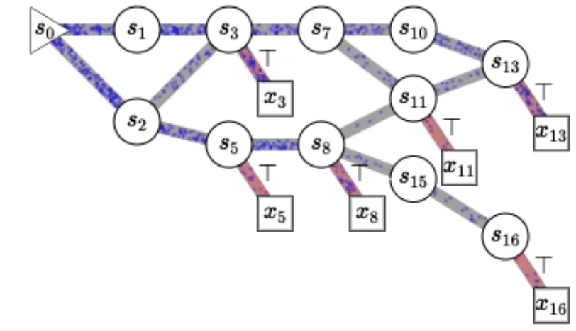
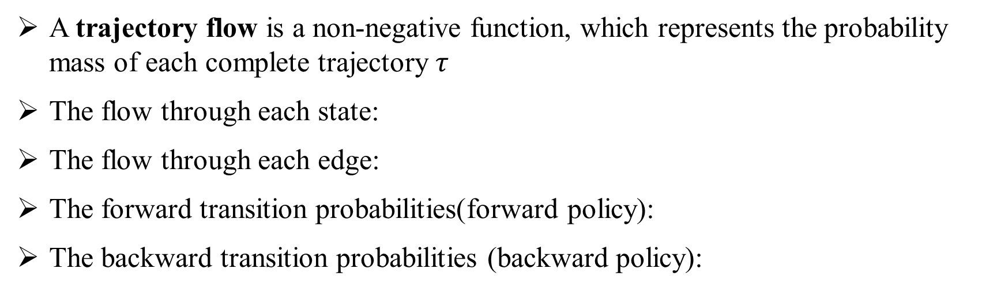
Background
GFlowNets: Flows
A trajectory flow is a non-negative function, which represents the probability mass of each complete trajectory $τ$
The flow through each state:
The flow through each edge:
The forward transition probabilities(forward policy):
The backward transition probabilities (backward policy):

Slide 8
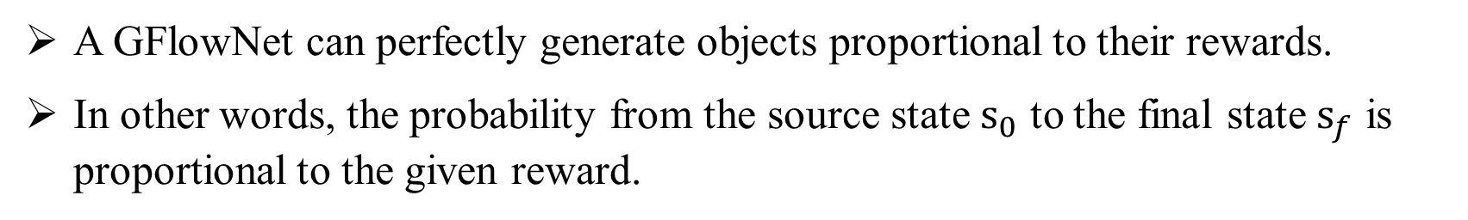
Background
GFlowNets: Learning Objective
A GFlowNet can perfectly generate objects proportional to their rewards.
In other words, the probability from the source state $s_{0}$ to the final state $s_{f}$ is proportional to the given reward.

Slide 9

Background
Optimal Transport Distance
For two discrete probability measures α and β over some space X
The set of transportation plans or joint probability distributions can be defined as:
The Kantorovich optimal transport between α and β is defined as follows:
where C is given cost matrix

Slide 10
Introduction
Background: GFlowNets & Optimal Transport Distance
Method: Path Regularization via Optimal Transport
Experiment
Conclusion

Slide 11

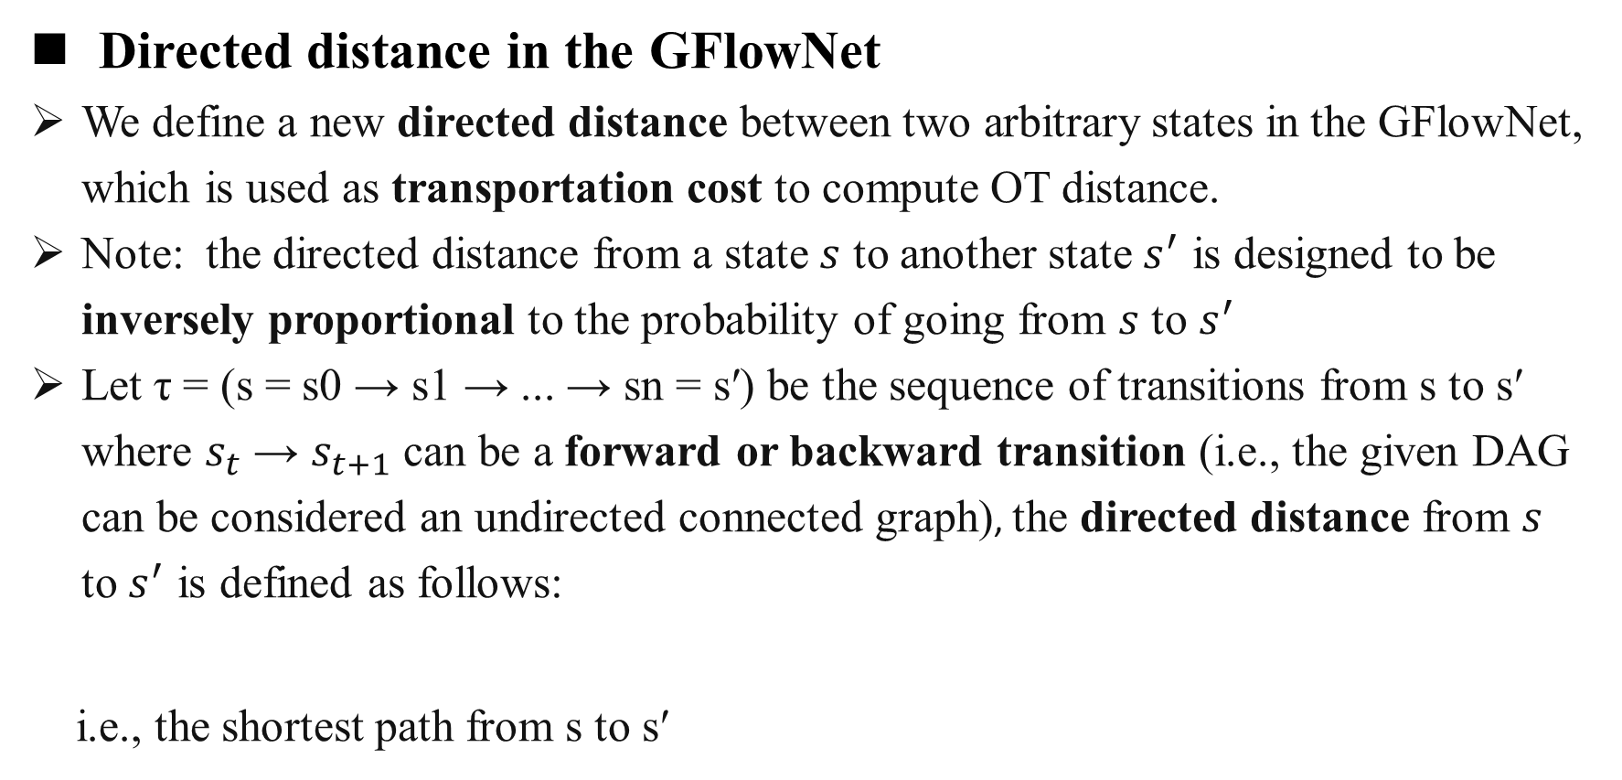
Method
Transportation cost -> OT distance -> Path Regularization
Directed distance in the GFlowNet
We define a new directed distance between two arbitrary states in the GFlowNet, which is used as transportation cost to compute OT distance.
Note: the directed distance from a state $s$ to another state $s^{′}$ is designed to be inversely proportional to the probability of going from $s$ to $s^{′}$
Let τ = (s = s0 → s1 → ... → sn = s′) be the sequence of transitions from s to s′ where $s_{t}$ → $s_{t+1}$ can be a forward or backward transition (i.e., the given DAG can be considered an undirected connected graph), the directed distance from $s$ to $s^{′}$ is defined as follows:
i.e., the shortest path from s to s′
The length of the trajectory τ

Slide 12

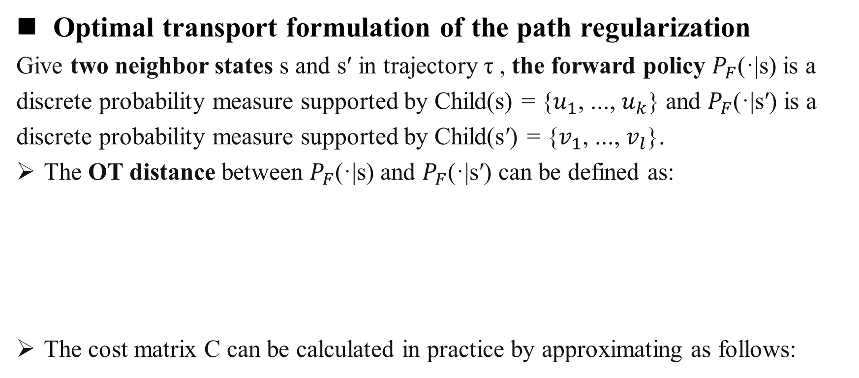

Method
Transportation cost -> OT distance -> Path Regularization
Optimal transport formulation of the path regularization
Give two neighbor states s and s′ in trajectory τ , the forward policy $P_{F}$(·|s) is a discrete probability measure supported by Child(s) = {$u_{1}$, ..., $u_{k}$} and $P_{F}$(·|s′) is a discrete probability measure supported by Child(s′) = {$v_{1}$, ..., $v_{l}$}.
The OT distance between $P_{F}$(·|s) and $P_{F}$(·|s′) can be defined as:
The cost matrix C can be calculated in practice by approximating as follows:
s
s′
$$u_{i}$$
$${ v}_{j}$$

Slide 13


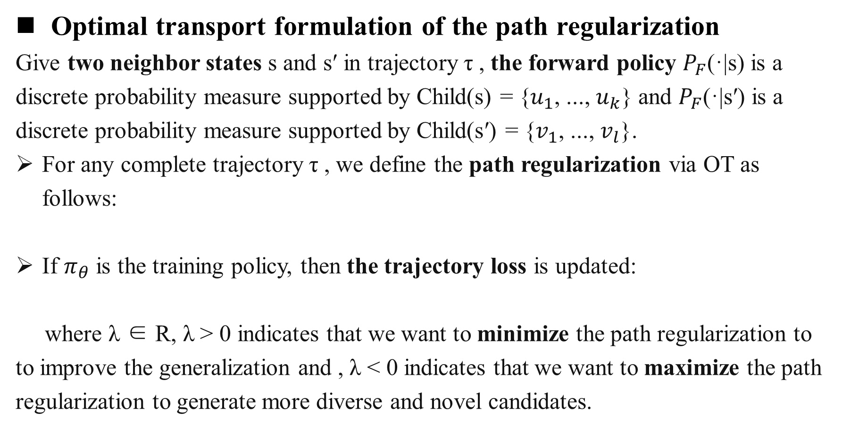
Method
Transportation cost -> OT distance -> Path Regularization
Optimal transport formulation of the path regularization
Give two neighbor states s and s′ in trajectory τ , the forward policy $P_{F}$(·|s) is a discrete probability measure supported by Child(s) = {$u_{1}$, ..., $u_{k}$} and $P_{F}$(·|s′) is a discrete probability measure supported by Child(s′) = {$v_{1}$, ..., $v_{l}$}.
For any complete trajectory τ , we define the path regularization via OT as follows:
If $π_{θ}$ is the training policy, then the trajectory loss is updated:
where λ ∈ R, λ > 0 indicates that we want to minimize the path regularization to to improve the generalization and , λ < 0 indicates that we want to maximize the path regularization to generate more diverse and novel candidates.

Slide 14
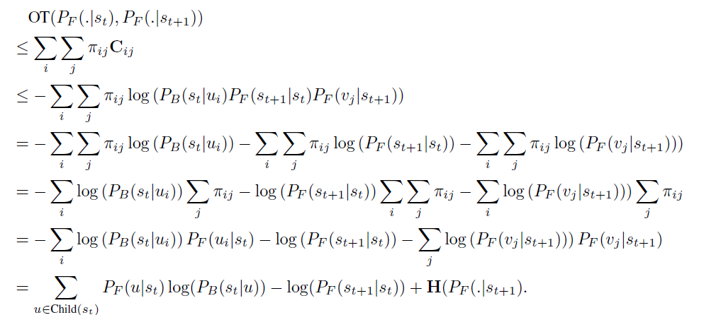
Method
Upper bound of optimal transport distance
Our path regularization’s definition requires computing the OT distances for all edges in the trajectory τ , which imposes a heavy burden on the computing
To overcome this problem, we propose the upper bound of the OT distance:

Slide 15


Method
Upper bound of optimal transport distance
Since the path regularization via OT can be difined as follows:
The path regularization via OT can be upper bound by:

Slide 16
Introduction
Background: GFlowNets & Optimal Transport Distance
Method: Path Regularization via Optimal Transport
Experiment
Conclusion

Slide 17
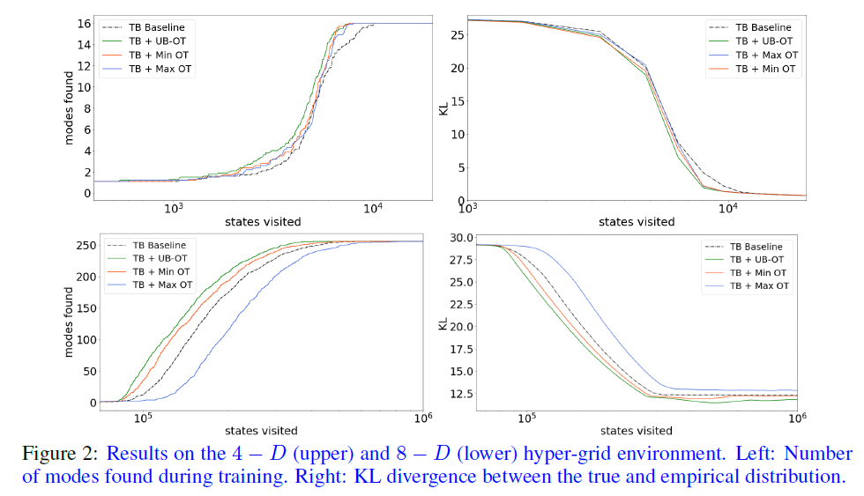
Experiment
Hyper-grid Environment
This task aims to evaluates the generalization ability of the GFlowNet to guess and sample unvisited modes of the interested distribution.
The GFlowNet model trained by minimizing the path regularization via OT and the upper bound both performer well in improving generalization ability.

Slide 18
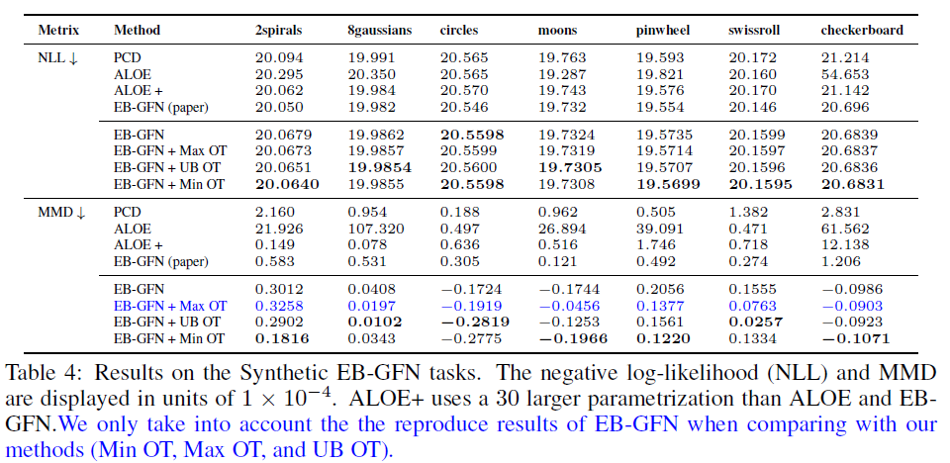
Experiment
Synthetic Discrete Probabilistic Modeling tasks
Training the GFlowNet with either minimizing the path regularization via OT (Min OT) or via the upper bound (UB OT) gains the better NLL and MMD scores than the baseline and Max OT.
* Zhang D, Malkin N, Liu Z, et al. Generative flow networks for discrete probabilistic modeling[C]//International Conference on Machine Learning. PMLR, 2022: 26412-26428.

Slide 19
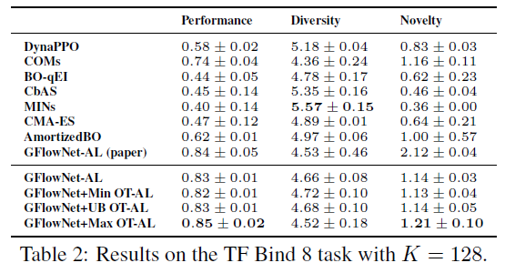
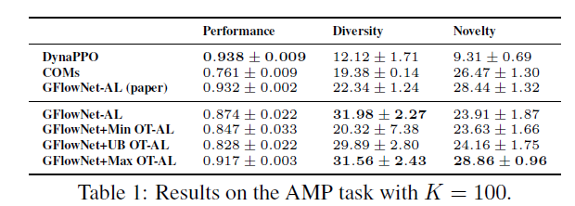
Experiment
Biological Sequences Design
The experiments are conducted in the multi-round active learning setting, with the goal of generating a diverse set of useful candidates after evaluation rounds.
* Jain M, Bengio E, Hernandez-Garcia A, et al. Biological sequence design with gflownets[C]//International Conference on Machine Learning. PMLR, 2022: 9786-9801.

Slide 20
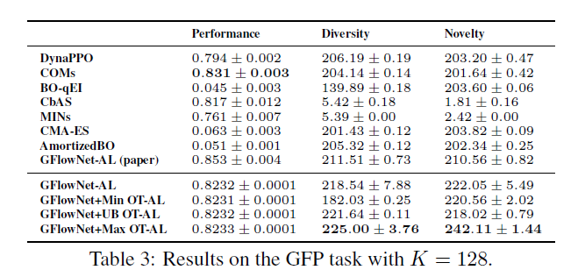
Experiment
Biological Sequences Design
The experiments are conducted in the multi-round active learning setting, with the goal of generating a diverse set of useful candidates after evaluation rounds.
The GFlowNet-AL model trained by maximizing the path regularization via OT performs well in generating more diverse and novel candidates.

Slide 21
Introduction
Background: GFlowNets & Optimal Transport Distance
Method: Path Regularization via Optimal Transport
Experiment
Conclusion

Slide 22
Conclusion
We propose to train the GFlowNet with an additional path regularization via Optimal Transport that places prior constraints on the underlying structure of the GFlowNet.
We derive an efficient implementation of the regularization by finding its closed-form solutions in specific cases and a meaningful upper bound that can be used as an approximation when we want to minimize the regularization term.
Experiments have shown that minimizing the path regularization via OT improves the GFlowNet’s generalization while maximizing the path regularization via OT enhances the exploration ability of the GFlowNet.

Slide 23
Thank You for listening!
Fanmeng Wang
2023-7-5

