Slide 1
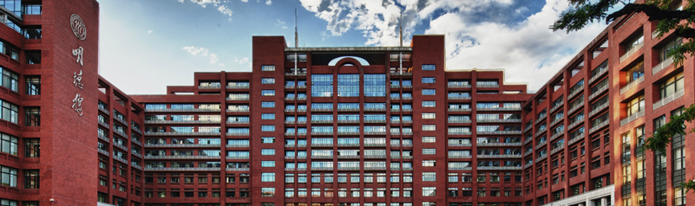

GPN: A Joint Structural Learning Framework for Graph Neural Networks
Qianggang Ding, Peilin Zhao, Deheng Ye, Tingyang Xu and Bang Liu

Slide 2
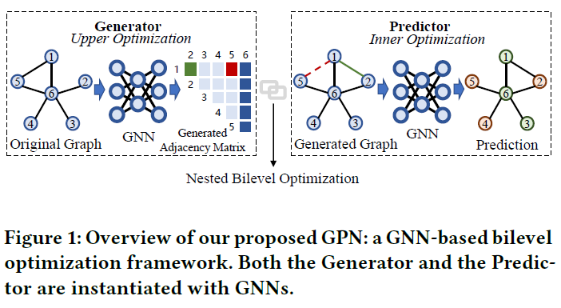
Motivation
Most existing works of GNNs are based on the assumption that the given graph structure of the data is optimal, while it is inevitable that there exists missing or incomplete edges in the graph for training, leading to degraded performance.

Slide 3
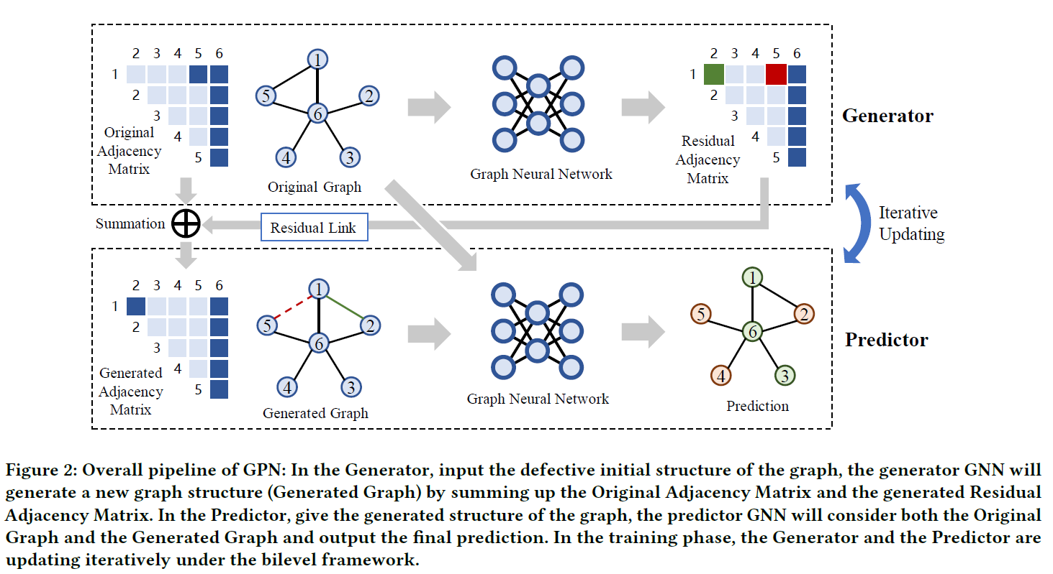
Pipeline of GPN

Slide 4

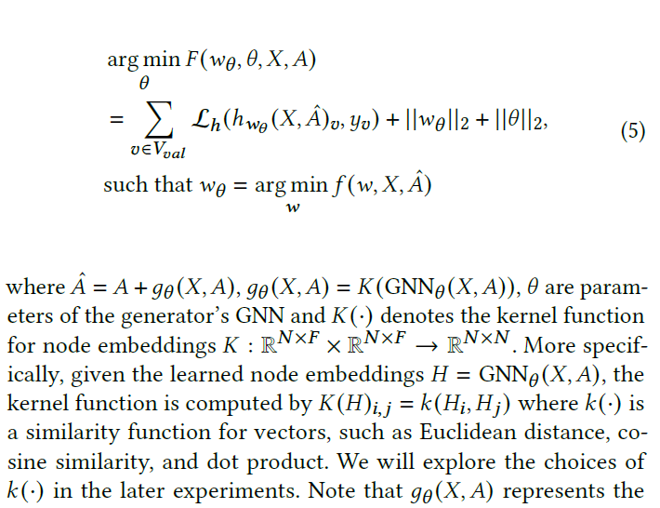

Slide 5
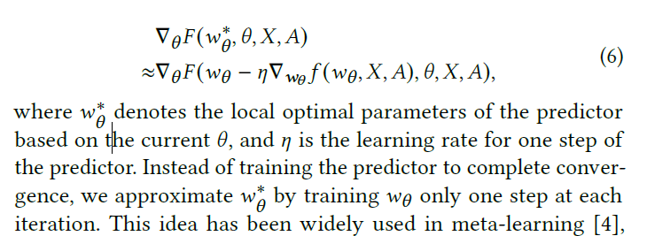

Slide 6
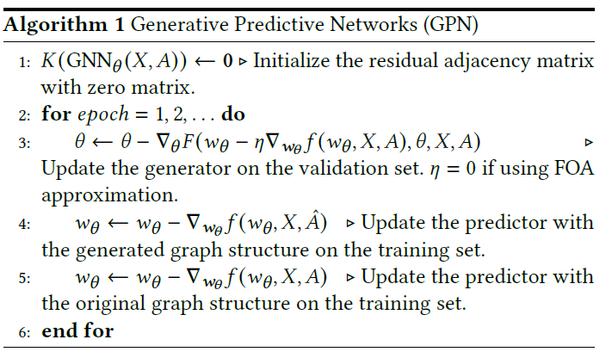

Slide 7
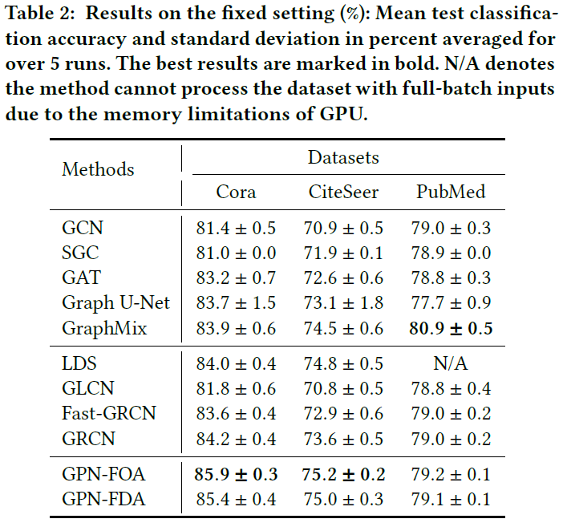

Slide 8
改进方向
模型过于简单
需要加入更多的理论分析
配图需要重新设计
实验方面，一些比较新的baseline需要加入

