Slide 1
Euclid
Education User-Client Learning Integrated Database
Bray Schurman, Sam Doiron, Nick McDonald, Aaron Hourie

Slide 2
Application Summary
Euclid is an Education Management Platform that enables student collaborative submission for educator-created assignments.
A professor may create an assignment with a list of requirements, and a total mark for all the students in a particular course.
Students can create group submissions and receive synchronized marks.
Students and teachers’ courses can be tracked individually and queried.

Slide 3
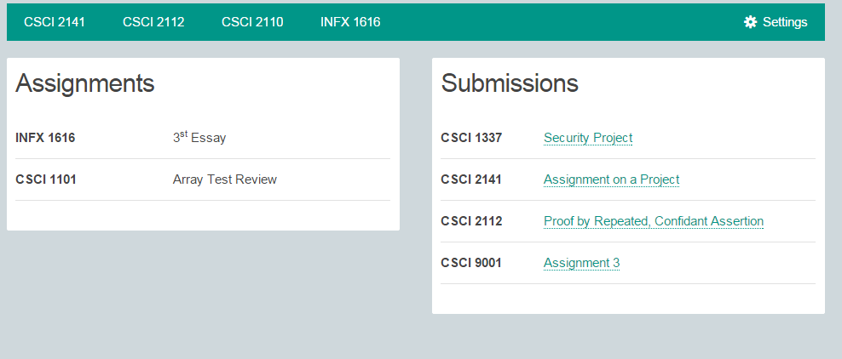
Web application

Slide 4
ER-Diagram
ID
Total
Name
Weight
Description
Description
Name
ID
Total
Weight
Assignment
1
Submitted For
1
Submission
M
1
ID
Email
Submissions
Name
Major
M
1
Student
M
In
Group
Assignment
ID
Group ID
Email
Teacher
Enrolled
Listing
Teaches
1
Name
Course
M

Slide 5
Schemas
Student (student_id, name, email, major)
Professor (prof_id, email, name)
Course (listing, name, teacher_id)
Submission (assignment_id, group_id, file_path, comments, submission_date)
Assignment (assignment_id, course_id, name, weight, description, max_points, due_date)
Group (group_id)
Group_Member (group_id, student_id)

Slide 6

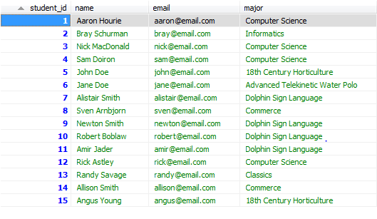
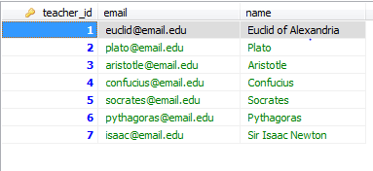
Tables

Slide 7
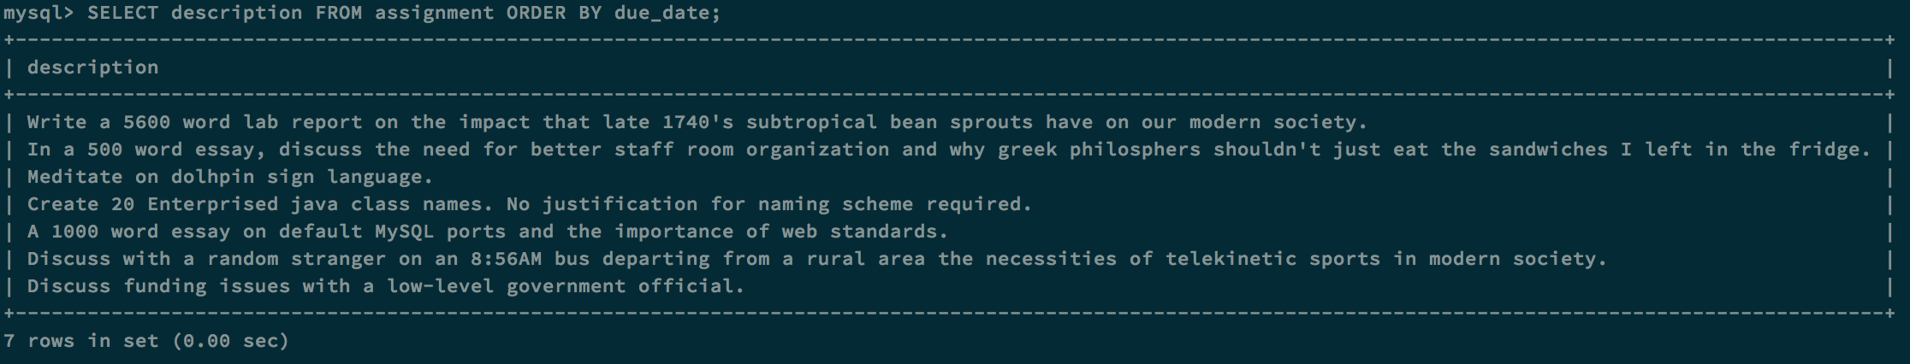
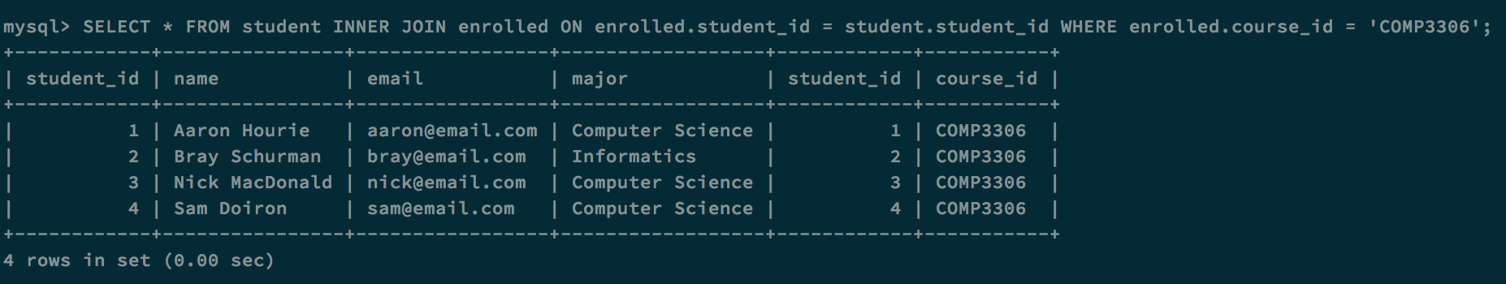
Queries

Slide 8
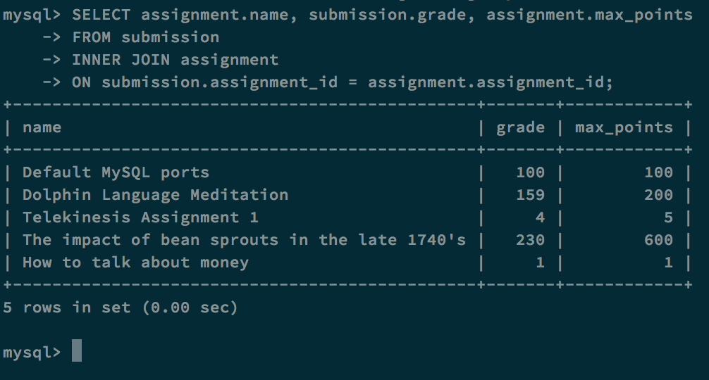
Queries cont.

Slide 9
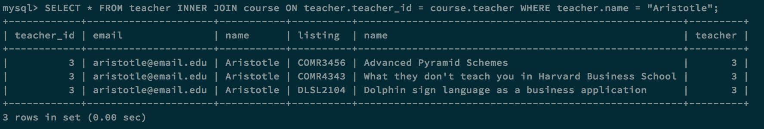
Queries cont.

Slide 10
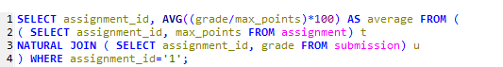

Queries cont.
A teacher wants to see the average mark on one assignment

Slide 11


Queries cont.
A student wants to view their mark on one assignment

Slide 12


Queries cont.
A teacher wants to retrieve all of the marks for one student

Slide 13
Euclid
Euclid efficiently manages assignments and grading for large amounts of students enrolled in different courses.
Group submissions are easy with the specialized group ID lookup table.
Using Cascading Style Sheets we can create a clean look for improved usability.
Overall Euclid is a highly sophisticated education management system built on the reliable MySQL database software.

