Slide 1
Euclid
Education User-Client Learning Integrated Database

Slide 2
Summary
Euclid is a MySQL database design meant to easily and efficiently store data on students, courses and assignments.
The database allows for professors to post assignments, and students to post submissions either by themselves or in easily created groups.
The database can track courses over years and which professors teach which courses.

Slide 4
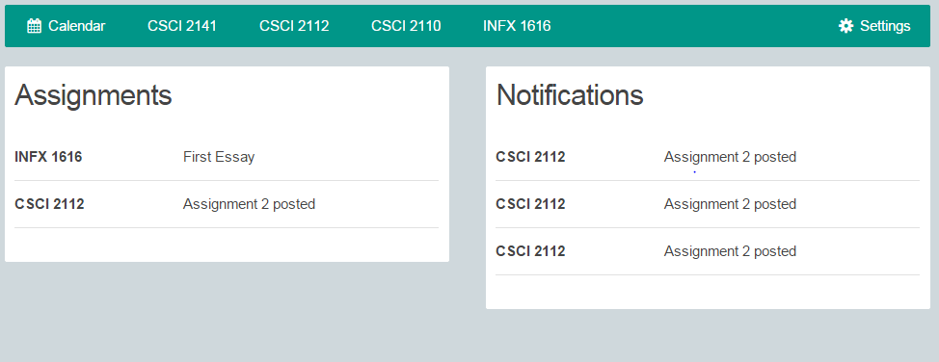
Features
Separated professor and student account types.
Easy case by case group submission interface.
Accessible assignment requirements and information.
Easily translated to a GUI for maximum useability.

Slide 5
Euclid vs. Moodle
Euclid
Allows professors to create assignments and students to add submissions
Allows group assignments to be uploaded
Does not allow professor to upload course-related documents
Moodle
Allows professors to create assignments and students to add submissions
Does not allow group assignments to be uploaded
Allows professor to upload course-related documents

