Slide 1
Civilcomments dataset
WILDS benchmark

Slide 2
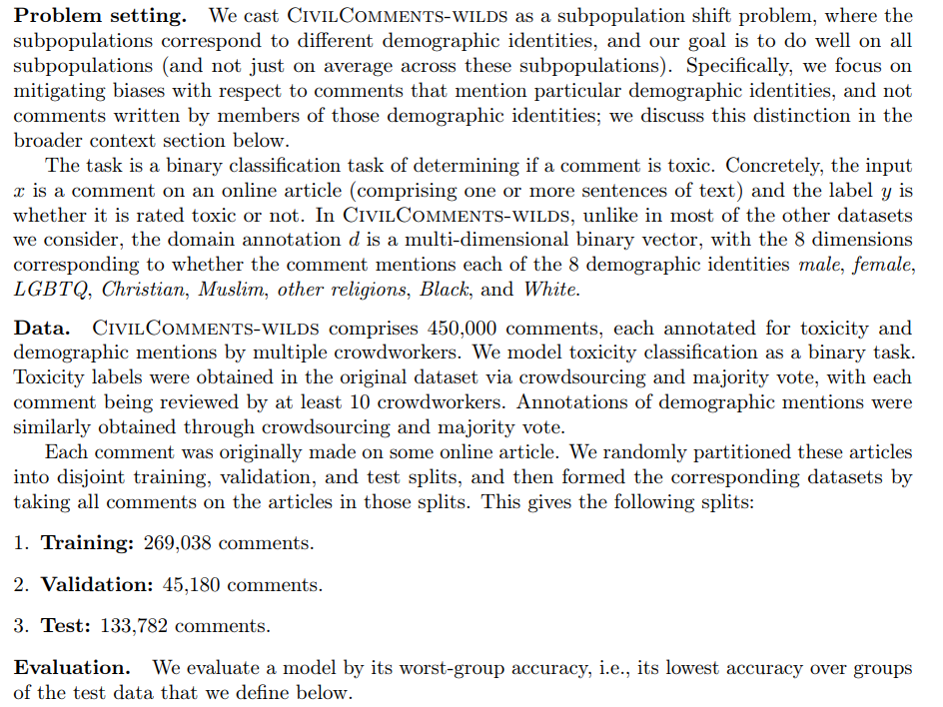

Slide 3
Lines of civilcomments
8 demographic identities;
16 groups: 8 identities * 2 labels to balance the true positive/negative rates
Toxicity and demographics are curated by at least 10 crowd workers, then use the majority voting
Comments are randomly split into train/val/test sets.
Then evaluate the subpopulation DS on the worst-group accuracy (on test data set).
Subpopulation: the comments that mention the specific demographic (i.e. male/female/)
Then evaluate the binary classifier performance on 16 subpopulations, and report the metrics on the worst-group

Slide 4
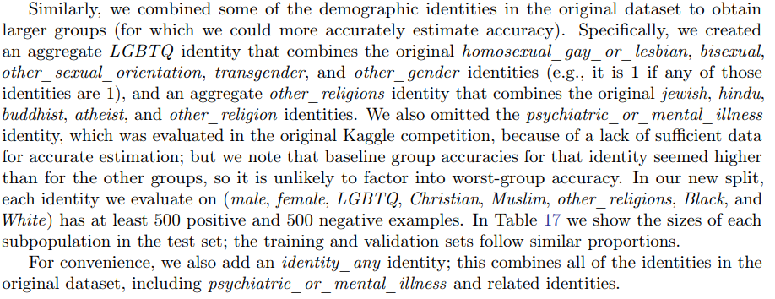
civilcomments
The original dataset contains many annotation features;
They combine different features into the 8 demographic identities.

Slide 5
preprocess
Grouping into 16 subpopulations:
X: comments, maximal 300 lengths. Requires a tokenizer
Y label: The column “toxicity” value >= 0.5 is 1, otherwise is 0.
Metadata: Used for evaluation step of subpopulation DS.

Slide 6
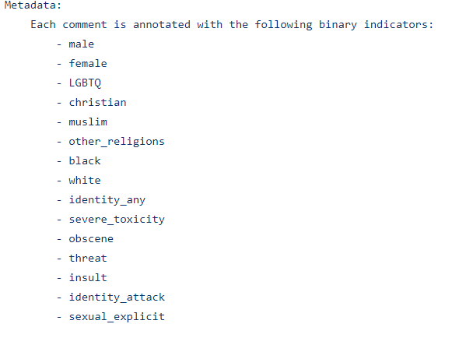
The meta data

Slide 7
How to get datapoint info in wilds package
A WildsSubset Object such as “data”
Data.__getitem__(self, index) return:
X, y, metadata of the specific index.

Slide 8
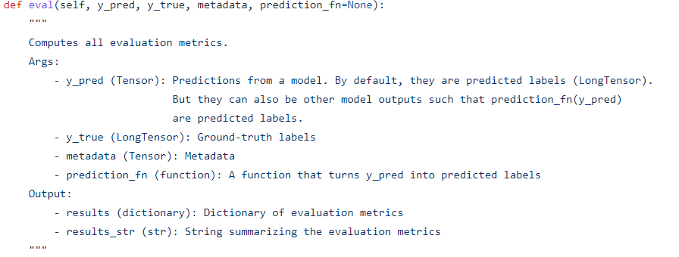
Benchmark evaluation
We must use their evaluator in the wilds library:

Slide 9
Amazon dataset
WILDS benchmark

Slide 10
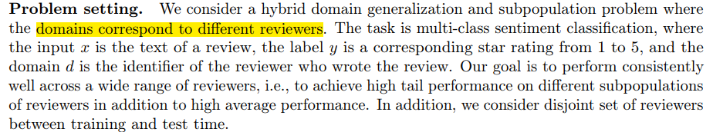
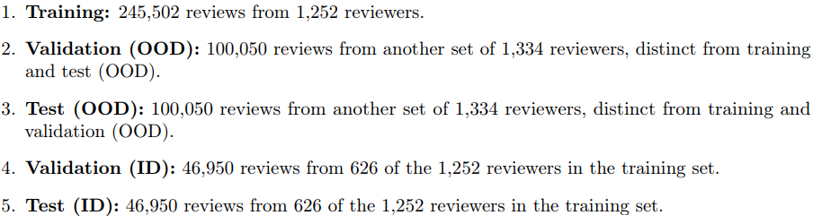
Data origin and problem setting
Reviews that have at least 75 reviews are included;
Review are randomly split into the following 5 sets:

Slide 11
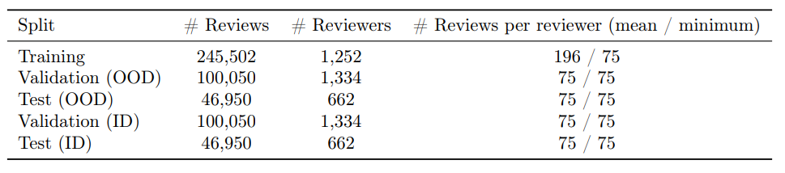
Data processing and split schemes
In order to study user DS, they randomly split the dataset as disjoint reviewers
To make a comparison between OOD and ID accuracy, they randomly split the reviews for each reviewer in the validation and test datasets, as shown below.

Slide 12
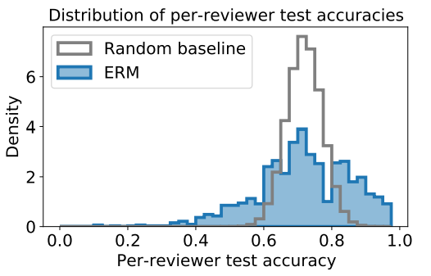
Evaluation metrics
Must use their evaluator: data.eval()
The 10th percentile worst reviewer can be identified easily using the prediction result and the metadata
The ERM has a large tail compared with a random-split baseline
The reason may be that some reviewers tend to write uninformative reviews

Slide 13
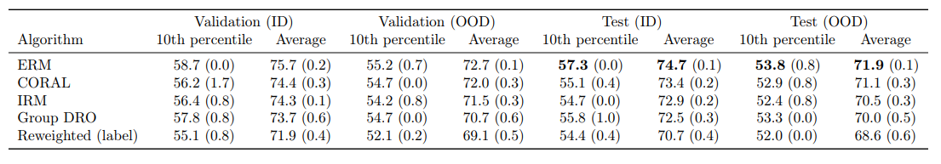
Possibility to leverage
There still gaps between the ID and OOD performances:

Slide 14
Other preprocess details
Reviews longer than 512 tokens removed
Product that has at least 30 reviews
Duplicated review
Reviews that contain HTML
Reviewers that have at least 150 reviews
For each reviewer, the 75 reviews are randomly sampled from the original dataset.

Slide 15
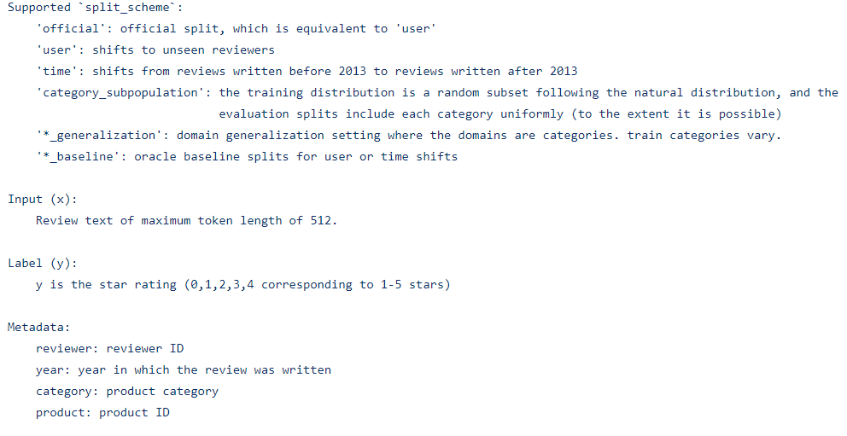
Other DS split schemes

