Slide 1
Distribution Shift, WILD benchmark Data Set and related algorithms

Slide 2
Background: Distribution Shift(DS)
Distribution shift from training data to the test data cause the degradation of the model accuracy in ML.
The scenario of the model application may have changed;
The original population of the training distribution may be slightly different;
The model is used in a sample set drawn from a different population
The model is overfitted in the sense that it weights too much on domain-dependent features

Slide 3
Background: DS types
1. Domain generalization:
training distribution and test distribution are from distinct but related domains (i.e. business analysis model trained on data from one country is used in a culturally distinct country)
Subpopulation shift:
The test data set is drawn from a subpopulation of the training dataset, and we want to make sure the model performs sufficiently well even on the worst-case subpopulation (i.e. the recommend system model trained on global data is used and tested specifically in a country which may have small population)
.
Hybrid of the two:
The test data distribution both has the above two DS types and the combinatorial impact is complicated, not just additive.
.

Slide 4
Important: The model needs to be robust to DS
In real-world, ML models must be applied carefully since the model may be developed using training+test dataset different from the current sample distribution
Especially true when the model is used in medical or some other critical area; In these situations, it may be necessary to have a well-explainable model
General enough to capture different domains
Good enough for unbalanced specific subpopulations

Slide 5
Crux: How to make ML model robust to DS?
Increasingly hot topic: need well-curated benchmark datasets
A variety of algorithms dedicated to:
Either: improve robustness to all ML models/scenario
Or: improve robustness to a specific model/scenario

Slide 6
DS in real world: WILD benchmark
10 domain-expert-curated datasets collected from real-word DS (wild)
Large in size: good for develop complex models
Diverse and representative in application fields: nature, hospital, images
Substantial drop of OOD performance compared with ID performance
Potential leverage: possible to solve, not arbitrary DS.
Convenient tools and API to download and manipulate the data
Provide baseline algorithms results to compete with
Previous benchmark datasets are synthetic, and mostly on relatively small datasets for image classification problems.

Slide 7
WILD: how to measure the DS?
Out-Of-Distribution(OOD) performance: official train/test splits
In-Distribution(ID) performance: Ideally measured in the test dataset since OOD is evaluated on the test dataset, we need to isolate the DS.
Then compare the gap between the OOD and ID

Slide 8
WILD: Problem of measuring the ID
In practice, sometimes we have to use different strategies rather than test ID when the test set is small:
Use the training-to-training ID;
Use the train-test-mix ID;
Use a random split (mixing train and test and then random split and compute the ID);
Average: treat the average performance as the ID and the worst-case subpopulation performance as OOD (i.e. Amazon dataset uses the worst 10th percentile users as the OOD performance).

Slide 9
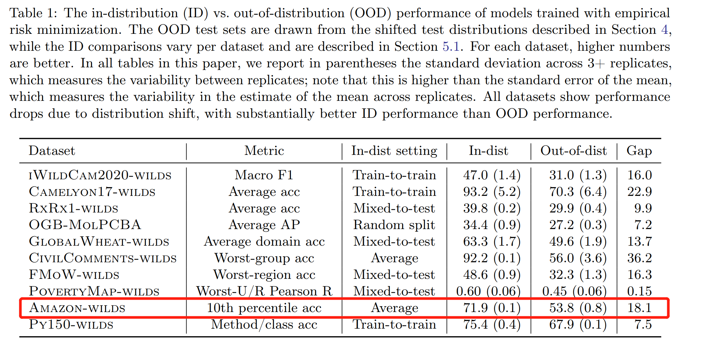
WILD: model architecture and result
Training-validation-test, with validation set for early stopping and hyper-parameter tuning.
Standard ERM (Empirical Risk Minimization) model structure (DistilBERT for text)

Slide 10
WILD: Baseline algorithms against DS
Domain generalization: CORAL and IRM
They introduce penalty term to the ERM objective that encourage the model to learn invariant representatives across domains
i.e. CORAL penalizes the differences of mean+covariance for the feature distribution
IRM: penalizes feature distributions that have different optimal
linear classifiers for each domain
Subpopulation shift: Group DRO
explicitly minimize the loss for the worst-case domain during training, thus aiming to achieve similar performance across domains

Slide 11
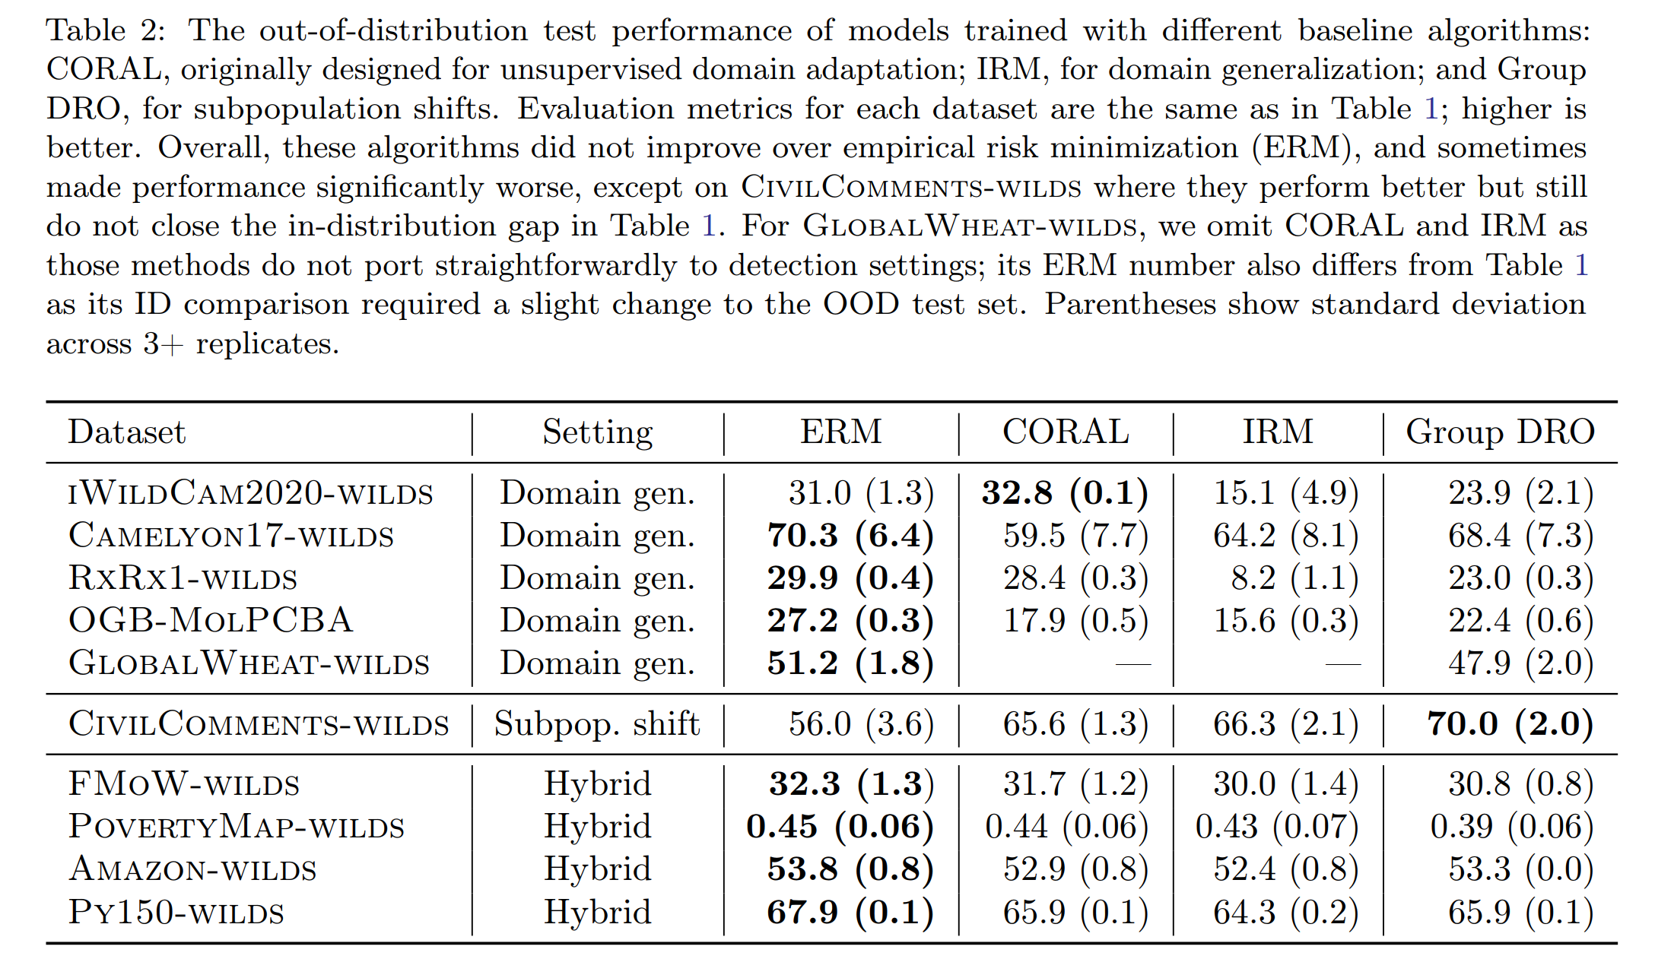
WILD: performance of baseline algorithms

Slide 12
Other strategies on Domain generalization
Conditional variance regularization: specifically used in image recognition, by identifying the “style” feature such as background color, hair color of the image, and try to add a penalty term in the ERM objective.
Self-supervision (i.e. by solving the jigsaw problem)
Meta-learning-based approaches: for example: one method simulates train/test domain shift during training by synthesizing virtual testing domains within each mini-batch.

Slide 13
Other strategy on Subpopulation Shift
Reweighting method based on class/domain frequencies
Label-distribution-aware margin losses
Adaptive Lispschitz regularization
Slice-based learning
Style transfer across domains
Unsupervised clustering
Upweighting high-loss points
Optimization for the worst-case over all subpopulation of a certain size regardless of domain

Slide 14
More related work
There are tons of methods against DS and related work to review
Need more time on such literature review, including those on the leaderboard

Slide 15
Example on the leaderboard
The mostly-improved dataset and top algorithm:
Camelyon17 avg accuracy from 73.3 to 93.3; Algo: MBDG
Civil-Comment worst-group accuracy from 56.0 to 75.3; Algo: Fish
Amazon dataset: All the algorithms in the leaderboard are not good at accurately predicting the worst-case 10th percentile, the best algorithm is LISA, with tail 10th accuracy from 53.8 to 54.7.
Are the algorithms limited?
But the Civil-Comment worst-group problem is a similar text problem with only subpopulation-shift but no domain generalization.

Slide 16
Why is Fish good
Fish is the algorithm that leads on the board for the Civil-Comments dataset,
Main features of Fish:
An objective that learns from features that are invariant across domains.
Using an Inter-domain gradient matching method.
IDGM is able to focus on the feature that is common between domains, and put more weights on those features that are domain-invariant.
Fish is also applied on the Amazon dataset, but unfortunately it has no significant improvement on it.

Slide 17
Problem: The unseen domain
We cannot foresee the future unseen domain until we encounter them in the real-world (cannot learn from the future test data set)
Therefore, we need to make the model irrelevant to spurious features (non-domain-invariant features)

Slide 18
Ideas: Why is the prediction bad for some instances?
First it is better to make a diagnosis of why the model prediction is bad for some unseen test data set?
Using model-explainer such as LIME and Shapley to check the feature contribution for a local prediction.
Select representatives from the test set, build locally-accurate simple linear model on those representatives respectively, and check the disparity of those local model and original model.
Use model-explainer to identify the domain-dependent features learned by the training model, check its weight

Slide 19
Ideas: human is excellent at DS adaptation
Search more paper on cognitive research in the psychology field and try to get inspired for the model heuristics?
For example, when a human encounters a new case which shares some similar feature from previous experience, he/she may try to decompose the new case and feed the components to different cognitive-modules (“models” in the brain), rather than input it as a whole to one big complex “model”. This might be the biggest difference between the human and current ML procedures?
So, can we work backwardly by first extracting the domain shift for the test instance compared with the original distribution, and try to do something on it? (not modifying the model but guide how to design the model in the first place)

Slide 20
Ideas: Decompose the “bad” test instance
Like the LIME algorithm, for a given test instance, they sample instances from training and give weights according to the distance. Then build a LASSO, compute the disparity of the local model and original model, sufficiently simple to explain the instance.
For our “bad” test cases, I guess there are not so much training samples close to it, or the test cases is clustered around the classification boarder in the original model space.
We can analysis which feature has the most DS, and try to extract the DS parts and build local model on the remaining part. Or we may transform the distribution of the test cases.
Tackle the DS part somehow (maybe use another at-shelf model suitable)

Slide 21
Ideas: human adapts the original “model” when encountering a similar unseen case
On seeing a DS, human brain may quickly “adjust” its original “model” in order to recognize this previous unseen case
In our case, we do not allow such adjustment based on the test set, but we can analyze what is the input for the adjustment

Slide 22
Research support:
Need more theoretical and literature review for the idea

Slide 23
Thank You!

