Slide 1
Submission guidelines and benchmark test
For WILD datasets

Slide 2
Requirement (standard submission)
Must have at least 3 replicates (CivilComments: 5)
Must follow the dataset class to split the data
Must use their evaluators
Testset not used in training or model selection
Val set: must use official split; only for hyperparameter tuning
Train+val: only use official data splits
Model should not use batch statistics during evaluation

Slide 3
Requirement (non-standard submission)
Must have at least 3 replicates (CivilComments: 5)
Must follow the dataset class to split the data
For example, you can use color augmentation;
Not restricted to the evaluation split
Use unlabeled datasets

Slide 4
Making submission
Upload predictions (.csv) to CodaLab
Filling up submission form

Slide 5
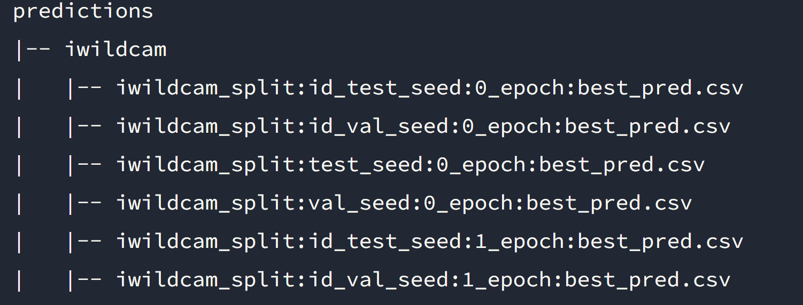
Submission folder structure
Folder structure:
Naming convention:

Slide 6
Format of CSV
Sample order must be the same as the original dataset
Each row contains a y_pred entry that represents the predicted class.

Slide 7
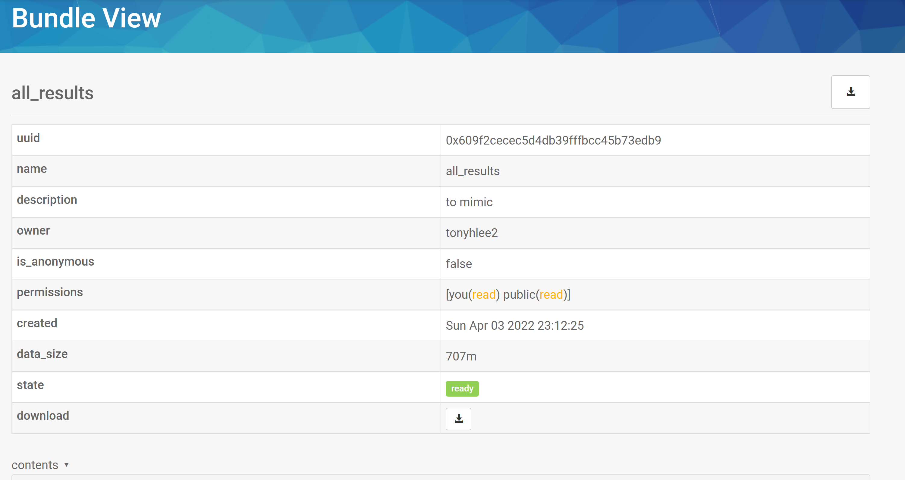
Upload
Using codaLab command line interface: https://codalab-worksheets.readthedocs.io/en/latest/CLI-Reference/
Make sure the submission bundle looks like:

Slide 8
Steps: get data and transform data
Wilds.get_dataset(**kwargs): specifying dataset, directory, etc.
Transform the data (Bert for example)
Transformation is handled inside the WildSubset class: since training and test may require different transformations.
For example, we can specify the transformation using the package:
transformers.BertTokenizerFast, and pass it to the WildSubset constructor.

Slide 9
Steps: Bert
Bert is a revolutionary NLP model created in 2018.
They key point is it uses pre-trained model and fine-tuning for the specific task.
It uses multilayer bidirectional transformer encoders for language representations.
Text inputs need to be transformed to numeric token ids and arranged in several Tensors before being input to BERT.
It transforms the input text into tensors ready for the Bert model.
12 layers for the full version; 6 layers for the base case.

Slide 10
Fine-tuning VS feature extraction
Two ways of using Bert: fine tune the pretrained model or extract features from the pretrained model and adjust the model structure
Usually the fine-tuning strategy is better, which is used by most of the algorithms in the leaderbord.
In our case, we may want input and tokenize the text to the Bert model, get the output features from the encoding layer, and then apply it on TDA+RF?
The default Bert-ouput-features size is 768.

Slide 11
Word embedding encoding extraction from Bert
We call the constructor for the huggingface ‘BertForSequenceClassification’ and get the pretrained Bert model;
Then we process our text to the model;
Then we get features from the encoding layer of the model, rather than the final classification;
And we transform it into 1-d feature vector and process them to the model we want.
After processed by DistillBert, the number of features is 768, which can be fed into our model for classification.

Slide 12
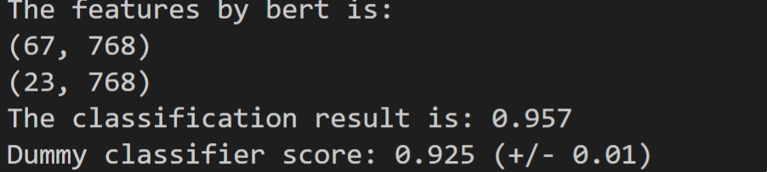
Toy dataset test:
Only use 90 samples due to memory restriction of the input matrix size (training: 67; test:23)
Use a RF model with default setting
The result is better than a dummy classifier.

Slide 13
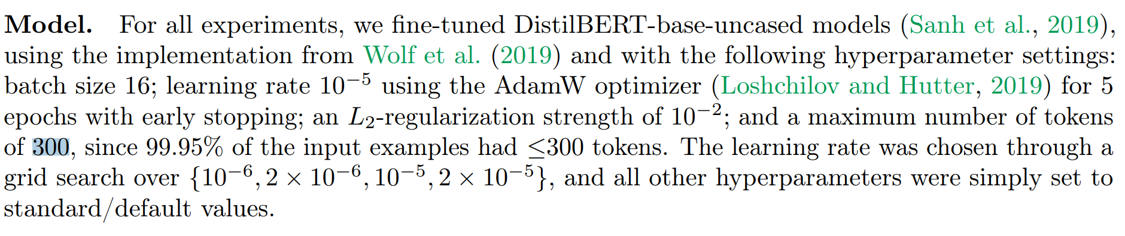
The model setup for civilcomments

Slide 14
Steps: get transformed data
It seems the library does not support outputting the transformed data. The intermediate data is directly passed to the loader.
We may add method to the “WildsSubset” class to support this because we may need to do descriptive analysis on it.

Slide 15
Steps: Dataset splits
Amazon: Specified in the split_*.csv:
'train': 0, 'val': 1, 'id_val': 2, 'test': 3, 'id_test': 4}
For different shift types (time, user, category), there are different split files (each contain values the indicates the train/va/test/id_val/id_test indexes)
Civilcomments: Can be extracted with the dataset.split_array:
{'train': 0, 'val': 1, 'test': 2}
Use dataset.get_subset() to acquire the train/val/test data sets.

Slide 16
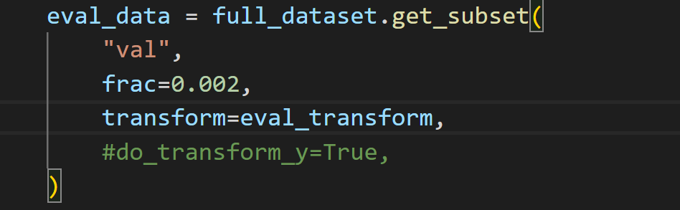
How to use split data:
For example:
This extracts the validation set. We can specify the transform of the original dataset (i.e. bert tokenizing), or use the original text and do some other forms of transformation.
Then in the training process, use “eval_data.__getitem__(index)” to acquire the specific item.

Slide 17
Steps: data loader
We should use:
wilds.common.data_loaders
Wilds.common.grouper
Wilds.common.utils
These modules prepare the train/val data loaders for the model, and changeable parameter such as batch size, whether to sample among groups or iid sampling, etc.

Slide 18
Steps: model training.
Only use eval set to tune the hyperparameters and select the models.
Could be in the ./model/ folder and define our model in it. And then we select the classifier we are using.
Examples: RF, CNN, resnet, BertSuquentialClassifier.

Slide 19
Steps: Objective
For example, we can specify the loss function as cross entropy

Slide 20
Steps: DS algorithm
May use wilds.common modules to manipulate the data.
For example, may modify the objective function by adding a penalty term; For domain shift issues;
Or reweight unbalanced while training for subpopulation shift issues.

Slide 21
Steps: Optimizer
For example, SGD, Adam
Specifying hyperparameter for the optimizer such as learning rate, weight decay, number of epochs, etc

Slide 22
Steps: Evaluator
For standard submission, we must use their evaluation metric.
The “wilds.common.metrics” modules defines the standard evaluation step and output the predictions.

Slide 23
Good Practice:
Multiple steps for tuning
So, we may modularize each step separately and use a config file to specify the parameter setting for our experiment runs.
According to the leaderboard, civilcomments seems easier to improve the OOD performance, we may test and debug our (data processing+model+DS) pipeline on this dataset, then on amazon.
The wilds library is not well documented. Hard to master the detail utilization within a short time period.

